Slide 1
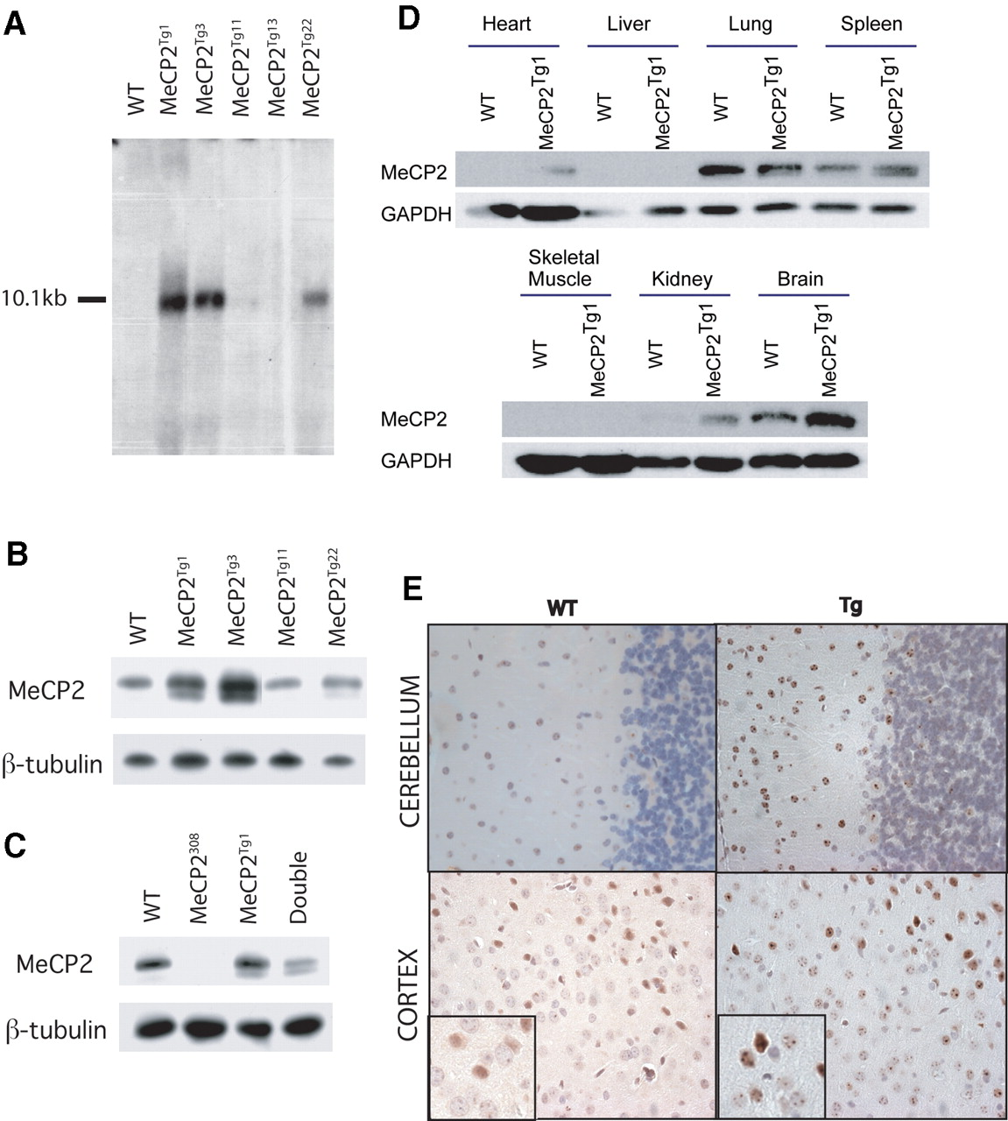
Figure 1. Expression of both RNA and protein from the PAC transgene. (A) Northern analysis of RNA from mouse ...
Notes:
Figure 1. Expression of both RNA and protein from the PAC transgene. (A) Northern analysis of RNA from mouse brain using a human specific probe reveals RNA expression in four transgenic lines. (B) Western blot analysis of brain protein extracts from four transgenic lines using anti-MeCP2 detects both human and mouse MeCP2 which run at approximately the same size. Both the long and short isoforms are detected in the transgenic animals. The various lines have different MeCP2 levels. (C) Western blot analysis of brain protein extracts from a male mouse that carries the MeCP2Tg1 and MeCP2308 alleles shows the levels of the transgenically produced MeCP2 protein to be similar to or slightly less than that of the endogenous protein in the wild-type lane. (D) Multi-tissue western blot analysis of tissues from MeCP2Tg1 mice shows that both wild-type and transgenic mice have high expression in the brain, lung and spleen. (E) Immunohistochemical analysis shows neuronal expression in wild-type and transgenic cerebellum and cortex. Subcellular localization to heterochromatic regions is also similar in wild-type and transgenic mice.
Unless provided in the caption above, the following copyright applies to the content of this slide: Human Molecular Genetics, Vol. 13, No. 21 © Oxford University Press 2004; all rights reserved

Slide 2
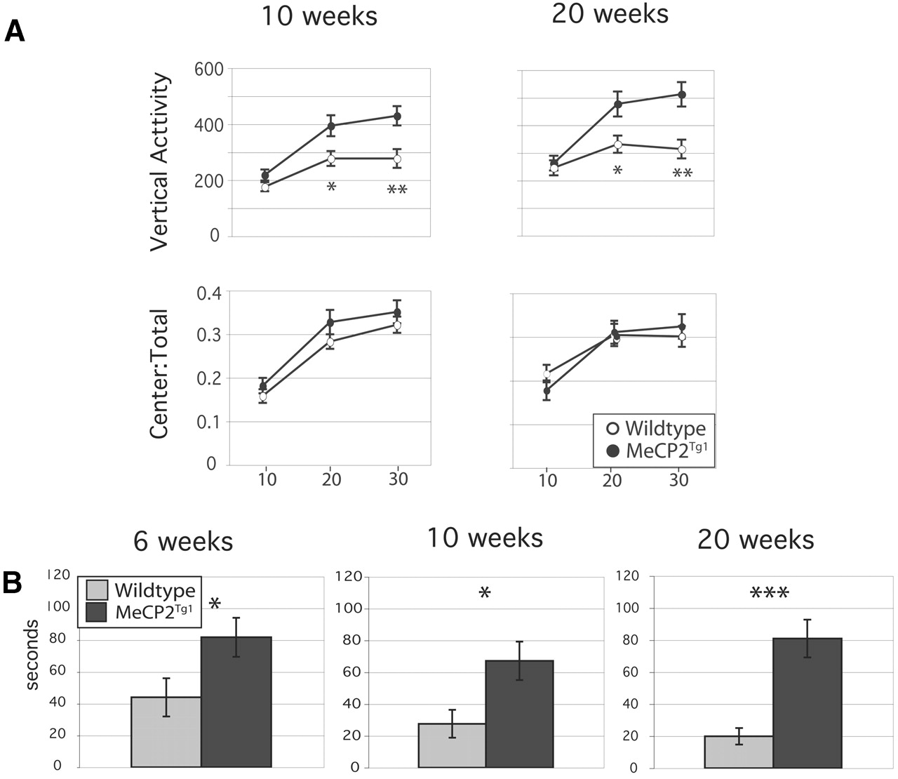
Figure 2. Anxiety and activity were explored using the open field and dowel tests. (A) Transgenic mice appear ...
Notes:
Figure 2. Anxiety and activity were explored using the open field and dowel tests. (A) Transgenic mice appear less anxious by open-field. Although the center to total distance ratio (bottom) appears similar, transgenic mice displayed increased vertical activity (top). At 10 weeks, n=12 wild-type and 16 MeCP2Tg1 mice; at 20 weeks, n=11 wild-type and 16 MeCP2Tg1 mice. (B) Transgenic mice show an increased latency to start walking along the dowel at 6, 10 and 20 weeks when compared with their wild-type littermates. At 6 weeks, n=9 wild-type and 9 MeCP2Tg mice. At 10 and 20 weeks, n=12 wild-type and 16 MeCP2Tg1 mice. *P<0.05; **P<0.01; ***P<0.001.
Unless provided in the caption above, the following copyright applies to the content of this slide: Human Molecular Genetics, Vol. 13, No. 21 © Oxford University Press 2004; all rights reserved

Slide 3
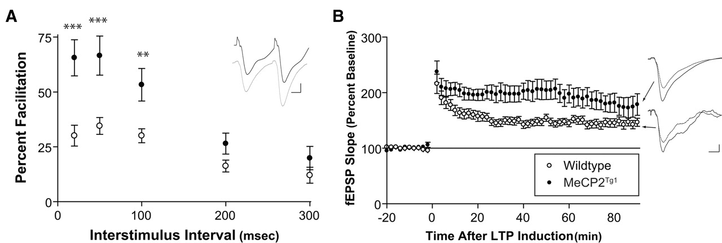
Figure 4. Electrophysiological analysis of MeCP2^{Tg1} mice reveals increased synaptic plasticity. ...
Notes:
Figure 4. Electrophysiological analysis of MeCP2Tg1 mice reveals increased synaptic plasticity. (A) Paired pulse facilitation, a very short-term form of synaptic plasticity, was assessed in the MeCP2Tg1 animals. The transgenic slices exhibited significantly more facilitation than littermate controls at interstimulus intervals of 20, 50 and 100 ms. Given that the I/O for MeCP2Tg1 and wild-type animals were identical (Supplementary Material, Fig. S3), these results suggest that MeCP2 overexpression may affect mechanisms involved in mediating facilitation, but not basal neurotransmitter release. F[1,268]=44; P<0.0001; n (slices/animals): wt=33/11, MeCP2Tg1=23/9; **P<0.01; ***P<0.001. Representative traces show PPF at 20 ms for slice isolated from wild-type (black) and MeCP2Tg1 (grey) animals. Scale bar indicates 1 mV and 5 ms. (B) LTP induced by two 100 Hz tetani (1 s, 20 s interstimuli interval) was enhanced in MeCP2Tg1 mice relative to wild-type. The enhanced potentiation was apparent 10 min after induction, and persisted for up to 90 min after induction. F[1,1745]=319, P<0.0001; n (slices/animals): wt=20/7, MeCP2Tg1=15/6. Representative traces are shown to the right of summary electrophysiology data for fEPSPs acquired 2 min before (dashed) and 90 min after (solid) LTP induction. Scale bar indicates 1 mV and 5 ms.
Unless provided in the caption above, the following copyright applies to the content of this slide: Human Molecular Genetics, Vol. 13, No. 21 © Oxford University Press 2004; all rights reserved

Slide 4
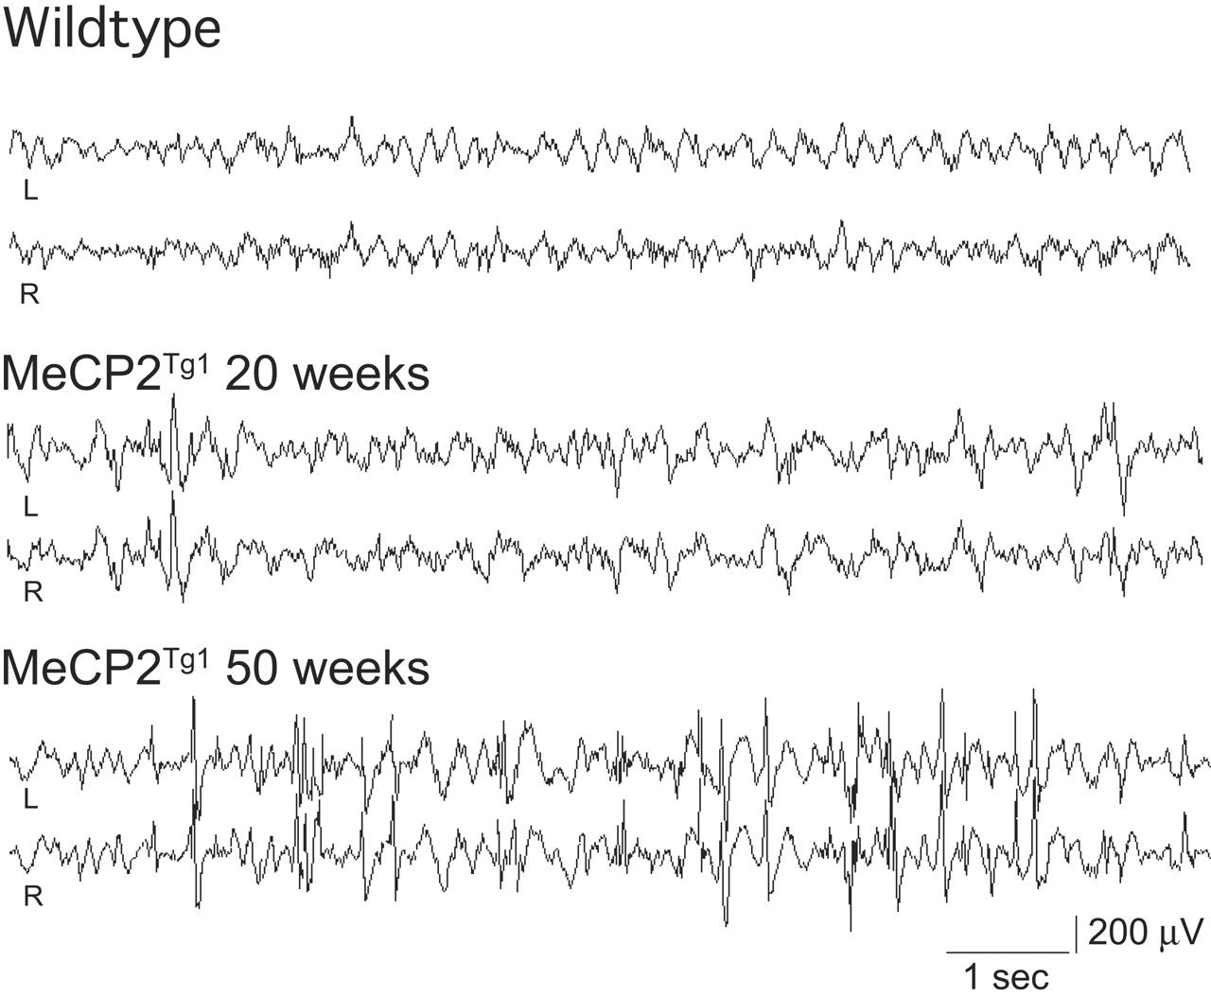
Figure 5. Abnormal synchronous EEG discharges in MeCP2^{Tg1} mice. Representative EEG tracings are ...
Notes:
Figure 5. Abnormal synchronous EEG discharges in MeCP2Tg1 mice. Representative EEG tracings are shown from chronic recordings in an adult wild-type FVB mouse as well as MeCP2Tg1 mice at 20 and 50 weeks of age. Prominent bilateral spike, spike wave and polyspike discharges are seen in adult mutant traces.
Unless provided in the caption above, the following copyright applies to the content of this slide: Human Molecular Genetics, Vol. 13, No. 21 © Oxford University Press 2004; all rights reserved

Slide 5
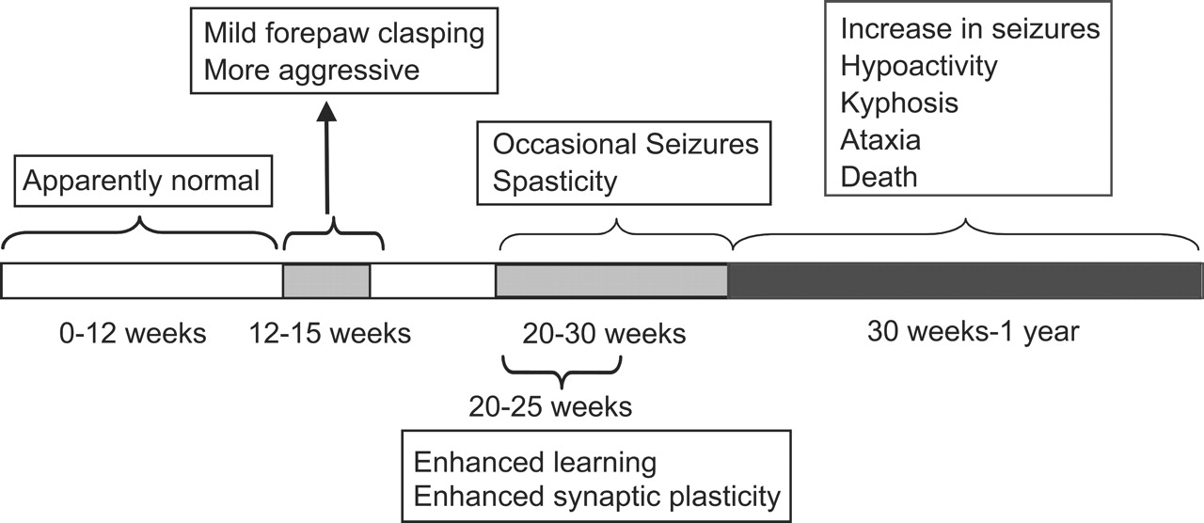
Figure 6. Summary of phenotypes and their onset in MeCP2^{Tg1} mice. Mice are grossly normal at ...
Notes:
Figure 6. Summary of phenotypes and their onset in MeCP2Tg1 mice. Mice are grossly normal at birth, but develop forepaw clasping and aggressiveness by 12–15 weeks. By 20–25 weeks, enhanced learning and enhanced synaptic plasticity can be detected, but the mice are also starting to develop seizures and spasticity during this time. Seizures and EEG abnormalities increase in severity and frequency as the mice age. The mice also become hypoactive and develop kyphosis. A third of the mice die prematurely and develop severe ataxia immediately prior to death.
Unless provided in the caption above, the following copyright applies to the content of this slide: Human Molecular Genetics, Vol. 13, No. 21 © Oxford University Press 2004; all rights reserved

