Slide 1
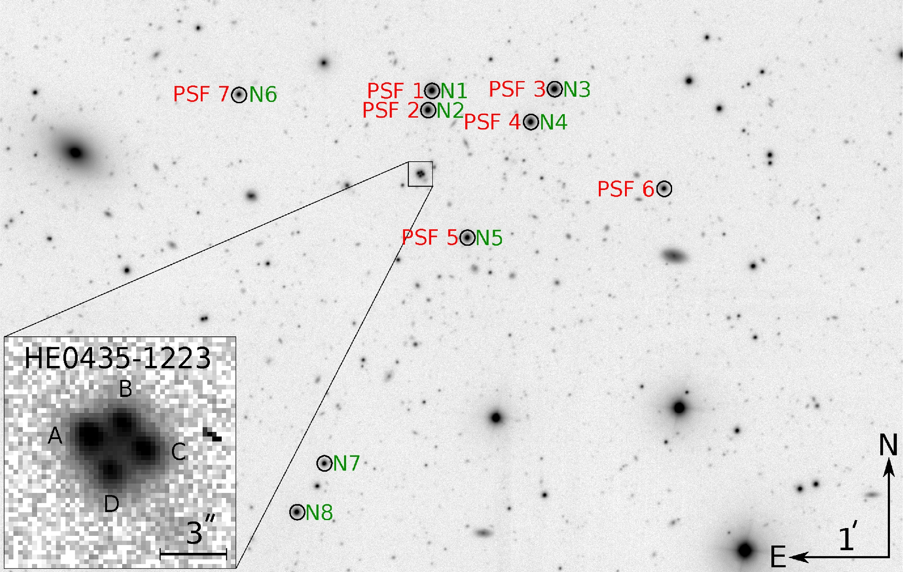
Figure 1. Part of the field of view of EulerCAM installed on the Swiss 1.2 m telescope around the quasar HE 0435−1223. ...
Notes:
Figure 1. Part of the field of view of EulerCAM installed on the Swiss 1.2 m telescope around the quasar HE 0435−1223. This image is a combination of 100 exposures of 360 s each, for a total exposure time of 10 h. The stars used to build a PSF model for each EulerCAM exposure are circled and labelled PSF1 to PSF7 in red, and the stars used for the photometric calibrations are circled and labelled N1–N8 in green. The insert in the bottom left shows the single, 360 s exposure of the lens, for reference. Note that photometric and spectroscopic redshifts are available for many galaxies in the field of view (see H0LiCOW Paper II and H0LiCOW Paper III for details).
Unless provided in the caption above, the following copyright applies to the content of this slide: © 2016 The Authors Published by Oxford University Press on behalf of the Royal Astronomical Society

Slide 2
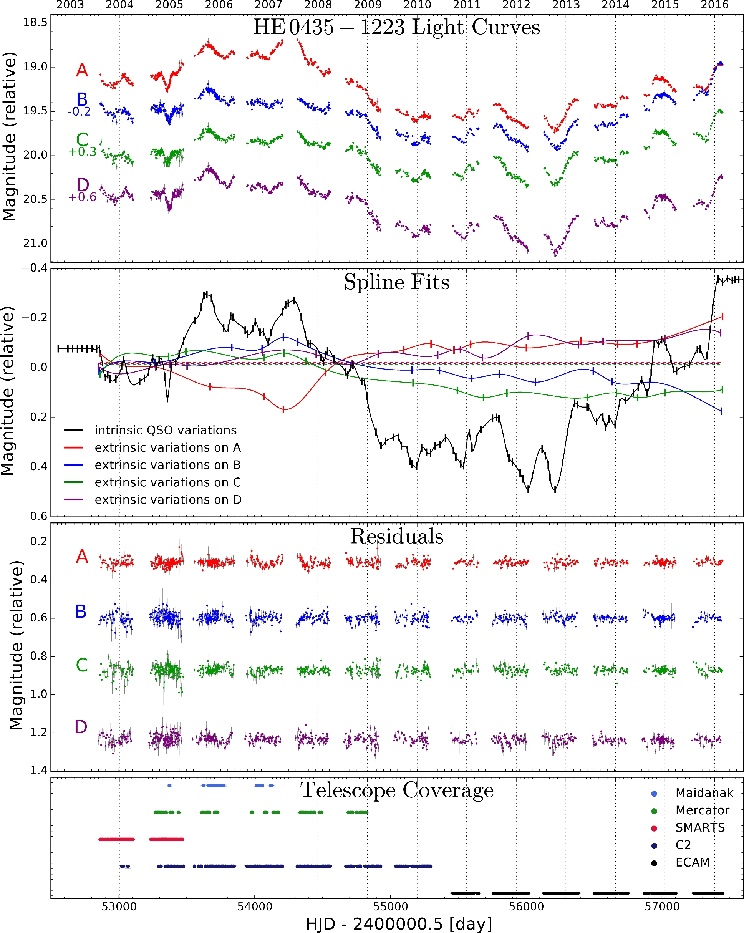
Figure 2. From top to bottom: light curves for the four lensed images of the quasar HE 0435−1223. The relative shifts ...
Notes:
Figure 2. From top to bottom: light curves for the four lensed images of the quasar HE 0435−1223. The relative shifts in magnitude are chosen to ease visualization, and do not influence the time-delay measurements. The second panel shows a model of the intrinsic variations of the quasar (black) and the four curves for the extrinsic variations in each quasar image using the free-knot spline technique (colour code). The vertical ticks indicate the position of the spline knots. The residuals of the fits for each light curve is shown in the next panel. Finally, the bottom panel displays the journal of the observations for HE 0435−1223 for the five telescopes or cameras used to gather the data over 13 yr (see column ‘$\#$obs’ of Table 1), where each point represents one monitoring night. The light curves are publicly available on the H0LiCOW,2 COSMOGRAIL3 and CDS websites.
Unless provided in the caption above, the following copyright applies to the content of this slide: © 2016 The Authors Published by Oxford University Press on behalf of the Royal Astronomical Society

Slide 3
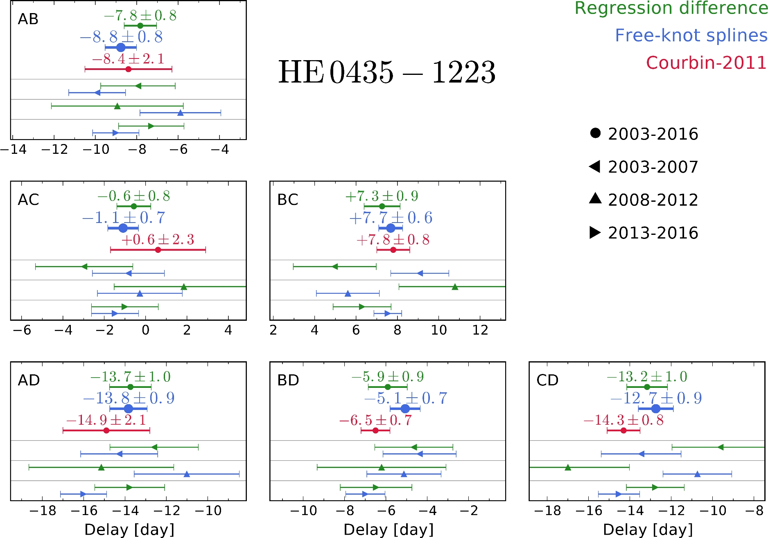
Figure 3. Time delays for the six pairs of quasar images, as indicated in top-left corner of each panel. In each panel, ...
Notes:
Figure 3. Time delays for the six pairs of quasar images, as indicated in top-left corner of each panel. In each panel, we show the time-delay measurement along with the 1σ error bar using our two best curve-shifting techniques, and compare with the measurement of Courbin et al. (2011). We also show the result of measurements carried out with the free-knot spline technique and regression difference technique when splitting the data in three continuous chunks of 4 or 5 yr each. All cosmological results in this work use the time-delay measurements from the free-knot splines (larger blue symbols on the figure).
Unless provided in the caption above, the following copyright applies to the content of this slide: © 2016 The Authors Published by Oxford University Press on behalf of the Royal Astronomical Society

Slide 4
Figure 4. Marginalized posterior probability distributions for H₀ in the UH₀, UΛCDM, UwCDM and ...
Notes:
Figure 4. Marginalized posterior probability distributions for H0 in the UH0, UΛCDM, UwCDM and UoΛCDM cosmologies using the constraints from the three strong lenses B1608+656, RXJ1131−1231 and HE 0435−1223. The overlaid histograms present the distributions for each individual strong lens (ignoring the other two data sets), and the solid black line corresponds to the distribution resulting from the joint inference from all three data sets (TDSL). The quoted values of H0 in the top-left corner of each panel are the median, 16th and 84th percentiles.
Unless provided in the caption above, the following copyright applies to the content of this slide: © 2016 The Authors Published by Oxford University Press on behalf of the Royal Astronomical Society

Slide 5
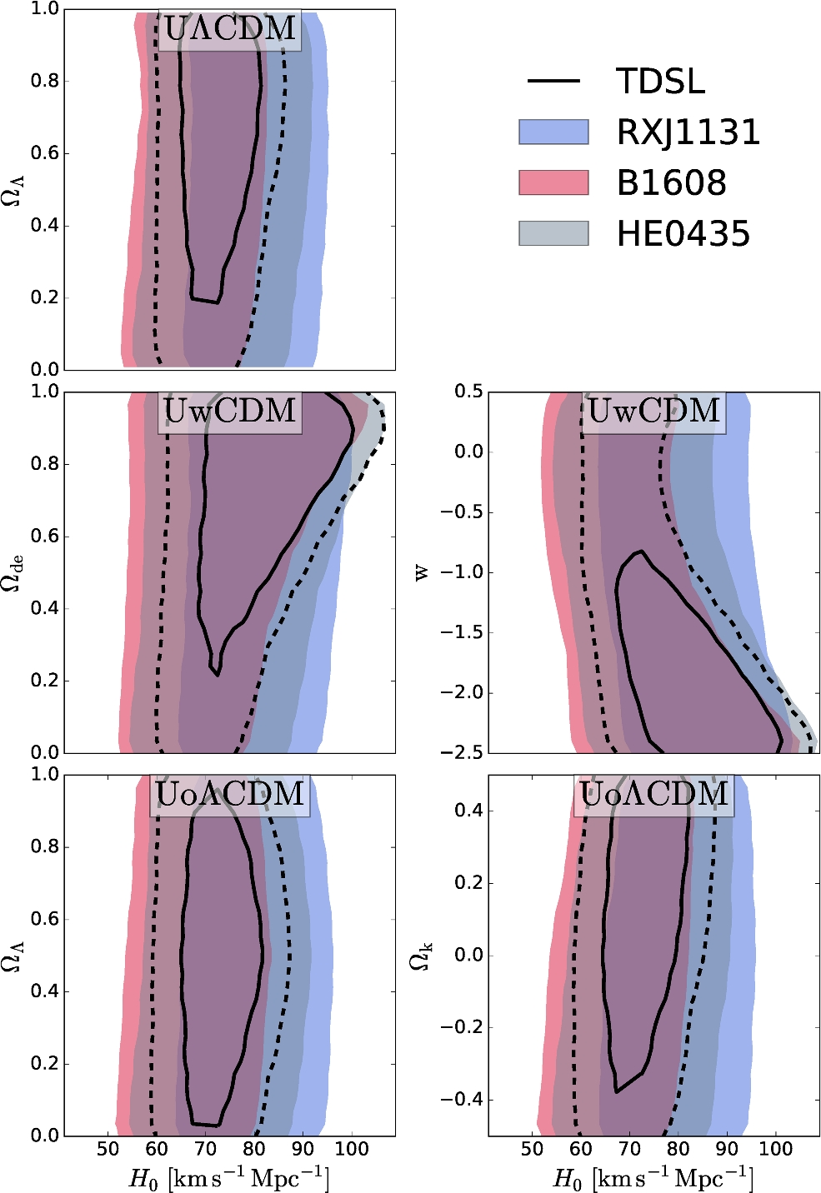
Figure 5. Comparison of the three strong lenses in the UΛCDM (top), UwCDM (middle) and UoΛCDM (bottom) cosmologies. The ...
Notes:
Figure 5. Comparison of the three strong lenses in the UΛCDM (top), UwCDM (middle) and UoΛCDM (bottom) cosmologies. The coloured overlays delimit the 95 per cent credible region for B1608+656, RXJ1131−1231 and HE 0435−1223. The solid and dashed black lines draw the contours of the 68.3 and 95 per cent credible regions, respectively, for the combination of the three lenses.
Unless provided in the caption above, the following copyright applies to the content of this slide: © 2016 The Authors Published by Oxford University Press on behalf of the Royal Astronomical Society

Slide 6
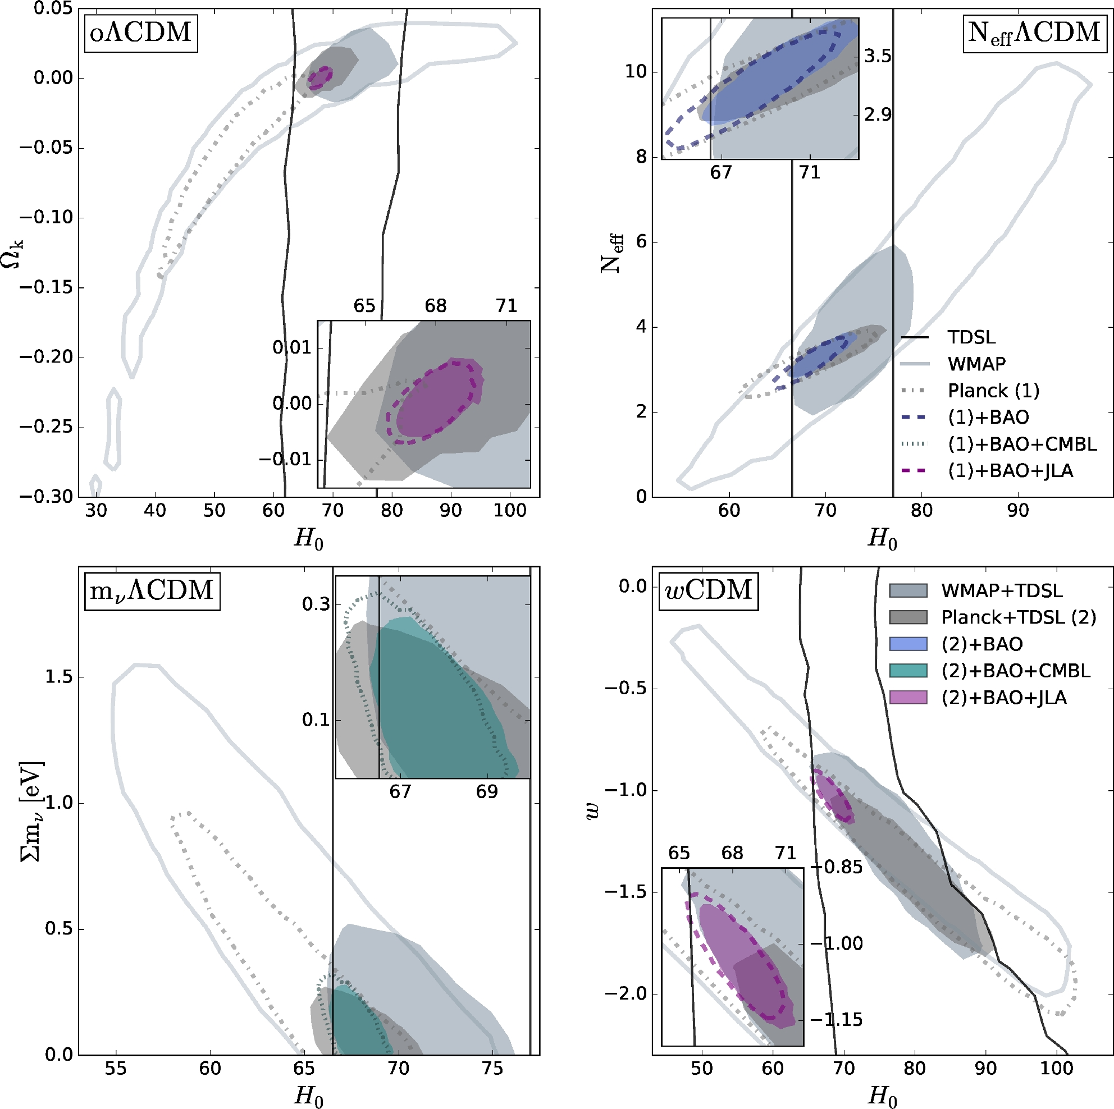
Figure 6. Cosmological constraints in one-parameter extensions to ΛCDM. We consider a non-flat universe with variable ...
Notes:
Figure 6. Cosmological constraints in one-parameter extensions to ΛCDM. We consider a non-flat universe with variable curvature Ωk (top-left), a variable effective number of relativistic neutrino species Neff (top-right), a variable total mass of neutrino species Σmν (bottom-left, in eV) and a variable time-invariant dark energy equation of state w (bottom-right). The filled regions and coloured lines delimit the marginalized 95 per cent credible regions (consistently smoothed due to the sparsity of the samples from the available MCMC chains) with and without the constraints from TDSL, respectively. The different colours represent the constraints from WMAP, Planck, Planck+CMBL, Planck+BAO, Planck+CMBL+BAO and Planck+BAO+JLA. The solid black lines delimit the 95 per cent credible region for TDSL alone in the corresponding uniform cosmology with no additional information.
Unless provided in the caption above, the following copyright applies to the content of this slide: © 2016 The Authors Published by Oxford University Press on behalf of the Royal Astronomical Society

Slide 7
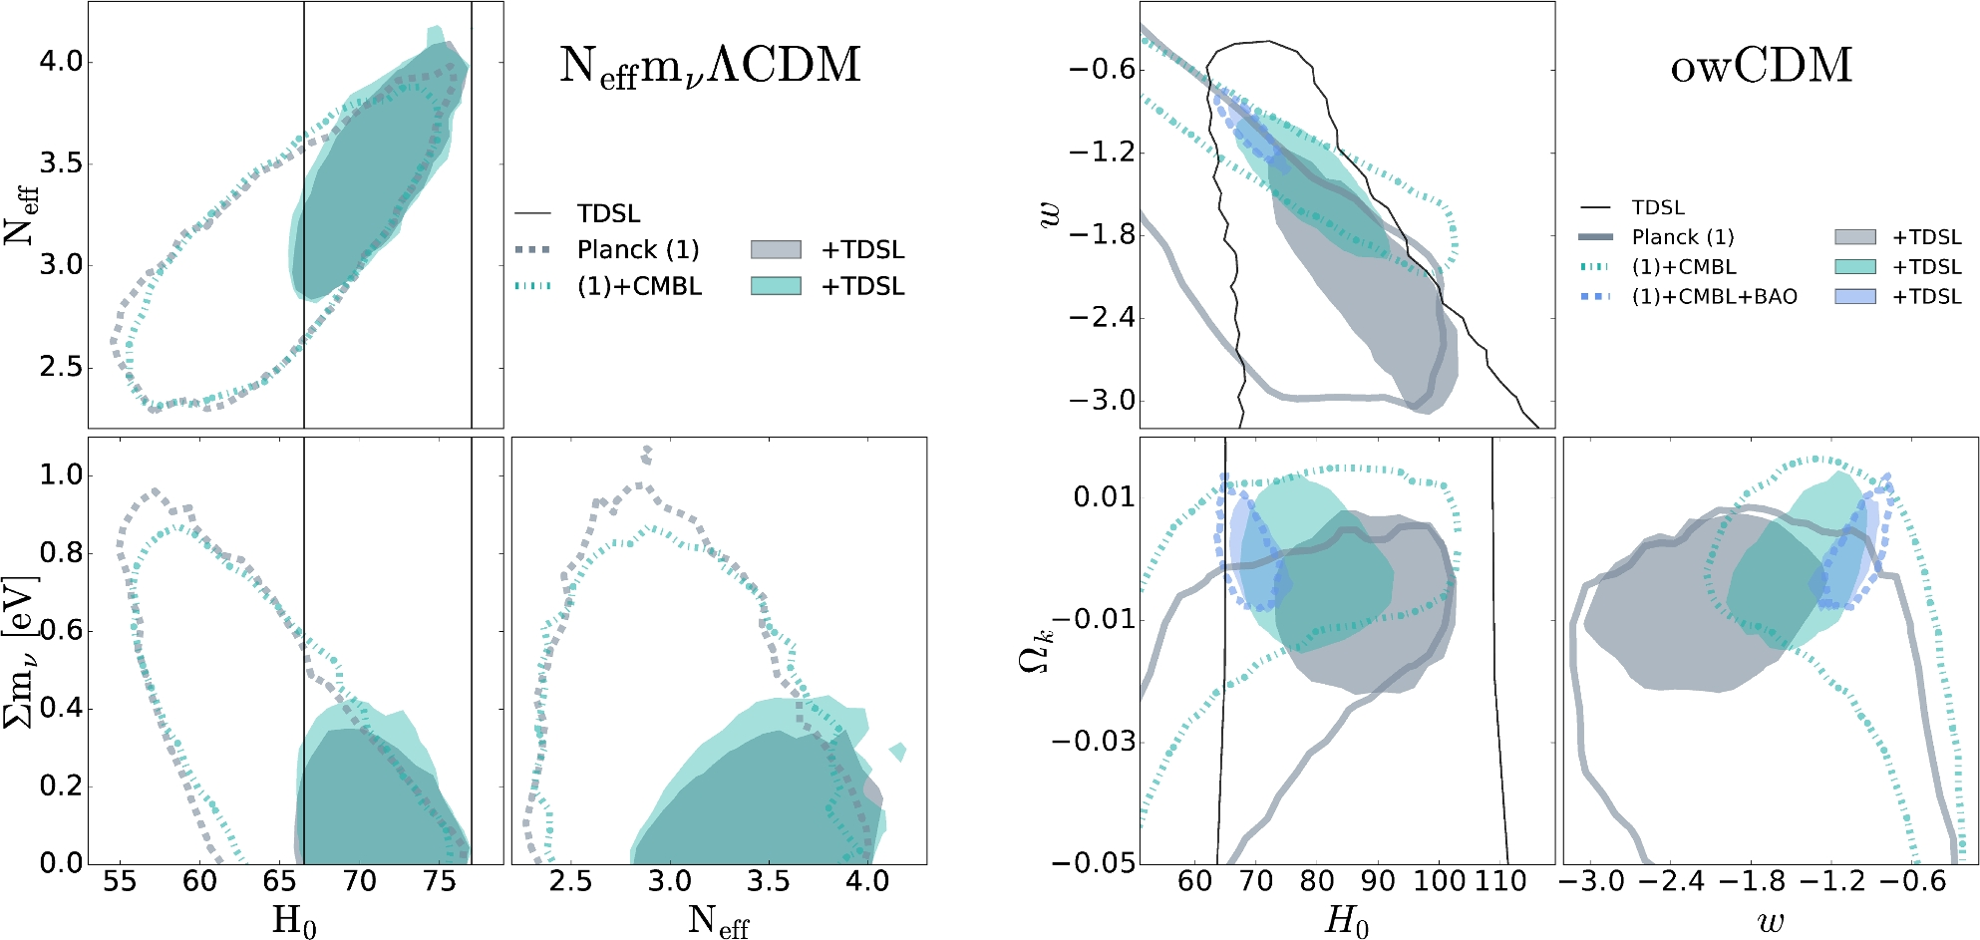
Figure 7. Cosmological constraints in two-parameter extensions to ΛCDM. We consider a flat universe with variable ...
Notes:
Figure 7. Cosmological constraints in two-parameter extensions to ΛCDM. We consider a flat universe with variable effective number of relativistic neutrino species Neff and total mass of neutrinos Σmν (left), and an open universe with variable dark energy equation of state parameters w (right). The coloured lines and filled areas are the same as in Fig. 6, and show marginalized 95 per cent credible regions. The TDSL contours in the owCDM cosmology are computed using uniform priors on Ωk [−0.5, 0.5] and w [−2.5, 0.5].
Unless provided in the caption above, the following copyright applies to the content of this slide: © 2016 The Authors Published by Oxford University Press on behalf of the Royal Astronomical Society

