Slide 1
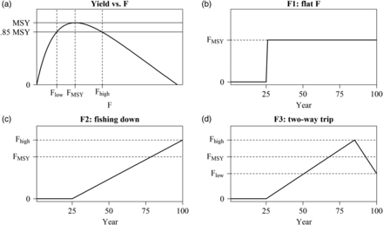
Figure 1. (a) Yield curve is for a hypothetical life history. The fishing mortality (F) values at MSY and 85% of MSY ...
Notes:
Figure 1. (a) Yield curve is for a hypothetical life history. The fishing mortality (F) values at MSY and 85% of MSY (FMSY, Flow, and Fhigh; dashed vertical lines) were used to create three catch trajectories. (b–d) The three catch trajectories used in the OM.
Unless provided in the caption above, the following copyright applies to the content of this slide: © International Council for the Exploration of the Sea 2014. All rights reserved. For Permissions, please email: journals.permissions@oup.com

Slide 2
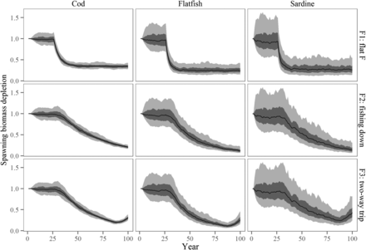
Figure 2. Time trajectories of SSB for the three life histories (cod, flatfish, and sardine) and for the three F ...
Notes:
Figure 2. Time trajectories of SSB for the three life histories (cod, flatfish, and sardine) and for the three F patterns (F1, F2, and F3) for the OMs.
Unless provided in the caption above, the following copyright applies to the content of this slide: © International Council for the Exploration of the Sea 2014. All rights reserved. For Permissions, please email: journals.permissions@oup.com

Slide 3
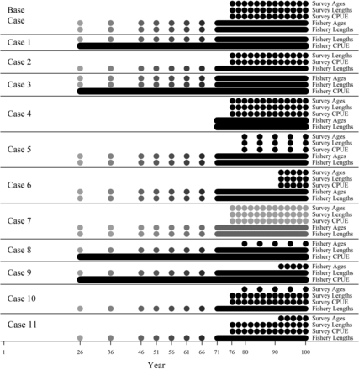
Figure 3. Presence/absence of data types and data quantity by scenario. Colour gradient corresponds to changes in ...
Notes:
Figure 3. Presence/absence of data types and data quantity by scenario. Colour gradient corresponds to changes in sample size where lightest grey represents n = 20 and black represents n = 100. Catch data are available without error for the entire modelled period for all scenarios.
Unless provided in the caption above, the following copyright applies to the content of this slide: © International Council for the Exploration of the Sea 2014. All rights reserved. For Permissions, please email: journals.permissions@oup.com

Slide 4
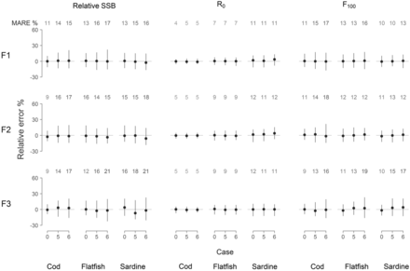
Figure 7. Estimation performance for relative SSB, R₀, and F₁₀₀ by species (columns), fishing ...
Notes:
Figure 7. Estimation performance for relative SSB, R0, and F100 by species (columns), fishing pattern (rows), and data case Base (0), 5, and 6 (x-axes). Dots indicate the MRE and vertical lines depict the interquartile range. MARE values are printed above each case and their colour gradient indicates the level of estimation accuracy; darker grey represents higher MARE values which imply lower accuracy.
Unless provided in the caption above, the following copyright applies to the content of this slide: © International Council for the Exploration of the Sea 2014. All rights reserved. For Permissions, please email: journals.permissions@oup.com

Slide 5
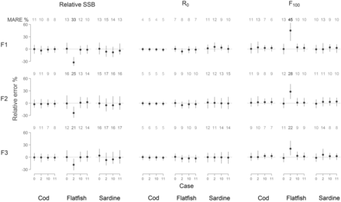
Figure 6. Estimation performance for relative SSB, R₀, and F₁₀₀ by species (columns), fishing ...
Notes:
Figure 6. Estimation performance for relative SSB, R0, and F100 by species (columns), fishing pattern (rows), and data case Base (0), 2, 10, and 11 (x-axes). Dots indicate the MRE and vertical lines depict the interquartile range. MARE values are printed above each case and their colour gradient indicates the level of estimation accuracy; darker grey represents higher MARE values which imply lower accuracy.
Unless provided in the caption above, the following copyright applies to the content of this slide: © International Council for the Exploration of the Sea 2014. All rights reserved. For Permissions, please email: journals.permissions@oup.com

Slide 6
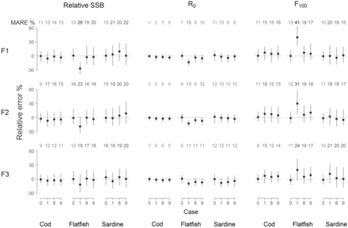
Figure 5. Estimation performance for relative SSB, R₀, and F₁₀₀ by species (columns), fishing ...
Notes:
Figure 5. Estimation performance for relative SSB, R0, and F100 by species (columns), fishing pattern (rows), and data case Base (0), 1, 8, and 9 (x-axes). Dots indicate the MRE and vertical lines depict the interquartile range. MARE values are printed above each case and their colour gradient indicates the level of estimation accuracy; darker grey represents higher MARE values which imply lower accuracy.
Unless provided in the caption above, the following copyright applies to the content of this slide: © International Council for the Exploration of the Sea 2014. All rights reserved. For Permissions, please email: journals.permissions@oup.com

Slide 7
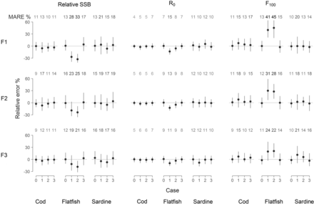
Figure 4. Estimation performance for relative SSB, R₀, and F₁₀₀ by species (columns), fishing ...
Notes:
Figure 4. Estimation performance for relative SSB, R0, and F100 by species (columns), fishing pattern (rows), and data case Base (0), 1, 2, and 3 (x-axes). Dots indicate the MRE and vertical lines depict the interquartile range. MARE values are printed above each case and their colour gradient indicates the level of estimation accuracy; darker grey represents higher MARE values which imply lower accuracy.
Unless provided in the caption above, the following copyright applies to the content of this slide: © International Council for the Exploration of the Sea 2014. All rights reserved. For Permissions, please email: journals.permissions@oup.com

Slide 8
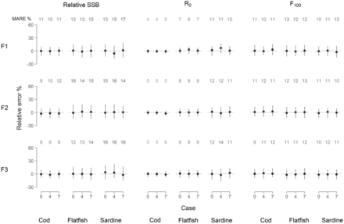
Figure 8. Estimation performance for relative SSB, R₀, and F₁₀₀by species (columns), fishing ...
Notes:
Figure 8. Estimation performance for relative SSB, R0, and F100by species (columns), fishing pattern (rows), and data case Base (0), 4 and 7 (x-axes). Dots indicate the MRE and vertical lines depict the interquartile range. MARE values are printed above each case and their color gradient indicates the level of estimation accuracy; darker grey represents higher MARE values which imply lower accuracy.
Unless provided in the caption above, the following copyright applies to the content of this slide: © International Council for the Exploration of the Sea 2014. All rights reserved. For Permissions, please email: journals.permissions@oup.com

