Slide 1
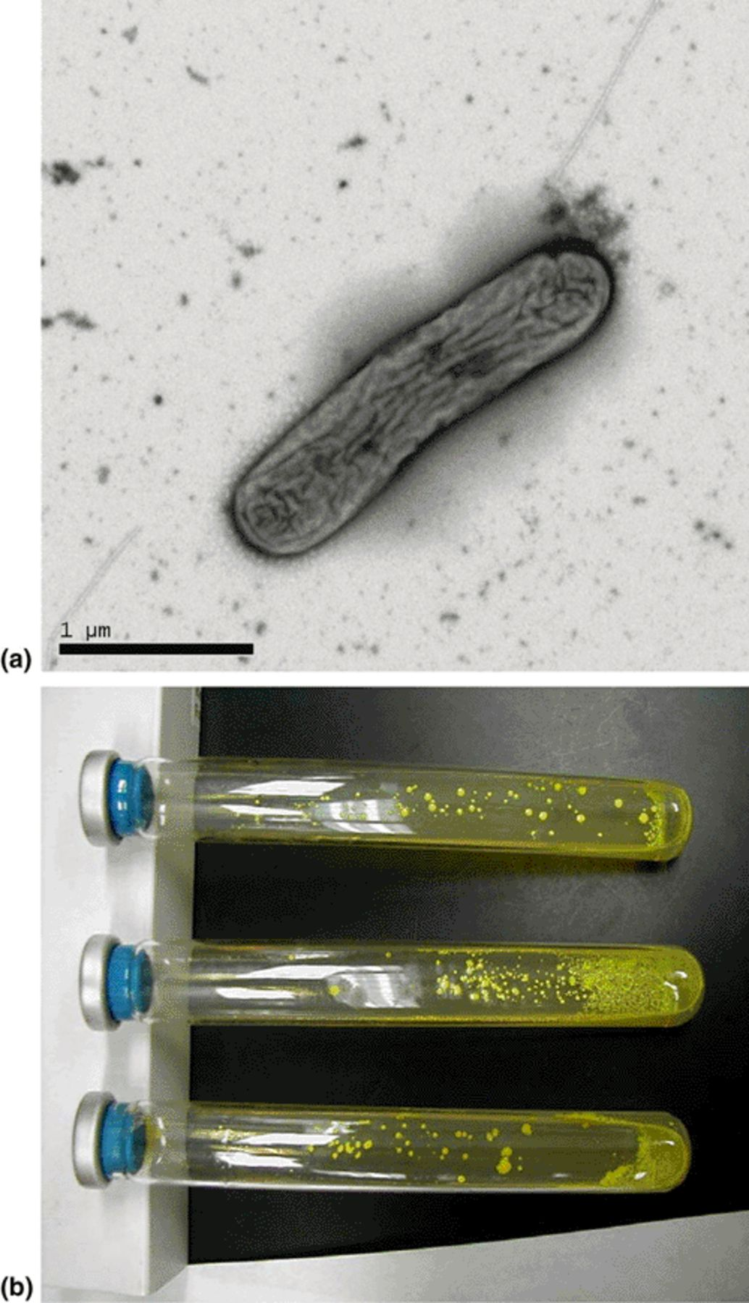
1 Colonies and electron micrograph of strain Y5. (a) Electron micrograph of strain Y5. (b) Colonies of strain ...
Notes:
1 Colonies and electron micrograph of strain Y5. (a) Electron micrograph of strain Y5. (b) Colonies of strain Y5 grown anaerobically on solid medium containing 10 mM lactate and 10 mM arsenate.
Unless provided in the caption above, the following copyright applies to the content of this slide: © 2004 Federation of European Microbiological Societies. Published by Elsevier Science B.V. All rights reserved.

Slide 2
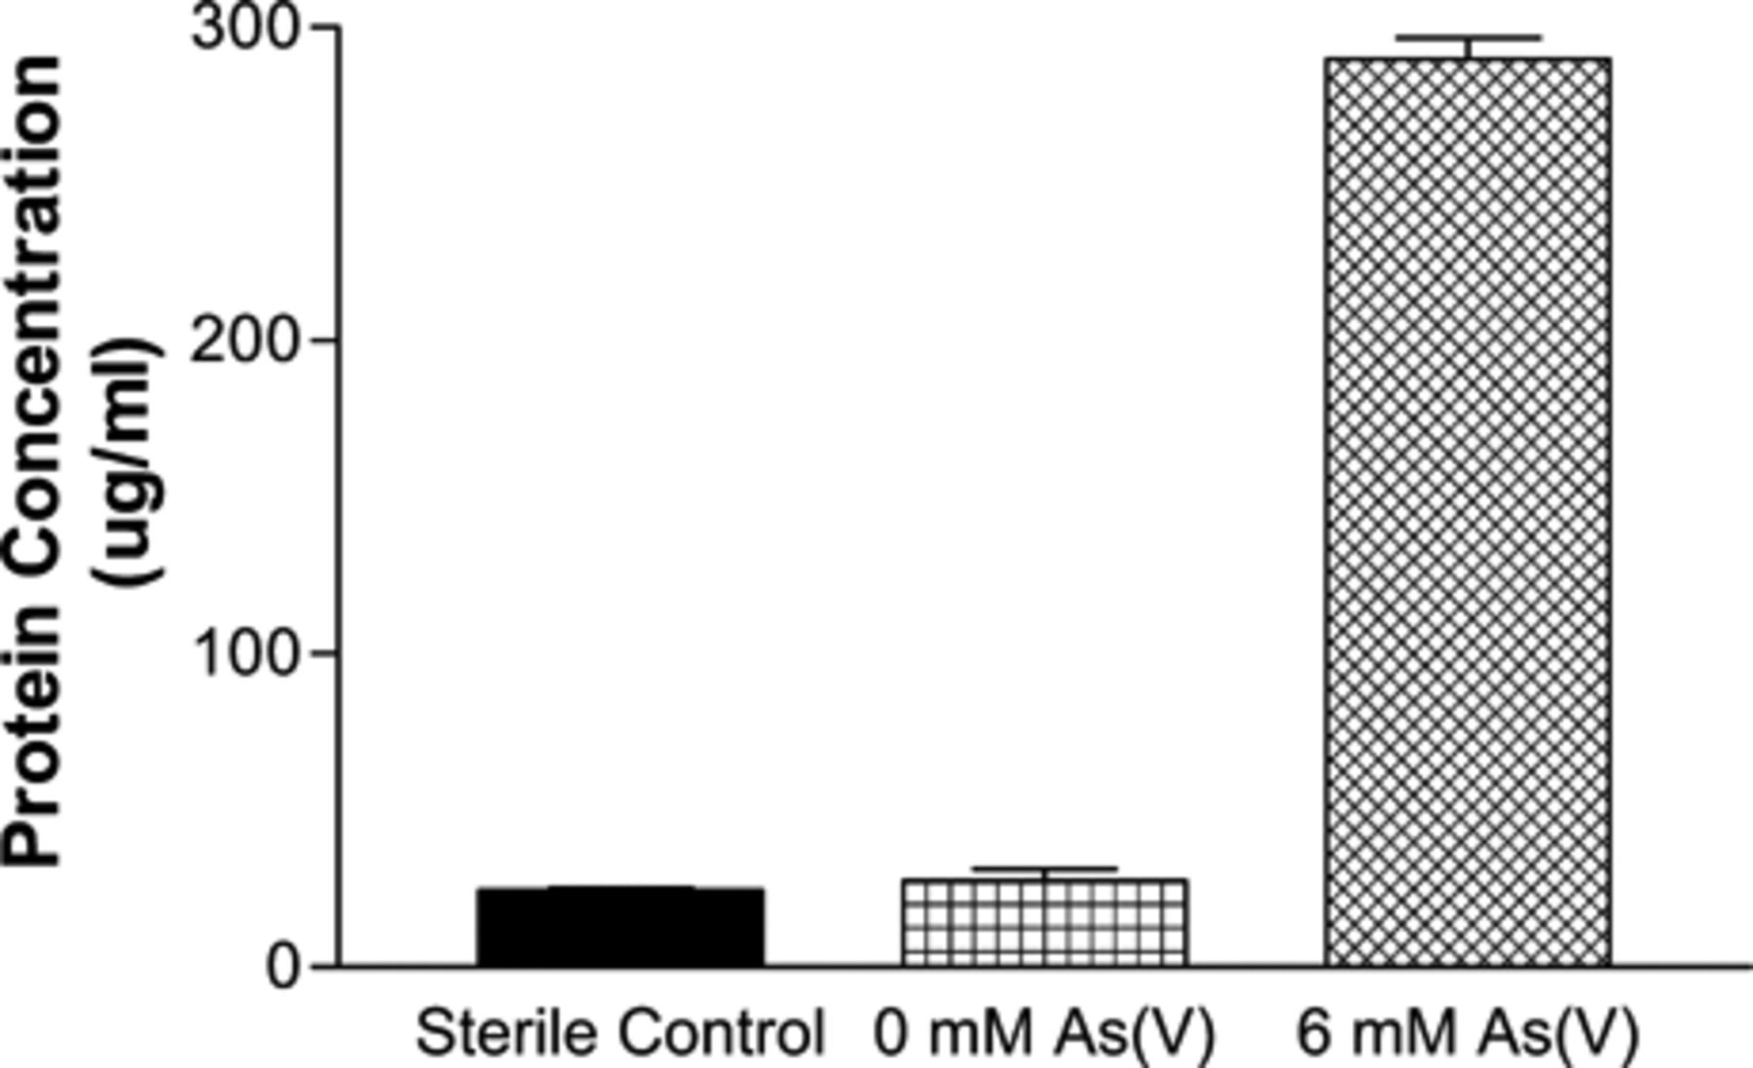
2 Protein concentration of strain Y5 after growth for 14 days in the absence and the presence of As(V). The ...
Notes:
2 Protein concentration of strain Y5 after growth for 14 days in the absence and the presence of As(V). The initial concentration of As(V) and syringic acid was 6 and 0.5 mM, respectively. As(V) was completely reduced to As(III) in 14 days. Data reported are averages of triplicates, and error bars are representative of standard deviations. Sterile controls were inoculated and autoclaved.
Unless provided in the caption above, the following copyright applies to the content of this slide: © 2004 Federation of European Microbiological Societies. Published by Elsevier Science B.V. All rights reserved.

Slide 3
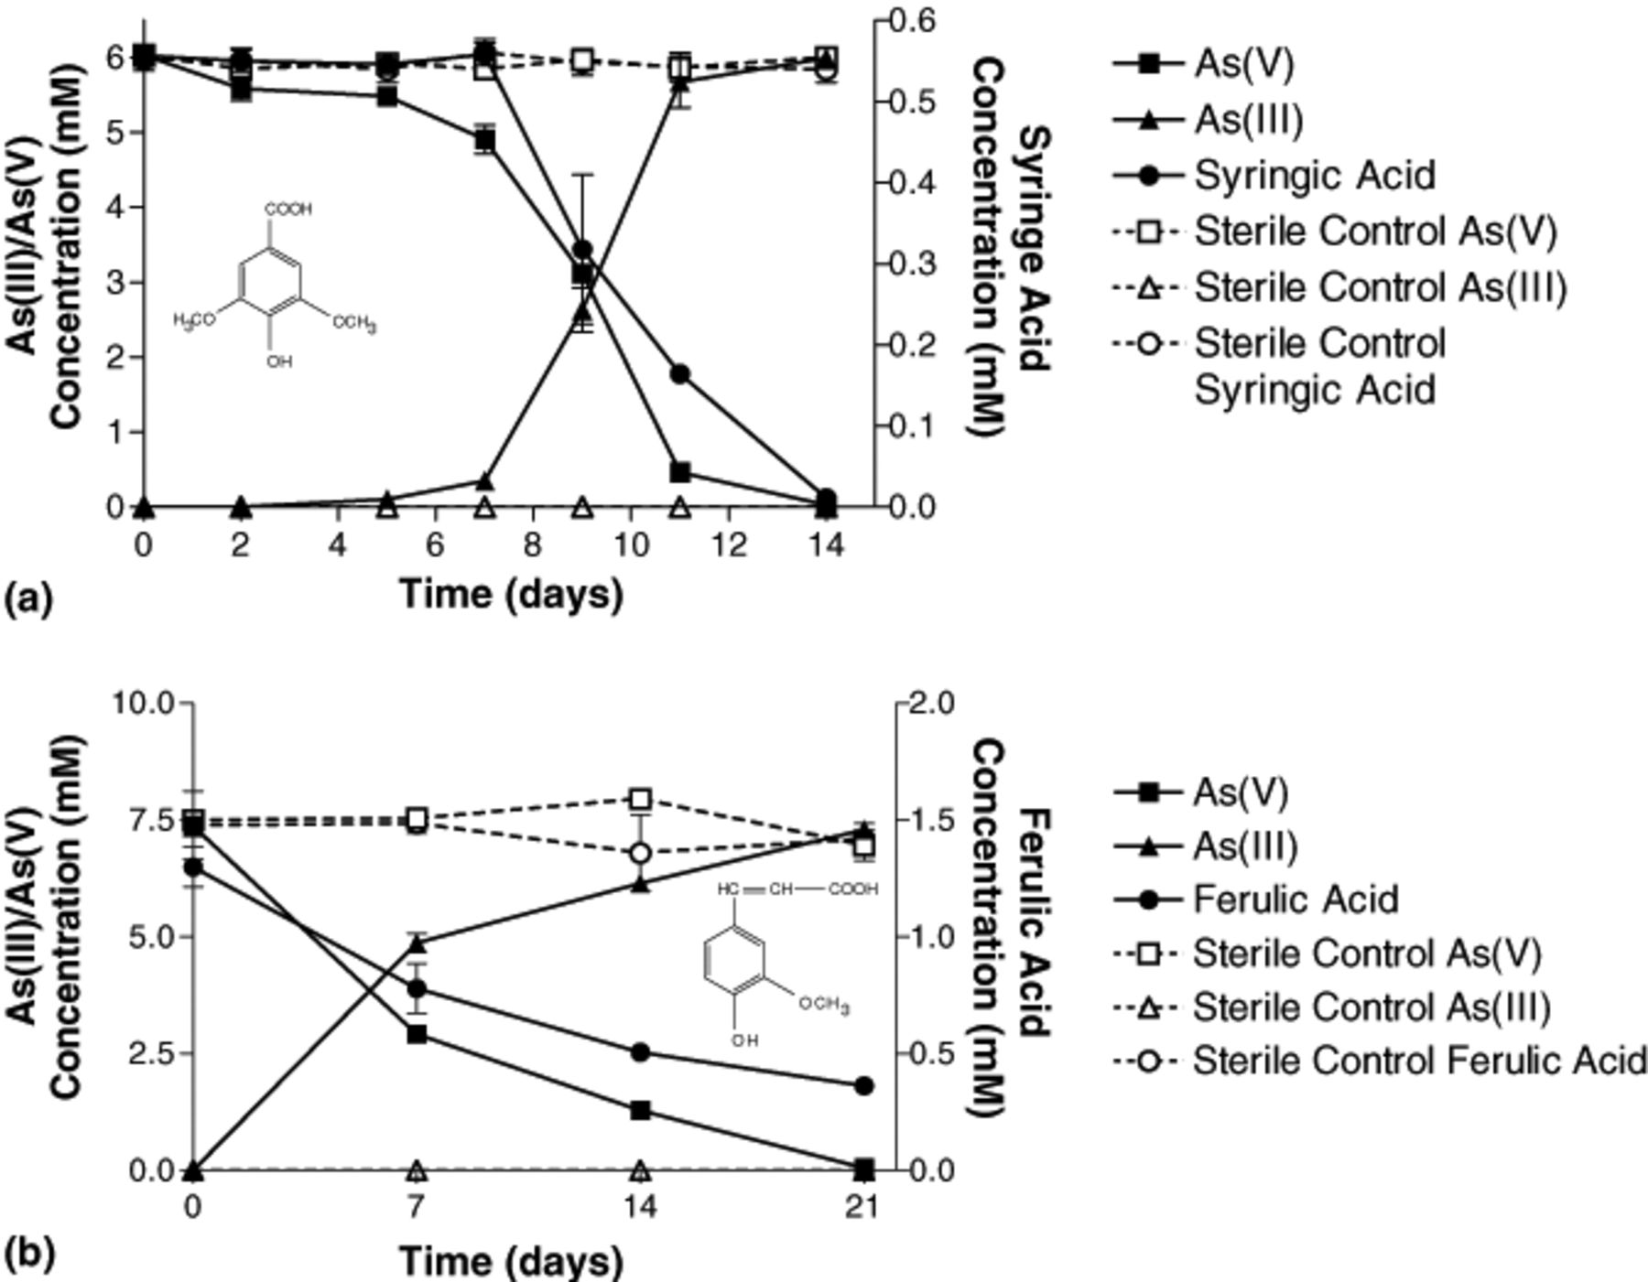
3 Arsenate reduction coupled to the degradation of ligno-aromatic compounds. (a) syringic acid, (b) ferulic ...
Notes:
3 Arsenate reduction coupled to the degradation of ligno-aromatic compounds. (a) syringic acid, (b) ferulic acid. Data reported are averages of triplicates, and error bars are representative of standard deviations.
Unless provided in the caption above, the following copyright applies to the content of this slide: © 2004 Federation of European Microbiological Societies. Published by Elsevier Science B.V. All rights reserved.

Slide 4
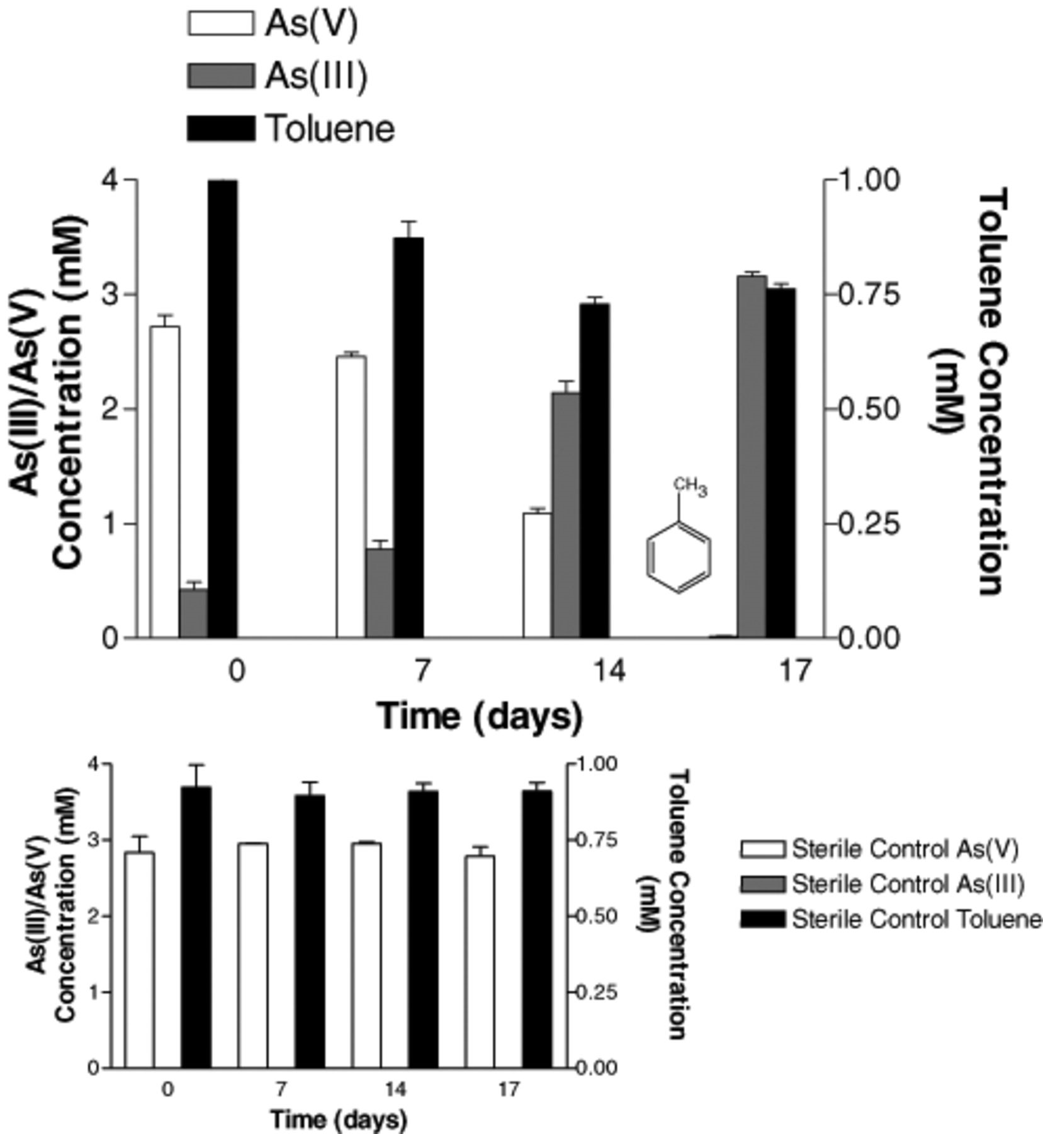
4 Arsenate reduction coupled to the degradation of toluene. Data are averages of triplicates, and error bars ...
Notes:
4 Arsenate reduction coupled to the degradation of toluene. Data are averages of triplicates, and error bars are representative of standard deviations.
Unless provided in the caption above, the following copyright applies to the content of this slide: © 2004 Federation of European Microbiological Societies. Published by Elsevier Science B.V. All rights reserved.

Slide 5
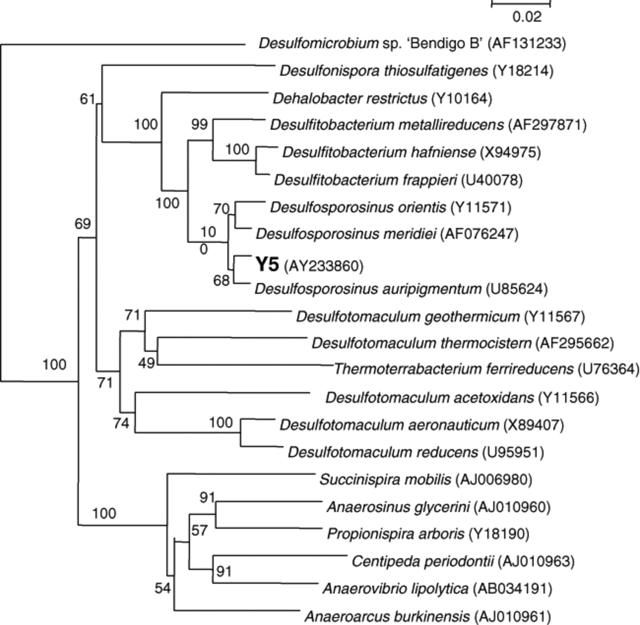
5 Phylogenetic dendrogram based on 16S rDNA sequence comparison of 1300 bases. The neighbor-joining tree was ...
Notes:
5 Phylogenetic dendrogram based on 16S rDNA sequence comparison of 1300 bases. The neighbor-joining tree was derived using ClustalX, bootstrap values (expressed as percentages of 1000 replicates) are shown at the branch points, and the bar equals 2% difference. Based on 16S rDNA sequence comparison, isolate Y5 belongs in the Peptococcaceae group, and is closely related to Desulfosporosinus meridiei and Desulfosporosinus auripigmentum.
Unless provided in the caption above, the following copyright applies to the content of this slide: © 2004 Federation of European Microbiological Societies. Published by Elsevier Science B.V. All rights reserved.

