Slide 1
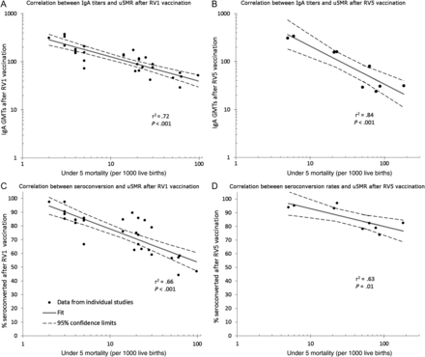
Figure 1. Relationship between under-5 child mortality and immune response to rotavirus vaccination.
Notes:
Figure 1. Relationship between under-5 child mortality and immune response to rotavirus vaccination.
Unless provided in the caption above, the following copyright applies to the content of this slide: Published by Oxford University Press on behalf of the Infectious Diseases Society of America 2013.

Slide 2
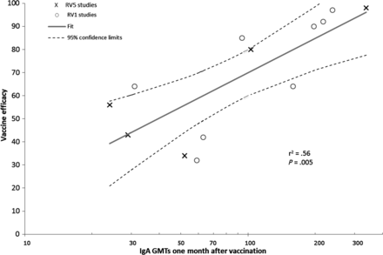
Figure 2. Relationship between anti-rotavirus serum IgA geometric mean titers/concentrations and rotavirus vaccine ...
Notes:
Figure 2. Relationship between anti-rotavirus serum IgA geometric mean titers/concentrations and rotavirus vaccine efficacy. Abbreviation: IgA, immunoglobulin A.
Unless provided in the caption above, the following copyright applies to the content of this slide: Published by Oxford University Press on behalf of the Infectious Diseases Society of America 2013.

Slide 3
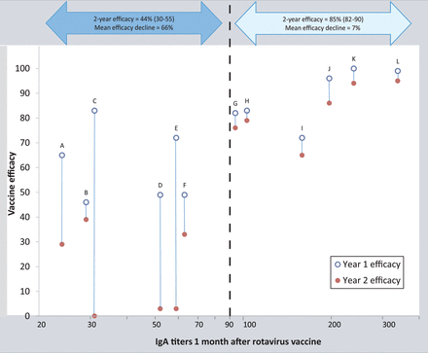
Figure 3. Decline in vaccine efficacy between year 1 (open circles) and year 2 (solid circles) after rotavirus ...
Notes:
Figure 3. Decline in vaccine efficacy between year 1 (open circles) and year 2 (solid circles) after rotavirus vaccination, by location and titers rotavirus IgA geometric mean titers/concentrations. A, Data from Japan are not included because efficacy stratified by year 1 and year 2 after vaccination was not reported. B, Dashed black line depicts IgA titer of 90, below which efficacy was significantly lower and waned between years 1 and 2 after vaccine. Abbreviation: IgA, immunoglobulin A.
Unless provided in the caption above, the following copyright applies to the content of this slide: Published by Oxford University Press on behalf of the Infectious Diseases Society of America 2013.

