Slide 1
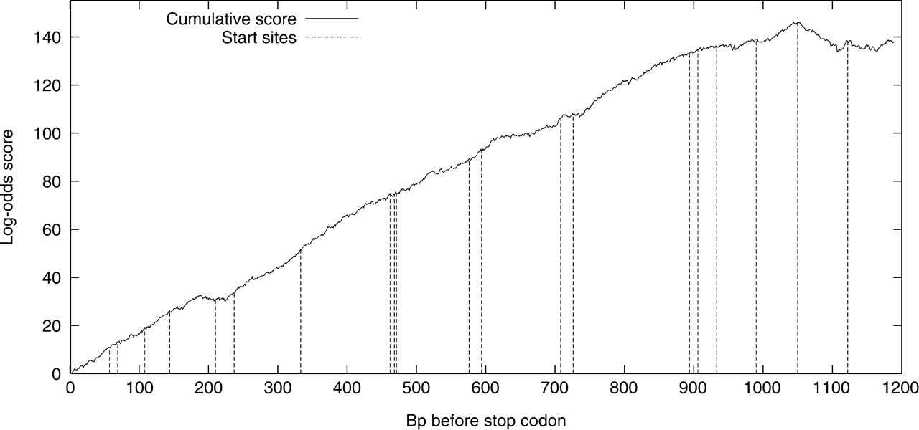
Fig. 1. Scoring an open reading frame from the stop codon backwards. The stop codon is at position 0 on the X-axis ...
Notes:
Fig. 1. Scoring an open reading frame from the stop codon backwards. The stop codon is at position 0 on the X-axis and the cumulative log-odds score is plotted as the solid line. Positions of possible start codons are indicated by vertical dashed lines. This ORF contains the fructose bis-P aldolase gene in Escherichia coli (EG14062) and the current Ecogene verified start site is at position 1050, near the peak score. This position is an update of the originally annotated start at position 1122.
Unless provided in the caption above, the following copyright applies to the content of this slide: © 2007 The Author(s)This is an Open Access article distributed under the terms of the Creative Commons Attribution Non-Commercial License (http://creativecommons.org/licenses/by-nc/2.0/uk/) which permits unrestricted non-commercial use, distribution, and reproduction in any medium, provided the original work is properly cited.

