Slide 1
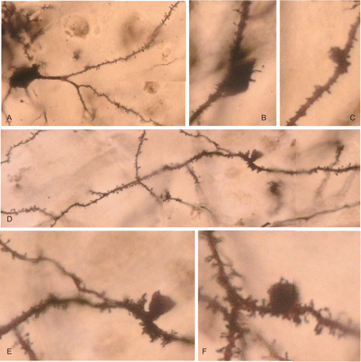
Fig. 2 AGD, Rapid Golgi method. (A) Neuron of the entorhinal cortex showing the normal morphology of dendrites and ...
Notes:
Fig. 2 AGD, Rapid Golgi method. (A) Neuron of the entorhinal cortex showing the normal morphology of dendrites and dendritic spines. (B) Spindle-shaped and (C) Round protrusions in dendrites. (D) Basilar dendrite with inverse-cone morphology with normal-appearing proximal (right) and distal (left) processes. (E) High magnification showing the smooth surface of the protrusion and the normal morphology of the spines in the mother dendrite. (F) Round protrusion covered with a few dendritic spines in a normal-appearing dendrite filled with dendritic spines.
Unless provided in the caption above, the following copyright applies to the content of this slide: © The Author (2008). Published by Oxford University Press on behalf of the Guarantors of Brain. All rights reserved. For Permissions, please email: journals.permissions@oxfordjournals.org

Slide 2
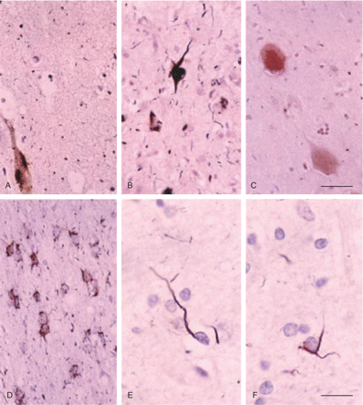
Fig. 1 AGD, Gallyas silver staining, showing argyrophilic tangles (A, B), grains (A, B), neuropil threads (B) in the ...
Notes:
Fig. 1 AGD, Gallyas silver staining, showing argyrophilic tangles (A, B), grains (A, B), neuropil threads (B) in the CA1 region (A) and entorhinal cortex (B), periventricular astrocytes (D), and oligodendroglial coiled bodies in the white matter of the temporal lobe (E, F). Ballooned neurons in the amygdala show a diffuse pale coloration (Gallyas negative). Sections lightly counterstained with haematoxylin. A–D, bar in C = 25 microns. E, F, bar in F = 10 microns.
Unless provided in the caption above, the following copyright applies to the content of this slide: © The Author (2008). Published by Oxford University Press on behalf of the Guarantors of Brain. All rights reserved. For Permissions, please email: journals.permissions@oxfordjournals.org

Slide 3
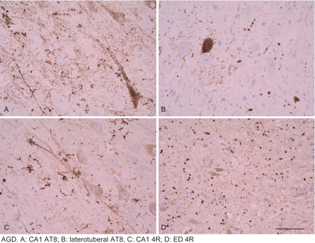
Fig. 3 Strong 4R tau immunoreactivity is observed in pre-tangle neurons, tangles and grains. Paraffin sections, ...
Notes:
Fig. 3 Strong 4R tau immunoreactivity is observed in pre-tangle neurons, tangles and grains. Paraffin sections, lightly counterstained with haematoxylin. Dilution of the 4R antibody (Upstate) 1:50. Bar = 25 microns.
Unless provided in the caption above, the following copyright applies to the content of this slide: © The Author (2008). Published by Oxford University Press on behalf of the Guarantors of Brain. All rights reserved. For Permissions, please email: journals.permissions@oxfordjournals.org

Slide 4
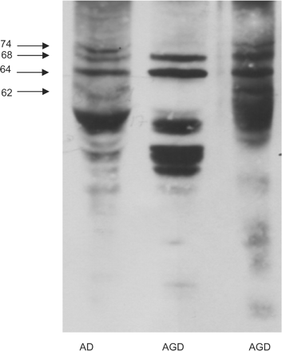
Fig. 4 Gel electrophoresis and western blotting of sarkosyl-insoluble fractions of the hippocampus in one case with ...
Notes:
Fig. 4 Gel electrophoresis and western blotting of sarkosyl-insoluble fractions of the hippocampus in one case with AD and one pure AGD processed in parallel. Four bands of 74, 68, 64 and 60/62 kDa are characteristic of AD. Two bands of 68 and 64 kDa are seen in AGD. In addition, several bands of lower molecular mass are found in AGD.
Unless provided in the caption above, the following copyright applies to the content of this slide: © The Author (2008). Published by Oxford University Press on behalf of the Guarantors of Brain. All rights reserved. For Permissions, please email: journals.permissions@oxfordjournals.org

Slide 5
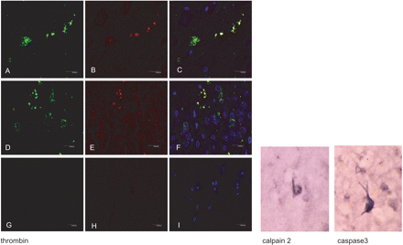
Fig. 5 Left panel: Double-labelling immunofluorescence and confocal microscopy showing co-localization of thrombin ...
Notes:
Fig. 5 Left panel: Double-labelling immunofluorescence and confocal microscopy showing co-localization of thrombin (green: A, D) and 4R tau (red: B, E) in grains (yellow: C, F) in CA1 area of the hippocampus (A–C) and dentate gyrus (D–F). (G–H): sections incubated without the primary antibodies serve as negative controls. Dilution of the thrombin antibody (American Diagnostica) 1:100 and 4R tau (Upstate) 1:50, respectively. TO-PRO counterstaining (blue) permits the visualization of nuclei. Right panel: calpain 2 (Calbiochem) 1:25 and active caspase 3 (17 kDa) (Cell Signalling) 1:25 immunohistochemistry. Immunoreactivity is restricted to neurofibrillary tangles.
Unless provided in the caption above, the following copyright applies to the content of this slide: © The Author (2008). Published by Oxford University Press on behalf of the Guarantors of Brain. All rights reserved. For Permissions, please email: journals.permissions@oxfordjournals.org

Slide 6
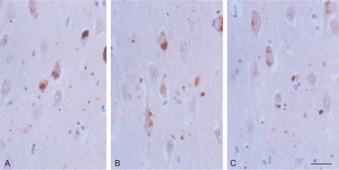
Fig. 6 GSK-3 (A), SAPK/JNK-P (B) and p38-P (C) immunoreactivity in the CA1 region of the hippocampus in AGD. Active ...
Notes:
Fig. 6 GSK-3 (A), SAPK/JNK-P (B) and p38-P (C) immunoreactivity in the CA1 region of the hippocampus in AGD. Active tau-kinases are expressed in pre-tangle neurons, tangles and grains. Paraffin section lightly counterstained with haematoxylin. Dilution of the antibodies p38-PThr180/Tyr182 (cell Signalling) 1:200; SAPK/JNK-PThr183/Tyr185 (Cell Signalling) 1:150, GSK-3β-PSer9 (Oncogen) 1:150. Bar = 25 microns.
Unless provided in the caption above, the following copyright applies to the content of this slide: © The Author (2008). Published by Oxford University Press on behalf of the Guarantors of Brain. All rights reserved. For Permissions, please email: journals.permissions@oxfordjournals.org

Slide 7
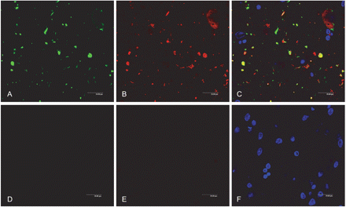
Fig. 8 Double-labelling immunofluorescence and confocal microscopy showing co-localization of tau AT8 (green: A) and ...
Notes:
Fig. 8 Double-labelling immunofluorescence and confocal microscopy showing co-localization of tau AT8 (green: A) and ubiquitin (red: B) in the majority of grains (yellow: C). G–H: sections incubated without the primary antibodies serve as negative controls. Dilution of AT8 (Innogenetics) 1:50 and ubiquitin (Dako) 1:500. TO-PRO counterstaining (blue) permits the visualization of nuclei.
Unless provided in the caption above, the following copyright applies to the content of this slide: © The Author (2008). Published by Oxford University Press on behalf of the Guarantors of Brain. All rights reserved. For Permissions, please email: journals.permissions@oxfordjournals.org

Slide 8
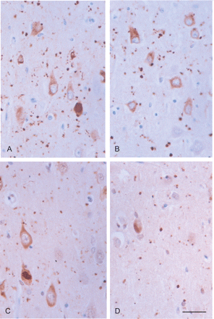
Fig. 7 p62 immunoreactivity (A, B) is found in pre-tangle neurons, tangles and grains in the CA1 region of two ...
Notes:
Fig. 7 p62 immunoreactivity (A, B) is found in pre-tangle neurons, tangles and grains in the CA1 region of two different AGD cases. Ubiquitin immunoreactivity (C, D) is also observed in pre-tangle neurons, tangles and grains in the same cases. Paraffin section lightly counterstained with haematoxylin. Dilution of anti-p62 C-terminal antibody (Progen) 1:100 and anti-ubiquitin (Dako) 1:500. Bar = 25 microns.
Unless provided in the caption above, the following copyright applies to the content of this slide: © The Author (2008). Published by Oxford University Press on behalf of the Guarantors of Brain. All rights reserved. For Permissions, please email: journals.permissions@oxfordjournals.org

Slide 9
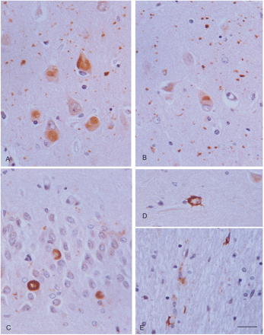
Fig. 9 Round elongated deposits of mutant ubiquitin (UBB⁺¹) immunoreactivity in neurons of the CA1 region ...
Notes:
Fig. 9 Round elongated deposits of mutant ubiquitin (UBB+1) immunoreactivity in neurons of the CA1 region (A), entorhinal cortex (B), and granule cells of the dentate gyrus (C), as well as in astrocytes (D) and coiled bodies (E). UBB+1 immunoreactivity is clearly present in grains (A, B). Paraffin section lightly counterstained with haematoxylin. Dilution of the rabbit polyclonal UBB+1antibody (Dr Fred W. van Leeuwen, Ubi2+1, 140994, for details see Fisher et al., 2003) 1:400. A, B, bar in B = 25 microns; C–E, bar in E = 10 microns.
Unless provided in the caption above, the following copyright applies to the content of this slide: © The Author (2008). Published by Oxford University Press on behalf of the Guarantors of Brain. All rights reserved. For Permissions, please email: journals.permissions@oxfordjournals.org

Slide 10
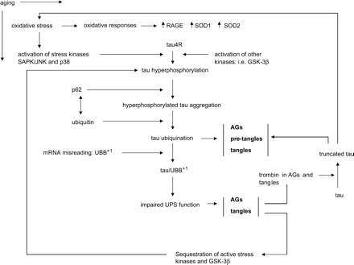
Fig. 10 Summary of pathologic events in AGD.
Notes:
Fig. 10 Summary of pathologic events in AGD.
Unless provided in the caption above, the following copyright applies to the content of this slide: © The Author (2008). Published by Oxford University Press on behalf of the Guarantors of Brain. All rights reserved. For Permissions, please email: journals.permissions@oxfordjournals.org

