Slide 1
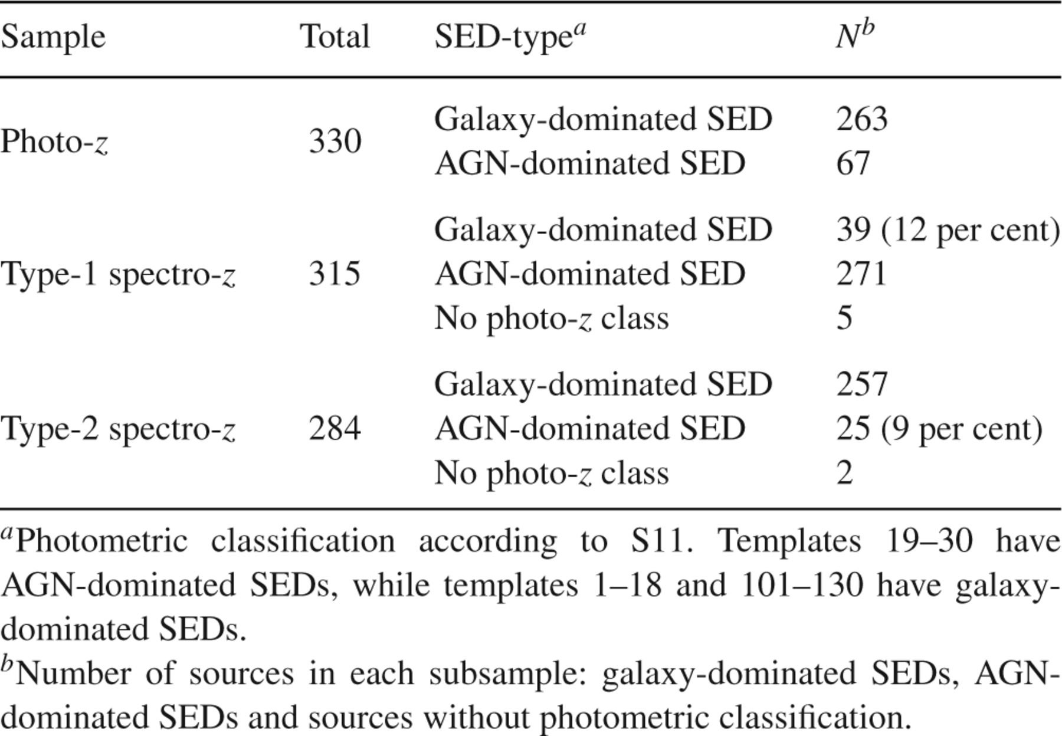
Table 1 Summary of the photometric classification criteria
Notes:
Table 1 Summary of the photometric classification criteria
Unless provided in the caption above, the following copyright applies to the content of this slide: © 2012 The Authors Monthly Notices of the Royal Astronomical Society © 2012 RAS

Slide 2
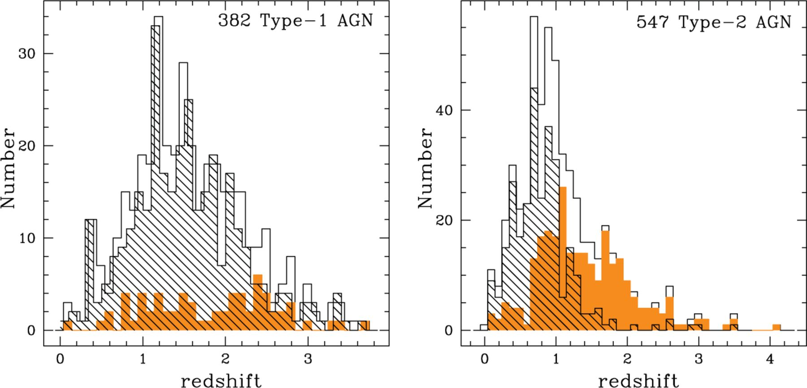
Figure 1 Redshift distribution of the hard X-ray selected Type-1 ( left-hand panel) and Type-2 (right-hand panel) AGN ...
Notes:
Figure 1 Redshift distribution of the hard X-ray selected Type-1 ( left-hand panel) and Type-2 (right-hand panel) AGN samples considered in this work. The hatched histogram shows the redshift distribution for the sample of spectroscopically identified sources, while the filled histogram is the redshift distribution for the sources without spectroscopic redshift. The total sample is reported with the open histogram.
Unless provided in the caption above, the following copyright applies to the content of this slide: © 2012 The Authors Monthly Notices of the Royal Astronomical Society © 2012 RAS

Slide 3
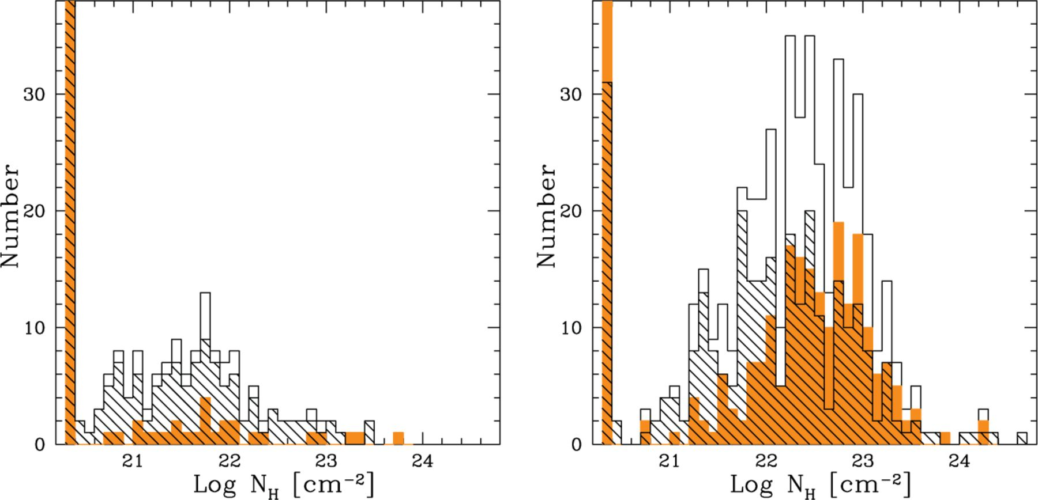
Figure 2 Column density distribution of the Type-1 (left-hand panel) and Type-2 (right-hand panel) AGN samples (black ...
Notes:
Figure 2 Column density distribution of the Type-1 (left-hand panel) and Type-2 (right-hand panel) AGN samples (black open histogram). About 67 per cent of the Type-1 AGN sample and 16 per cent of the Type-2 AGN sample have NH values consistent with the Galactic one. Note that the first bin in the left-hand panel is much higher than what is plotted in the histogram (206 spectro-z and 40 photo-z have NH = 20.5 cm−2), while for the right-hand panel 56 spectro-z and 33 photo-z have NH consistent with the Galactic value. The hatched histogram shows the NH distribution for the sample of spectroscopically identified sources, while the filled histogram is the NH distribution for the sources without spectroscopic redshift. 60 percent (322/547) of the Type-2 AGN sample and 10 per cent (39/382) of the Type-1 AGN sample have Log NH ≥ 22 cm−2.
Unless provided in the caption above, the following copyright applies to the content of this slide: © 2012 The Authors Monthly Notices of the Royal Astronomical Society © 2012 RAS

Slide 4
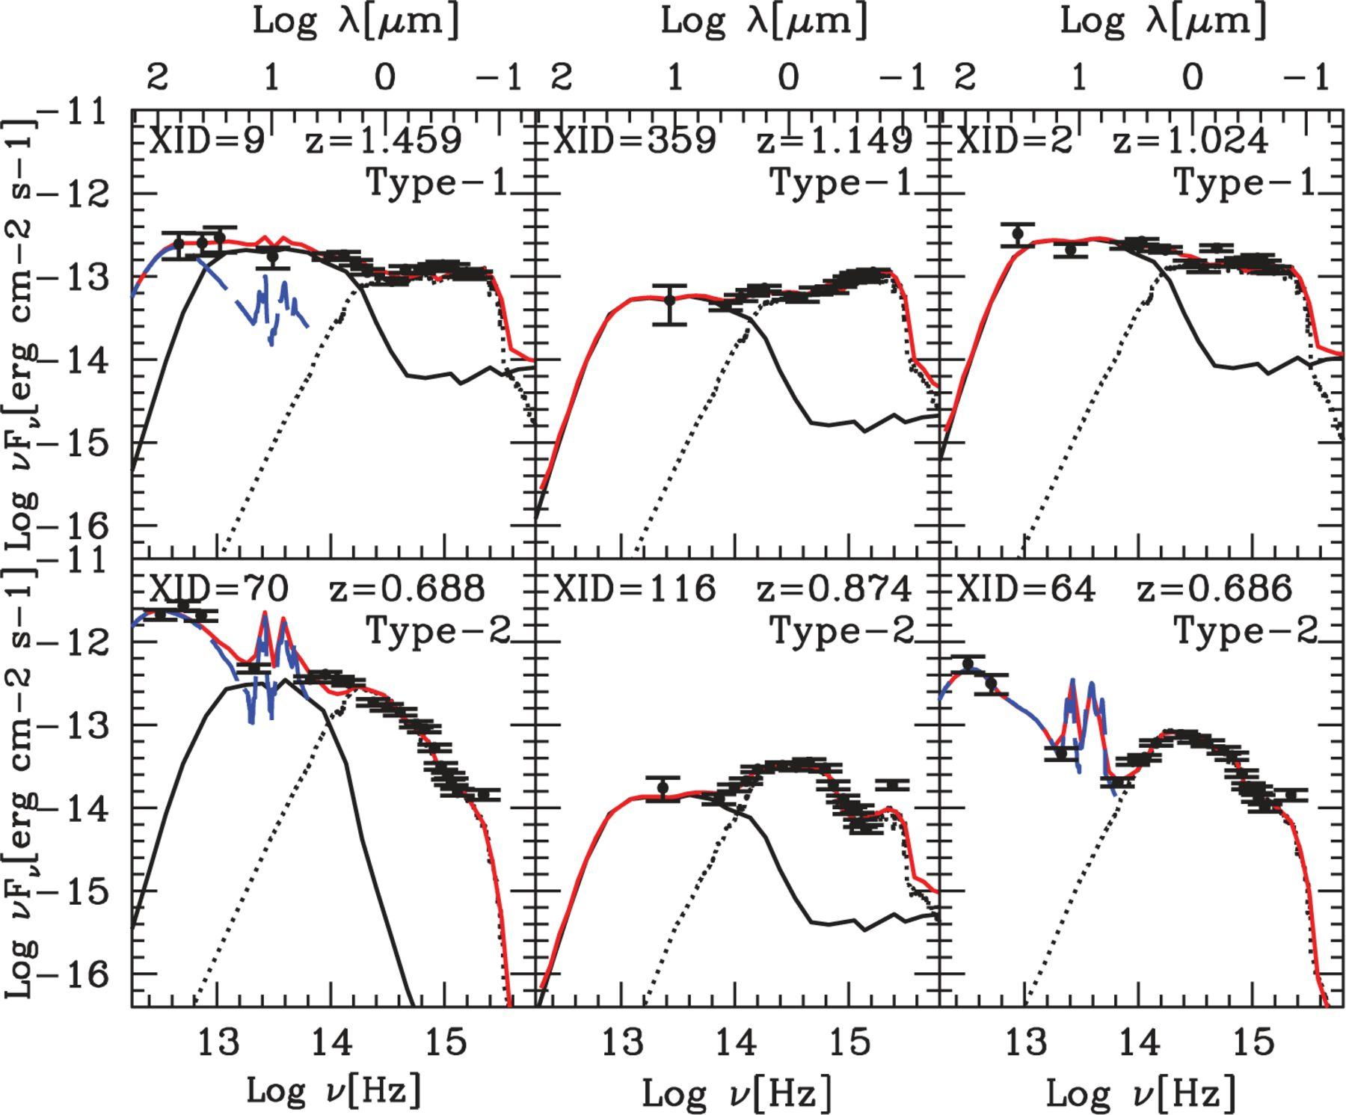
Figure 3 Examples of SED decompositions. The black circles correspond to the observed photometry in the rest frame ...
Notes:
Figure 3 Examples of SED decompositions. The black circles correspond to the observed photometry in the rest frame (from the far-IR to the optical-UV). The blue long-dashed, black solid and dotted lines correspond, respectively, to the starburst, AGN and host-galaxy templates found as the best-fitting solution. The red line represents the best-fitting SED. The top three panels are Type-1 AGN, while the bottom three are Type-2 AGN.
Unless provided in the caption above, the following copyright applies to the content of this slide: © 2012 The Authors Monthly Notices of the Royal Astronomical Society © 2012 RAS

Slide 5
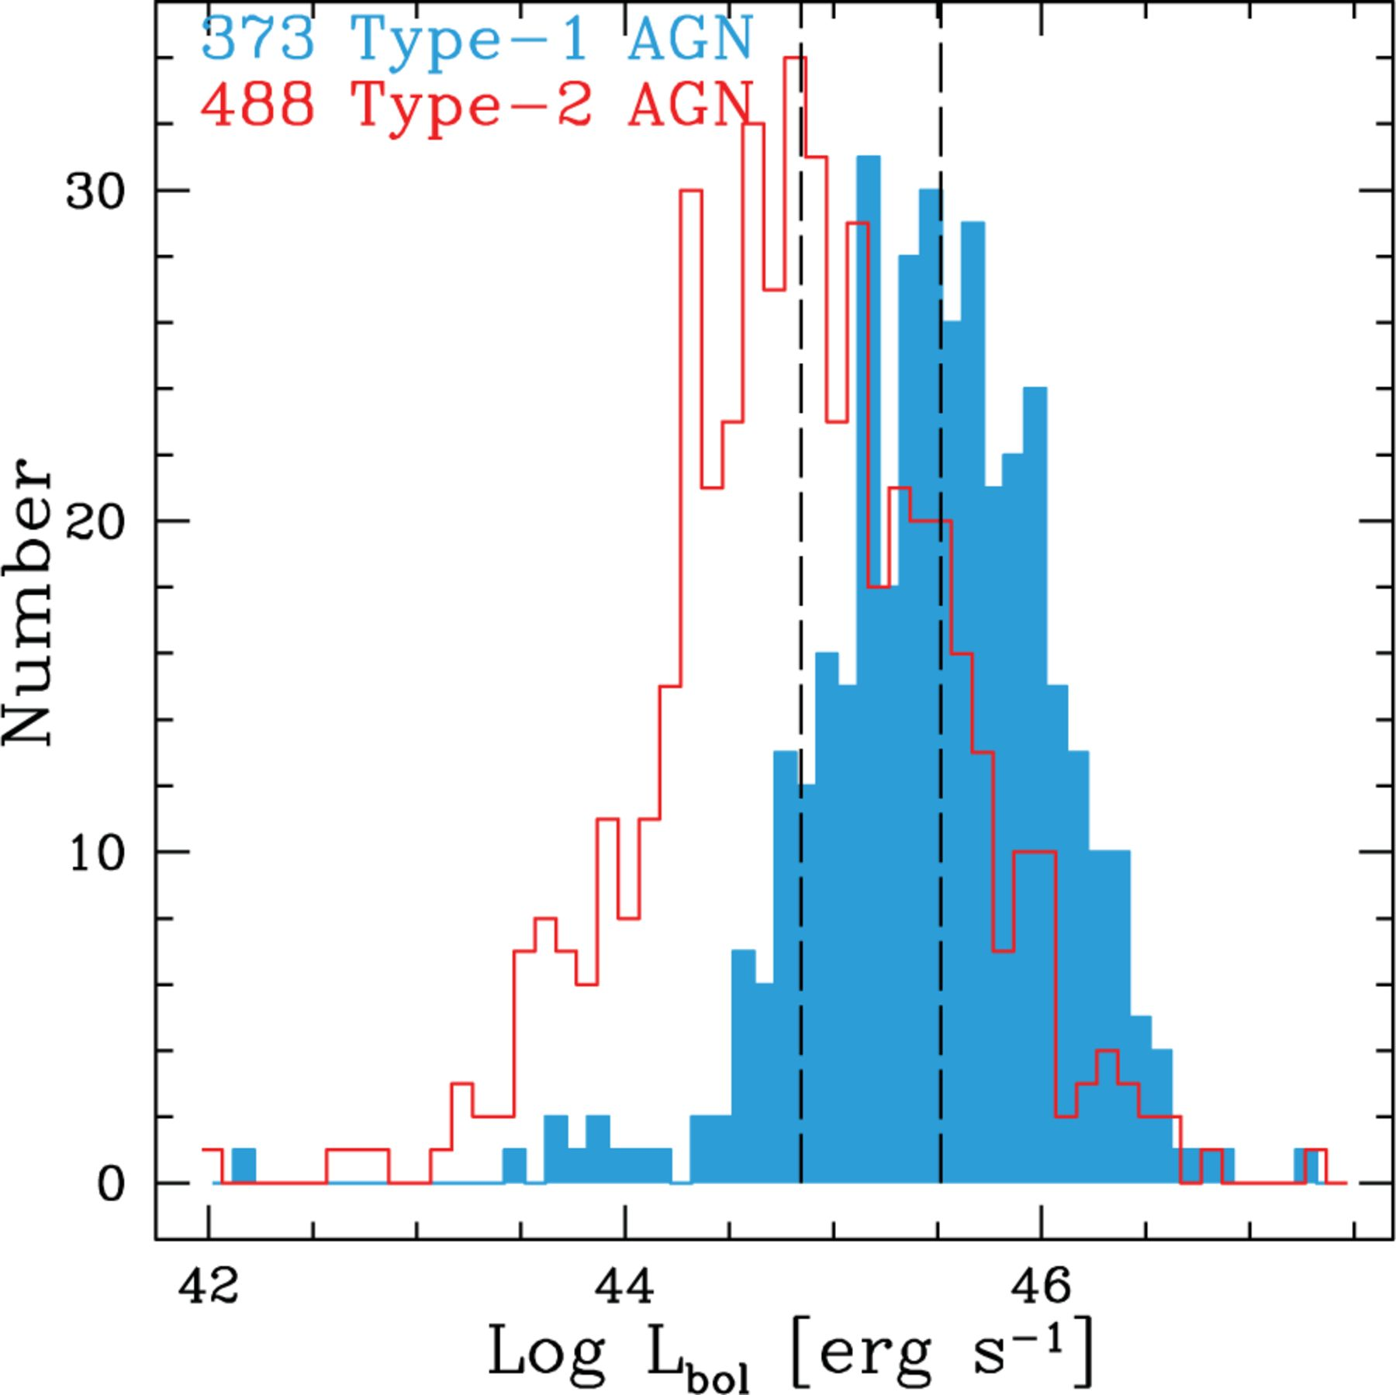
Figure 4 Histogram of bolometric luminosities for Type-1 AGN (blue filled histogram) and for Type-2 AGN (red open ...
Notes:
Figure 4 Histogram of bolometric luminosities for Type-1 AGN (blue filled histogram) and for Type-2 AGN (red open histogram) with AGN best fit available from the SED-fitting code. The two dashed lines show the median Lbol values for Type-1 AGN Lbol = 3.2 × 1045 erg s−1 (right) and for Type-2 AGN Lbol = 7.1 × 1044 erg s−1 (left).
Unless provided in the caption above, the following copyright applies to the content of this slide: © 2012 The Authors Monthly Notices of the Royal Astronomical Society © 2012 RAS

Slide 6
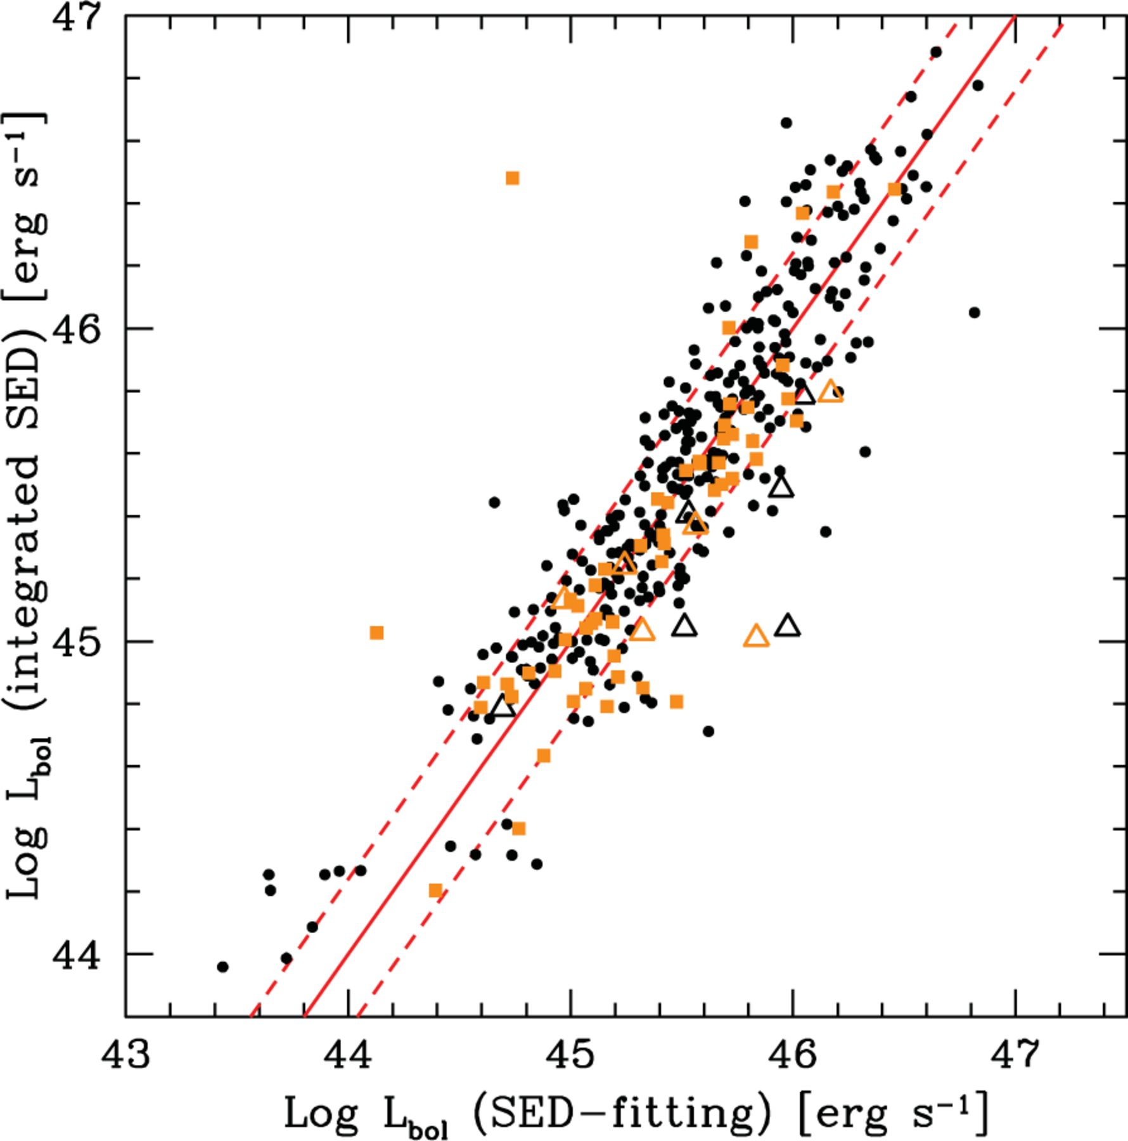
Figure 5 Comparison between the values of bolometric luminosity computed by the SED-fitting code and those obtained by ...
Notes:
Figure 5 Comparison between the values of bolometric luminosity computed by the SED-fitting code and those obtained by integrating the restframe SED from 1 -m to the X-ray for the Type-1 AGN sample. The black and orange symbols represent the spectro-z and the photo-z sample, respectively. The open squares represent AGN with an upper limit in the soft X-ray band. The red solid line and the dashed lines represent the one-to-one correlation and 1σ scatter of 0.24 dex, respectively.
Unless provided in the caption above, the following copyright applies to the content of this slide: © 2012 The Authors Monthly Notices of the Royal Astronomical Society © 2012 RAS

Slide 7
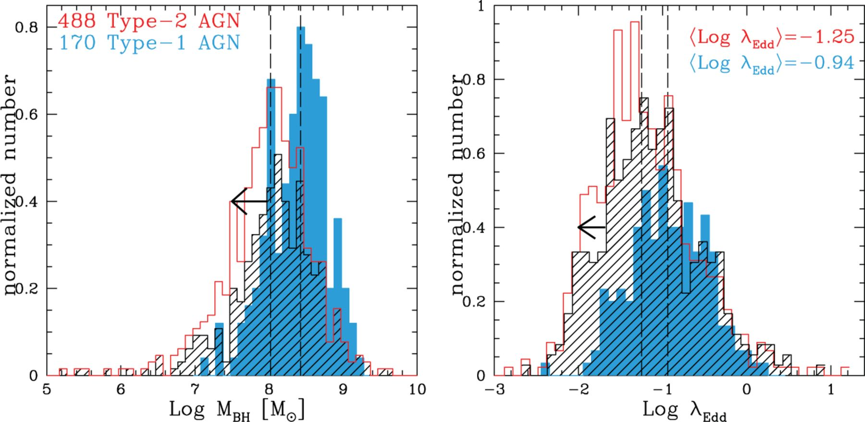
Figure 6 Left-hand panel: histogram of estimated BH masses from virial estimators for Type-1 AGN (blue filled ...
Notes:
Figure 6 Left-hand panel: histogram of estimated BH masses from virial estimators for Type-1 AGN (blue filled histogram), and from stellar masses for Type-2 AGN (red open histogram). The two dashed lines show the median MBH values for Type-1 AGN MBH = 2.7 × 108 M⊙ (right) and for Type-2 AGN MBH ∽ 108M⊙ (left). Right-hand panel: histogram of estimated Eddington ratios for Type-1 AGN (blue filled histogram) and for Type-2 AGN (red open histogram). The two dashed lines show the median λEdd values for Type-1 AGN λEdd = 0.12 (right) and for Type-2 AGN λEdd = 0.06 (left). Counts are normalized in order to better compare the samples. The black hatched histogram represents the subsample of Type-2 AGN (344 objects) for which B/Tot ratios are fixed to 1 and MBH estimates are considered upper limits.
Unless provided in the caption above, the following copyright applies to the content of this slide: © 2012 The Authors Monthly Notices of the Royal Astronomical Society © 2012 RAS

Slide 8
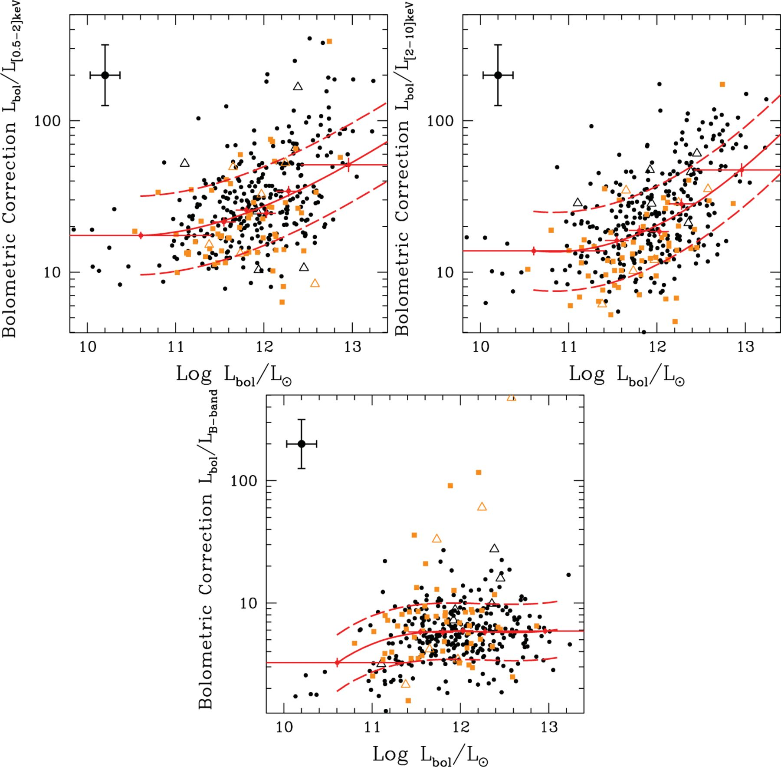
Figure 7 Bolometric correction as a function of the bolometric luminosity at [0.5-2] and [2-10] keV, and in the B band ...
Notes:
Figure 7 Bolometric correction as a function of the bolometric luminosity at [0.5-2] and [2-10] keV, and in the B band at 0.44-m for the Type-1 AGN sample. The spectro-z sample with detection in both X-ray bands is represented with black points (N = 304), while sources with spectroscopic redshift and an upper limit in the soft X-ray band are represented with black open triangles (N = 6). The orange symbols represent the photo-z sample (N = 63). The orange squares indicate photometric sources with detection in both X-ray bands (N = 57), while the orange open triangles Type-1 AGN that belong to the photo-z sample with an upper limit in the soft X-ray band (N = 6). The red bins are computed using 373 Type-1 AGN (six bins with about 62 sources per bin). The red points represent the median of the sources in each bin, the bars in the y-axis represent the error on the median (1.4826 MAD/, while the bars in the x-axis represent the width of the bin. The red solid line represents the best-fitting relations using a third-order polynomial, while the dashed lines represent 1σ dispersion after performing a 3.5σ clipping. Bolometric corrections have uncertainties of ∼0.2 dex, while Lbol uncertainties are of the order of 0.17 dex, as shown by the typical error bars in the upper-left of each panel.
Unless provided in the caption above, the following copyright applies to the content of this slide: © 2012 The Authors Monthly Notices of the Royal Astronomical Society © 2012 RAS

Slide 9
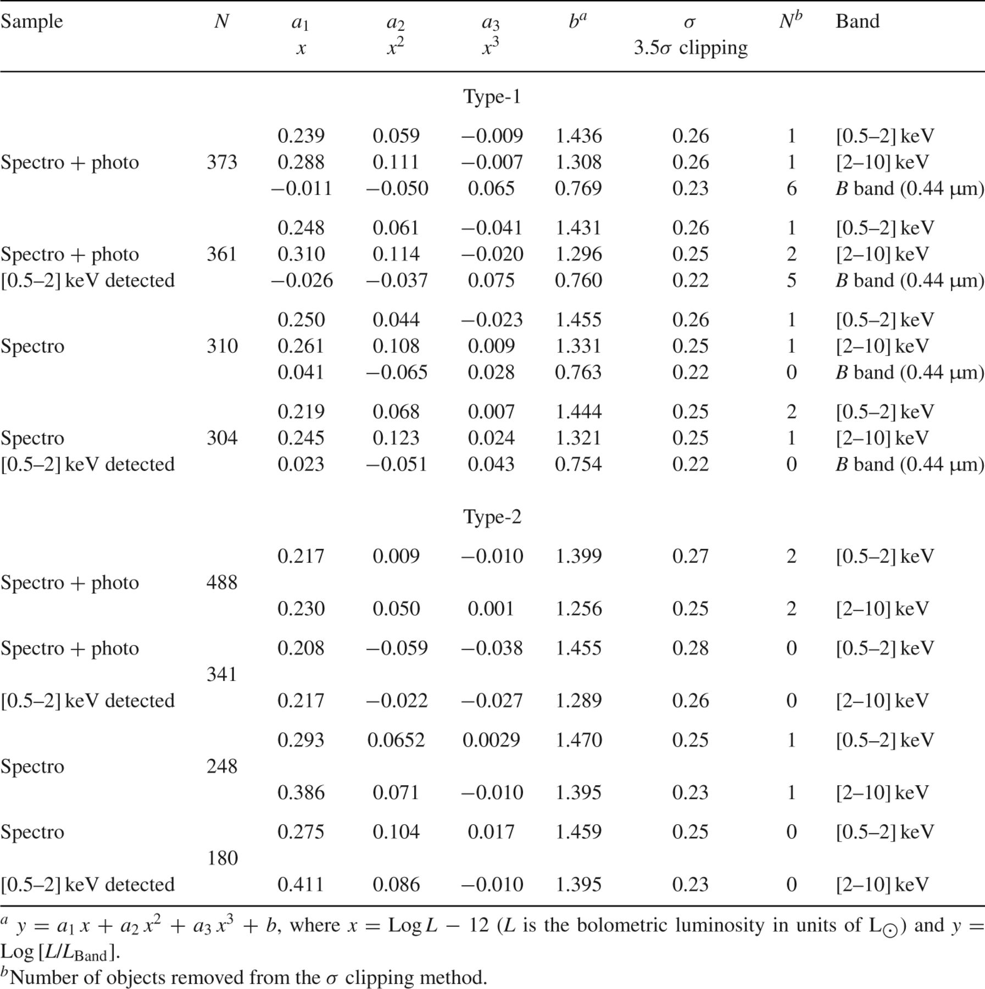
Table 2 Bolometric correction relations in different bands for the X-ray selected Type-1 and Type-2 AGN samples
Notes:
Table 2 Bolometric correction relations in different bands for the X-ray selected Type-1 and Type-2 AGN samples
Unless provided in the caption above, the following copyright applies to the content of this slide: © 2012 The Authors Monthly Notices of the Royal Astronomical Society © 2012 RAS

Slide 10
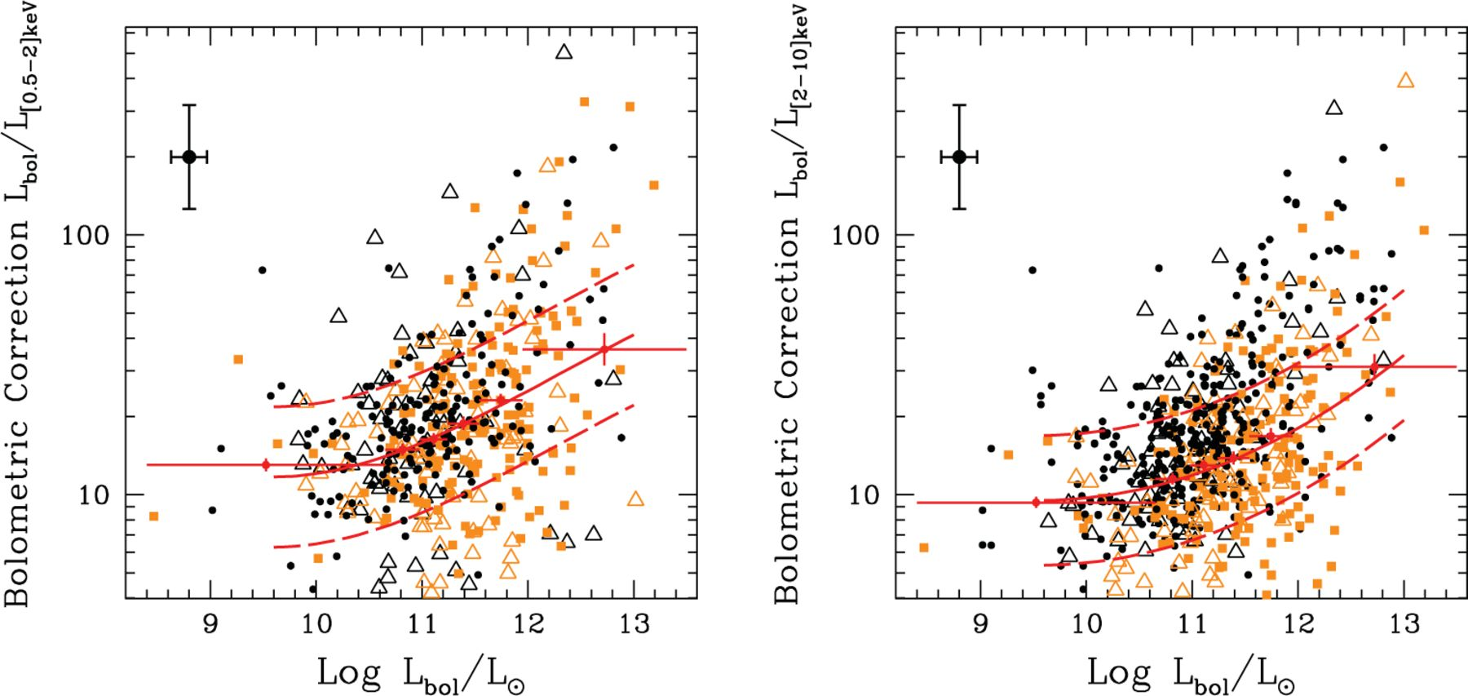
Figure 8 Bolometric correction as a function of the bolometric luminosity in the [0.5-2] and [2-10] keV bands for the ...
Notes:
Figure 8 Bolometric correction as a function of the bolometric luminosity in the [0.5-2] and [2-10] keV bands for the Type-2 AGN sample with AGN best fit. The symbol keys are the same as those in Fig. 7. The sample used to compute the bins is composed as follows: 180 spectroscopic Type-2 AGN with both X-ray detections (black points), 68 objects with spectro-z and [0.5-2] keV upper limits (black open triangles), 161 photo-z Type-2 AGN with both X-ray detections (orange squares) and 79 photo-z Type-2 AGN with [0.5-2] keV upper limits (orange open triangles). The red bins are computed using the 488 Type-2 AGN sample (six bins with about 80 sources per bin).
Unless provided in the caption above, the following copyright applies to the content of this slide: © 2012 The Authors Monthly Notices of the Royal Astronomical Society © 2012 RAS

Slide 11
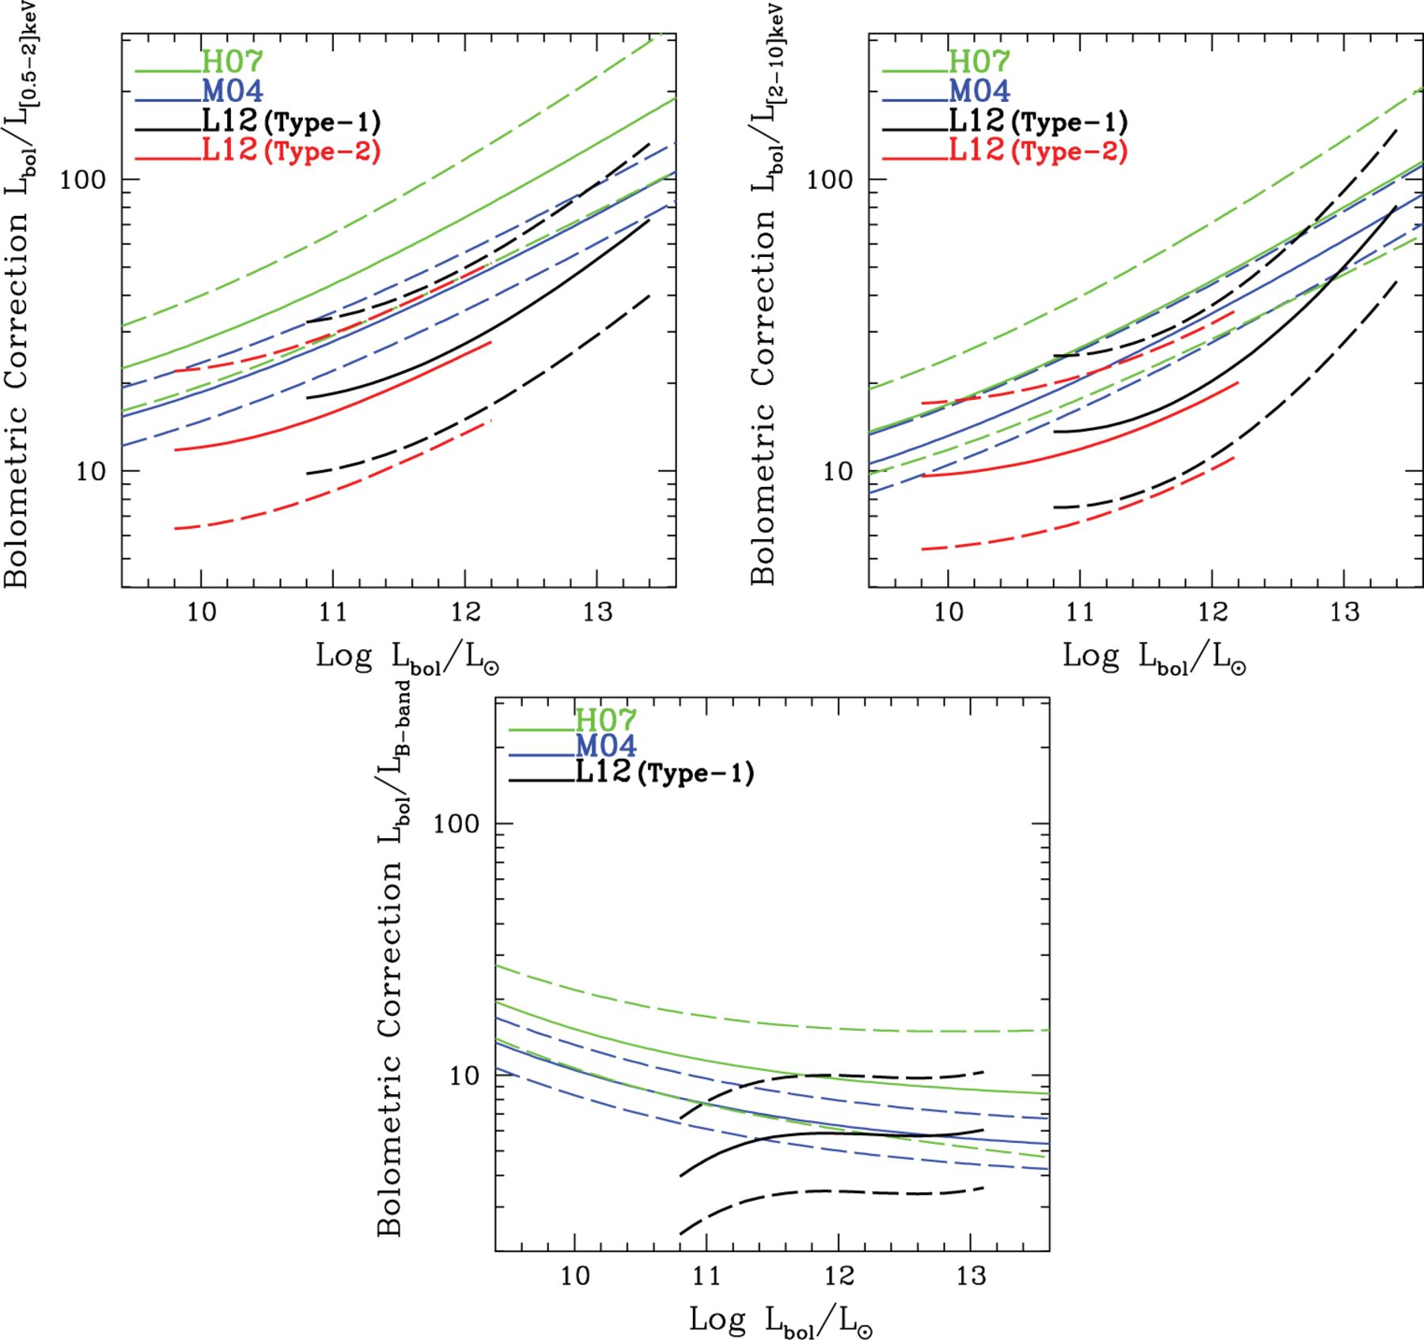
Figure 9 Bolometric correction as a function of the bolometric luminosity in the soft, hard and B bands for the Type-1 ...
Notes:
Figure 9 Bolometric correction as a function of the bolometric luminosity in the soft, hard and B bands for the Type-1 AGN sample (N = 373, black solid line), soft and hard bands for the Type-2 AGN sample with AGN best fit (N = 488, red solid line). The 1σ dispersion after performing a 3.5σ clipping is also reported with the dashed lines. The green and blue lines represent the bolometric correction in the hard band and 1σ dispersion obtained by H07 and M04, respectively.
Unless provided in the caption above, the following copyright applies to the content of this slide: © 2012 The Authors Monthly Notices of the Royal Astronomical Society © 2012 RAS

Slide 12
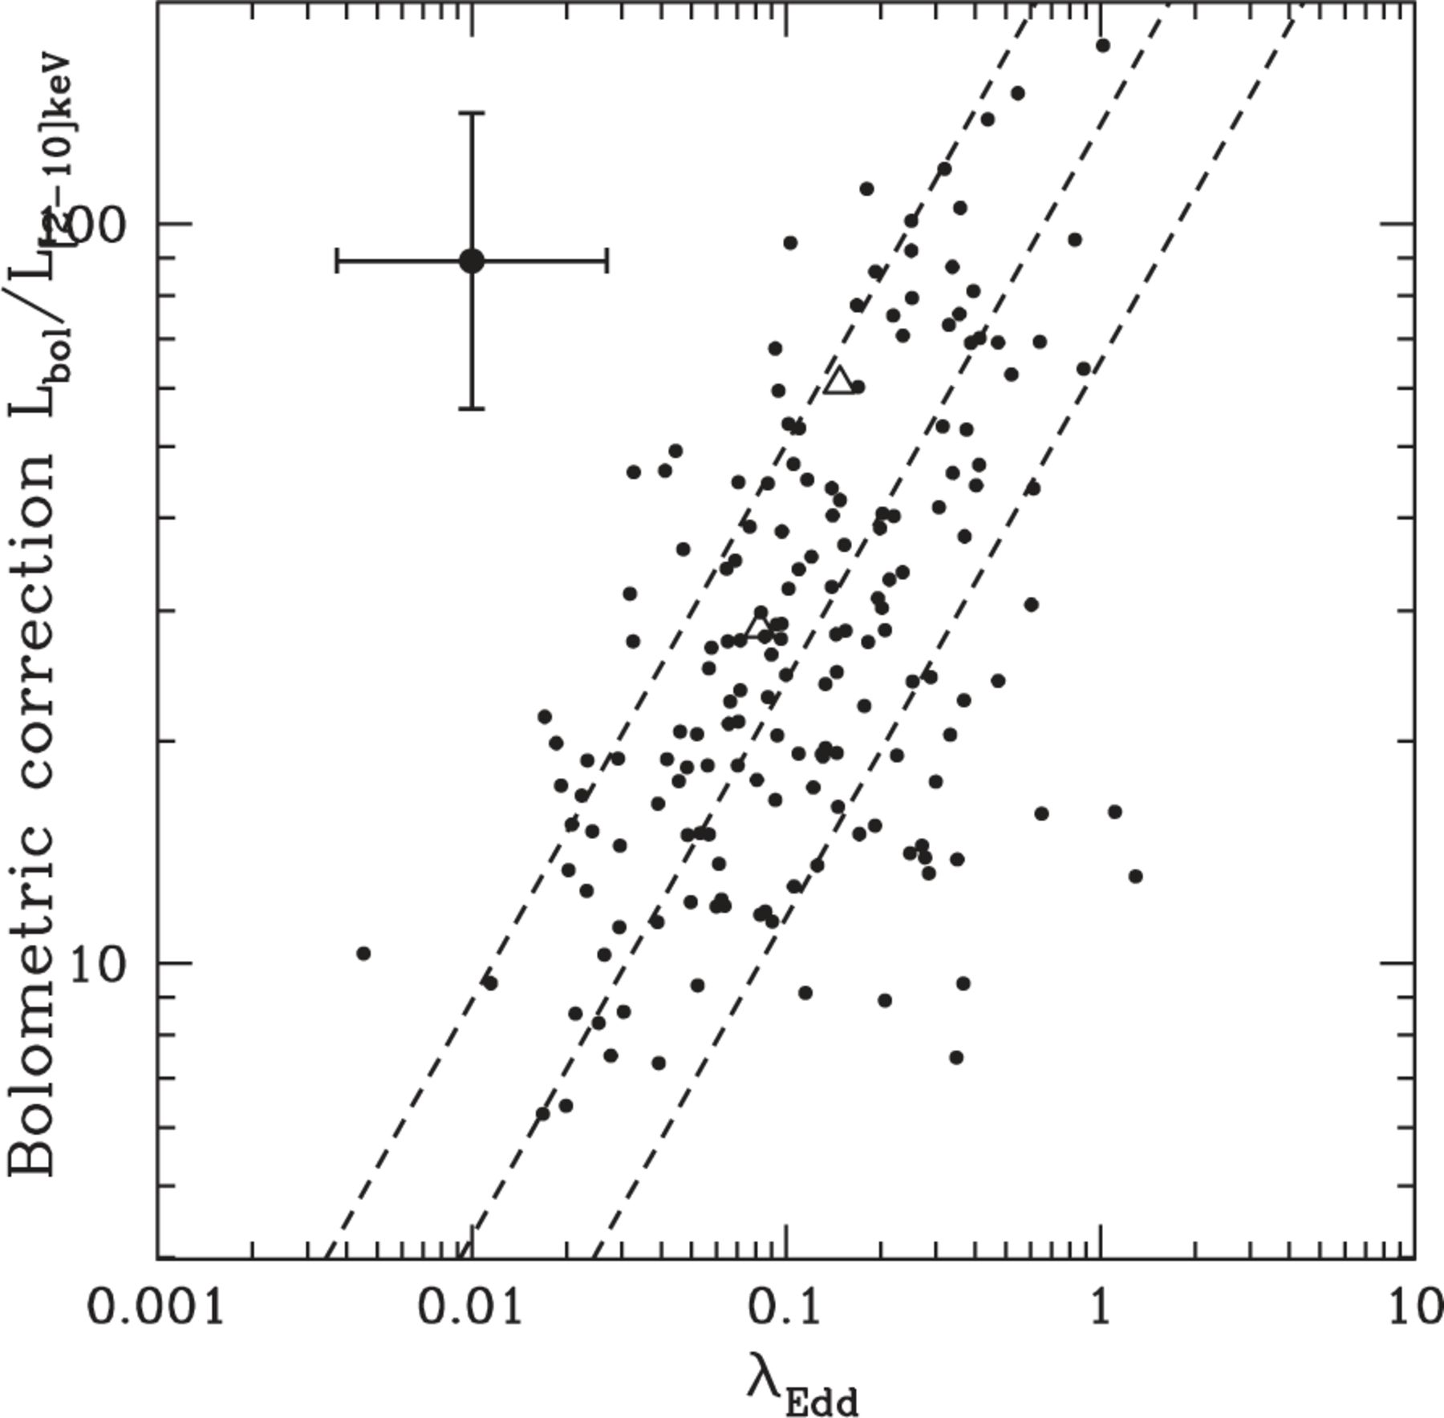
Figure 10 Hard X-ray bolometric correction versus Eddington ratio for the 170 Type-1 AGN (black points) with BH mass ...
Notes:
Figure 10 Hard X-ray bolometric correction versus Eddington ratio for the 170 Type-1 AGN (black points) with BH mass estimate from broad lines. The short-dashed black line shows the best-fitting relation and 1σ dispersion that we found using the OLS bisector algorithm. The typical error bars in the upper-left of the panel are shown for both λEdd (0.43 dex) and kbol (0.2 dex).
Unless provided in the caption above, the following copyright applies to the content of this slide: © 2012 The Authors Monthly Notices of the Royal Astronomical Society © 2012 RAS

Slide 13
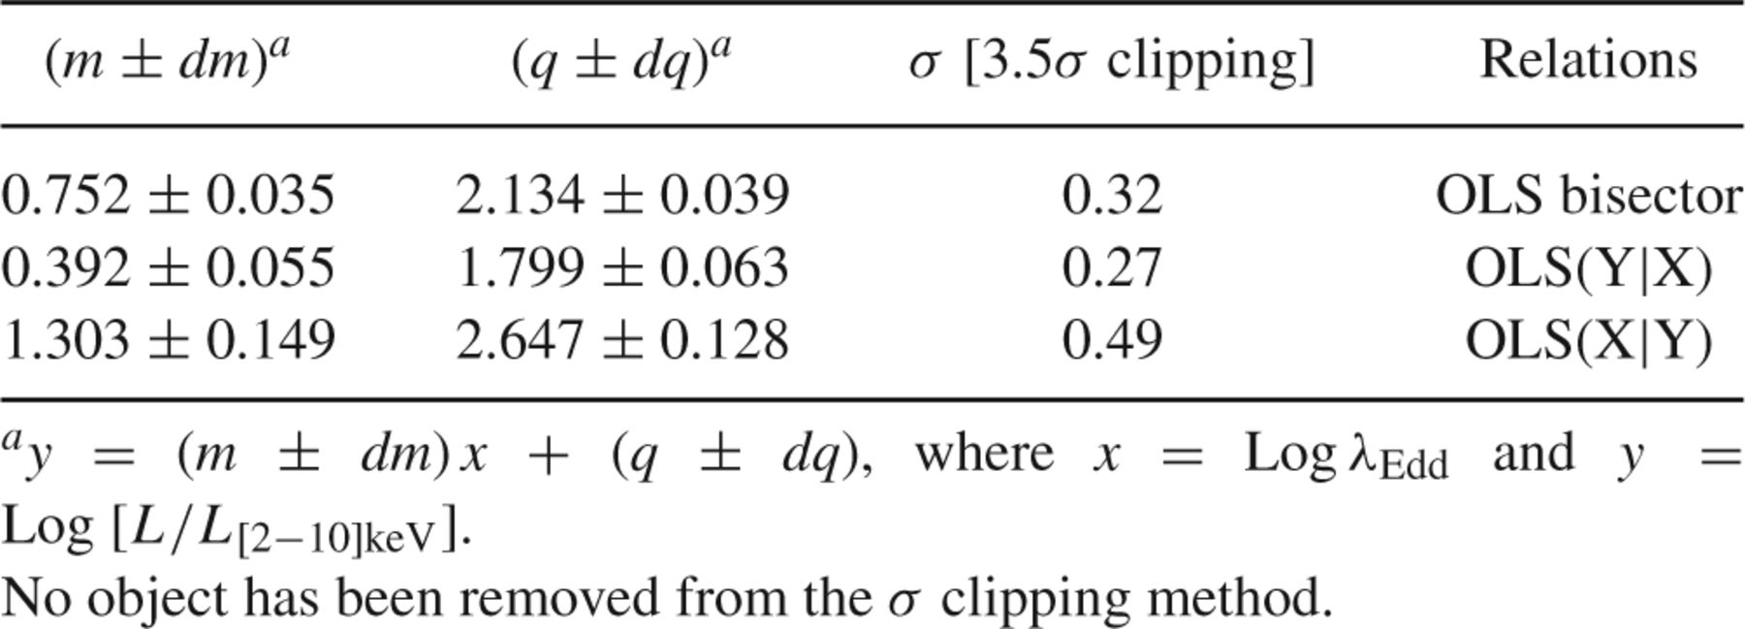
Table 3 Hard X-ray bolometric correction as a function of the Eddington ratio for the X-ray selected 170 Type-1 AGN ...
Notes:
Table 3 Hard X-ray bolometric correction as a function of the Eddington ratio for the X-ray selected 170 Type-1 AGN sample with MBH available.
Unless provided in the caption above, the following copyright applies to the content of this slide: © 2012 The Authors Monthly Notices of the Royal Astronomical Society © 2012 RAS

Slide 14
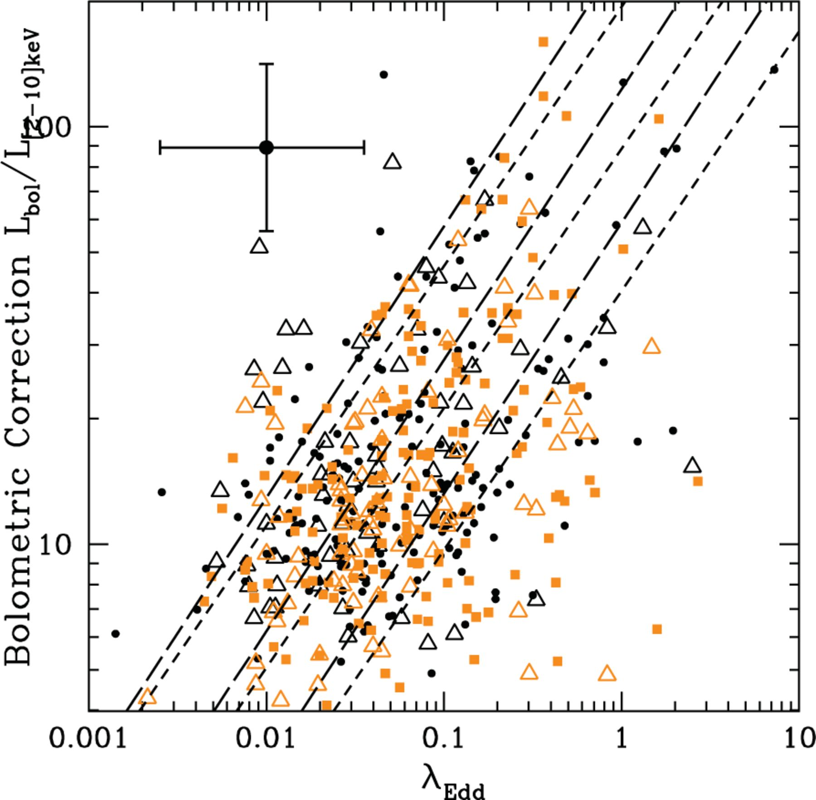
Figure 11 Hard X-ray bolometric correction versus Eddington ratio for the 488 Type-2 AGN with bolometric luminosities ...
Notes:
Figure 11 Hard X-ray bolometric correction versus Eddington ratio for the 488 Type-2 AGN with bolometric luminosities and stellar masses available from the SED fitting. Symbol keys are the same as those in Fig. 7. The short-dashed black line shows the OLS bisector and 1σ dispersion for the 488 Type-2 AGN with Lbol and M* available. The long-dashed black line shows the OLS bisector and 1σ dispersion for the 144 Type-2 AGN with Lbol, M* and morphology classification available. The typical error bars in the upper-left of the panel are shown for both λEdd (0.55 dex) and kbol (0.2 dex).
Unless provided in the caption above, the following copyright applies to the content of this slide: © 2012 The Authors Monthly Notices of the Royal Astronomical Society © 2012 RAS

Slide 15
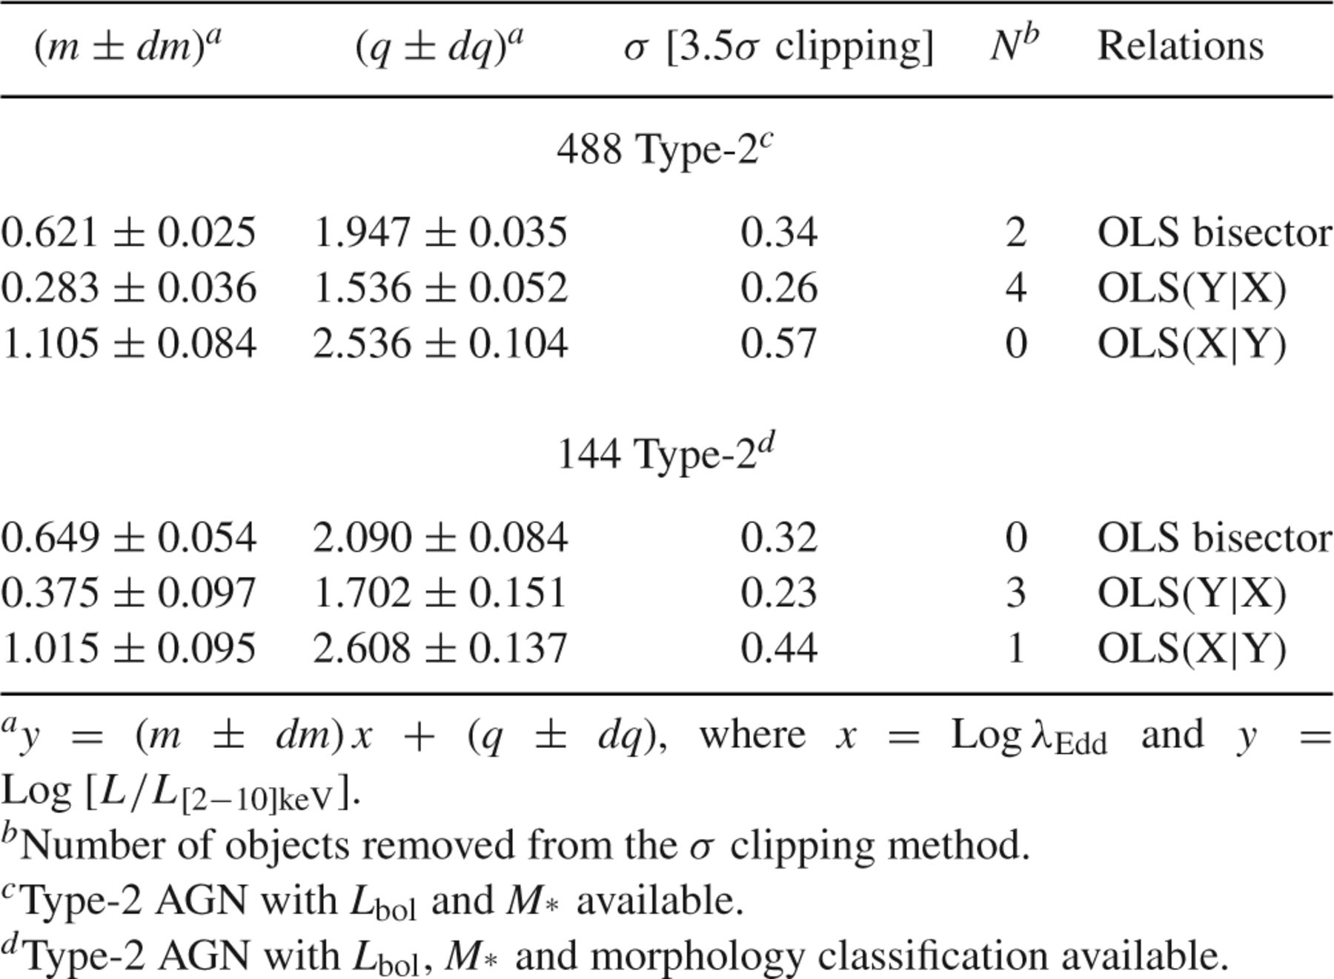
Table 4 Hard X-ray bolometric correction as a function of the Eddington ratio for the X-ray selected Type-2 AGN ...
Notes:
Table 4 Hard X-ray bolometric correction as a function of the Eddington ratio for the X-ray selected Type-2 AGN sample
Unless provided in the caption above, the following copyright applies to the content of this slide: © 2012 The Authors Monthly Notices of the Royal Astronomical Society © 2012 RAS

Slide 16
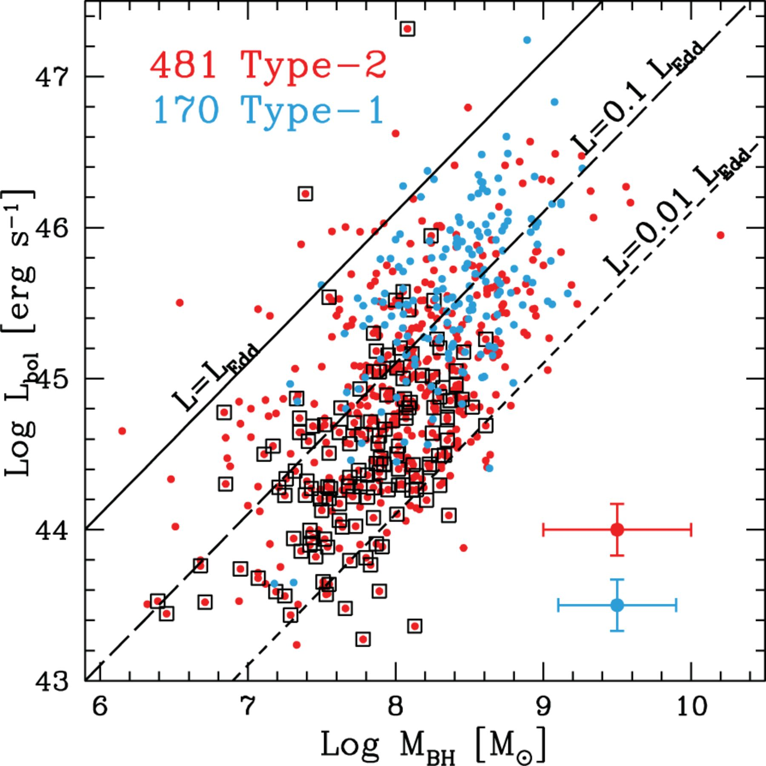
Figure 12 Bolometric luminosities as a function of BH masses for both Type-1 (blue symbols) and Type-2 ( red symbols) ...
Notes:
Figure 12 Bolometric luminosities as a function of BH masses for both Type-1 (blue symbols) and Type-2 ( red symbols) AGN samples. Diagonal lines represent the trend between Lbol and MBH at different fractions of the Eddington luminosity: λEdd = 1, 0.1 and 0.01 (solid, long-dashed and short-dashed lines, respectively). The Black open squares mark 144 Type-2 AGN with Lbol, M* and morphology classification available. Typical error bars in the lower-right of the panel are showed for both MBH (0.4 dex for Type-1 AGN in blue and 0.5 dex for Type-2 AGN in red) and kbol (0.2 dex for both Type-1 and Type-2 AGN).
Unless provided in the caption above, the following copyright applies to the content of this slide: © 2012 The Authors Monthly Notices of the Royal Astronomical Society © 2012 RAS

Slide 17
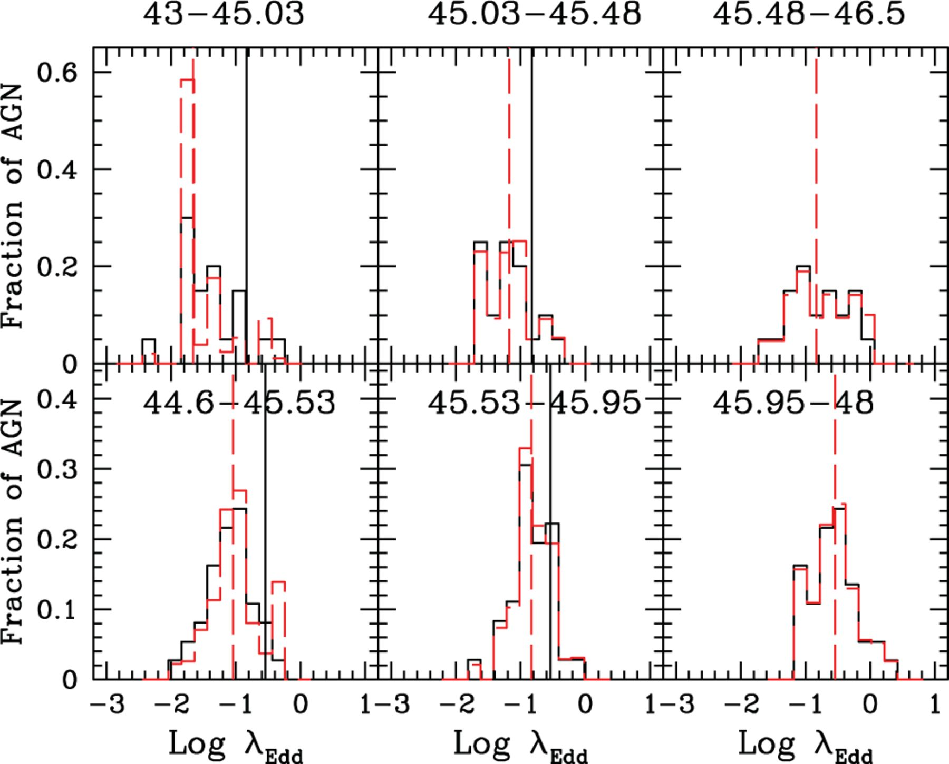
Figure 13 Distributions of Eddington ratios in bins of luminosity and redshift for the Type-1 AGN sample. The panels ...
Notes:
Figure 13 Distributions of Eddington ratios in bins of luminosity and redshift for the Type-1 AGN sample. The panels are divided between z < 1.2 (top three panels) and 1.2 ≤ z ≤ 2.3 (lower three panels), and bolometric luminosities increase from left to right [Log Lbol (erg s−1) intervals are reported on top of each panel]. The black histograms showthe observed ?Edd distributions, while the red dashed histograms represent the distributions corrected for incompleteness, according to the V/Vmax method described in Section 6.5. The dashed red lines represent the median values corresponding to the completeness-corrected distributions, while the solid black lines in the first and in the second bins are plotted at the λEdd value corresponding to the median in the highest luminosity bin. There are ∼20 and ∼37 objects in each bin at z < 1.2 and 1.2 ≤ z ≤ 2.3, respectively. The numbers of AGN in the completeness-corrected λEdd distributions are 98, 22 and 21 at z < 1.2, while 88, 51 and 38 at 1.2 ≤ z ≤ 2.3, from left to right.
Unless provided in the caption above, the following copyright applies to the content of this slide: © 2012 The Authors Monthly Notices of the Royal Astronomical Society © 2012 RAS

Slide 18
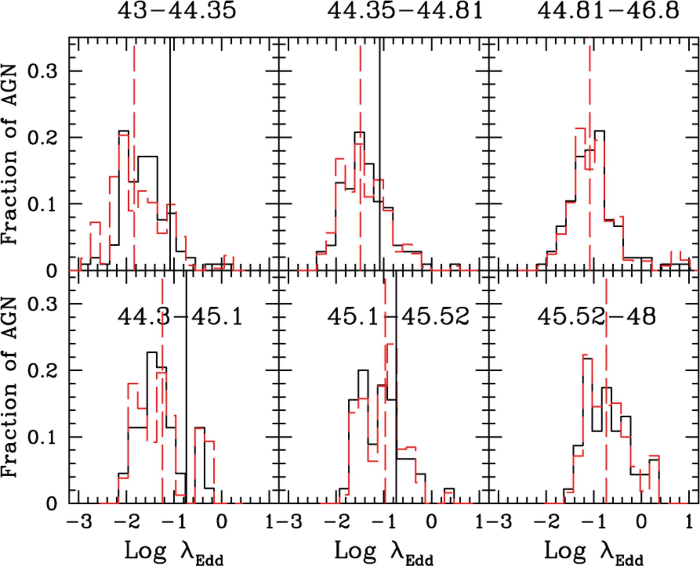
Figure 14 Distributions of Eddington ratios in bins of luminosity and redshift for the Type-2 AGN sample. Description ...
Notes:
Figure 14 Distributions of Eddington ratios in bins of luminosity and redshift for the Type-2 AGN sample. Description as that in Fig. 13. There are ∼106 and ∼45 objects in each bin at z < 1.2 and 1.2 ≤ z ≤ 2.3, respectively. The numbers of AGN in the completeness-corrected λEdd distributions are 1317, 234 and 140 at z < 1.2, while 259, 77 and 62 at 1.2 ≤ z ≤ 2.3 from left to right.
Unless provided in the caption above, the following copyright applies to the content of this slide: © 2012 The Authors Monthly Notices of the Royal Astronomical Society © 2012 RAS

Slide 19
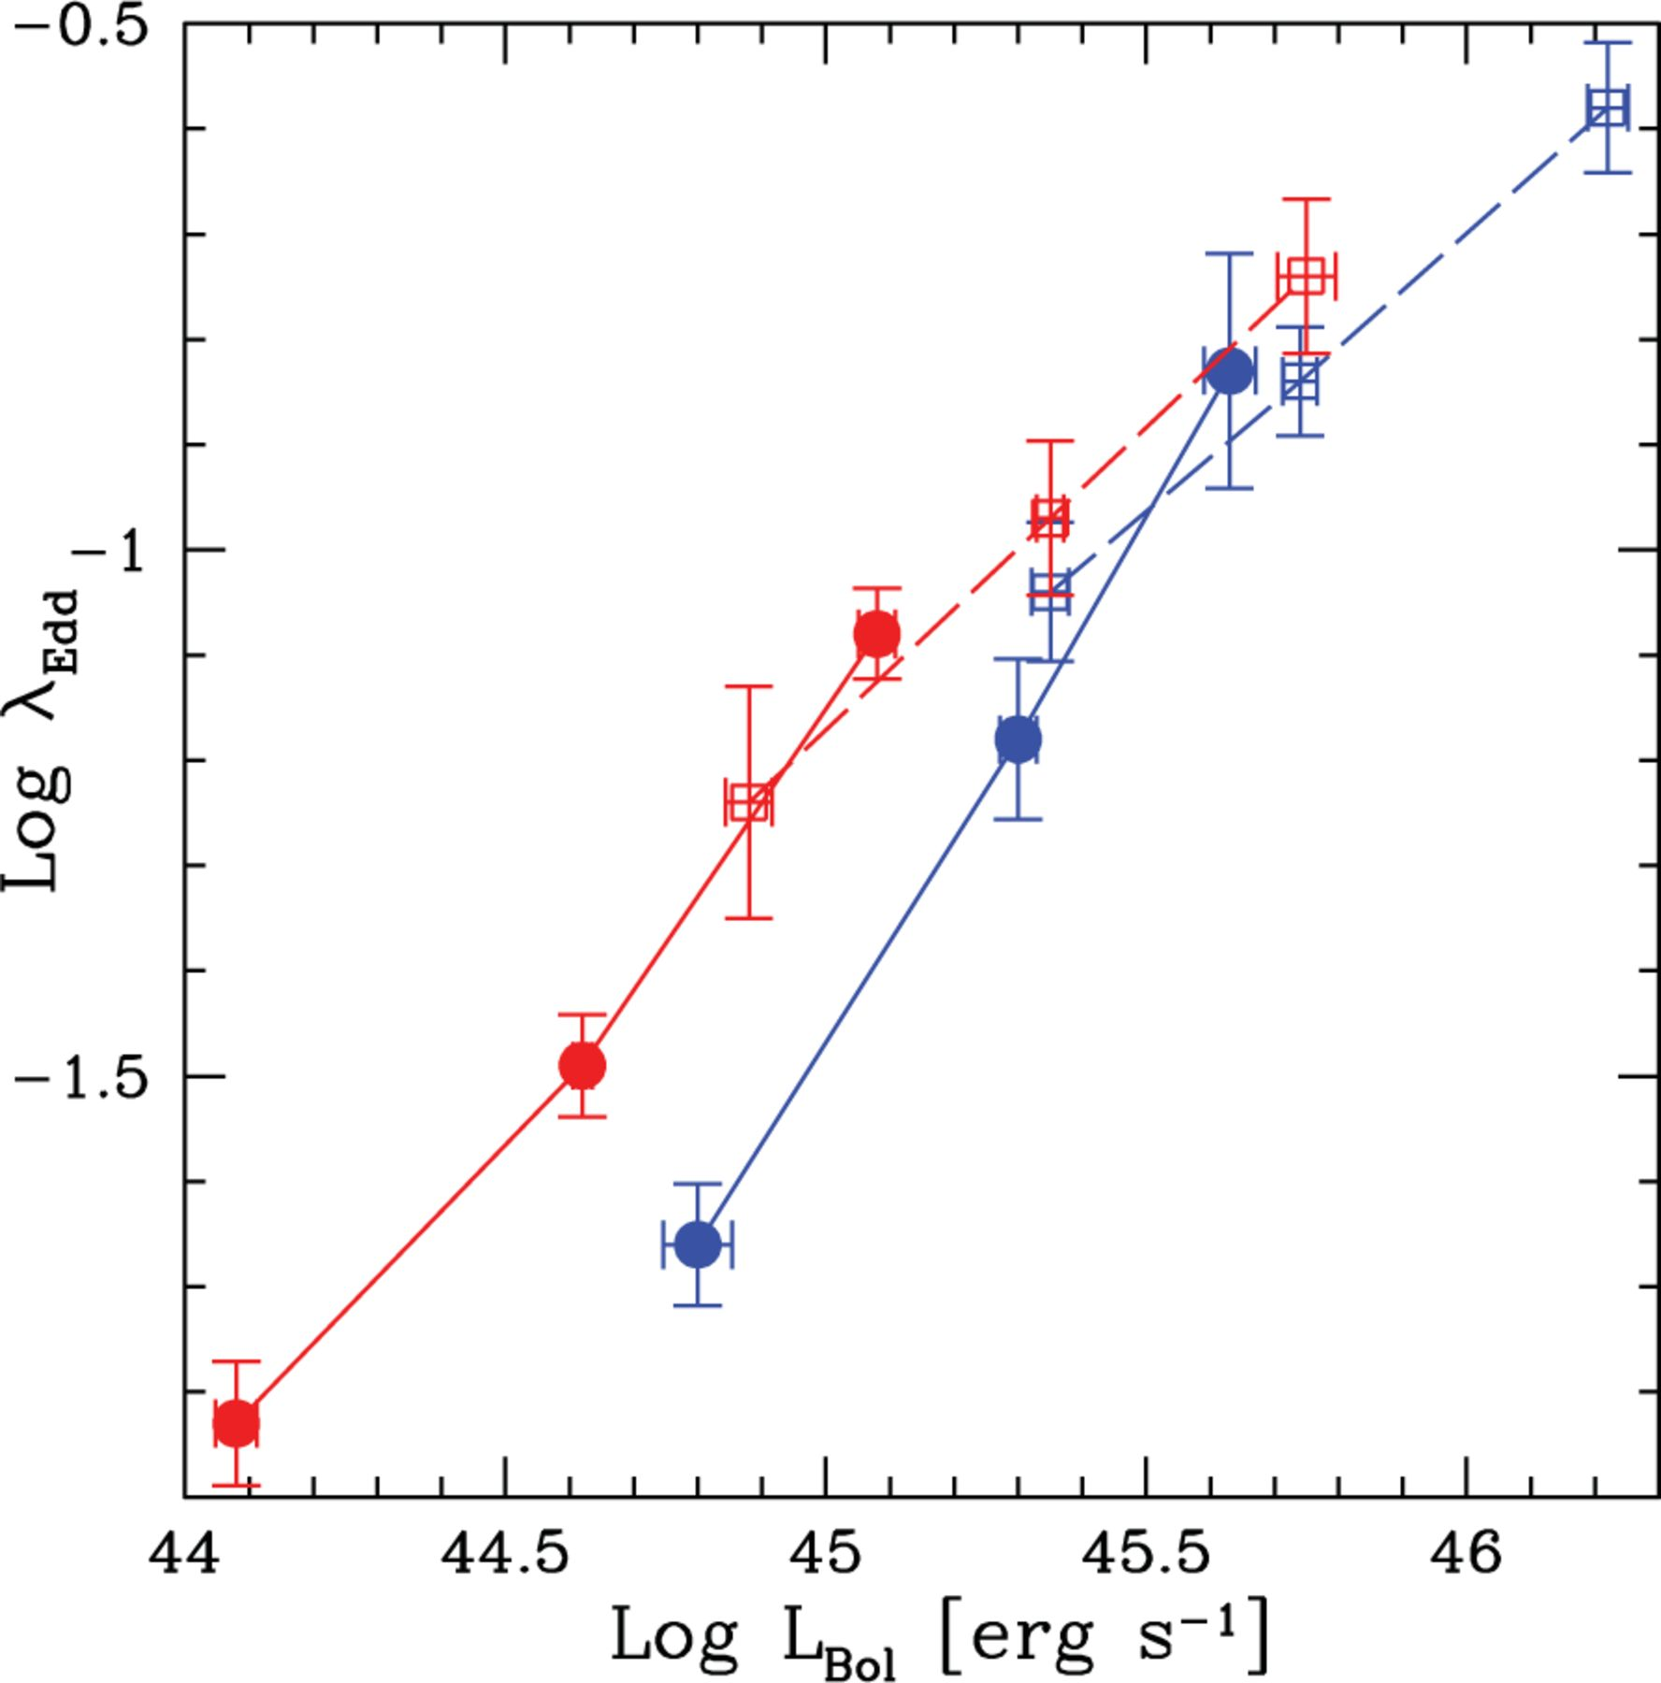
Figure 15 Median Eddington ratios as a function of the median Lbol for Type-1 (blue symbols) and Type-2 AGN (red ...
Notes:
Figure 15 Median Eddington ratios as a function of the median Lbol for Type-1 (blue symbols) and Type-2 AGN (red symbols). The filled circles and open squares represent the median λEdd for z < 1.2 and 1.2 ≤ z ≤ 2.3, respectively. The solid lines connect low-redshift bins, while the dashed ones connect high-redshift bins. The error bars on the median are estimated considering the 16th and 84th percentile divided by the square root of the number of observed AGN.
Unless provided in the caption above, the following copyright applies to the content of this slide: © 2012 The Authors Monthly Notices of the Royal Astronomical Society © 2012 RAS

Slide 20
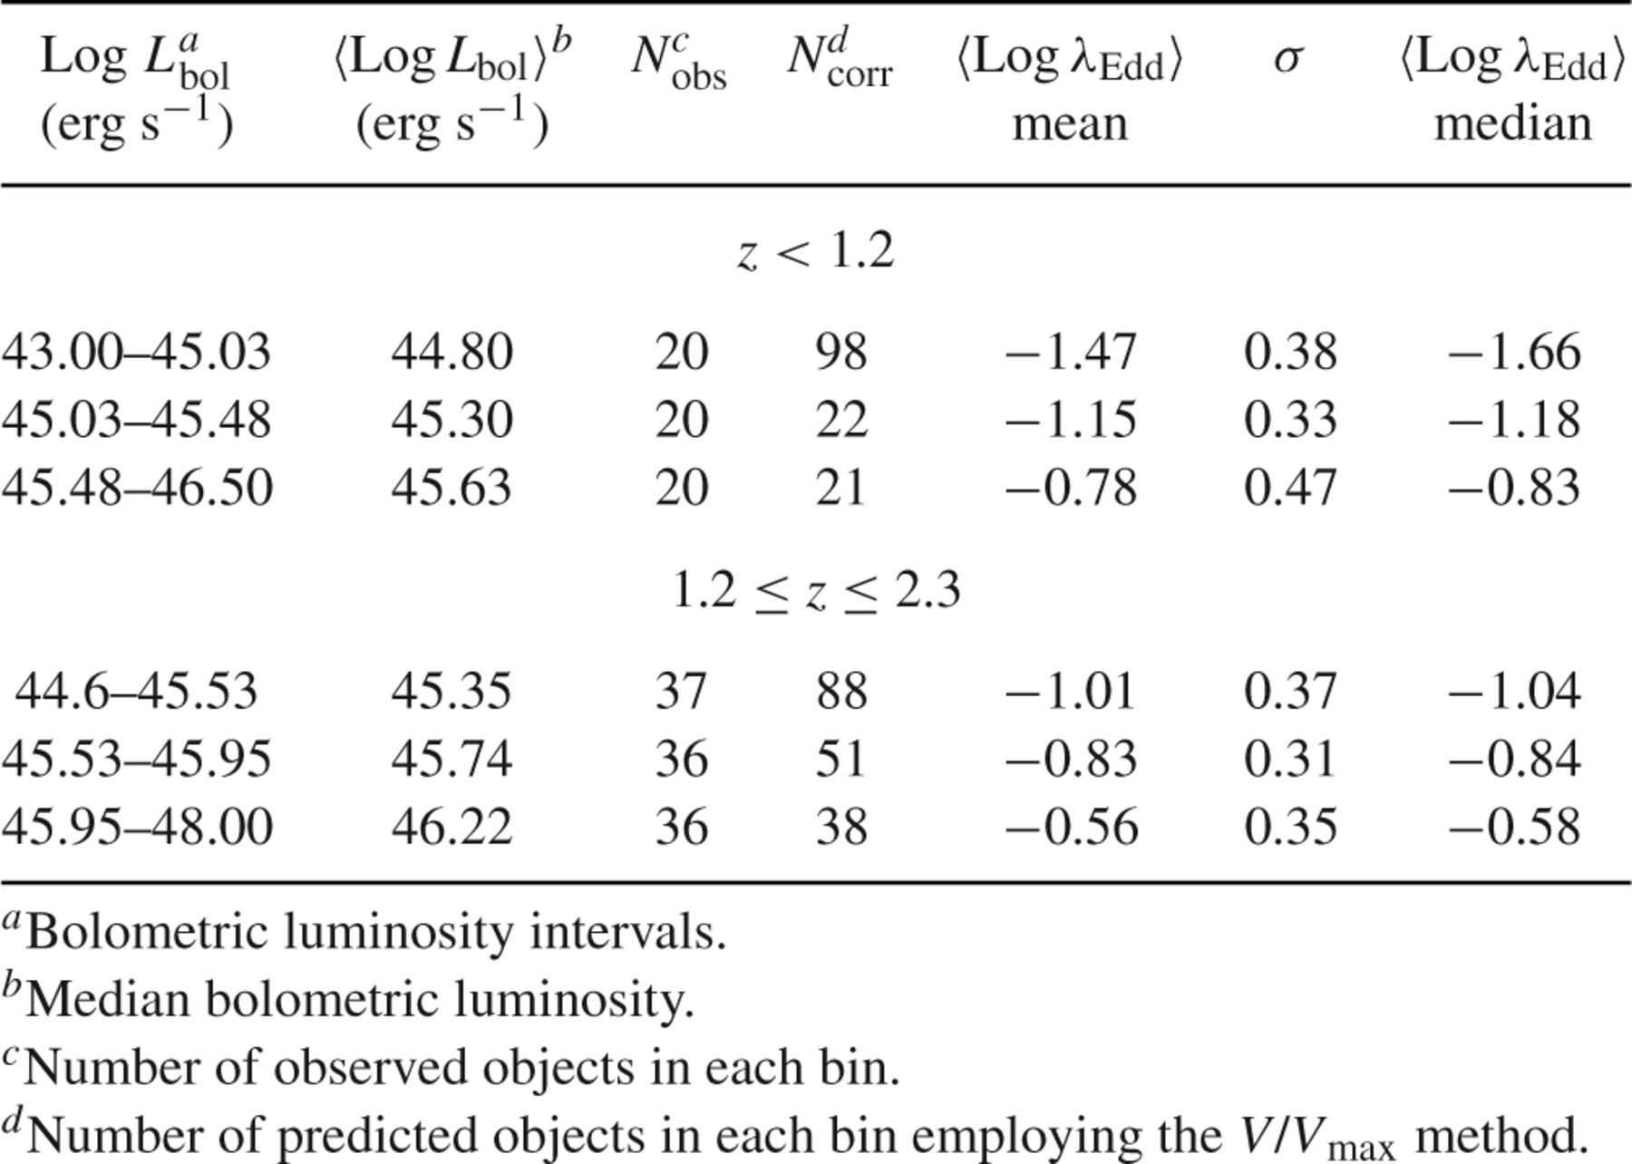
Table 5 Average Log λ_{Edd} values in L_{bol}-z bins for Type-1 AGN.
Notes:
Table 5 Average Log λEdd values in Lbol-z bins for Type-1 AGN.
Unless provided in the caption above, the following copyright applies to the content of this slide: © 2012 The Authors Monthly Notices of the Royal Astronomical Society © 2012 RAS

Slide 21
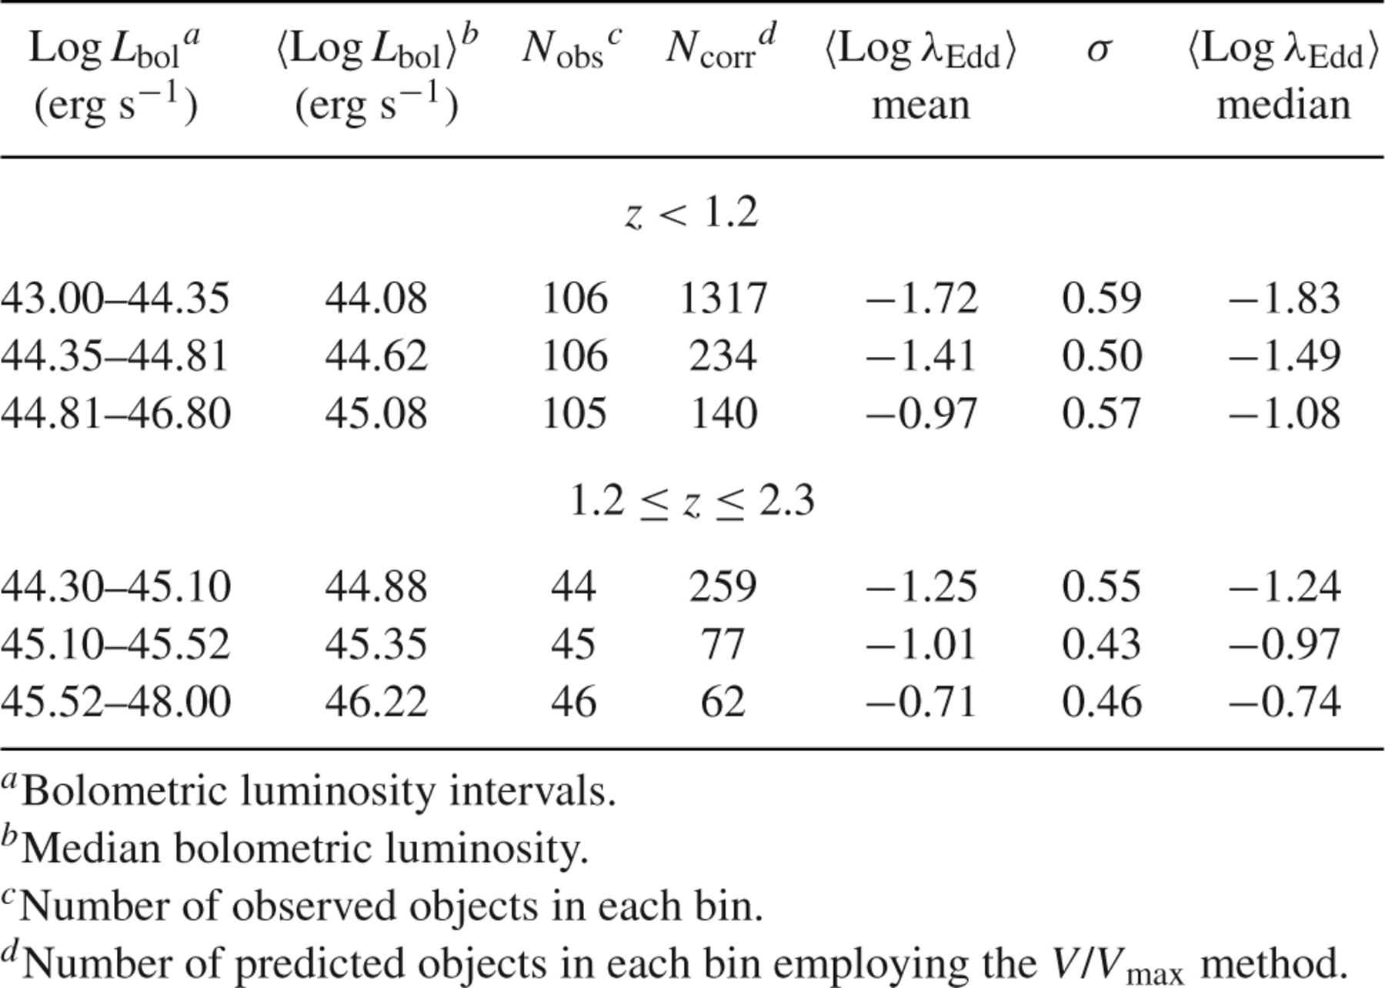
Table 6 Average Log λ_{Edd} values in L_{bol}-z bins for Type-2 AGN.
Notes:
Table 6 Average Log λEdd values in Lbol-z bins for Type-2 AGN.
Unless provided in the caption above, the following copyright applies to the content of this slide: © 2012 The Authors Monthly Notices of the Royal Astronomical Society © 2012 RAS

Slide 22
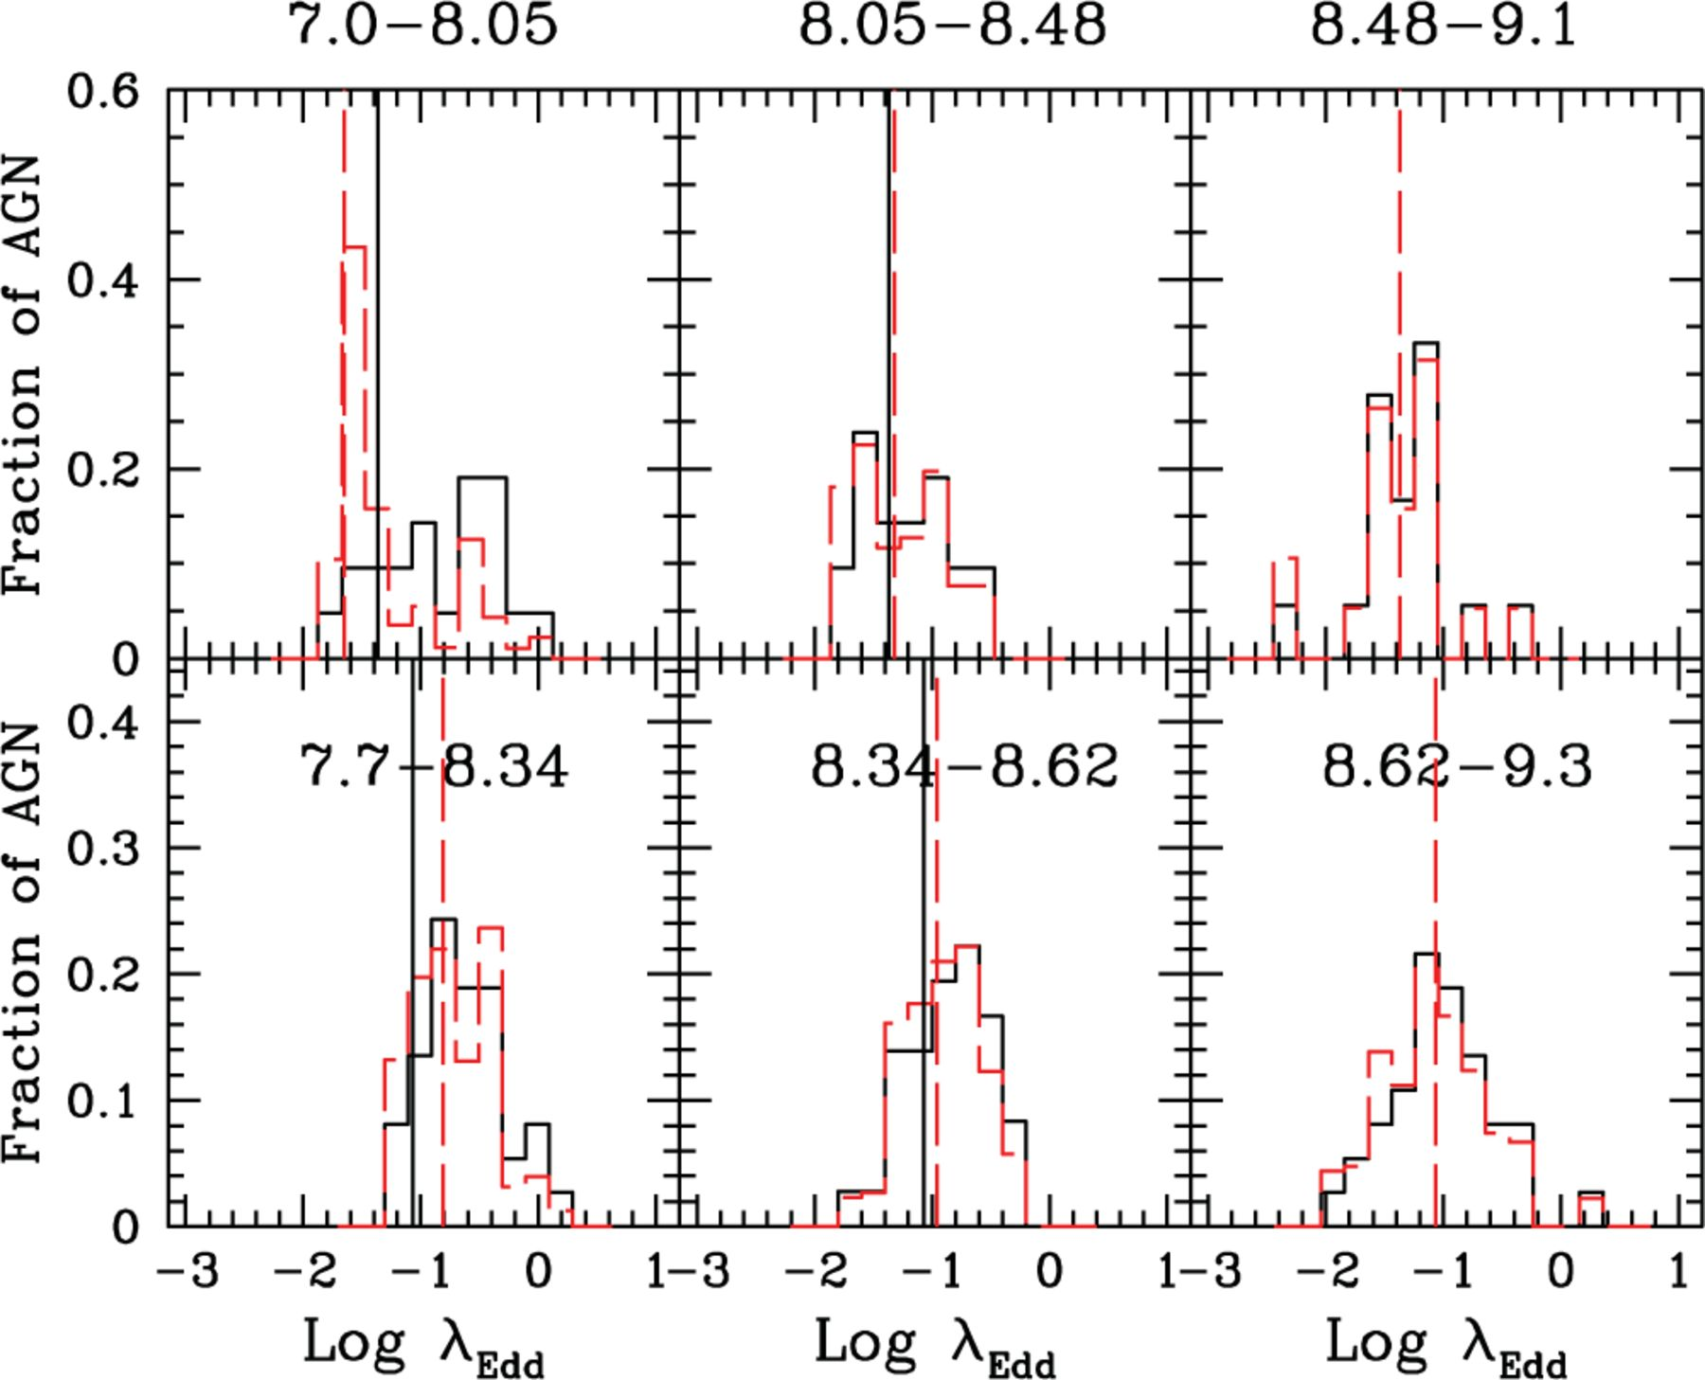
Figure 16 Distributions of Eddington ratios in bins of BH mass and redshift for the Type-1 AGN sample. The panels are ...
Notes:
Figure 16 Distributions of Eddington ratios in bins of BH mass and redshift for the Type-1 AGN sample. The panels are divided between z < 1.2 (top three panels) and 1.2 ≤ z ≤ 2.3 (lower three panels), and BH masses increase from left to right [Log MBH (M⊙) intervals are reported on top of each panel]. The black histograms show the observed λEdd distributions, while the red dashed histograms represent the distributions corrected for incompleteness. The dashed red lines represent the median values corresponding to the completeness-corrected distributions, while the solid black lines in the first and in the second bins are plotted at the λEdd value corresponding to the median in the highest luminosity bin. There are ∼20 and ∼37 objects in each bin at z < 1.2 and 1.2 ≤ z ≤ 2.3, respectively. The numbers of AGN in the completeness-corrected λEdd distributions are 96, 26 and 19 at z < 1.2, while 79, 52 and 45 at 1.2 ≤ z ≤ 2.3 from left to right.
Unless provided in the caption above, the following copyright applies to the content of this slide: © 2012 The Authors Monthly Notices of the Royal Astronomical Society © 2012 RAS

Slide 23
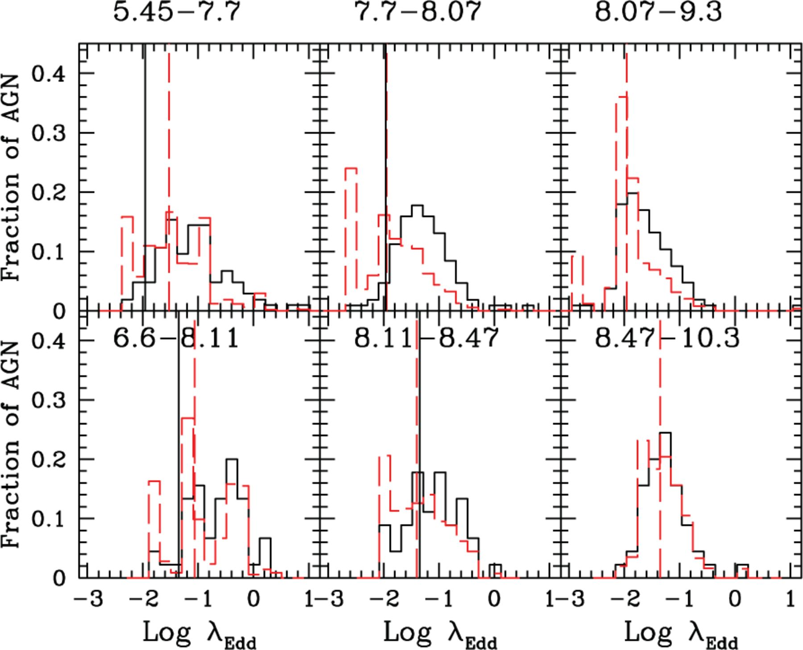
Figure 17 Distributions of Eddington ratios in bins of MBH and redshift for the Type-2 AGN sample. Description as that ...
Notes:
Figure 17 Distributions of Eddington ratios in bins of MBH and redshift for the Type-2 AGN sample. Description as that in Fig. 16. There are ∼106 and ∼55 objects in each bin at z ≤ 1.2 and 1.2 ≤ z ≤ 2.3, respectively. The numbers of AGN in the completeness-corrected λEdd distributions are 1046, 384 and 262 at z ≤ 1.2, while 201, 132 and 65 at 1.2 ≤ z ≤ 2.3 from left to right.
Unless provided in the caption above, the following copyright applies to the content of this slide: © 2012 The Authors Monthly Notices of the Royal Astronomical Society © 2012 RAS

Slide 24
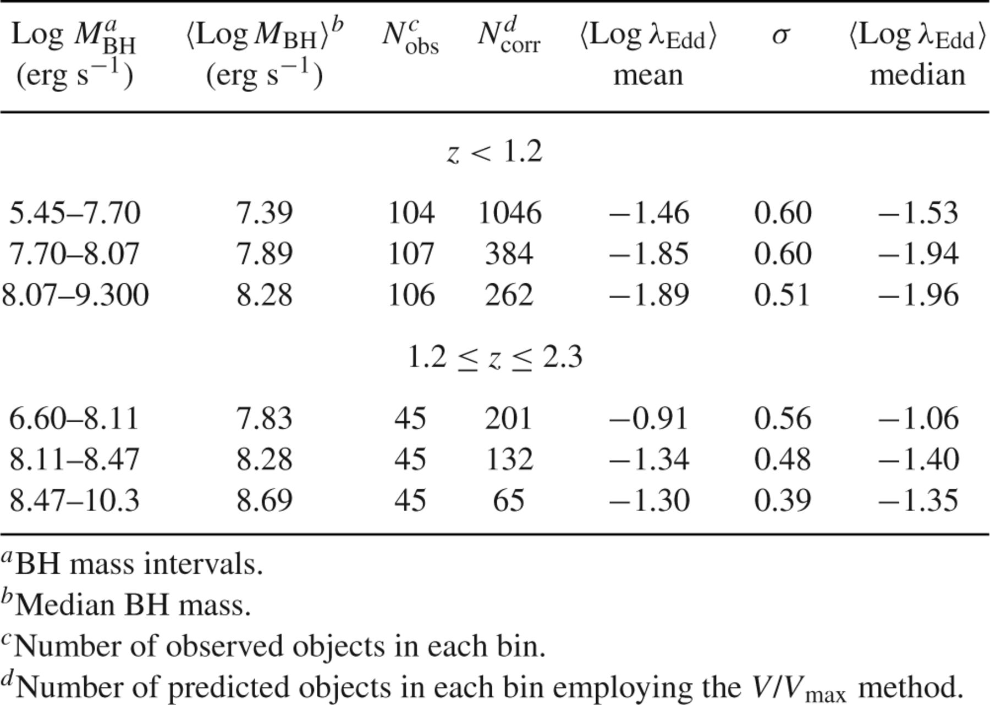
Table 8 Mean Log λ_{Edd} values in M_{BH}-z bins for Type-2 AGN.
Notes:
Table 8 Mean Log λEdd values in MBH-z bins for Type-2 AGN.
Unless provided in the caption above, the following copyright applies to the content of this slide: © 2012 The Authors Monthly Notices of the Royal Astronomical Society © 2012 RAS

Slide 25
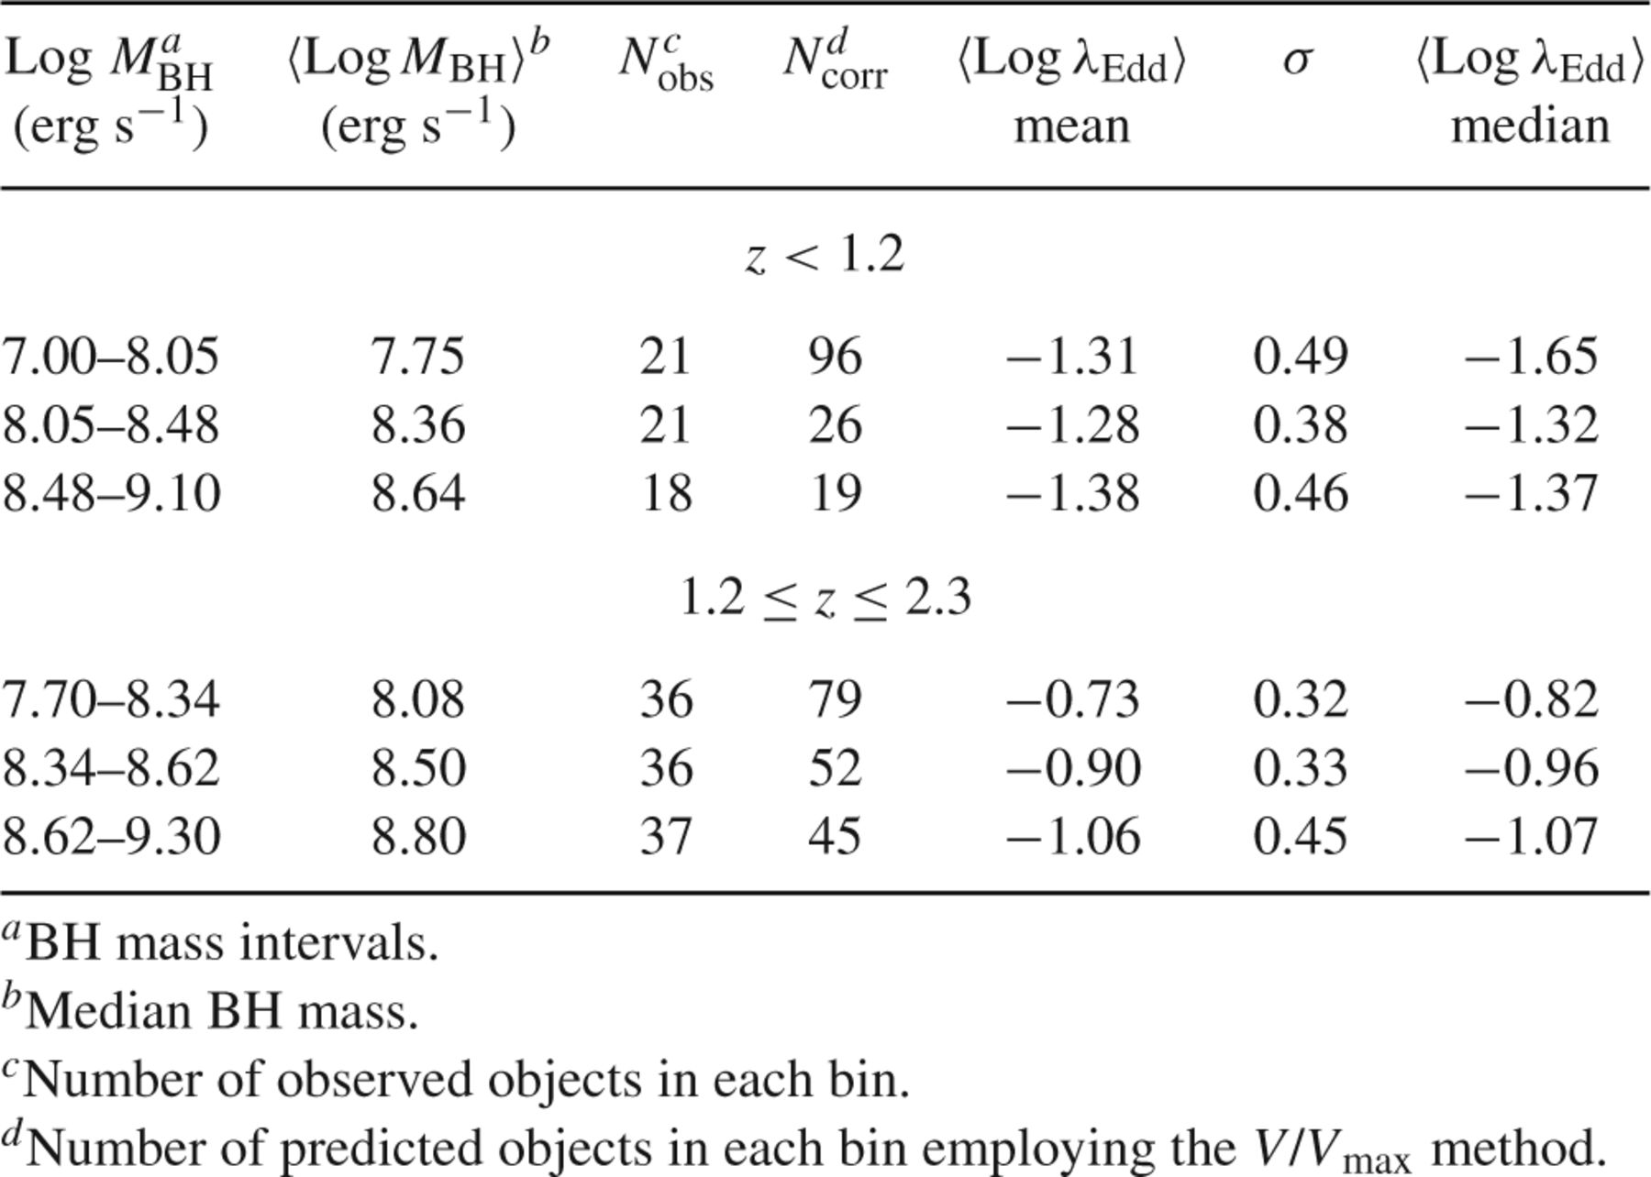
Table 7 Average Log λ_{Edd} values in M_{BH}-z bins for Type-1 AGN.
Notes:
Table 7 Average Log λEdd values in MBH-z bins for Type-1 AGN.
Unless provided in the caption above, the following copyright applies to the content of this slide: © 2012 The Authors Monthly Notices of the Royal Astronomical Society © 2012 RAS

Slide 26
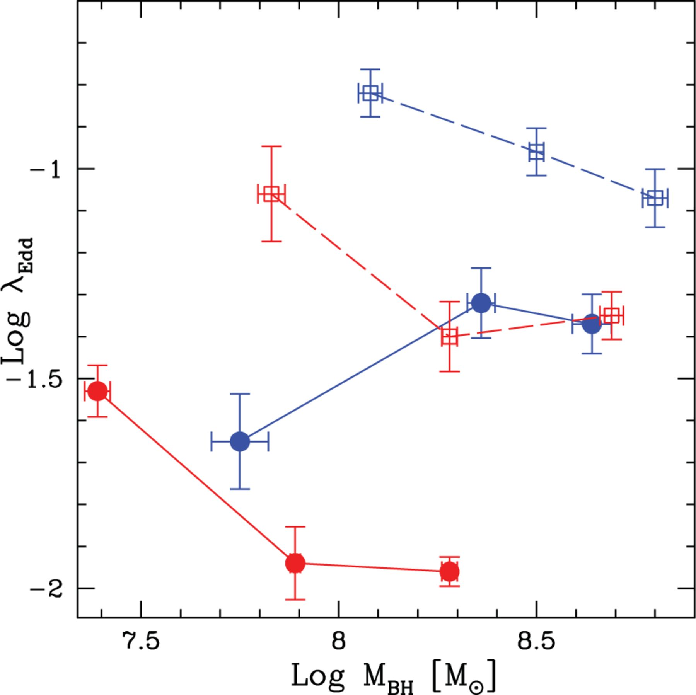
Figure 18 Median Eddington ratios as a function of the median MBH for Type-1 (blue symbols) and Type-2 AGN (red ...
Notes:
Figure 18 Median Eddington ratios as a function of the median MBH for Type-1 (blue symbols) and Type-2 AGN (red symbols). The filled circles and open squares represent the median λEdd for z < 1.2 and 1.2 ≤ z ≤ 2.3, respectively. The solid lines connect low-redshift bins, while the dashed ones connect high-redshift bins. The error bars on the median are estimated considering the 16th and 84th percentile divided by the square root of the observed number of AGN.
Unless provided in the caption above, the following copyright applies to the content of this slide: © 2012 The Authors Monthly Notices of the Royal Astronomical Society © 2012 RAS

