Slide 1
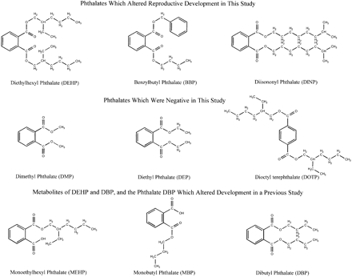
FIG. 1. Structure of phthalate esters which did (upper panel) or did not (middle panel) alter sexual differentiation ...
Notes:
FIG. 1. Structure of phthalate esters which did (upper panel) or did not (middle panel) alter sexual differentiation of the male rat. Structure of dibutyl phthalate (DBP), which also alter sexual differentiation of the rat and rabbit, and the presumptive active metabolites of DBP (MBP) and DEHP (MEHP).
Unless provided in the caption above, the following copyright applies to the content of this slide: © 2000 Society of Toxicology

Slide 2
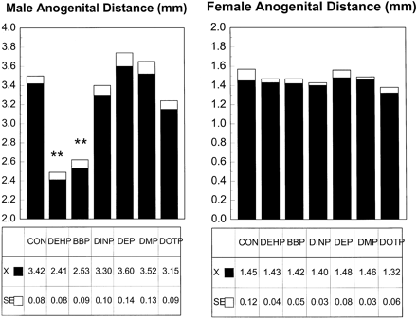
FIG. 2. Maternal DEHP and BBP treatments (0.75 g/kg/day from day 14 of gestation to day 3 of lactation) reduced ...
Notes:
FIG. 2. Maternal DEHP and BBP treatments (0.75 g/kg/day from day 14 of gestation to day 3 of lactation) reduced anogenital distance (mm) in male but not female rat pups. Both of these phthalate esters reduced the sexual dimorphism in this trait by about 50%; **p < 0.001 for litter-based values, including body weight as a covariate in the analysis of these data.
Unless provided in the caption above, the following copyright applies to the content of this slide: © 2000 Society of Toxicology

Slide 3
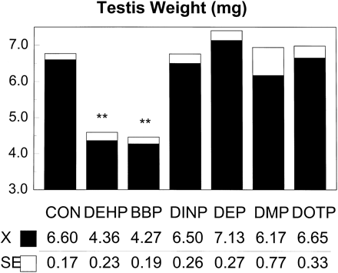
FIG. 3. Maternal DEHP and BBP treatments (0.75 g/kg/day from day 14 of gestation to day 3 of lactation) reduced ...
Notes:
FIG. 3. Maternal DEHP and BBP treatments (0.75 g/kg/day from day 14 of gestation to day 3 of lactation) reduced paired testes weights in male offspring (1/litter) at 2 days of age, including body weight as a covariate in the analysis of these data.
Unless provided in the caption above, the following copyright applies to the content of this slide: © 2000 Society of Toxicology

Slide 4
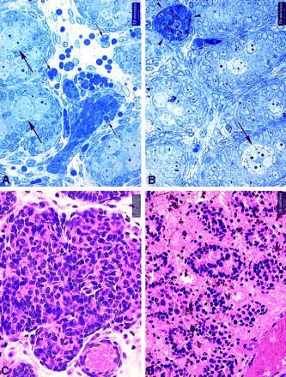
FIG. 4. Photomicrographs of testicular sections of rats exposed to DEHP at 750 mg/kg/day between GD 14 and PND 3 ...
Notes:
FIG. 4. Photomicrographs of testicular sections of rats exposed to DEHP at 750 mg/kg/day between GD 14 and PND 3 showing the progression of the testicular lesions from PND 2 to PND 10. (A) Testis at PND 2 stained with toluidine blue. Hemorrhage is seen, as evidenced by extravasated erythrocytes in the interstitium. Note aggregation of cells predominantly appearing to be fibroblasts and histiocytes. Phagocytosis of erythrocytes and erythrophagosomes are seen (arrows). Also note the presence of multinucleated gonocytes in seminiferous tubules (large arrow). (B) Testis at PND 3 stained with toluidine blue. Note encapsulated clustering of cells in the interstitium (arrow heads). Phagocytosis (arrow) and hemosiderin resulting from degraded erythrocytes within the cells are evident. Also note multinucleated gonocyte in the seminiferous tubule (large arrow). (C and D) Testes at PND 10 stained with hematoxylin and eosin. Formation of focal granulomata in the interstitium (C) and coagulative necrosis of the entire testis (D). When hemorrhage was limited to focal areas of the interstitium, localized granulomatous reaction was observed with remaining areas of the testis appearing normal; if the hemorrhage was multifocal and extensive, coagulative necrosis involving both interstitial and seminiferous epithelial elements was observed.
Unless provided in the caption above, the following copyright applies to the content of this slide: © 2000 Society of Toxicology

Slide 5
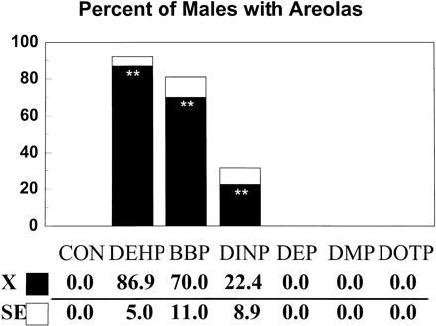
FIG. 5. Maternal treatment with DEHP, BBP, or DINP (0.75 g/kg/day from GD 14 to day 3 of lactation) significantly ...
Notes:
FIG. 5. Maternal treatment with DEHP, BBP, or DINP (0.75 g/kg/day from GD 14 to day 3 of lactation) significantly increased the incidence of male offspring with areolas (with and without nipple buds); **p < 0.01 based on litter means analysis.
Unless provided in the caption above, the following copyright applies to the content of this slide: © 2000 Society of Toxicology

Slide 6
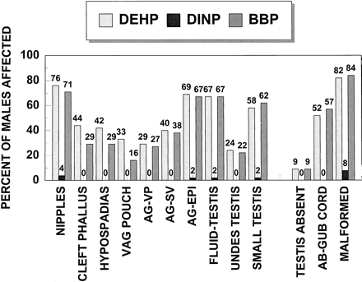
FIG. 6. Maternal treatment with DEHP, BBP or DINP (0.75 g/kg/day from GD 14 to day 3 of lactation) significantly ...
Notes:
FIG. 6. Maternal treatment with DEHP, BBP or DINP (0.75 g/kg/day from GD 14 to day 3 of lactation) significantly increased the incidence of male offspring with malformations of the androgen-dependent organs and testes on an individual (as shown here) or litter basis.
Unless provided in the caption above, the following copyright applies to the content of this slide: © 2000 Society of Toxicology

Slide 7
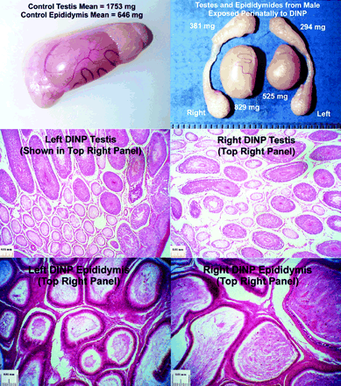
FIG. 7. Maternal treatment with DINP (0.75 g/kg/day from GD 14 to day 3 of lactation) significantly increased the ...
Notes:
FIG. 7. Maternal treatment with DINP (0.75 g/kg/day from GD 14 to day 3 of lactation) significantly increased the incidence of male offspring with reproductive malformations on an individual (4/52, as shown here). The lesions seen in one male from the DINP group are displayed here. This male displayed paired testicular and epididymal atrophy and the anterior portion of the right testis appeared malformed (top right panel). A control testis and epididymis is provided in the top left for comparison. Both left and right testes from this DINP-treated male display atrophic tubules that lack any evidence of spermatogenesis (middle right and left panels, respectively). In addition, the lumen of both the left and right caudae epididymidis from this male contain cellular debris and reduced numbers of sperm.
Unless provided in the caption above, the following copyright applies to the content of this slide: © 2000 Society of Toxicology

Slide 8
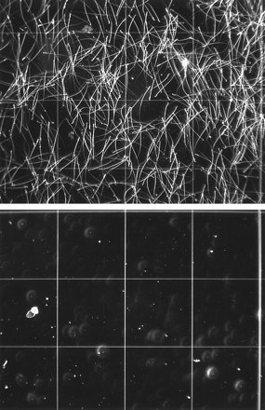
FIG. 8. Maternal treatment with DINP (0.75 g/kg/day from day 14 of gestation to day 3 of lactation) significantly ...
Notes:
FIG. 8. Maternal treatment with DINP (0.75 g/kg/day from day 14 of gestation to day 3 of lactation) significantly increased the incidence of male offspring with reproductive malformations on an individual (4/52, as shown here). A photomicrograph of an undiluted sample of fluid from cauda epididymidis of a control (upper panel with sperm) and DINP male (lower panel), resulting from caput/corpus epididymal agenesis and a fluid-filled testis, is shown here.
Unless provided in the caption above, the following copyright applies to the content of this slide: © 2000 Society of Toxicology

Slide 9
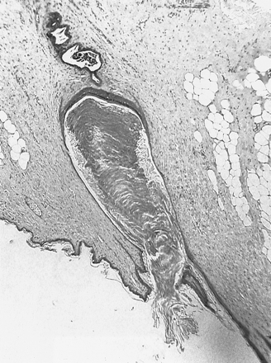
FIG. 9. Maternal treatment with DINP (0.75 g/kg/day from GD 14 to day 3 of lactation) significantly increased the ...
Notes:
FIG. 9. Maternal treatment with DINP (0.75 g/kg/day from GD 14 to day 3 of lactation) significantly increased the incidence of male offspring with reproductive malformations on an individual (4/52, as shown here). One of the six permanent nipples seen in one male from the DINP group is shown here.
Unless provided in the caption above, the following copyright applies to the content of this slide: © 2000 Society of Toxicology

