Slide 1
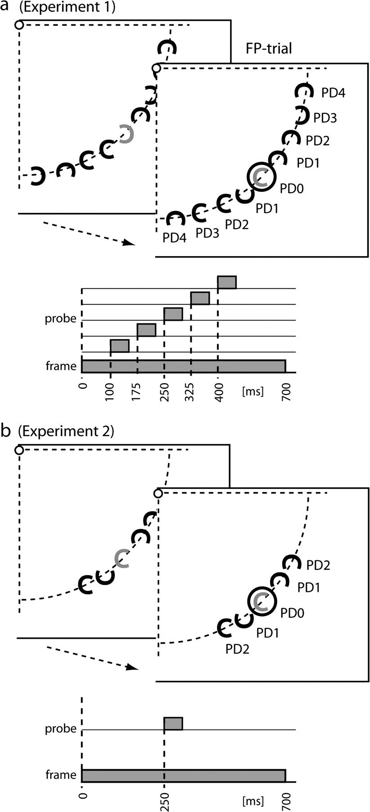
Figure 1. (a) Stimulus setup and presentation sequence of Experiment 1. While fixating the center of the screen, ...
Notes:
Figure 1. (a) Stimulus setup and presentation sequence of Experiment 1. While fixating the center of the screen, subjects searched for a luminance-popout target (shown as gray ‘C’) among 9 items presented at an isoeccentric distance (8° of visual angle) in the right lower visual quadrant. In 50% of the trials, a white ring (the probe) was presented at the center position with varying delay relative to search frame onset. On each trial, the target appeared randomly at any of 9 item positions, providing 5 attention-to-probe distances: attention at probe (PD0), attention 1–4 items away from the probe toward the horizontal or the vertical meridian (PD1–PD4). As illustrated in the lower chart, the frame-probe SOA was varied in 5 steps of 75 ms beginning with an SOA of 100 ms. (b) Stimulus setup and presentation sequence of Experiment 2. Subjects searched for a color popout (red or green C among blue distractor Cs) and were required to either discriminate the color (color task) or the gap orientation of the popout target (orientation task). The probe appeared on 50% of the trials as in Experiment 1 but with a fixed frame-probe SOA of 250 ms. Items were not presented at positions PD3 and PD4 in this experiment in order to maximize the number of trials per condition.
Unless provided in the caption above, the following copyright applies to the content of this slide: © The Author 2008. Published by Oxford University Press. All rights reserved. For permissions, please e-mail: journals.permissions@oxfordjournals.org

Slide 2
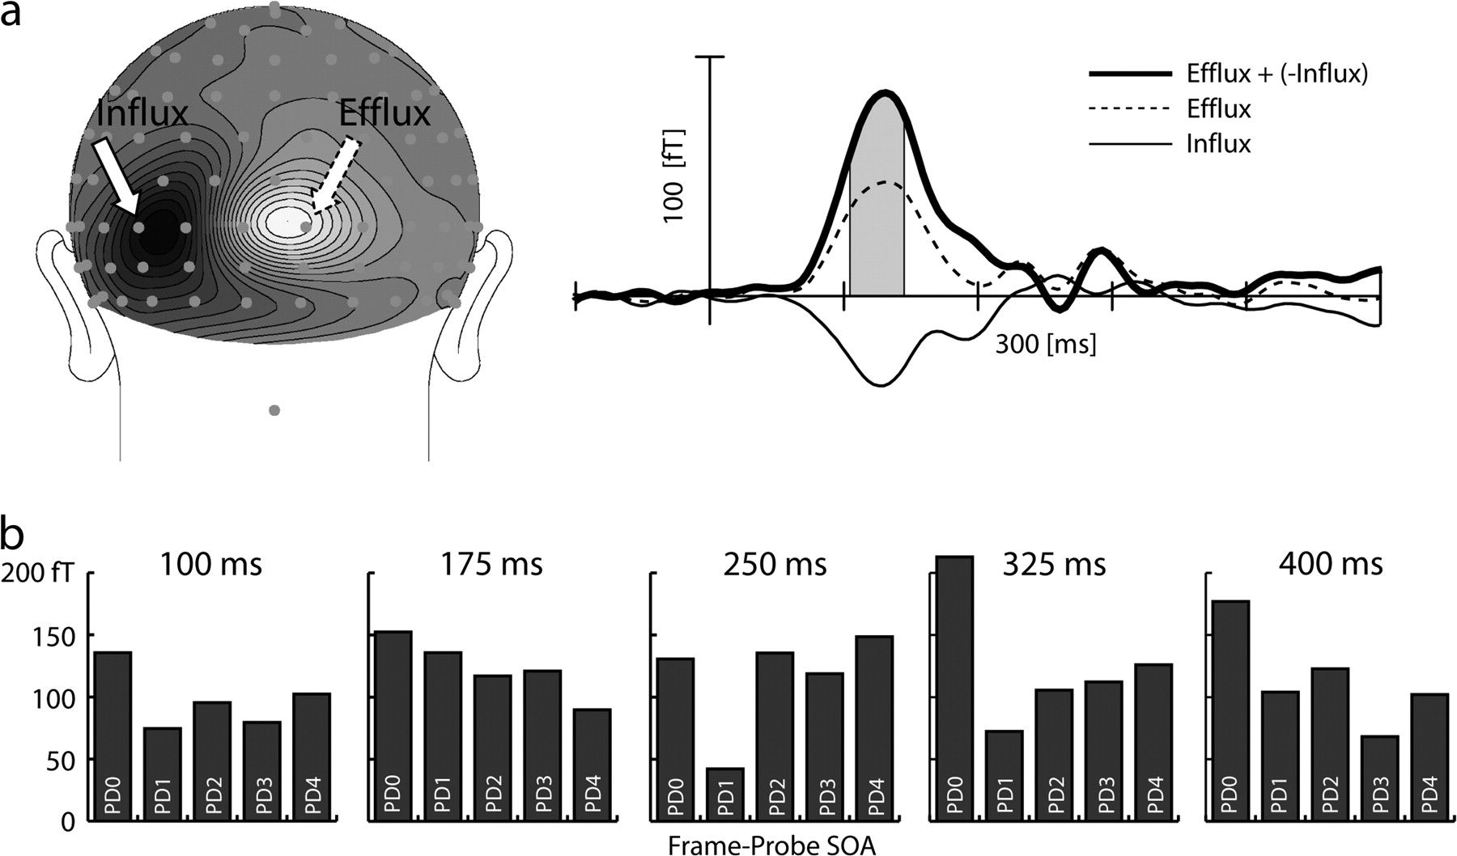
Figure 2. ERMF results of Experiment 1. (a) Left: Topographical distribution of the probe-related ERMF response (FP ...
Notes:
Figure 2. ERMF results of Experiment 1. (a) Left: Topographical distribution of the probe-related ERMF response (FP minus FO difference of the 250 ms SOA condition) at 130 ms after probe presentation over occipital regions (rear view). Dark areas represent regions of magnetic influx and white regions of corresponding efflux (see arrows). Right: Time course of the probe-related ERMF response (250 ms SOA condition) at the efflux (dashed line) and influx maximum (thin solid line). For data quantification, the ERMF response was collapsed across efflux and influx maxima (efflux minus influx, bold solid line). Then, the mean response amplitude was obtained between 110 and 140 ms after probe onset (gray area under the bold solid line), which provided the measurement for the bar graphs shown in panel (b). (b) Size of the probe-related response for the 5 different frame-probe SOAs. Each bar graph shows the size of the response at probe distances PD0–PD4. The responses at the same probe distances toward the vertical and horizontal meridian were collapsed.
Unless provided in the caption above, the following copyright applies to the content of this slide: © The Author 2008. Published by Oxford University Press. All rights reserved. For permissions, please e-mail: journals.permissions@oxfordjournals.org

Slide 3
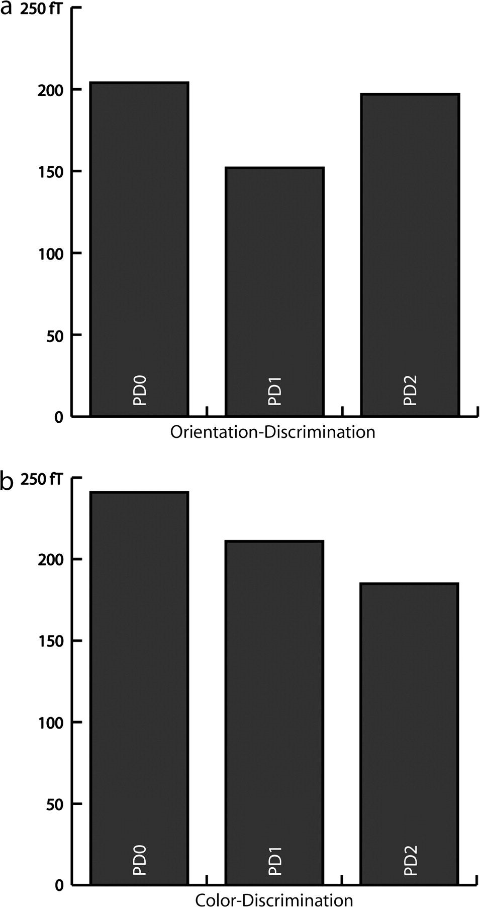
Figure 3. ERMF results of Experiment 2. (a) Size of the probe-related response at probe distances PD0–PD2 of the ...
Notes:
Figure 3. ERMF results of Experiment 2. (a) Size of the probe-related response at probe distances PD0–PD2 of the orientation task. Responses at the same PDs toward the vertical and horizontal meridian are collapsed. (b) Size of the probe-related response at probe distances PD0–PD2 of the color task.
Unless provided in the caption above, the following copyright applies to the content of this slide: © The Author 2008. Published by Oxford University Press. All rights reserved. For permissions, please e-mail: journals.permissions@oxfordjournals.org

Slide 4
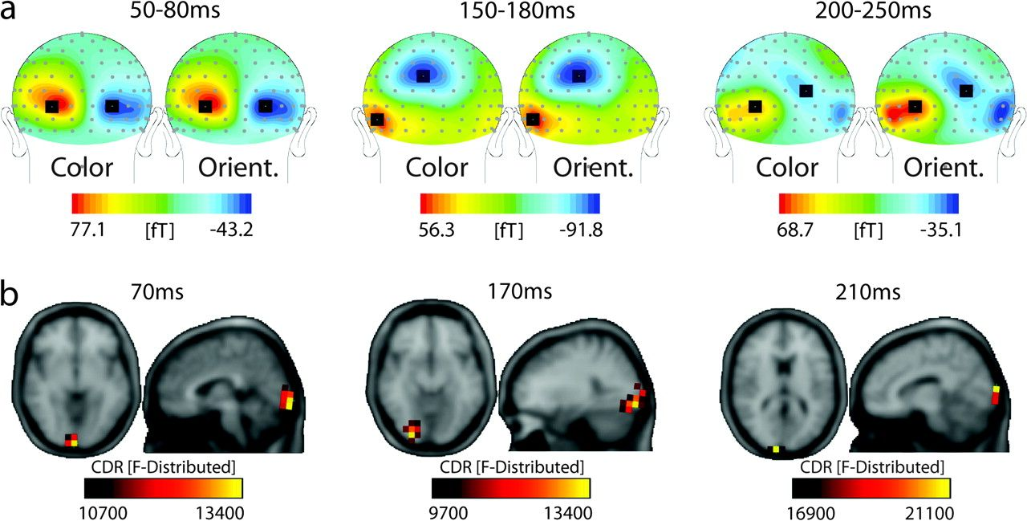
Figure 4. (a) Topographical distributions of the ERMF response of the color task (Color) and the orientation task ...
Notes:
Figure 4. (a) Topographical distributions of the ERMF response of the color task (Color) and the orientation task (Orient.) in 3 selected time ranges before probe onset. The maps represent data collapsed across FP and FO trials as both trial types are identical until probe onset. The black squares highlight sensor sites used for statistical validation. The ERMF responses for the color and orientation task are virtually identical between 50 and 80 ms and 150 and 180 ms. The occipital response between 200 and 250 ms, however, is obviously stronger in the orientation task. (b) Current source localization results (sLORETA). Shown are current density maxima at 3 representative time points before probe onset (orientation task).
Unless provided in the caption above, the following copyright applies to the content of this slide: © The Author 2008. Published by Oxford University Press. All rights reserved. For permissions, please e-mail: journals.permissions@oxfordjournals.org

Slide 5
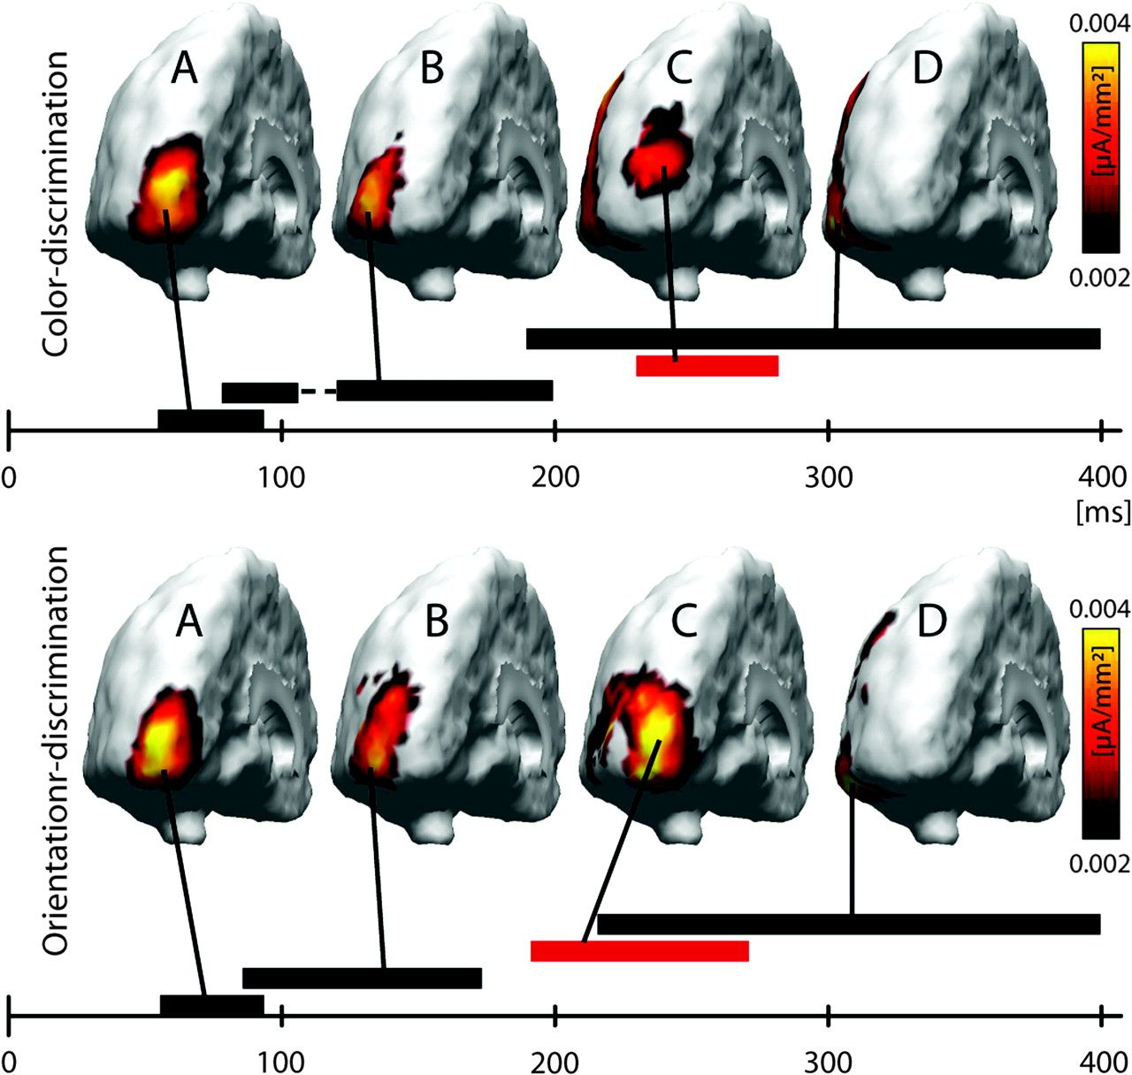
Figure 5. Cortical surface-constrained current source analysis (MNLS estimates) of the ERMF response elicited by search ...
Notes:
Figure 5. Cortical surface-constrained current source analysis (MNLS estimates) of the ERMF response elicited by search frames (no-probe trials only) of the orientation and color discrimination task in Experiment 2. Estimates were computed in a time range between 0 and 400 ms after search frame onset. A sequence of 4 different distributional patterns was observed (A–D) shown here at the time point of their current density maximum. The temporal extension of those distributions is indicated by the horizontal bars below. Whereas the initial feedforward response in early visual cortex around 75 ms (A) as well as the subsequent extrastriate activity (B) did not differ between the color and the orientation task, the following maximum in early visual cortex (C) was substantially larger in the orientation than the color task. Notably, for both experimental tasks, the maximum in (C) appeared at approximately the same location in early visual cortex as the maximum of the initial feedforward response (A), suggesting (C) to represent recurrent activity.
Unless provided in the caption above, the following copyright applies to the content of this slide: © The Author 2008. Published by Oxford University Press. All rights reserved. For permissions, please e-mail: journals.permissions@oxfordjournals.org

