Slide 1
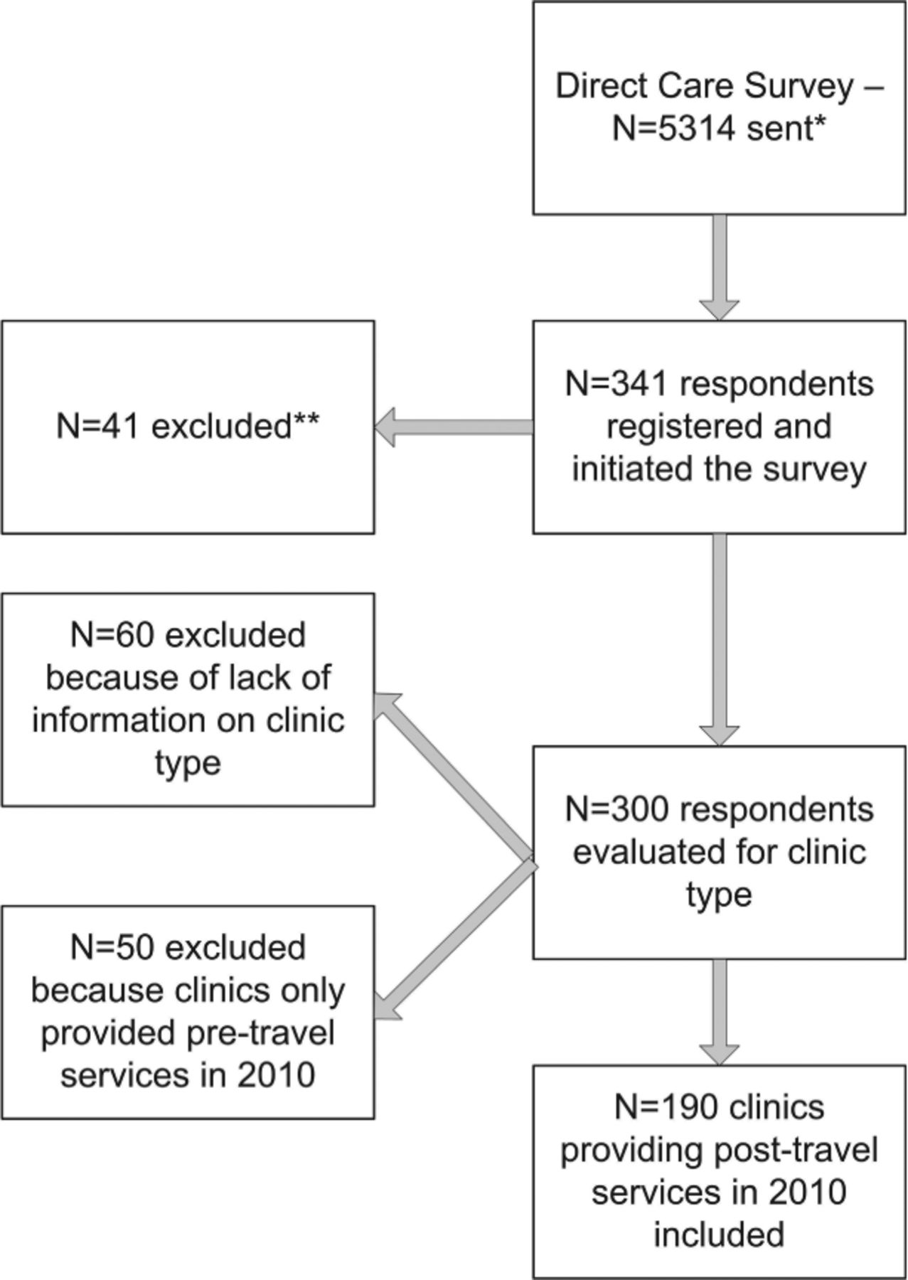
Figure 1 Direct care survey respondents to the Evaluation of the Global Availability of Rabies Immune Globulin and ...
Notes:
Figure 1 Direct care survey respondents to the Evaluation of the Global Availability of Rabies Immune Globulin and Rabies Vaccine for Travelers: Direct Care Survey, 2010. *Although 5,314 surveys were distributed by e‐mail to the participating organizations, many surveys went to members of the organization that were not the target audience of the survey and that did not provide direct patient care. This was unavoidable as the organizations do not distinguish the member's profession or current position. The number of targeted individual e‐mails is not known for an accurate response rate. Therefore, this survey distribution and response was understood to be a convenience sample. **Of the 41 that were initially excluded, 36 were excluded because of multiple clinic responses and 5 were excluded because although the respondent registered for the survey, no responses were recorded.
Unless provided in the caption above, the following copyright applies to the content of this slide: © 2013 International Society of Travel Medicine

Slide 2
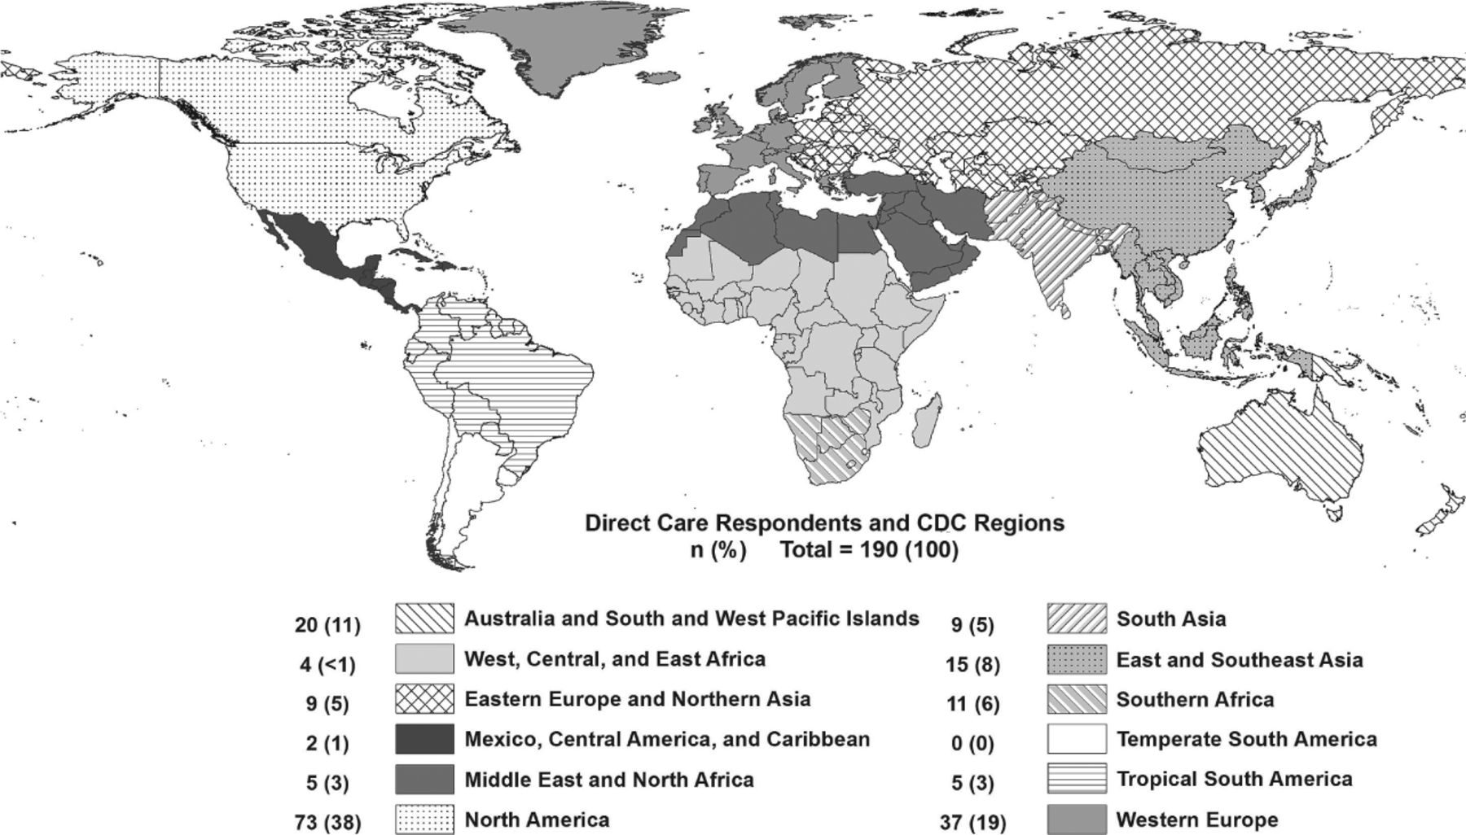
Figure 2 Participating clinic locations by region of those responding to the Evaluation of the Global Availability of ...
Notes:
Figure 2 Participating clinic locations by region of those responding to the Evaluation of the Global Availability of Rabies Immune Globulin and Rabies Vaccine for Travelers: Direct Care Survey, 2010
Unless provided in the caption above, the following copyright applies to the content of this slide: © 2013 International Society of Travel Medicine

Slide 3
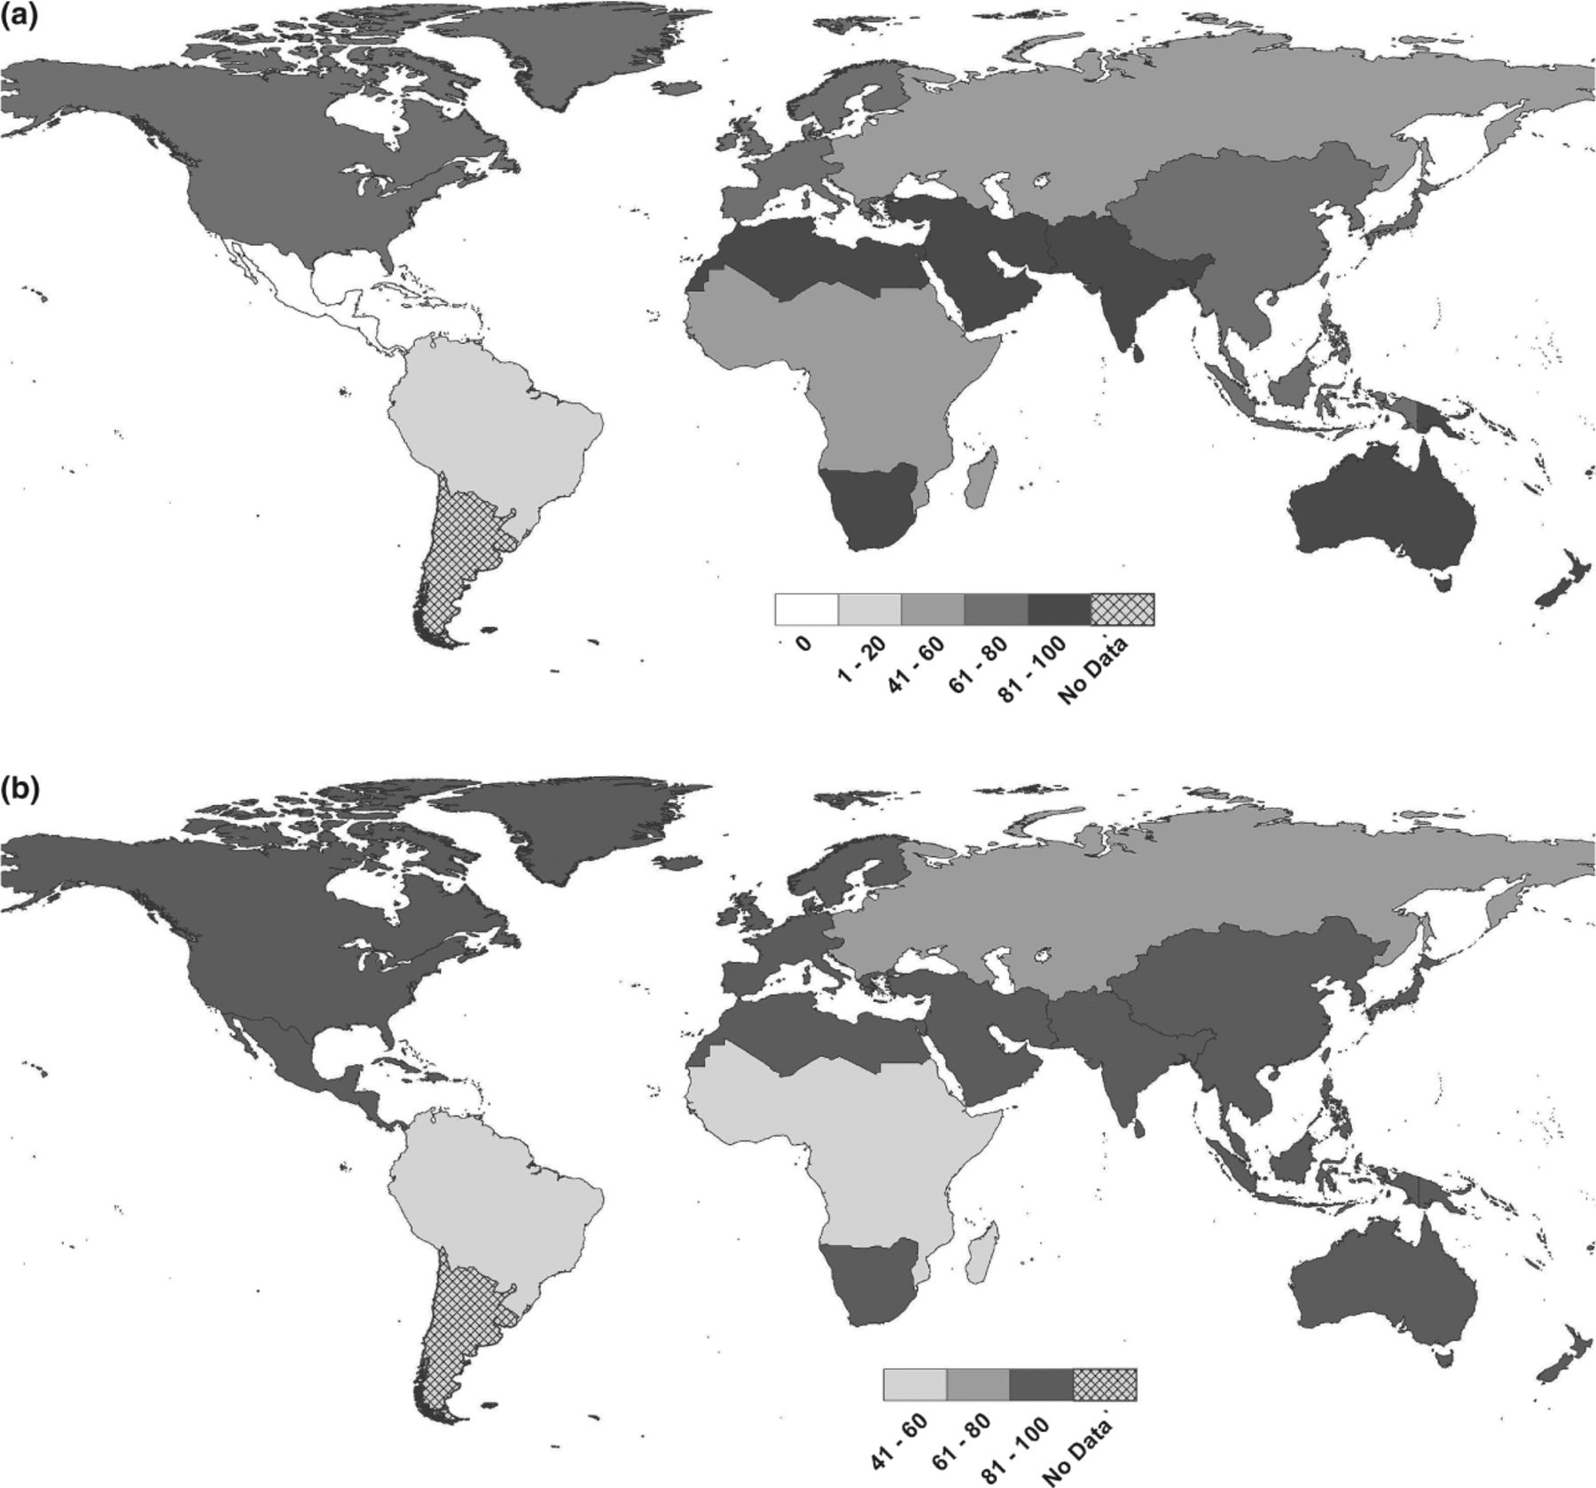
Figure 3 (a) Percentage of respondents for whom rabies immune globulin was often or always accessible when needed for ...
Notes:
Figure 3 (a) Percentage of respondents for whom rabies immune globulin was often or always accessible when needed for patients in those providing direct patient care to travelers in the Evaluation of the Global Availability of Rabies Immune Globulin and Rabies Vaccine for Travelers: Direct Care Survey, 2010. (b) Percentage of respondents for whom rabies vaccine was often or always accessible when needed for patients as reported by respondents providing direct patient care to travelers in the Evaluation of the Global Availability of Rabies Immune Globulin and Rabies Vaccine for Travelers: Direct Care Survey, 2010.
Unless provided in the caption above, the following copyright applies to the content of this slide: © 2013 International Society of Travel Medicine

Slide 4
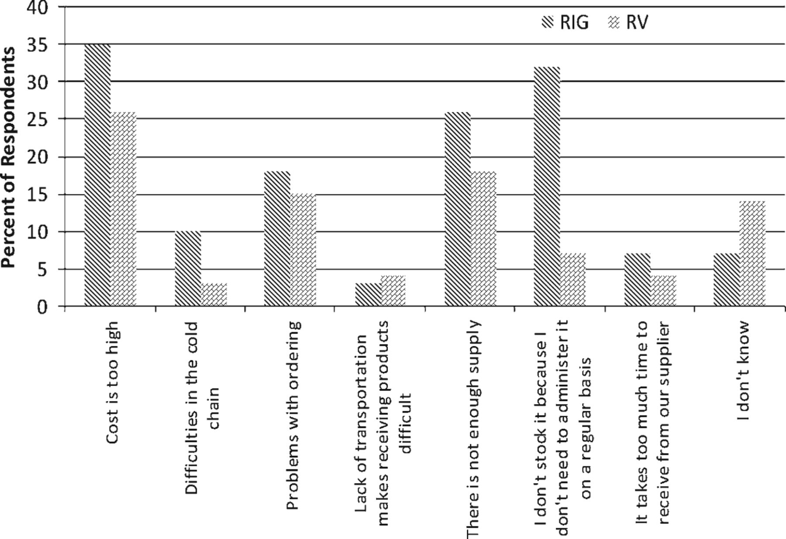
Figure 4 Reported barriers to availability of rabies immune globulin (RIG) and rabies vaccine (RV) by respondents ...
Notes:
Figure 4 Reported barriers to availability of rabies immune globulin (RIG) and rabies vaccine (RV) by respondents providing direct patient care to travelers in the Evaluation of the Global Availability of Rabies Immune Globulin and Rabies Vaccine for Travelers: Direct Care Survey, 2010.
Unless provided in the caption above, the following copyright applies to the content of this slide: © 2013 International Society of Travel Medicine

