Slide 1
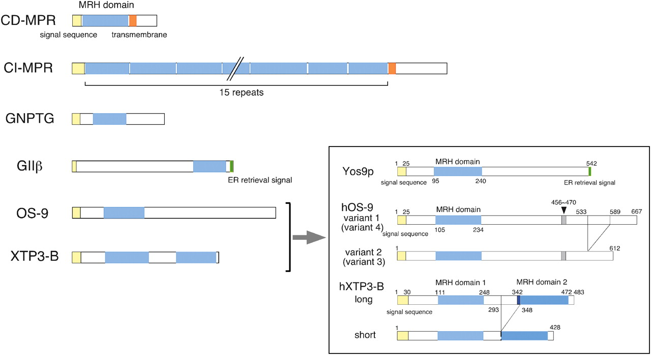
Fig. 1 MRH domain-containing proteins. The domain organization of six human MRH domain-containing proteins is ...
Notes:
Fig. 1 MRH domain-containing proteins. The domain organization of six human MRH domain-containing proteins is presented. In the inset, yeast Yos9p and transcription variants of human OS-9 and XTP3-B are compared. The MRH domain is shown in light blue, the signal sequence in yellow, the transmembrane region in orange and the ER retrieval signal in green. The numbers in the inset designate the amino acid residue numbers. The segment in human OS-9 in gray is missing in variants 3 and 4. The short form of human XTP3-B lacks 54 amino acids between the two MRH domains and the six N-terminal amino acids of MRH domain 2 (indicated by dark blue) containing one of the conserved cysteines required for the tertiary structure formation.
Unless provided in the caption above, the following copyright applies to the content of this slide: © Oxford University Press 2010

Slide 2
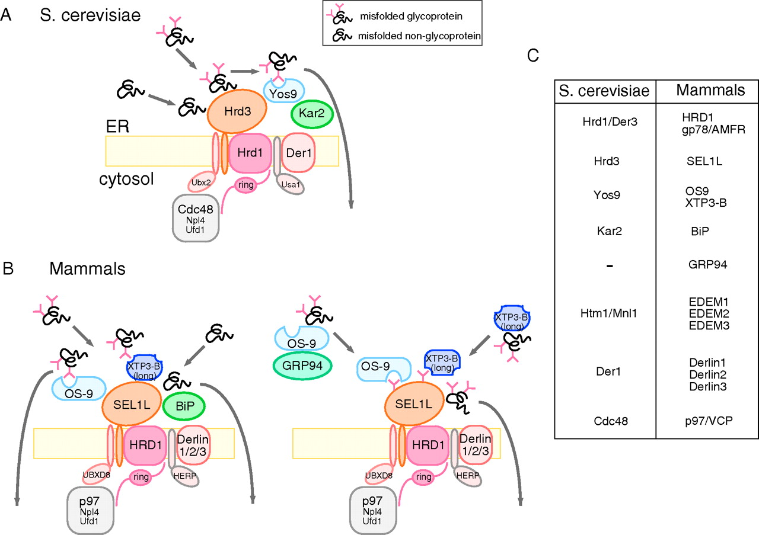
Fig. 2 The function of the HRD1–SEL1L ubiquitin ligase holocomplex on the ER membrane. (A) The Hrd1–Hrd3 ubiquitin ...
Notes:
Fig. 2 The function of the HRD1–SEL1L ubiquitin ligase holocomplex on the ER membrane. (A) The Hrd1–Hrd3 ubiquitin ligase holocomplex of S. cerevisiae. Hrd1/Der3, a multimembrane-spanning protein containing a ubiquitin ligase domain in the cytosol, forms a stoichiometric complex with the single transmembrane protein, Hrd3. Hrd1–Hrd3 forms a large complex with other transmembrane ERAD components and is connected to the cytosolic AAA ATPase Cdc48 complex. In the lumen of the ER, Yos9 and Kar2 associate with this ubiquitin ligase complex by binding to the large luminal domain of Hrd3. Unfolded portions of misfolded glycoproteins and non-glycosylated proteins are recognized by Hrd3. Thereafter, the sugar moiety on misfolded glycoproteins is surveyed by Yos9, and only those presenting an N-glycan degradation signal are recognized and sorted for retrotranslocation. Non-glycosylated proteins are retained in the ER. Note that not all of the components contained in the holocomplex are presented in this illustration. (B) The HRD1–SEL1L ubiquitin ligase holocomplex in mammals. Two models are proposed. Left: OS-9 and XTP3-B are stably incorporated in the complex on the ER membrane through interaction with SEL1L. The N-glycans on misfolded glycoproteins are recognized by the MRH domains of these lectins. Misfolded non-glycosylated proteins are also recognized by this membrane ubiquitin ligase holocomplex before retrotranslocation, most probably through BiP binding. Right: OS-9 and XTP3-B dynamically associate with the HRD1–SEL1L ubiquitin ligase complex on the ER membrane. Misfolded glycoproteins in the lumen are recognized by the OS9-GRP94 complex or XTP3-B and transferred to the membrane ubiquitin ligase complex. The association of SEL1L and MRH domain-containing lectins is mediated by the recognition of N-glycans on SEL1L by the MRH domains. Not all of the components of the holocomplex are depicted in this illustration. (C) A list of homologue proteins that are involved in the ubiquitin ligase holocomplex in S. cerevisiae and mammals.
Unless provided in the caption above, the following copyright applies to the content of this slide: © Oxford University Press 2010

Slide 3
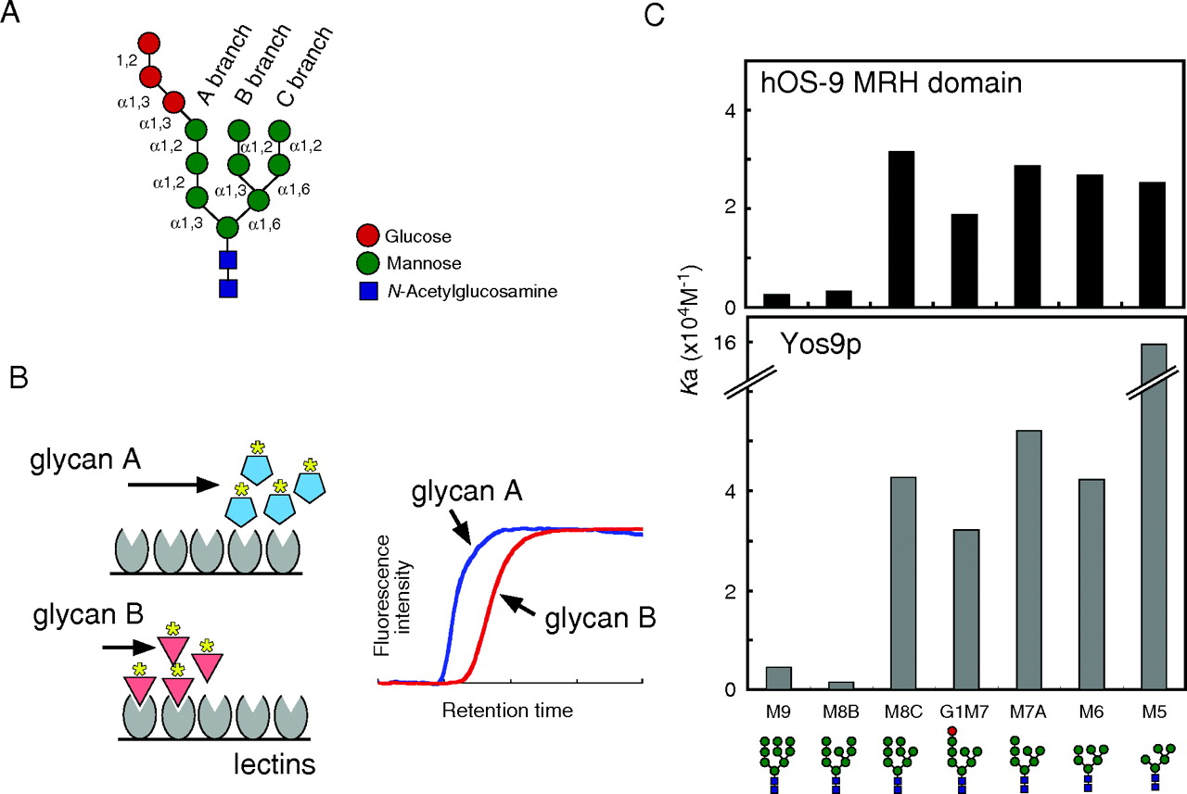
Fig. 3 The specificities of N-glycans recognized by Yos9p and the hOS-9 MRH domain. (A) The structure of the ...
Notes:
Fig. 3 The specificities of N-glycans recognized by Yos9p and the hOS-9 MRH domain. (A) The structure of the N-linked oligosaccharide G3M9. The name of each branch and the glycosidic linkages between mannoses and glucoses are indicated. (B) A scheme representing detection of the lectin–glycan interaction by FAC. Purified lectins are immobilized on the column, and fluorescence-labeled glycans are applied. When a glycan (glycan B) interacts with the lectin, the elution of the glycan through the column is delayed compared to that of the glycans that do not bind to this lectin (glycan A). (C) The binding affinity of yeast Yos9p (upper panel; Quan et al. 2008) and the human OS-9 MRH domain (lower panel; Hosokawa et al. 2009) for each oligosaccharide. The affinity is indicated by the Ka value. Values are the mean of three independent experiments.
Unless provided in the caption above, the following copyright applies to the content of this slide: © Oxford University Press 2010

Slide 4
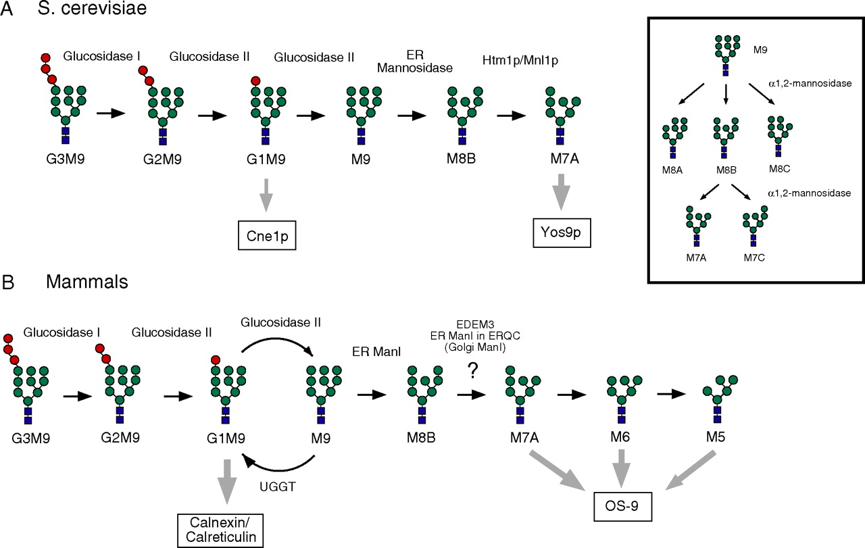
Fig. 4 N-glycan processing and recognition by the lectins in the ER. (A) N-glycan processing and recognition in S. ...
Notes:
Fig. 4 N-glycan processing and recognition by the lectins in the ER. (A) N-glycan processing and recognition in S. cerevisiae. Glucose residues from the G3M9 oligosaccharide attached to nascent polypeptides are sequentially processed by glucosidases I and II. Monoglucosylated N-linked oligosaccharide is recognized by Cne1p, the yeast homologue of calnexin. The terminal mannose on the middle branch of the N-glycan is trimmed by ER α1,2-mannosidase, generating M8B. Subsequently, Htm1p/Mnl1p processes the α1,2-mannose on the C branch of N-glycan to create M7A, which is then recognized by Yos9p as a degradation signal. Isomers of M8 and M7 are indicated in the inset. (B) N-glycan processing and recognition in mammals. Calnexin and calreticulin bind to monoglucosylated N-glycans and assist in the folding of glycoproteins. These lectins dissociate from the glycoprotein upon removal of the terminal glucose on monoglucosylated N-glycans by glucosidase II. In mammals, UDP-glucose:glycoprotein glucosyltransferase (UGGT), which is absent from the yeast genome, adds a glucose back onto the N-glycan if the glycoprotein has still not acquired the native conformation, thus forming the calnexin/calreticulin or monoglucose cycle. ER ManI generates M8B, followed by further mannose trimming to produce M7A, M6 and M5 N-glycans, which are recognized by OS-9. The candidate α1,2-mannosidases responsible for this process include EDEM3, ER ManI concentrated in the ER quality control compartment (ERQC), and Golgi α1,2-mannosidases for the ERAD substrates that may recycle between the ER and Golgi prior to degradation.
Unless provided in the caption above, the following copyright applies to the content of this slide: © Oxford University Press 2010

