Slide 1
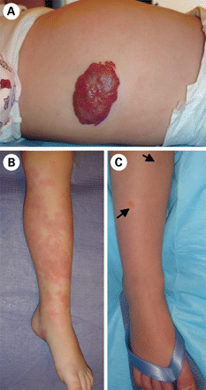
Figure 1. Vascular tumors and malformations (A) proliferating hemangioma, a benign tumor of infancy. (B) Extensive ...
Notes:
Figure 1. Vascular tumors and malformations (A) proliferating hemangioma, a benign tumor of infancy. (B) Extensive sporadic CM, distinct from (C) small, multifocal CMs with pale halo, characteristic of CM–AVM.
Unless provided in the caption above, the following copyright applies to the content of this slide: © The Author 2009. Published by Oxford University Press. All rights reserved. For Permissions, please email: journals.permissions@oxfordjournals.org

Slide 2
Figure 2. The many faces of venous anomalies. Identification of their genetic bases has helped distinguish between (A) ...
Notes:
Figure 2. The many faces of venous anomalies. Identification of their genetic bases has helped distinguish between (A) GVM, caused by loss-of-function of glomulin (GLMN), (B and C) VMCM, caused by inherited gain-of-function changes in TIE2/TEK, and (D) sporadic venous malformations, caused by somatic gain-of-function mutations in TIE2/TEK.
Unless provided in the caption above, the following copyright applies to the content of this slide: © The Author 2009. Published by Oxford University Press. All rights reserved. For Permissions, please email: journals.permissions@oxfordjournals.org

