Slide 1
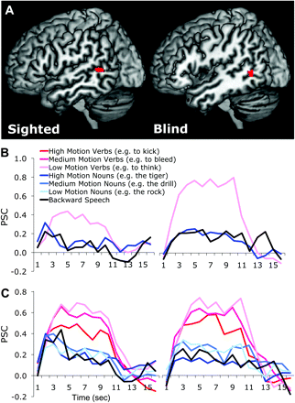
Figure 1. (A) Greater activation for high-motion verbs than low-motion nouns in blind (right) and sighted (left) ...
Notes:
Figure 1. (A) Greater activation for high-motion verbs than low-motion nouns in blind (right) and sighted (left) adults. Results from a whole-brain random-effect analyses, P nouns contrast.
Unless provided in the caption above, the following copyright applies to the content of this slide: © The Author 2011. Published by Oxford University Press. All rights reserved. For permissions, please e-mail: journals.permissions@oup.com

