Slide 1
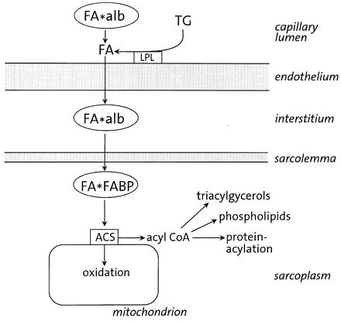
Fig. 1 (A) simplified schematic representation of fatty acid uptake and transport in the heart, highlighting ...
Notes:
Fig. 1 (A) simplified schematic representation of fatty acid uptake and transport in the heart, highlighting potential membrane barriers such as the endothelium and sarcolemma. Aqueous compartments such as the interstitial compartment and cardiac cytoplasm are also considered. LPL, lipoprotein lipase; TG, circulating triacylglycerols (being part of chylomicrons or very low-density lipoproteins); FA, (unesterified) long-chain fatty acids; alb, albumin; FABP, cytoplasmic fatty acid-binding protein; ACS, acylCoA synthetase.
Unless provided in the caption above, the following copyright applies to the content of this slide: Copyright © 2000, European Society of Cardiology

Slide 2
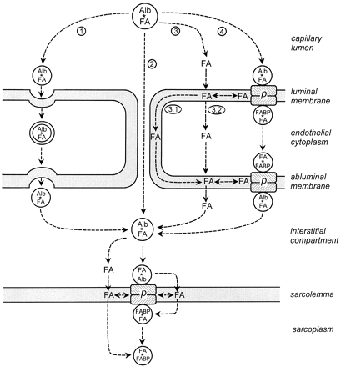
Fig. 2 Alternative transport routes of long-chain fatty acids from the microvascular compartment to the main site of ...
Notes:
Fig. 2 Alternative transport routes of long-chain fatty acids from the microvascular compartment to the main site of metabolic conversion, i.e., the interior of the cardiac myocyte. (1) Transport of the albumin–fatty acid complex through the interendothelial clefts; (2, 3.1, 3.2 and 4) various transport routes of the albumin–fatty acid complex or of the dissociated fatty acids through the endothelial cells. Alb, albumin; FABP, cytoplasmic fatty acid-binding protein; FA, long-chain fatty acids; p, membrane-associated (complex of) protein(s). See text for detailed explanation.
Unless provided in the caption above, the following copyright applies to the content of this slide: Copyright © 2000, European Society of Cardiology

Slide 3
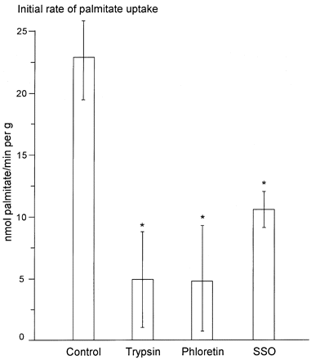
Fig. 3 Effect of selected inhibitors on fatty acid uptake by cardiac muscle cells. Isolated adult rat cardiomyocytes ...
Notes:
Fig. 3 Effect of selected inhibitors on fatty acid uptake by cardiac muscle cells. Isolated adult rat cardiomyocytes were incubated in the presence of 90 μM palmitic acid and 300 μM albumin for 3 min. 14C-palmitate was added to monitor the initial uptake rate of fatty acids. Interventions included (pre)treatment of the cells with trypsin (0.25%), phloretin (0.4 mM) or sulfo-N-succinimidyl oleate (SSO) (0.4 mM). Asterisk indicates significantly different from control cells. See for details Luiken et al. [66].
Unless provided in the caption above, the following copyright applies to the content of this slide: Copyright © 2000, European Society of Cardiology

Slide 4
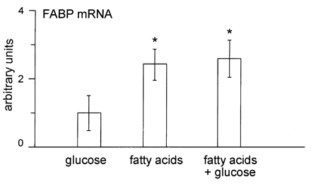
Fig. 4 H-FABP mRNA content of isolated rat neonatal cardiomyocytes as a function of type of substrates present in ...
Notes:
Fig. 4 H-FABP mRNA content of isolated rat neonatal cardiomyocytes as a function of type of substrates present in the culture medium. Cells were cultured for 48 h in medium containing either glucose (10 mM, left bar), or a combination of palmitate and oleate (each 0.25 mM, middle bar) or a combination of glucose (10 mM) and these fatty acids (each 0.25 mM, right bar). Values of the glucose group were arbitrarily set at 1.0. Values of the other groups were normalized on the glucose group. Asterisk indicates significantly different from the glucose group; for details see Van Bilsen et al. [10].
Unless provided in the caption above, the following copyright applies to the content of this slide: Copyright © 2000, European Society of Cardiology

