Slide 1
Figure 1 Quantitation of mtDNA in ρ ⁺ and ρ º 143B (TK−) cell lines by PCR. PCR was performed ...
Notes:
Figure 1 Quantitation of mtDNA in ρ + and ρ o 143B (TK−) cell lines by PCR. PCR was performed as indicated in Materials and Methods. PCR products were resolved on an 8% sequencing gel containing 40% formamide and subjected to autoradiography. Lane 1, ρ + 143B (TK−); lane 2, ρ o 143B (TK−)#4; lane 3, ρ o 143B (TK−)#14; and lane 4, ρ + LS180. The locations of the mtLeu tRNA representing the presence of mtDNA and DNA pol γ products from nuclear DNA are indicated. The two species forDNA pol γ are due to a difference in size of the two alleles, while the two products observed for mtLeu tRNA are believed to be the heavy- and light-strand sequences.
Unless provided in the caption above, the following copyright applies to the content of this slide: © 1996 Oxford University Press

Slide 2
Figure 2 Ribonuclease protection assay analysis of DNA pol γ message levels in 143B (TK−) ρ ⁺ (lanes 1, 2 ...
Notes:
Figure 2 Ribonuclease protection assay analysis of DNA pol γ message levels in 143B (TK−) ρ + (lanes 1, 2 and 7) and 143B (TK−) ρ o (lanes 3–6, 8 and 9) cells. Ribonuclease protection on 20 µg of total cell RNA was performed as indicated in Materials and Methods. The first and second lanes of each pair for the DNA pol γ (lanes 1–6) correspond to protection with 2 and 4 ng of probe respectively. Lanes 7–9 show protection with 0.2 ng of the β-actin probe as a control. Lanes 10 and 11 are yeast RNA controls with the DNA pol γ or β-actin probes respectively, and lanes 12 and 13 correspond to ∼0.25 ng of the undegraded DNA pol γ probe and 0.025 ng of the undegraded β-actin probe respectively.
Unless provided in the caption above, the following copyright applies to the content of this slide: © 1996 Oxford University Press

Slide 3
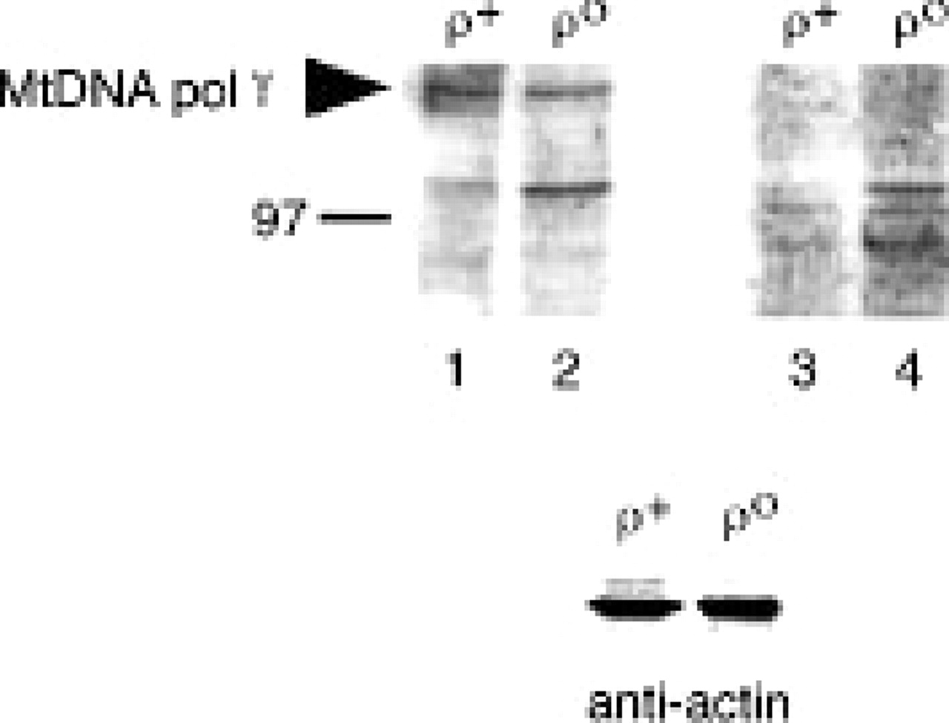
Figure 3 Western blot analysis ofmtDNA polymerase γ protein in 143B (TK−) cells. ( Top ) Equal amounts of protein ...
Notes:
Figure 3 Western blot analysis ofmtDNA polymerase γ protein in 143B (TK−) cells. ( Top ) Equal amounts of protein from whole-cell extracts (20 µg) from 143B (TK−) ρ + (lanes 1 and 3) or ρ o cells (lanes 2 and 4) were resolved by SDS-PAGE and blotted onto a nitrocellulose membrane. The blot was cut in half and probed either with anti-DNA polymerase γ (lanes 1 and 2) or pre-immune serum (lanes 3 and 4). 140 kDa mtDNA polymerase γ protein in ρ + cell extracts is indicated (arrowhead), as is the position of a 97 kDa molecular weight size standard. Note that a few other protein species were immunoreactive with anti-DNA polymerase γ but most were also apparent with the pre-immune serum. ( Bottom ) same as in top panel, except blot was probed with a monoclonal anti-actin antibody (see Materials and Methods for details).
Unless provided in the caption above, the following copyright applies to the content of this slide: © 1996 Oxford University Press

Slide 4
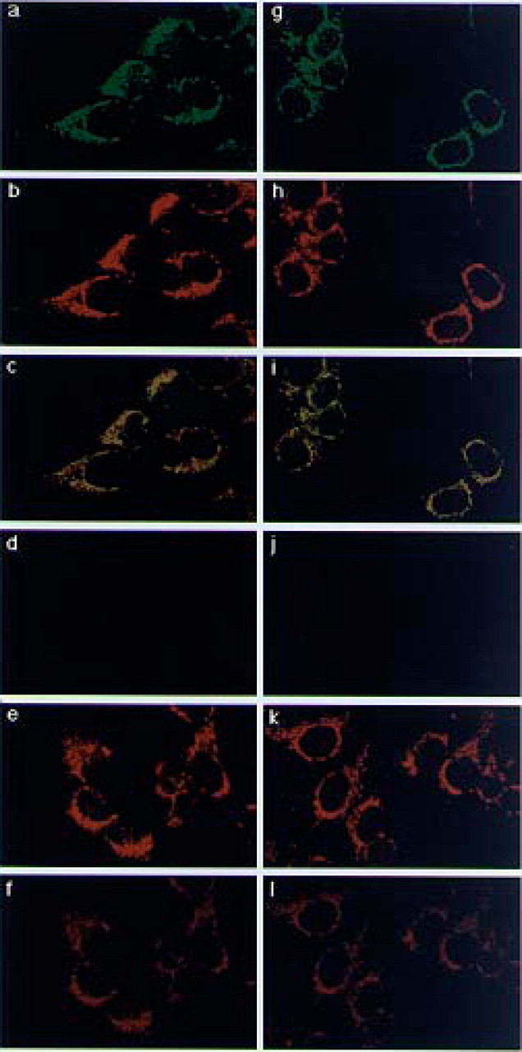
Figure 4 Immunocytochemical analysis of 143B (TK−) cells. 143B (TK−) cells were subjected to double-label confocal ...
Notes:
Figure 4 Immunocytochemical analysis of 143B (TK−) cells. 143B (TK−) cells were subjected to double-label confocal microscopy as described in Materials and Methods. ( a–f ) 143B (TK−) ρ + cells. ( g–l ) 143B (TK−) ρ o cells. Cells labeled with Mitotracker™ (b, e, h and k), stained with anti-DNA polymerase γ (a and g) or pre-immune serum (d and j) are shown, as are merged images (c, f, i and l).
Unless provided in the caption above, the following copyright applies to the content of this slide: © 1996 Oxford University Press

Slide 5
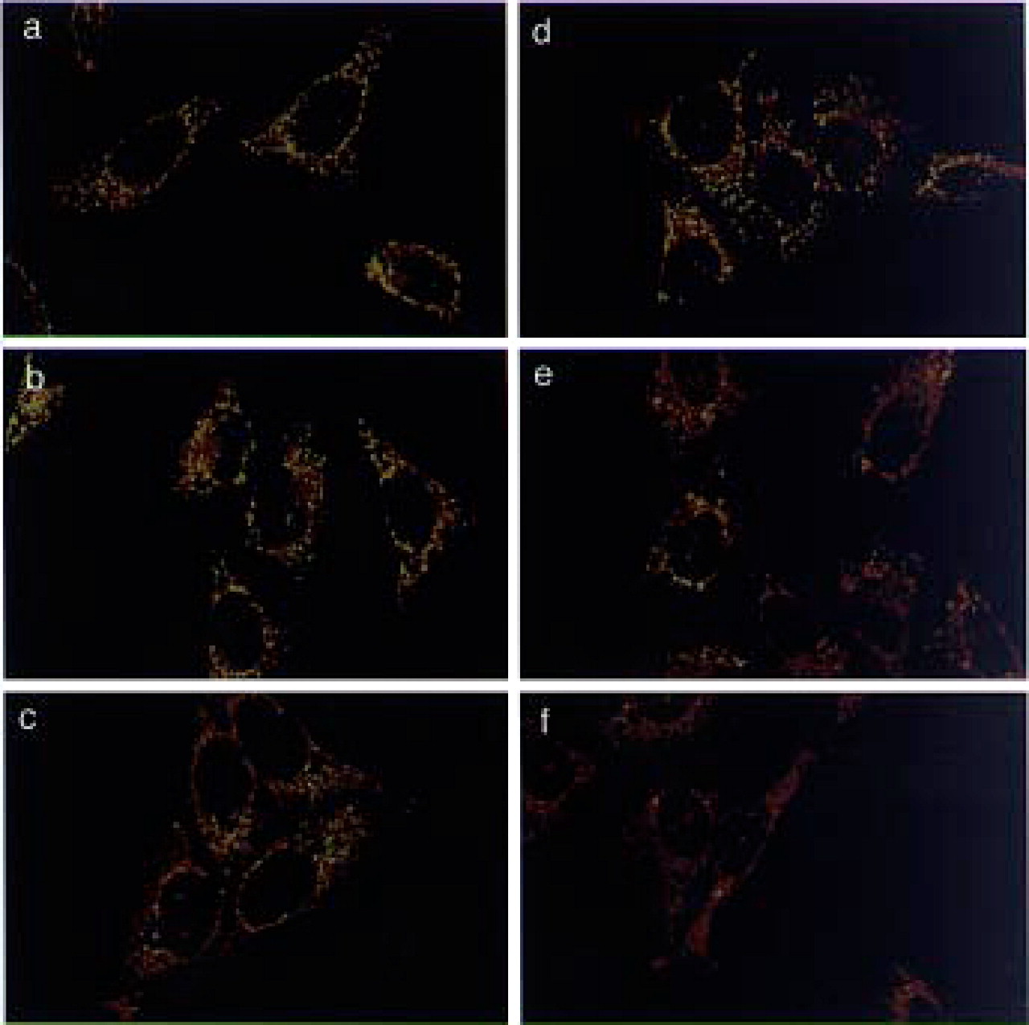
Figure 5 Immunocytochemical analysis of EB-treated HeLa cells. HeLa cells were subjected to double-label confocal ...
Notes:
Figure 5 Immunocytochemical analysis of EB-treated HeLa cells. HeLa cells were subjected to double-label confocal microscopy as described in Materials and Methods. Cells were stained with anti-DNA polymerase γ ( a–c ) or anti-mtTFA ( d–f ). Shown are untreated cells (a and d) or cells treated for 3 days with 20 ng/ml EB (b and e) or 100 ng/ml EB (c and f).
Unless provided in the caption above, the following copyright applies to the content of this slide: © 1996 Oxford University Press

