Slide 1
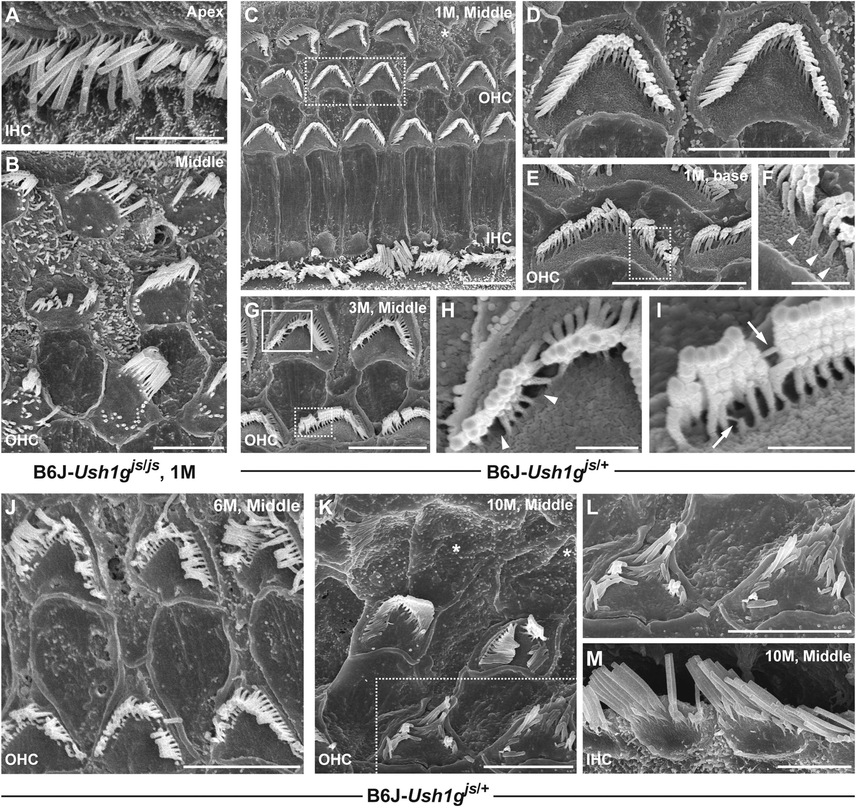
Figure 6. SEM images showing the stereocilia of the hair cells from the organ of Corti in ...
Notes:
Figure 6. SEM images showing the stereocilia of the hair cells from the organ of Corti in B6J-Ush1gjs/js homozygous and -Ush1gjs/+ heterozygous mice. (A and B) Stereociliary morphology of the IHCs (A) and OHCs (B) from the apex (A) and middle (B) areas in B6J-Ush1gjs/js mice at 1 month of age (1 M). (C–F) Stereociliary morphology of the hair cells from the middle (C and D) and base (E and F) areas of the organ of Corti in B6J-Ush1gjs/+ mice at 1 M. The asterisks indicate OHCs with absent bundles. Highly magnified images of the stereocilia in the dotted boxes in C and E are shown in D and F, respectively. (G–I) Stereociliary phenotypes of the OHCs (middle area) in B6J-Ush1gjs/+ mice at 3 M. Highly magnified images of the stereocilia in the solid box and dotted box in G are shown in H and I, respectively. The arrowheads (F and H) indicate the absence of stereocilia, and the arrows (I) indicate the elongated stereociliary links. (J–M) Age-related degeneration of stereocilia on cochlear hair cells in B6J-Ush1gjs/+ heterozygous mice. Stereociliary phenotypes of OHCs (J–L) and IHCs (M) from the middle area of the organ of Corti in B6J-Ush1gjs/+ mice at 6 (6M, J) and 10 months of age (10M, K–M). Scale bars = 5 µm (A–E, G and J–M) and 2 µm (F, H and I).
Unless provided in the caption above, the following copyright applies to the content of this slide: © The Author 2016. Published by Oxford University Press. All rights reserved. For Permissions, please email: journals.permissions@oup.com

Slide 2
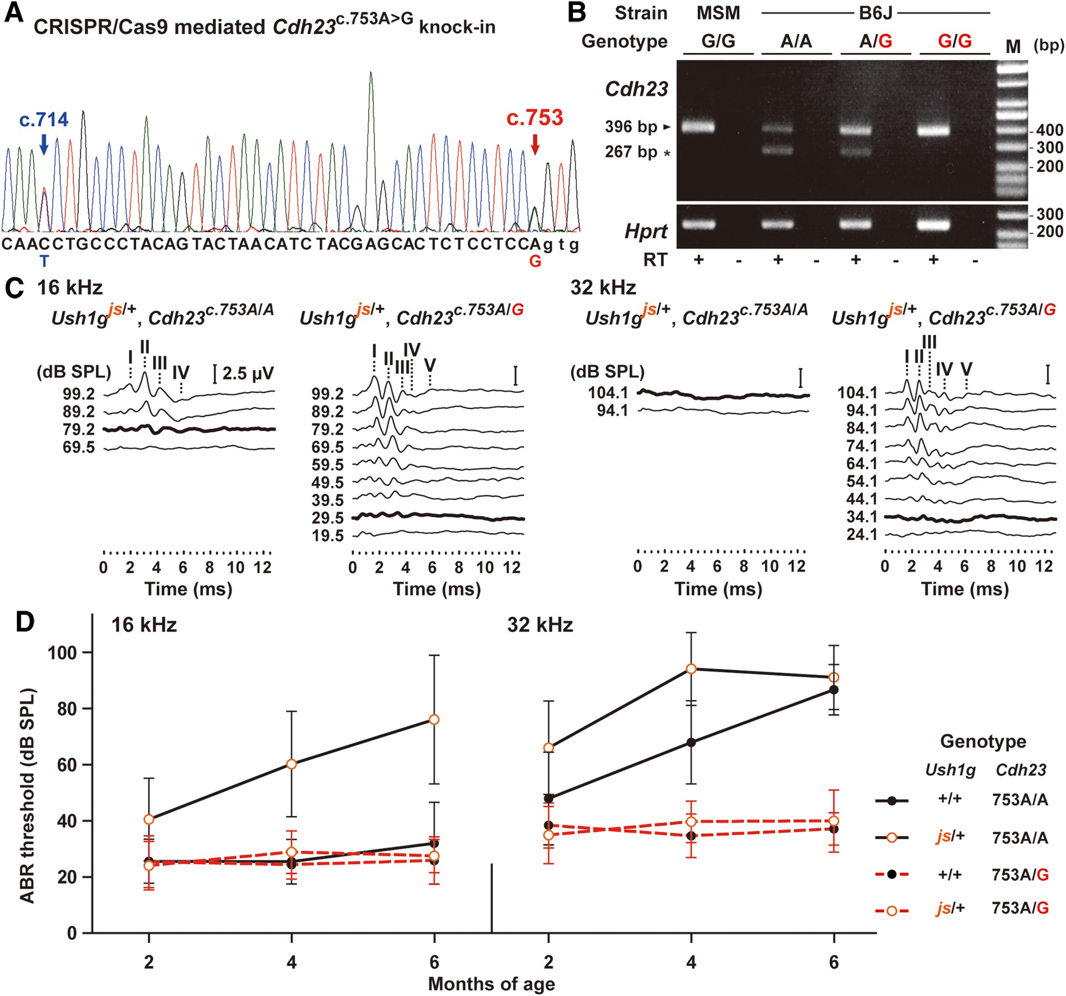
Figure 5. Targeted Cdh23^{c.753A>G} KI in the B6J mice using CRISPR/Cas9 genome editing and rescue of the ePHL ...
Notes:
Figure 5. Targeted Cdh23c.753A>G KI in the B6J mice using CRISPR/Cas9 genome editing and rescue of the ePHL in B6J-Ush1gjs/+ mice. (A) A sequence of the targeted region in Cdh23 from a F0 offspring (No. 33) produced by co-injection of the Cas9 mRNA, Cdh23-sgRNA and donor oligonucleotide (Supplementary Material, Fig. S4A and Supplementary Data). The C/T and A/G hetero peaks were detected in synonymous c.714 (blue arrow) and c.753 (red arrow) sites, respectively. (B) Rescue of partial alternative splicing of exon 7 of Cdh23 in B6J mice by Cas9-mediated KI. The upper panel shows the electrophoretic profile of RT-PCR products amplified from cochlear cDNA from Cdh23753G (MSM and B6J-Cdh23c.753G/G) and Cdh23753A (B6J) homozygous mice and B6J-Cdh23c.753A/G heterozygous mice using Cdh23-specific primers located in exons 6 and 8 (Supplementary Material, Table S3). The 396 and 267 bp bands indicate spliced in and out exon 7, respectively. cDNA integrity was confirmed using a hypoxanthine-guanine phosphoribosyl transferase (Hprt) control band (bottom panel). M: marker (100-bp DNA ladder). (C) Representative ABR waveforms from B6J-Ush1gjs/+, -Cdh23c.753A/A and -Ush1gjs/+, -Cdh23c.753A/G mice at 4 months of age. The waveforms represent the ABR in response to tone-pip stimuli at 16 (left) and 32 (right) kHz. The bold lines represent the thresholds detected. The locations of Peaks I–V are indicated. Scale bars = 2.5 µV. (D) The means (circles) and SDs (error bars) of ABR threshold measurements for 16 and 32 kHz stimuli are shown for B6J mice of four different combinations in Ush1g and Cdh23 genotypes at 2, 4 and 6 months of age.
Unless provided in the caption above, the following copyright applies to the content of this slide: © The Author 2016. Published by Oxford University Press. All rights reserved. For Permissions, please email: journals.permissions@oup.com

Slide 3
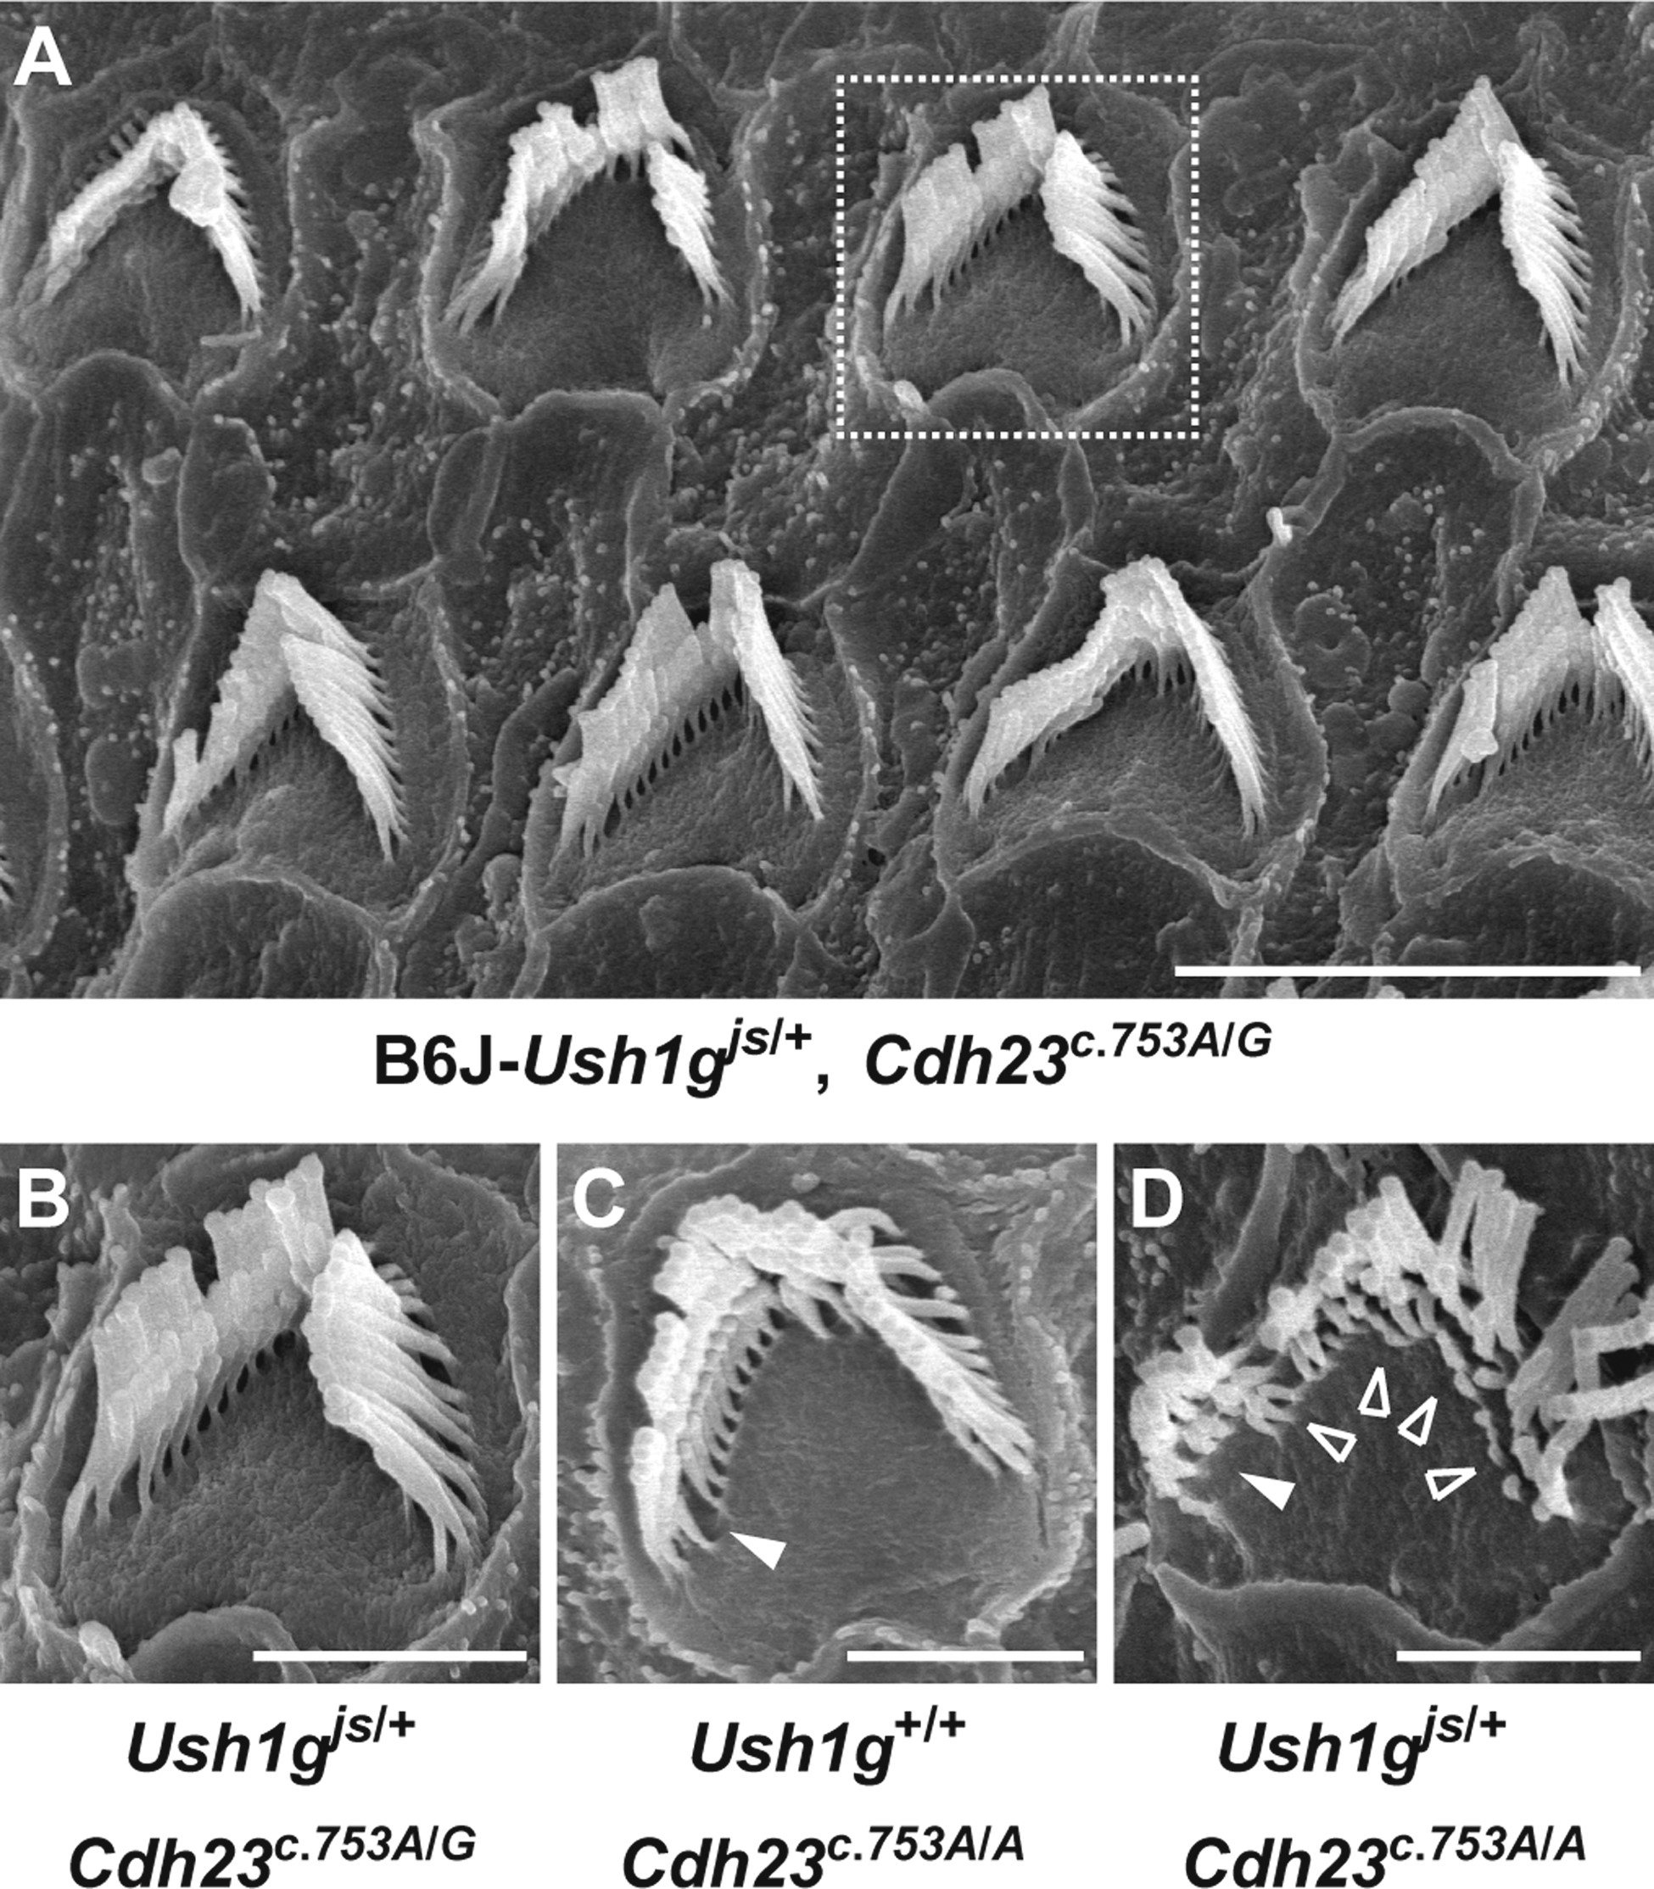
Figure 8. Rescue of the stereocilia degeneration in B6J-Ush1g^{js/+} mice by Cas9-mediated ...
Notes:
Figure 8. Rescue of the stereocilia degeneration in B6J-Ush1gjs/+ mice by Cas9-mediated Cdh23c.753A>G KI. (A–D) Representative stereociliary morphology (A) in B6J-Ush1gjs/+, -Cdh23c.753A/G double-heterozygous mouse and comparison among the phenotypes of OHC from the middle area in B6J-Ush1gjs/+, -Cdh23c.753A/G (B, highly magnified images of the dotted box in A), -Ush1g+/+, -Cdh23c.753A/A (C) and -Ush1gjs/+, -Cdh23c.753A/A (D) mice at 6 months of age. The arrowheads and opened arrowheads indicate the absence and shortened of stereocilia, respectively. Scale bars = 5 µm (A) and 2 µm (B–D).
Unless provided in the caption above, the following copyright applies to the content of this slide: © The Author 2016. Published by Oxford University Press. All rights reserved. For Permissions, please email: journals.permissions@oup.com

Slide 4
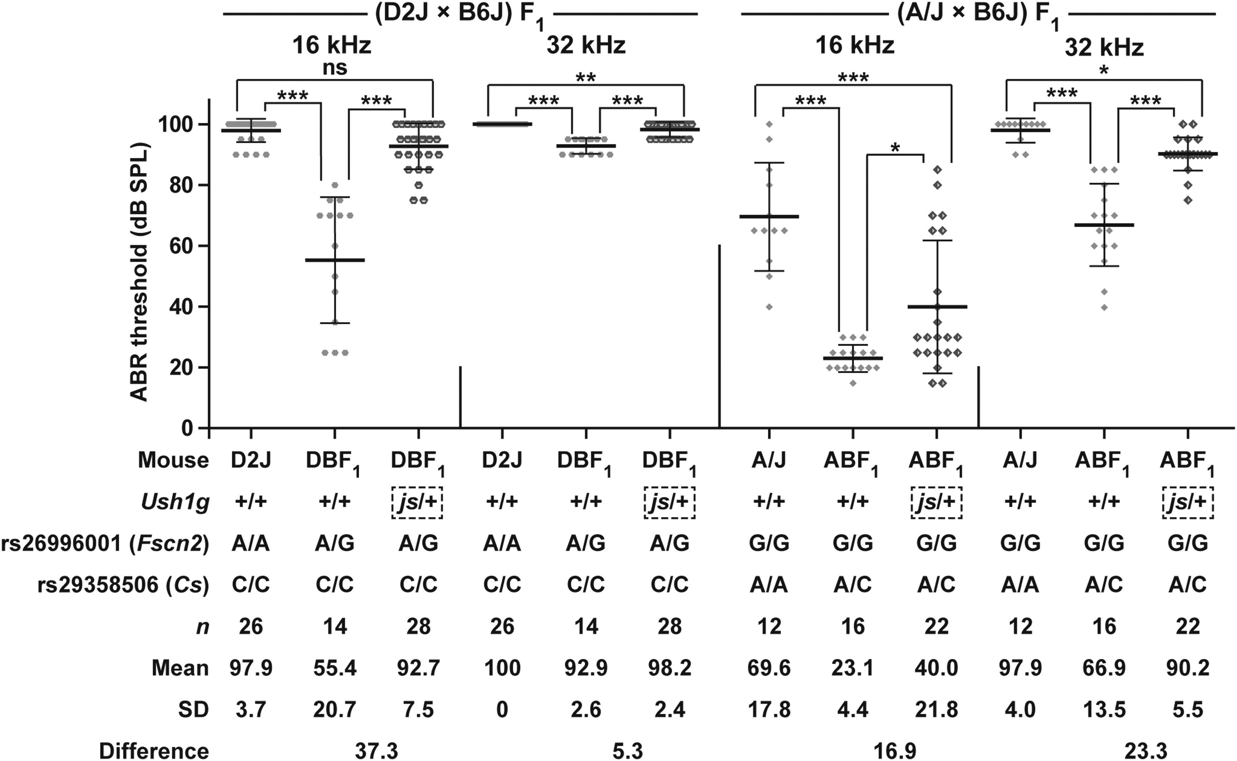
Figure 4. Effects of the Ush1g^{js} allele on ePHL in the (D2J × B6J) F₁ and (A/J × B6J) ...
Notes:
Figure 4. Effects of the Ush1gjs allele on ePHL in the (D2J × B6J) F1 and (A/J × B6J) F1 mice. The means (middle bold lines), SDs (error bars) and phenotypes (dots) of individual mice of the ABR thresholds at 16 and 32 kHz are shown for each Ush1g+/+ and Ush1gjs/+ genotype at 4 months of age. The data for ABR threshold measurements in D2J mice are cited from our previous study (44). Differences between the means of mice of Ush1g+/+ and Ush1gjs/+ genotypes in each F1 mouse are shown. In the Fscn2 locus: G, wild-type allele; A, ahl8 mutant allele. In the Cs locus: C, wild-type allele; A, ahl4 mutant allele. ns, no significant difference; *P < 0.05, **P < 0.01 and ***P < 0.001.
Unless provided in the caption above, the following copyright applies to the content of this slide: © The Author 2016. Published by Oxford University Press. All rights reserved. For Permissions, please email: journals.permissions@oup.com

Slide 5
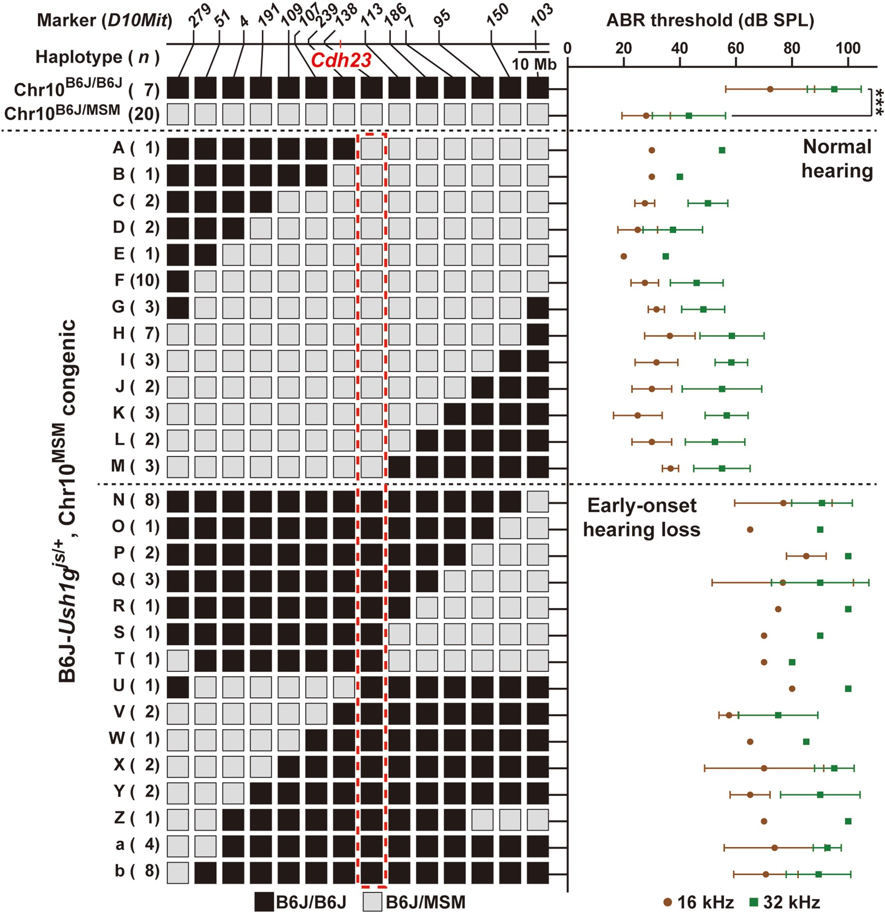
Figure 3. Genetic analysis of the susceptibility gene associated with ePHL of B6J-Ush1g^{js/+}, ...
Notes:
Figure 3. Genetic analysis of the susceptibility gene associated with ePHL of B6J-Ush1gjs/+, -Chr10MSM congenic mice produced by cross of (B6J × B6J-Chr10MSM/MSM consomic mice) F1 × B6J-Ush1gjs/js mice. The left panel shows the haplotypes of Chr10 in B6J-Ush1gjs/+, -Chr10B6J/B6J (n = 7), -Chr10B6J/MSM (n = 20) and -Chr10MSM congenic (n = 78) mice. The positions of the genetic markers and Cdh23 are indicated above the haplotype map. The red dashed box indicates genotypes of congenic mice in D10Mit138, which was non-recombinant with hearing phenotypes. The right graph indicates the means (circles and squares) and SDs (error bars) of the ABR threshold measurements for 16 (brown) and 32 (green) kHz stimuli in B6J-Ush1gjs/+, -Chr10B6J/B6J, -Chr10B6J/MSM and -Chr10MSM congenic mice at 4 months of age. ***P < 0.001.
Unless provided in the caption above, the following copyright applies to the content of this slide: © The Author 2016. Published by Oxford University Press. All rights reserved. For Permissions, please email: journals.permissions@oup.com

Slide 6
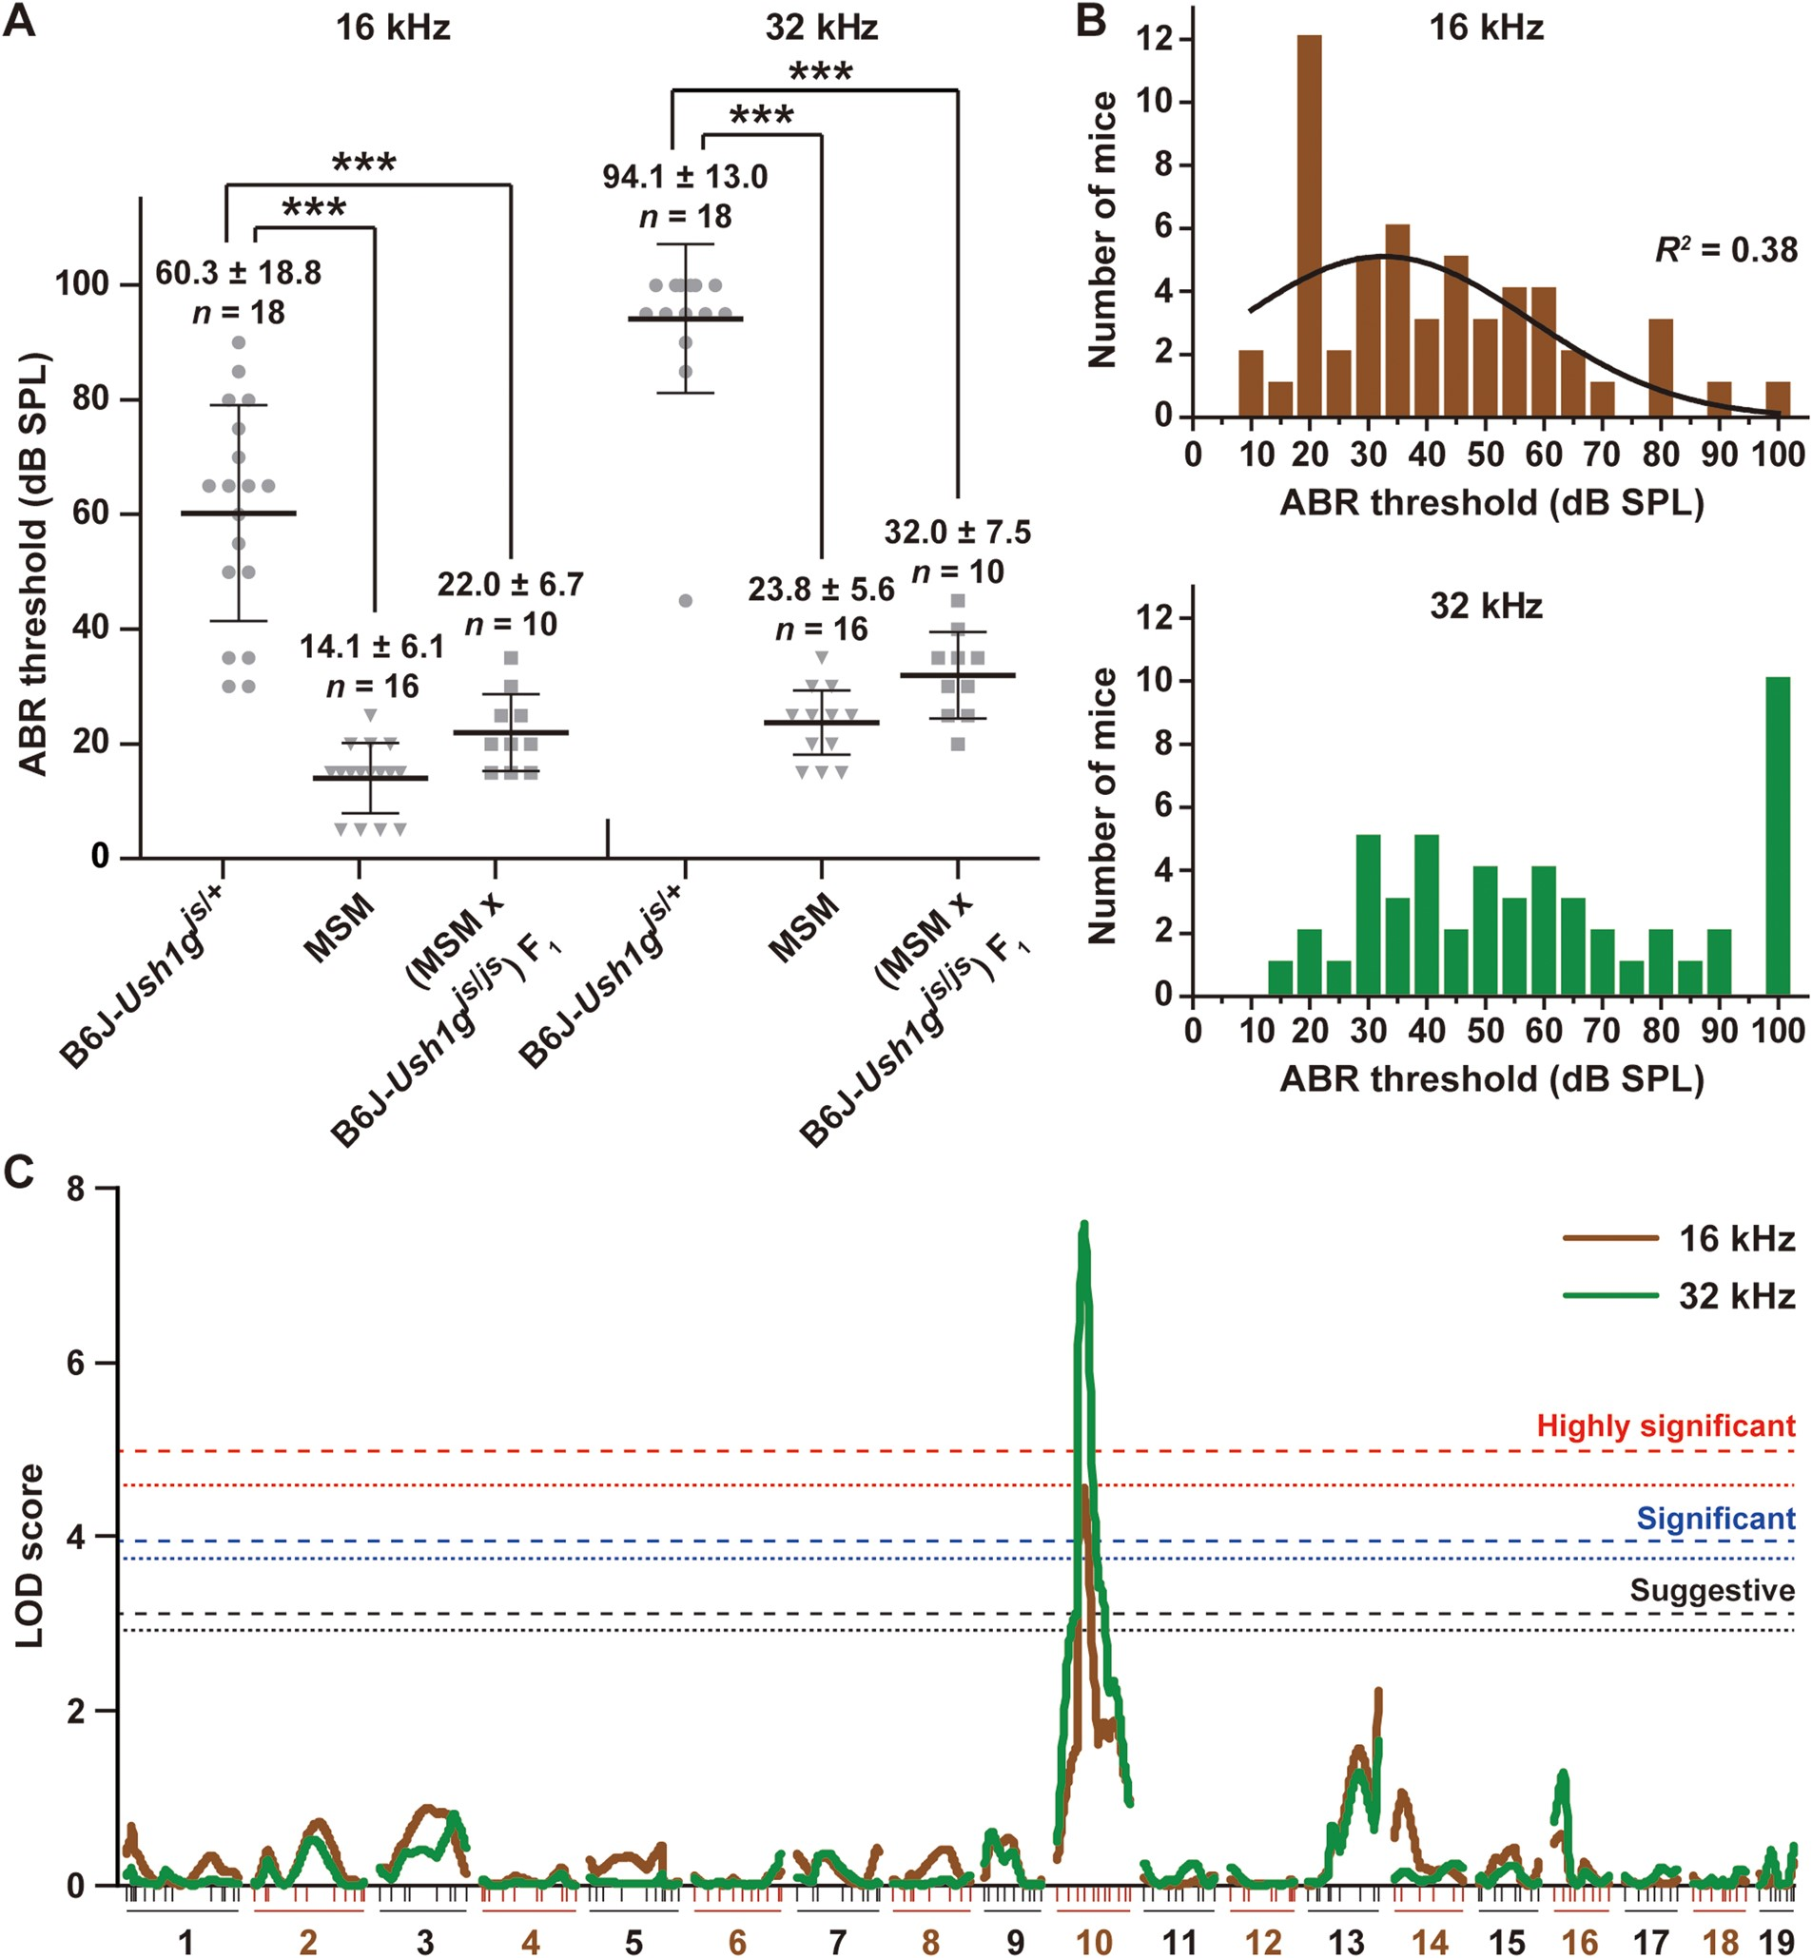
Figure 2. Genetic analysis of the susceptibility gene associated with ePHL of B6J-Ush1g^{js/+} ...
Notes:
Figure 2. Genetic analysis of the susceptibility gene associated with ePHL of B6J-Ush1gjs/+ heterozygous mice. (A) The means (middle bold lines) and SDs (error bars) of ABR threshold measurements for 16 and 32 kHz stimuli in B6J-Ush1gjs/+, MSM and (MSM × B6J-Ush1gjs/js) F1 mice at 4 months of age. The dots represent the ABR thresholds of individual mice. ***P < 0.001. (B) Distributions of ABR thresholds for 16 (top, brown bars) and 32 (bottom, green bars) kHz stimuli among the (MSM × B6J-Ush1gjs/js) F1 × B6J-Ush1gjs/js backcrossed (N2) mice of the Ush1gjs/+ heterozygous genotype. The best-fit curves for a Gaussian distribution are shown in black. The regression coefficient for the curve is given as R2 and was calculated using the D'Agostino and Pearson test. (C) Genome-wide interval mapping for the susceptibility gene associated with ePHL for 16 (brown curve) and 32 (green curve) kHz stimuli of the N2-Ush1gjs/+ heterozygous mice. Chromosome numbers and marker positions (vertical bars) are given beneath the linkage maps. The horizontal dotted (16 kHz) and dashed (32 kHz) lines indicate suggestive (black, P < 0.05, LOD score = 16 kHz: 2.92 and 32 kHz: 3.11), significant (blue, P < 0.01, LOD = 16 kHz: 3.74 and 32 kHz: 3.94) and highly significant (red, P < 0.001, LOD = 16 kHz: 4.58 and 32 kHz: 4.97) linkage associations.
Unless provided in the caption above, the following copyright applies to the content of this slide: © The Author 2016. Published by Oxford University Press. All rights reserved. For Permissions, please email: journals.permissions@oup.com

Slide 7
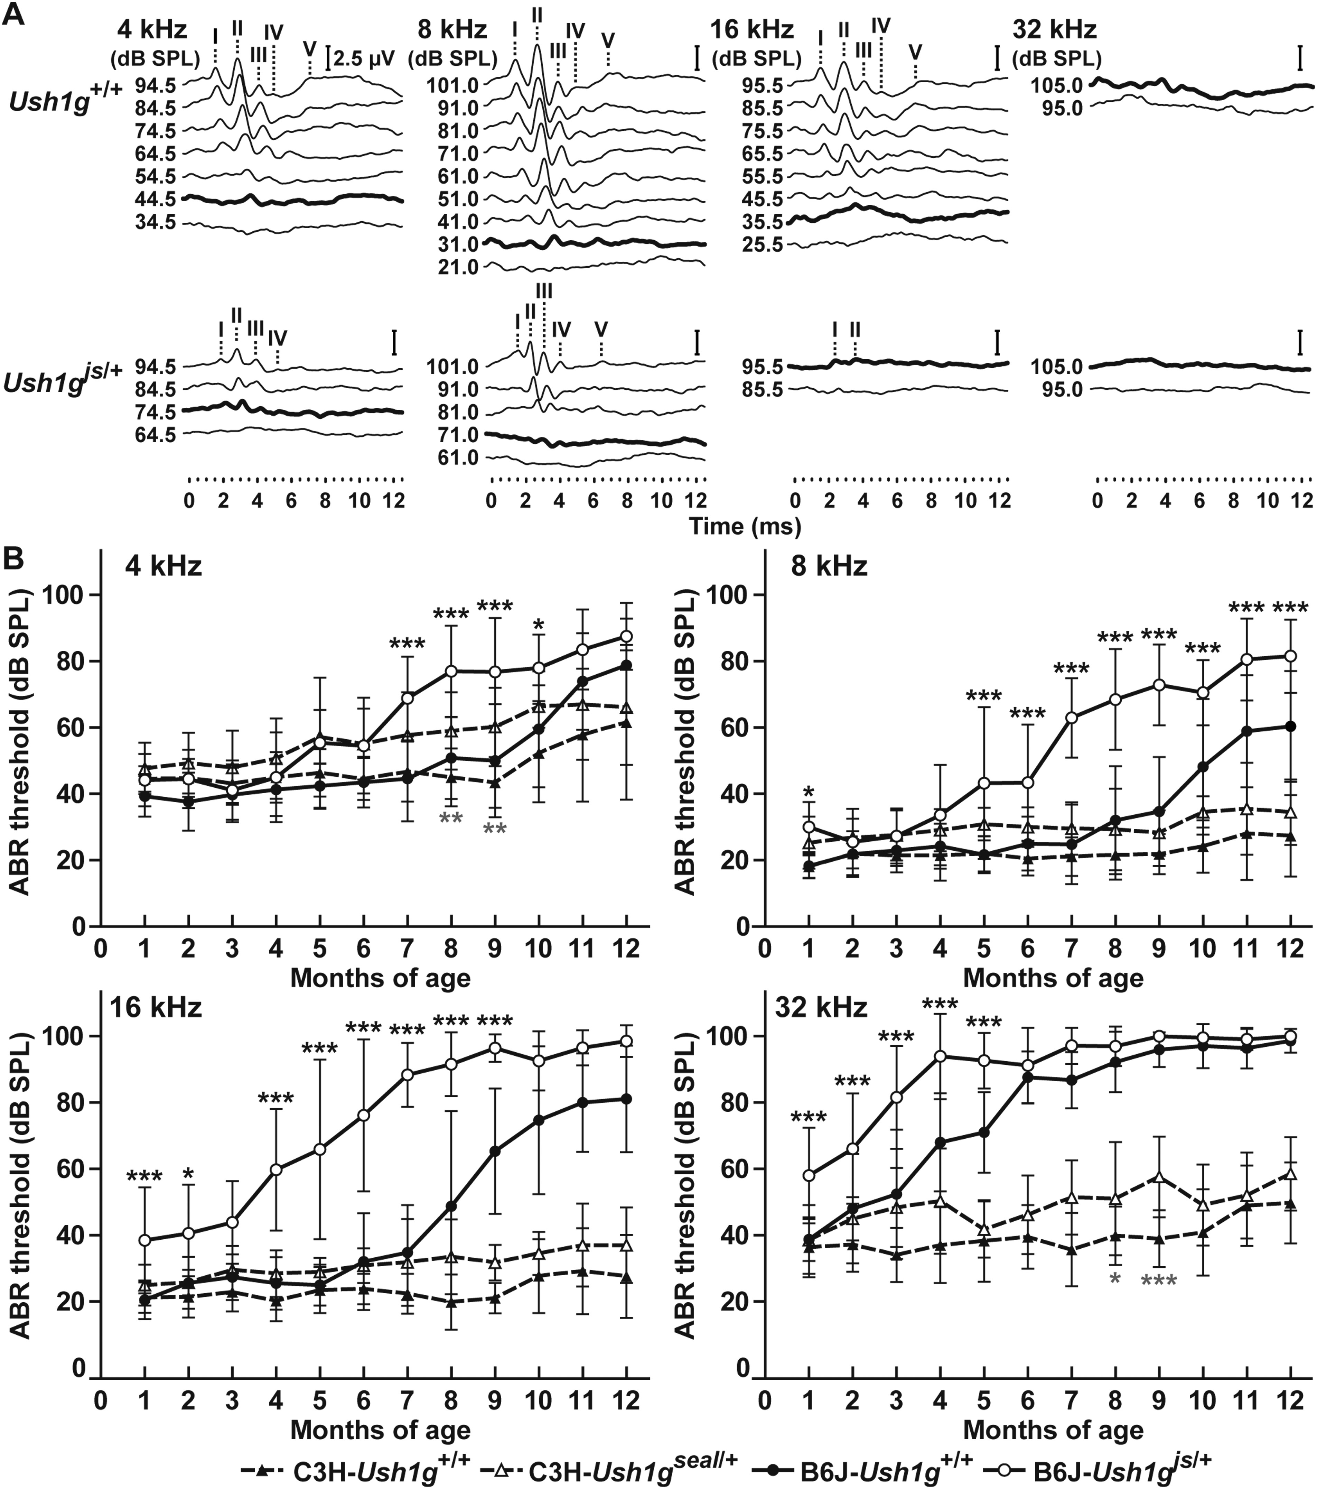
Figure 1. Early-onset PHL in B6J-Ush1g^{js/+} heterozygous mice. (A) Representative ABR waveforms ...
Notes:
Figure 1. Early-onset PHL in B6J-Ush1gjs/+ heterozygous mice. (A) Representative ABR waveforms from B6J-Ush1g+/+ and -Ush1gjs/+ heterozygous mice at 6 months of age. The waveforms represent the ABR in response to tone-pip stimuli at 4, 8, 16 and 32 kHz. The bold lines represent the thresholds detected. The locations of Peaks I–V are indicated. Scale bars = 2.5 µV. (B) The means (circles and upper triangles) and SDs (error bars) of ABR threshold measurements for 4, 8, 16 and 32 kHz stimuli are shown for B6J-Ush1g+/+, -Ush1gjs/+, C3H-Ush1g+/+ and -Ush1gseal/+ mice at 1–12 months of age. The data for ABR threshold measurements in B6J-Ush1g+/+ mice are cited from our previous study (15). The data for ABR thresholds are listed in Supplementary Material, Table S1. The upper black and lower gray asterisks indicate significant differences (*P < 0.05, **P < 0.01 and ***P < 0.001) between the ABR thresholds for B6J-Ush1g+/+ versus -Ush1gjs/+ and in C3H-Ush1g+/+ versus -Ush1gseal/+ mice, respectively.
Unless provided in the caption above, the following copyright applies to the content of this slide: © The Author 2016. Published by Oxford University Press. All rights reserved. For Permissions, please email: journals.permissions@oup.com

Slide 8
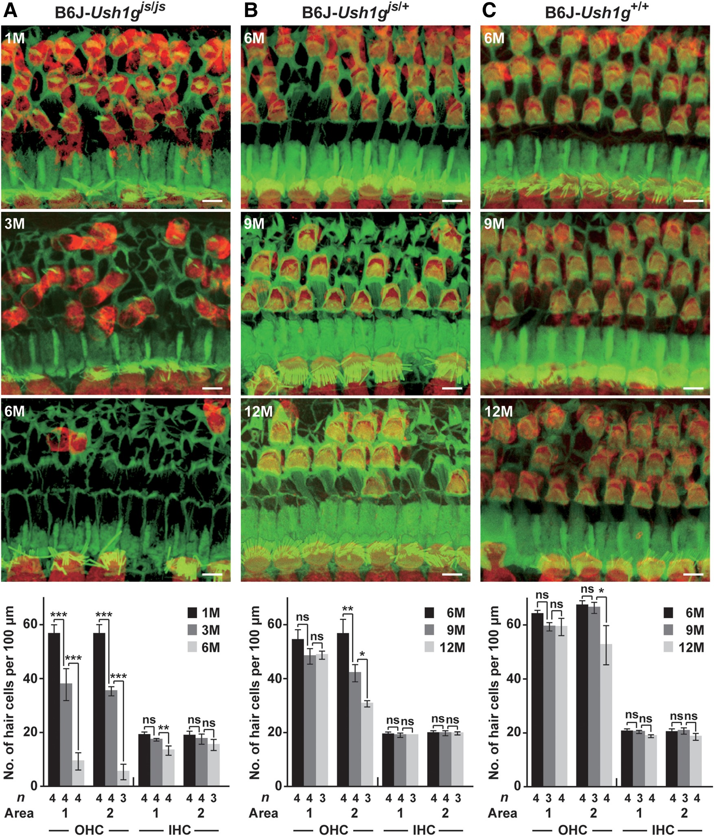
Figure 7. Defect of OHCs in B6J-Ush1g^{js/+} heterozygous mice. (A) Confocal images (first to third ...
Notes:
Figure 7. Defect of OHCs in B6J-Ush1gjs/+ heterozygous mice. (A) Confocal images (first to third panels from the top) of the hair cells and the counts (bottom) of the hair cells in Areas 1 and 2 (1.2–1.5 and 2.1–2.4 mm from the apex, see Supplementary Material, Fig. S9) in the organ of Corti of B6J-Ush1gjs/js homozygous mice. The images show hair cells from Area 2 visualized by immunohistochemistry of phalloidin (green) and anti-MYO6 antibody (red) in mice at 1 (1st), 3 (2nd) and 6 (3rd) months of age. (B and C) Confocal images of hair cells and counts (bottom) of the hair cells from Areas 1 and 2 in the organ of Corti of B6J-Ush1gjs/+ (B) and -Ush1g+/+ (C) mice at 6 (1st), 9 (2nd) and 12 (3rd) months of age. Scale bars = 5 µm.
Unless provided in the caption above, the following copyright applies to the content of this slide: © The Author 2016. Published by Oxford University Press. All rights reserved. For Permissions, please email: journals.permissions@oup.com

