Slide 1
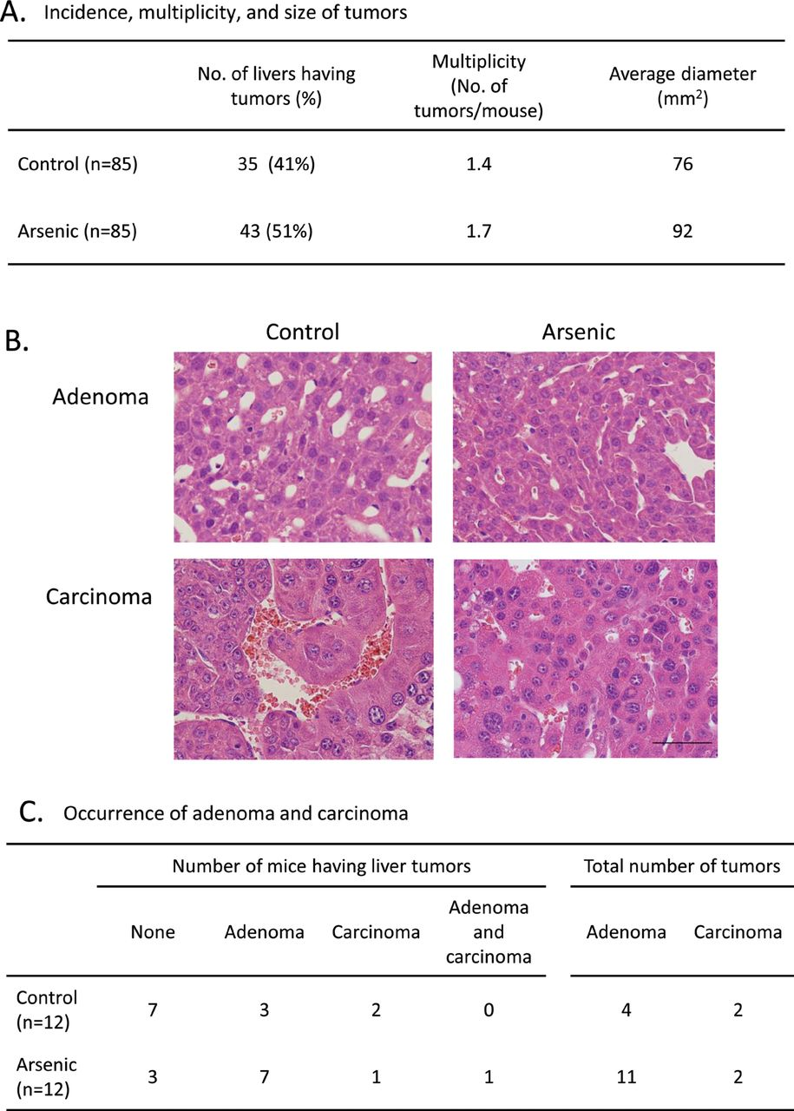
FIG. 1. Characterization of the hepatic tumors of adult male C3H mice which had been gestationally exposed to ...
Notes:
FIG. 1. Characterization of the hepatic tumors of adult male C3H mice which had been gestationally exposed to arsenic. The livers of 85 male offspring from 74 to 84 weeks of age in a control group and gestationally arsenic-exposed group were examined for macroscopic tumors in an age-matched manner. (A) Arsenic exposure increased the incidence, multiplicity, and average size of the macroscopic tumors. (B) Representative sections of hepatocellular adenoma and carcinoma from the livers of control and arsenic-exposed mice. Bar = 50 µm. (C) Gestational arsenic exposure mainly increased the incidence of adenomas.
Unless provided in the caption above, the following copyright applies to the content of this slide: © The Author 2012. Published by Oxford University Press on behalf of the Society of Toxicology. All rights reserved. For permissions, please email: journals.permissions@oup.com

Slide 2
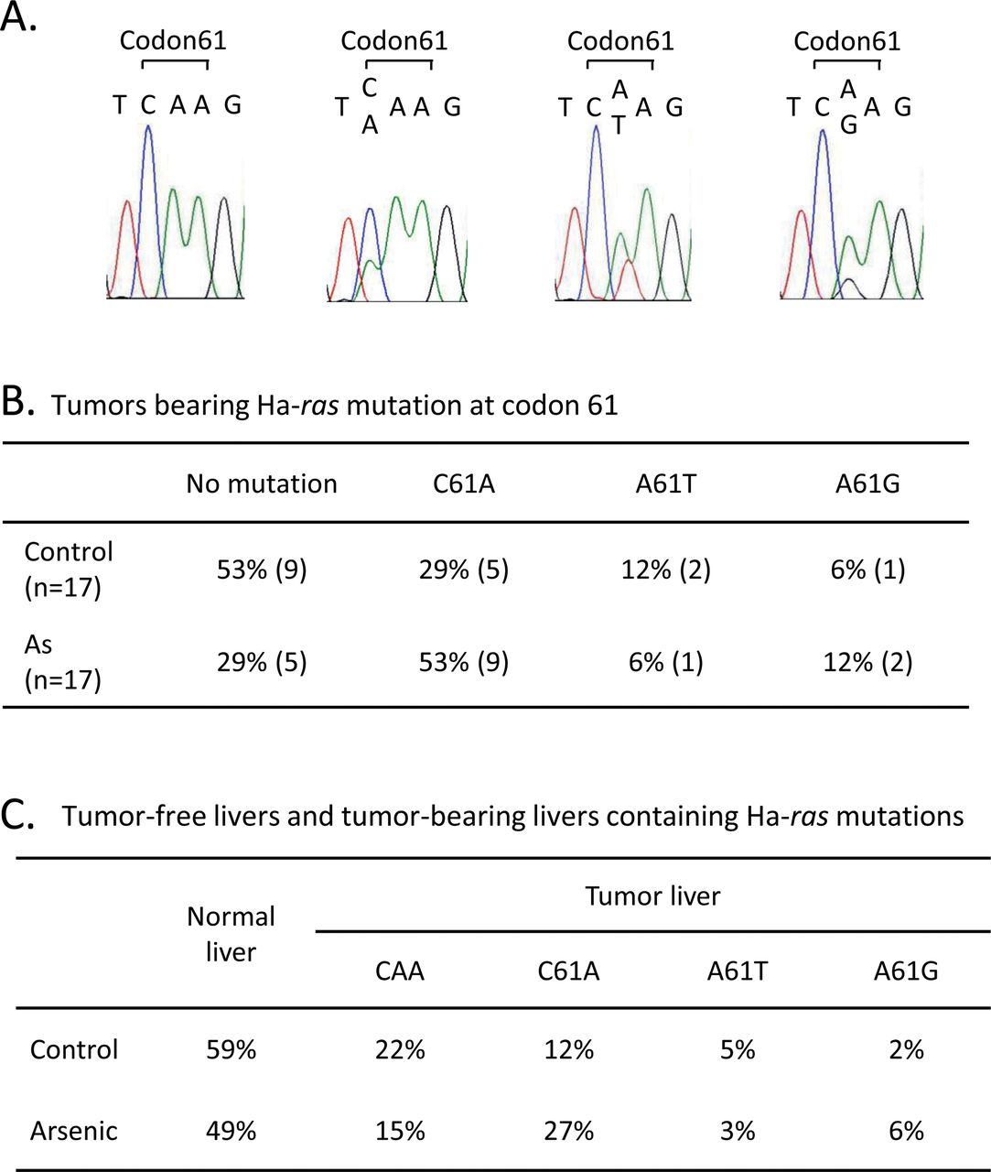
FIG. 2. Gestational arsenic exposure increased hepatic tumors bearing a C61A Ha-ras mutation. (A) Chromatograms of ...
Notes:
FIG. 2. Gestational arsenic exposure increased hepatic tumors bearing a C61A Ha-ras mutation. (A) Chromatograms of the results of directly sequencing Ha-ras codon 61. (B) Tumors bearing a Ha-ras mutation at codon 61 expressed as a percentage of all tumors. The number in parenthesis is the number of tumors bearing a Ha-ras mutation among a total of 17 tumors. (C) Tumor-free livers and tumor-bearing livers containing Ha-ras mutations expressed as a percentage of all livers. The percentages were calculated using the tumor incidence data shown in Fig. 1A and the percentages of total mutation shown in Fig. 2B.
Unless provided in the caption above, the following copyright applies to the content of this slide: © The Author 2012. Published by Oxford University Press on behalf of the Society of Toxicology. All rights reserved. For permissions, please email: journals.permissions@oup.com

Slide 3
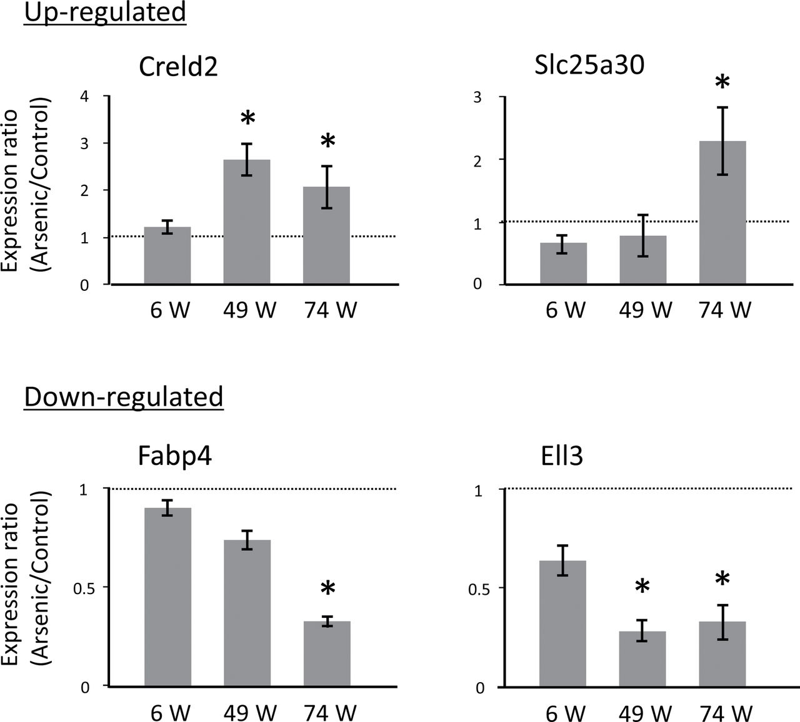
FIG. 3. Late-onset changes in gene expression in the non-tumor-bearing livers of male mice gestationally exposed to ...
Notes:
FIG. 3. Late-onset changes in gene expression in the non-tumor-bearing livers of male mice gestationally exposed to arsenic. Expression of four genes in the livers of control and gestationally arsenic-exposed mice was measured by real-time PCR at 6, 49, and 74 weeks of age and normalized to the expression of CPB. The graphs show the ratio of expression in the arsenic group normalized to expression in the control group. The data shown are the means ± SE (n = 11 for 6 weeks, n = 4 for 49 weeks, n = 8 for 74 weeks). * Significant difference between the two groups at p < 0.05.
Unless provided in the caption above, the following copyright applies to the content of this slide: © The Author 2012. Published by Oxford University Press on behalf of the Society of Toxicology. All rights reserved. For permissions, please email: journals.permissions@oup.com

Slide 4
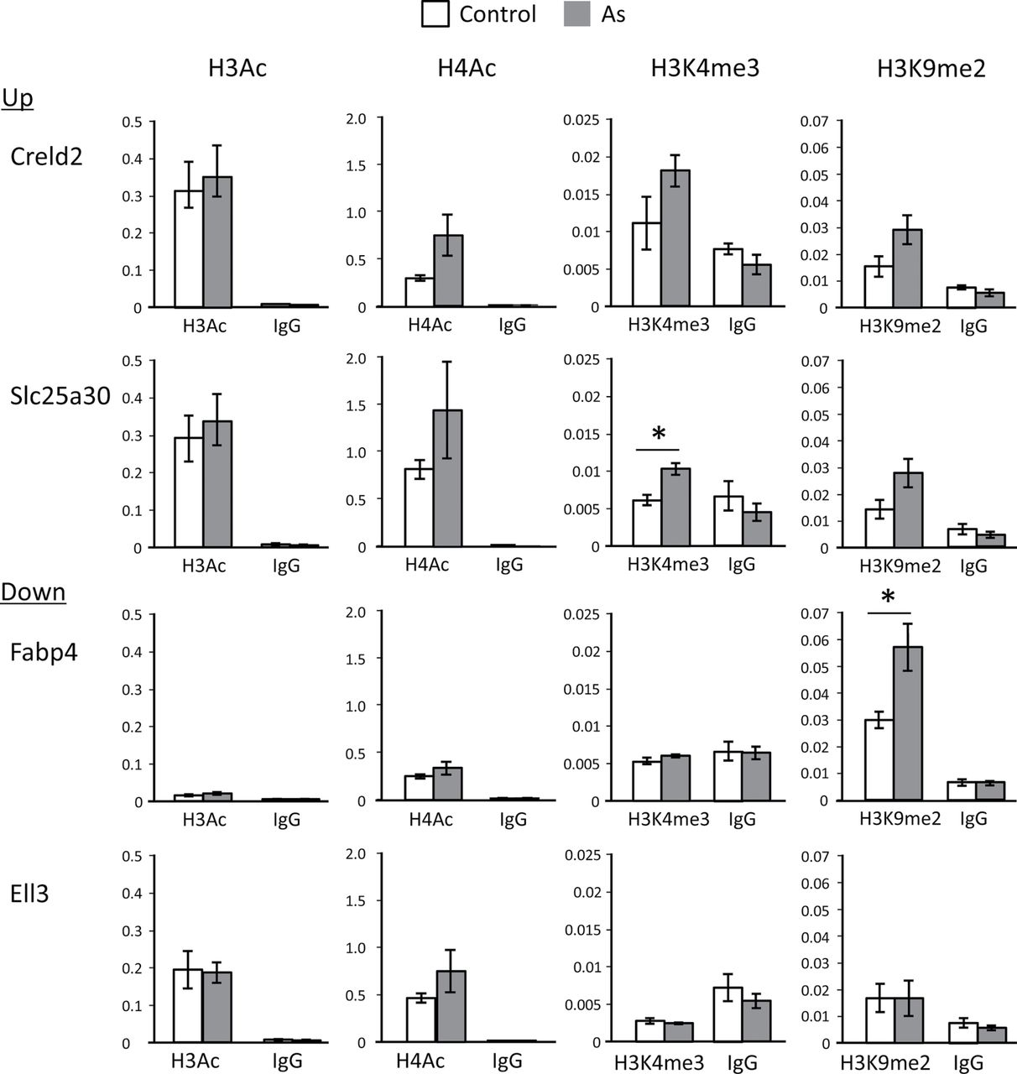
FIG. 4. Histone modifications in the promoter regions of the four genes whose expression was altered in the liver at ...
Notes:
FIG. 4. Histone modifications in the promoter regions of the four genes whose expression was altered in the liver at 74 weeks of age as a result of gestational arsenic exposure. Liver tissue was analyzed by ChIP analysis for four representative histone modifications, which activate or suppress gene expression. Normal rabbit IgG was used as a negative control antibody. The results of the ChIP analysis were quantitated as the mean ratio of precipitated DNA to input DNA determined by real-time PCR. Results are reported as means ± SE (n = 4). *Significant difference between the two groups at p < 0.05.
Unless provided in the caption above, the following copyright applies to the content of this slide: © The Author 2012. Published by Oxford University Press on behalf of the Society of Toxicology. All rights reserved. For permissions, please email: journals.permissions@oup.com

Slide 5
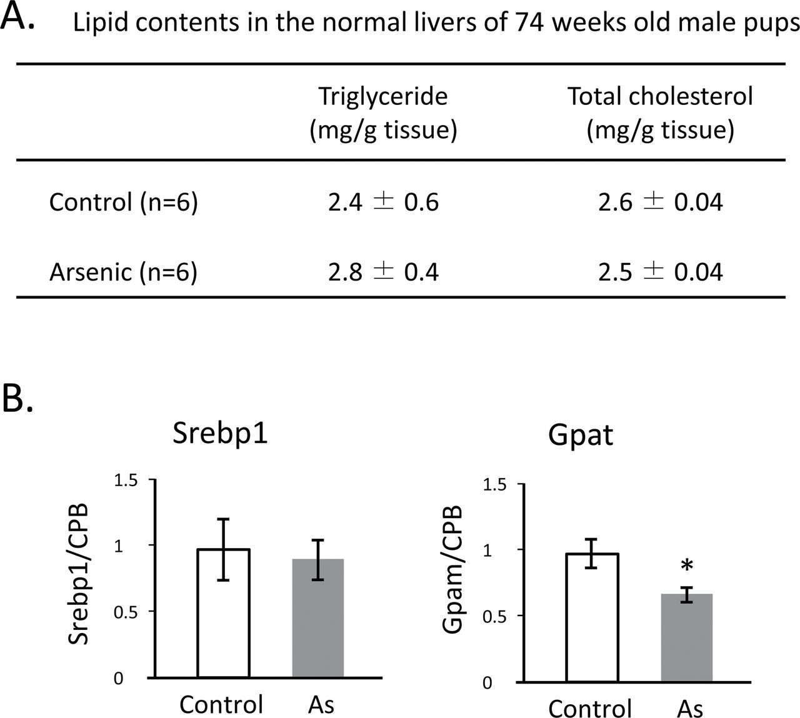
FIG. 5. Lipid contents and expression of Srebp1 and its target gene Gpat in the normal livers of 74 weeks old male ...
Notes:
FIG. 5. Lipid contents and expression of Srebp1 and its target gene Gpat in the normal livers of 74 weeks old male pups. (A) The amounts of triglycerides and total cholesterol were measured as described in the Materials and Methods section. (B) Expression of Srebp1 and Gpat were measured by real-time PCR and normalized to the expression of CPB. Results are reported as means ± SE (n = 8). *Significant difference between the two groups at p < 0.05.
Unless provided in the caption above, the following copyright applies to the content of this slide: © The Author 2012. Published by Oxford University Press on behalf of the Society of Toxicology. All rights reserved. For permissions, please email: journals.permissions@oup.com

Slide 6
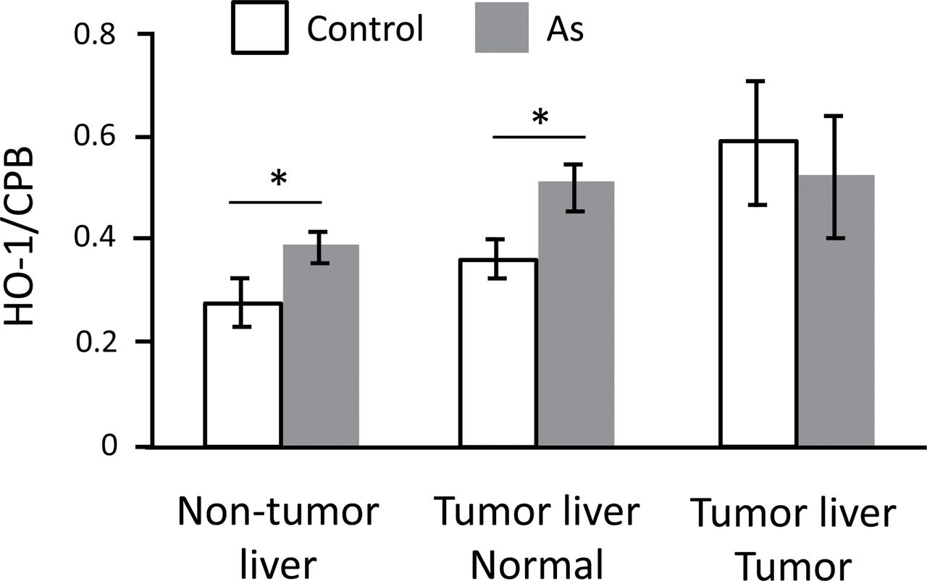
FIG. 6. Increased HO-1 expression in the livers of adult male mice gestationally exposed to arsenic. Expression of ...
Notes:
FIG. 6. Increased HO-1 expression in the livers of adult male mice gestationally exposed to arsenic. Expression of HO-1 in normal adult livers, normal tissue from tumor-bearing livers, and tumor tissue from tumor-bearing livers were measured by real-time PCR and normalized to the expression of CPB. Results are reported as means ± SE (n = 8). *Significant difference between the two groups at p < 0.05.
Unless provided in the caption above, the following copyright applies to the content of this slide: © The Author 2012. Published by Oxford University Press on behalf of the Society of Toxicology. All rights reserved. For permissions, please email: journals.permissions@oup.com

Slide 7
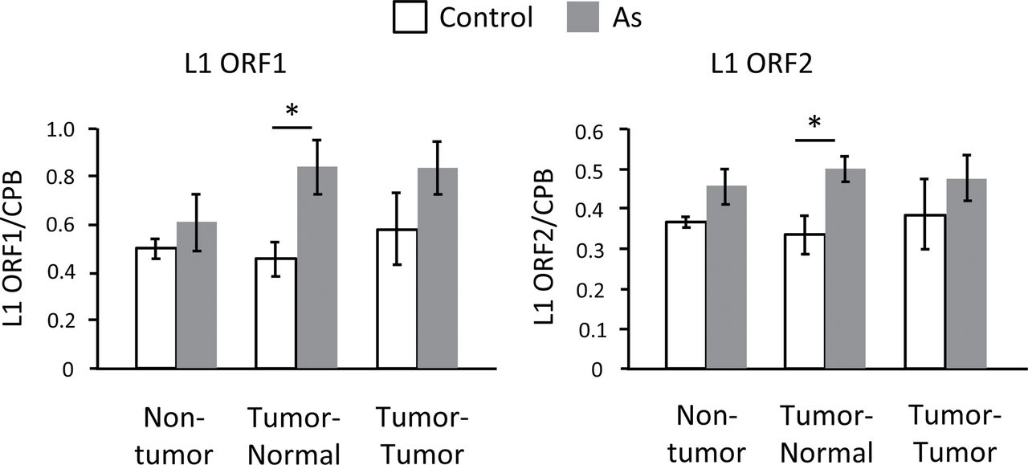
FIG. 7. Increased L1 RNA expression in the livers of adult male mice gestationally exposed to arsenic. Expression of ...
Notes:
FIG. 7. Increased L1 RNA expression in the livers of adult male mice gestationally exposed to arsenic. Expression of ORF1 and ORF2 in normal adult livers, normal tissue from tumor-bearing livers, and tumor tissue from tumor-bearing livers were measured by real-time PCR and normalized to the expression of CPB. Results are reported as means ± SE (n = 6). *Significant difference between the two groups at p < 0.05.
Unless provided in the caption above, the following copyright applies to the content of this slide: © The Author 2012. Published by Oxford University Press on behalf of the Society of Toxicology. All rights reserved. For permissions, please email: journals.permissions@oup.com

Slide 8
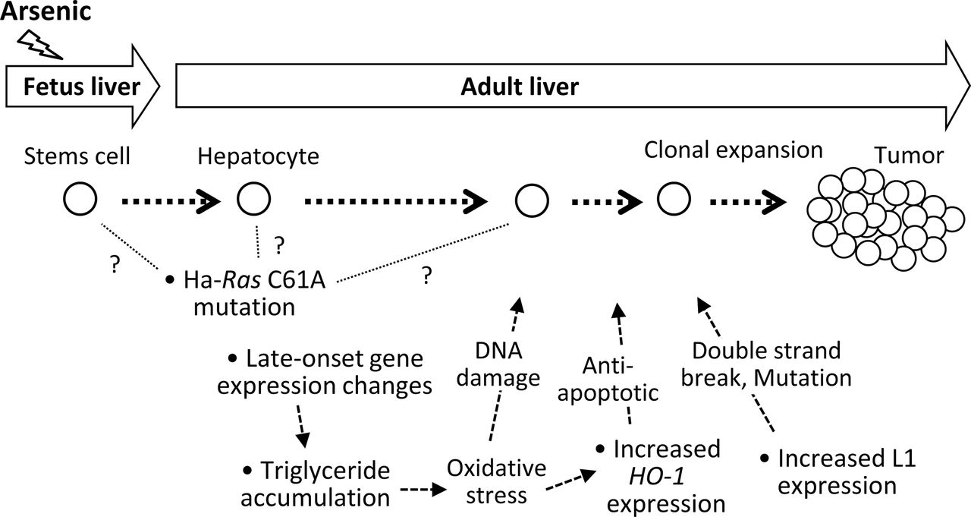
FIG. 8. Possible actions of gestationally exposed arsenic in the hepatic tumorigenesis in the mice.
Notes:
FIG. 8. Possible actions of gestationally exposed arsenic in the hepatic tumorigenesis in the mice.
Unless provided in the caption above, the following copyright applies to the content of this slide: © The Author 2012. Published by Oxford University Press on behalf of the Society of Toxicology. All rights reserved. For permissions, please email: journals.permissions@oup.com

