Slide 1
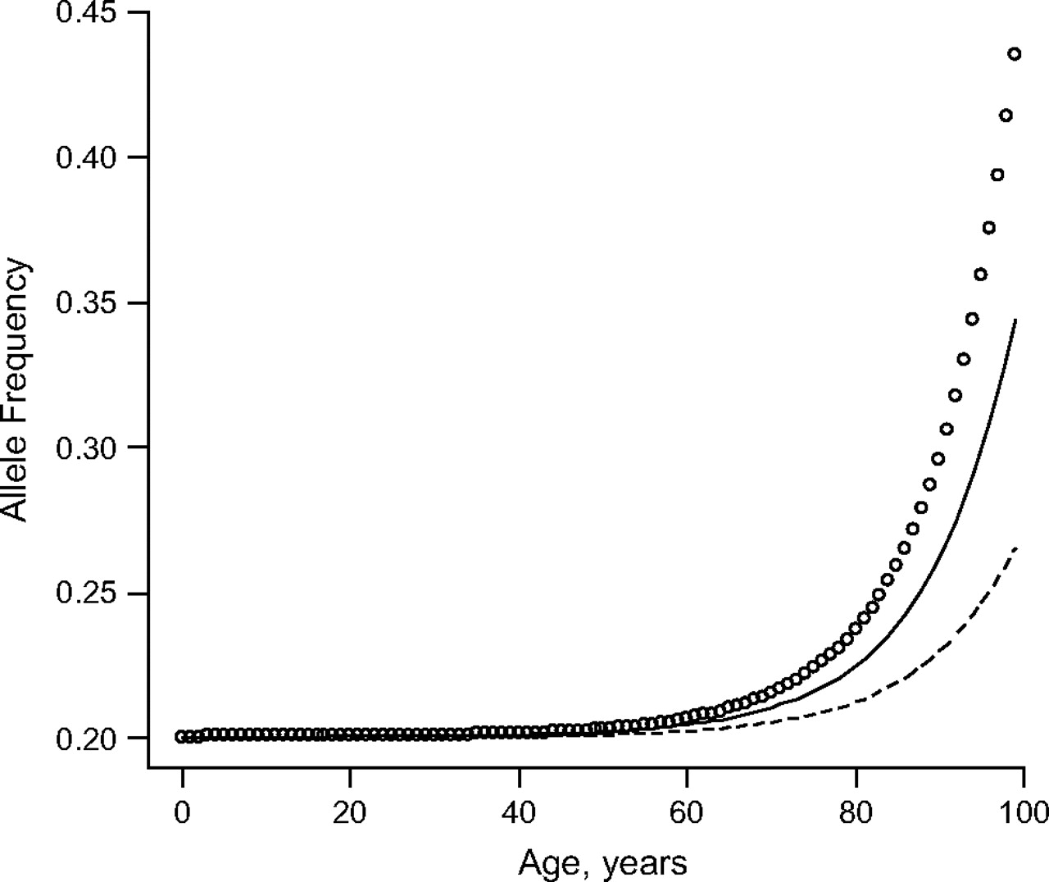
Figure 1. Allele frequency by age for an allele with a frequency at birth of 0.20 and relative risks of 0.7 (circle ...
Notes:
Figure 1. Allele frequency by age for an allele with a frequency at birth of 0.20 and relative risks of 0.7 (circle line), 0.8 (solid line), and 0.9 (dashed line).
Unless provided in the caption above, the following copyright applies to the content of this slide: American Journal of Epidemiology © The Author 2008. Published by the Johns Hopkins Bloomberg School of Public Health. All rights reserved. For permissions, please e-mail: journals.permissions@oxfordjournals.org.

