Slide 1
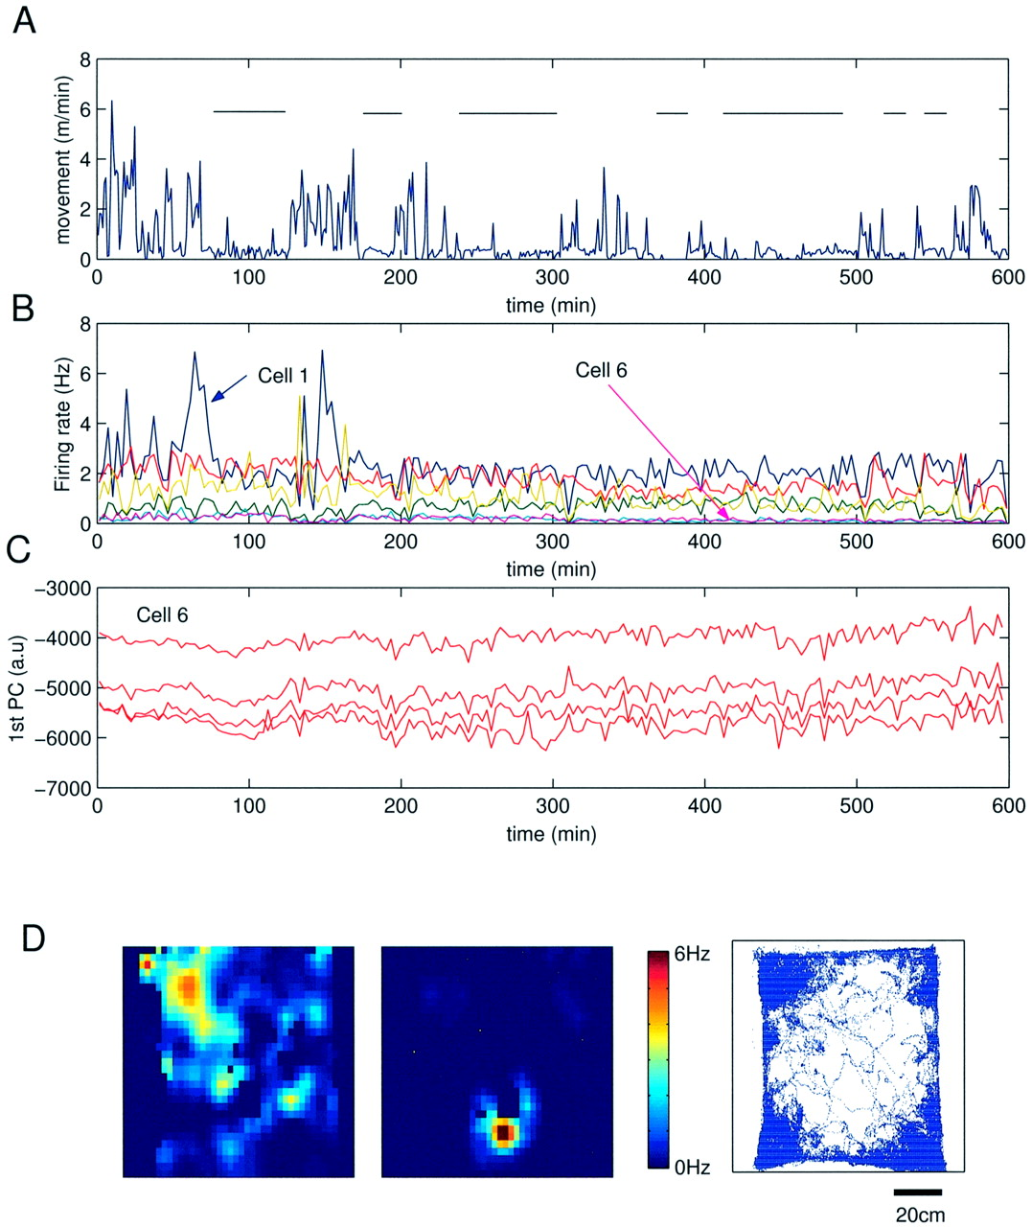
Figure 1. Long-term preservation of discharge frequency of individual pyramidal cells. (A) A 10_h record of movement ...
Notes:
Figure 1. Long-term preservation of discharge frequency of individual pyramidal cells. (A) A 10_h record of movement activity of a rat in a rectangular box. Horizontal lines indicate low activity (immobility and presumed sleep) periods. (B) Firing rates of six simultaneously recorded pyramidal neurons. Place correlates of cells 3 and 6 are shown in (D). Note constant firing frequency of neurons during sleep–wake episodes. (C) The first principal component (1st PC) of cell 6, used for unit clustering (Csicsvari et al., 1998), is shown for each of the tetrode wires. Note recording stability as a function of time. (D) Place fields of cells 3 and 6. Occupancy map (right) shows locomotor activity. Only activity during the first hour of recording is shown to facilitate visibility of traces. The upper left corner (place field of cell 3) was frequently visited whereas the rat only rarely visited place field of cell 6.
Unless provided in the caption above, the following copyright applies to the content of this slide: © Oxford University Press

Slide 2
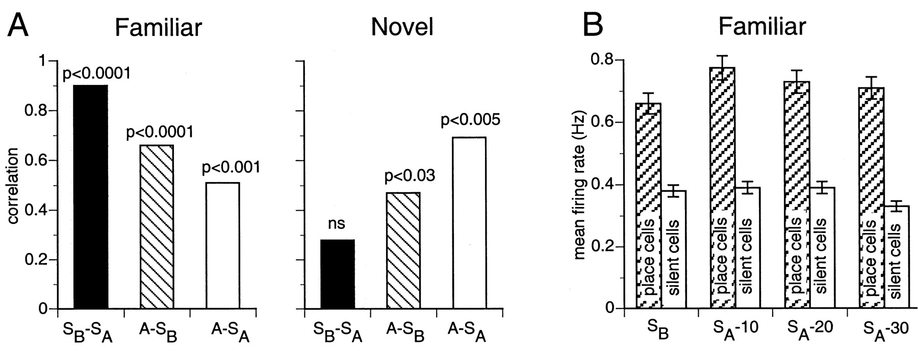
Figure 2. Preservation of and perturbation of discharge frequency of individual pyramidal cells in familiar and novel ...
Notes:
Figure 2. Preservation of and perturbation of discharge frequency of individual pyramidal cells in familiar and novel environments, respectively. (A) Mean correlation values of firing rates for ‘sleep before’ vs ‘sleep after’ (SB–SA), ‘awake’ versus ‘sleep before’ (A–SB) and ‘awake’ vs ‘sleep after’ (A–SA) sessions in the well-trained (familiar) task and in a novel environment. Note the high and low correlations of firing rates between successive sleep sessions in the familiar and novel environments, respectively (black columns). (B) Firing rates of neurons with place correlates (place cells) and no detectable place fields (termed ‘silent’ cells) during a sleep episode before (SB) and 10, 20 and 30 min epochs during sleep (SA) following exploration in a familiar environment. Note stability of firing rates over time [A, modified after Hirase et al. (Hirase et al., 2001); B, modified after Kudrimoti et al. (Kudrimoti et al., 1999)].
Unless provided in the caption above, the following copyright applies to the content of this slide: © Oxford University Press

Slide 3
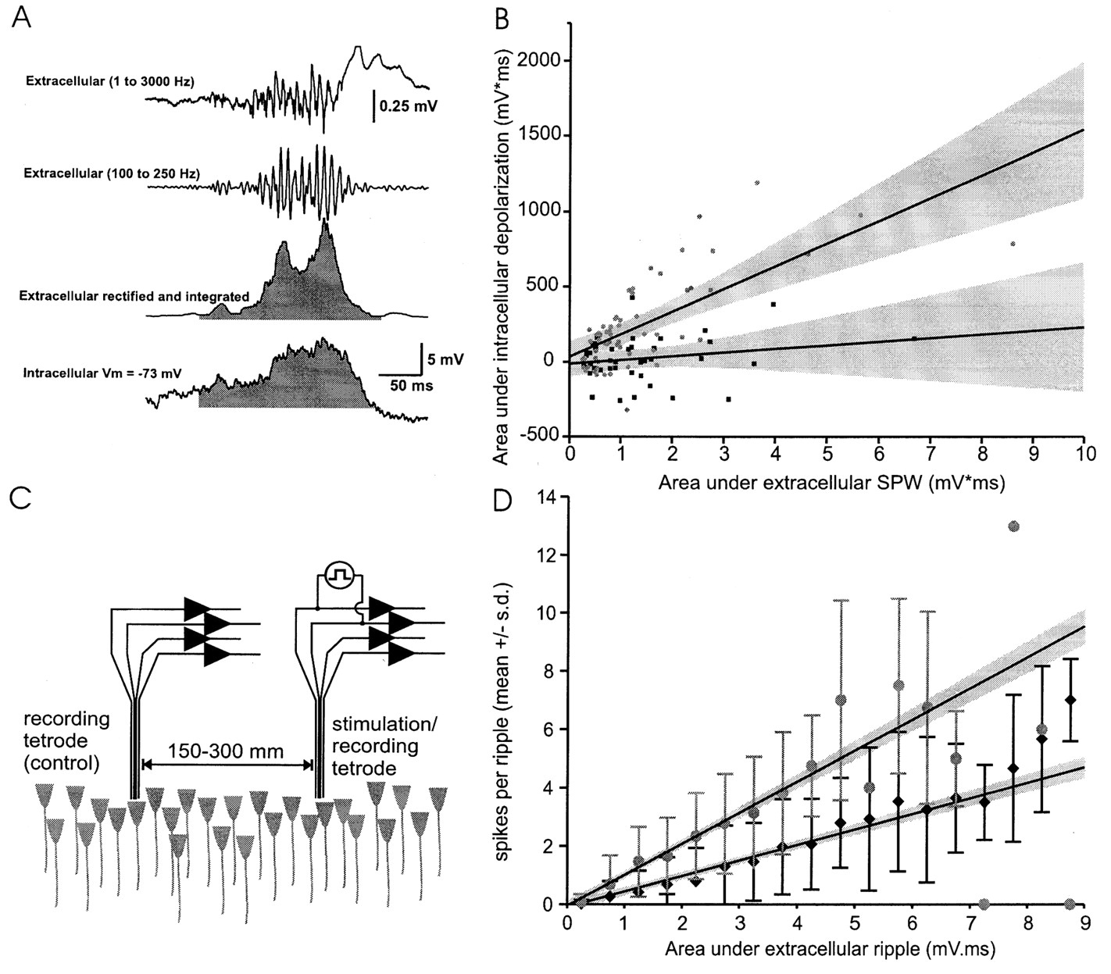
Figure 3. Hebbian pairing can increase participation of single pyramidal neurons in sharp wave-ripple events. (A) ...
Notes:
Figure 3. Hebbian pairing can increase participation of single pyramidal neurons in sharp wave-ripple events. (A) Detection and quantification of CA1 ripples and ripple-related intracellular potentials. Upper traces: broad-band extracellular field and its filtered derivative. Third trace: rectified and smoothed ripple. Bottom trace: intracellular membrane potential changes associated with the ripple. The shaded areas in the extracellular and intracellular signals were used to calculate the relationship between the magnitude of the intracellular and extracellular ripple-related events. (B) Relationship between extracellular and intracellular ripple signals in an example cell before (filled square) and 20 min following the training protocol (circle). The solid lines are the best-fit linear regression lines for each group. During training, the extracellular signal was fed back to the impaled neuron so that the cell consistently discharged bursts of action potentials during every ripple event (50 pairings). (C,D) A similar experiment in the freely moving rat. (C) First the relationships between ripple, recorded with the control electrode, and integrated multiple unit activity, recorded by both tetrodes, were established. During training, units recorded with the training tetrode (stimulation/recording) were consistently discharged by ripple-timed stimuli (50 ms wide pulses). (D) Relationship between extracellular and ripple events and associated multiple units spikes before (filled diamond) and after training (gray circle). The slope between these events did not change under the unstimulated electrode [not shown; after King et al. (King et al., 1999)].
Unless provided in the caption above, the following copyright applies to the content of this slide: © Oxford University Press

Slide 4
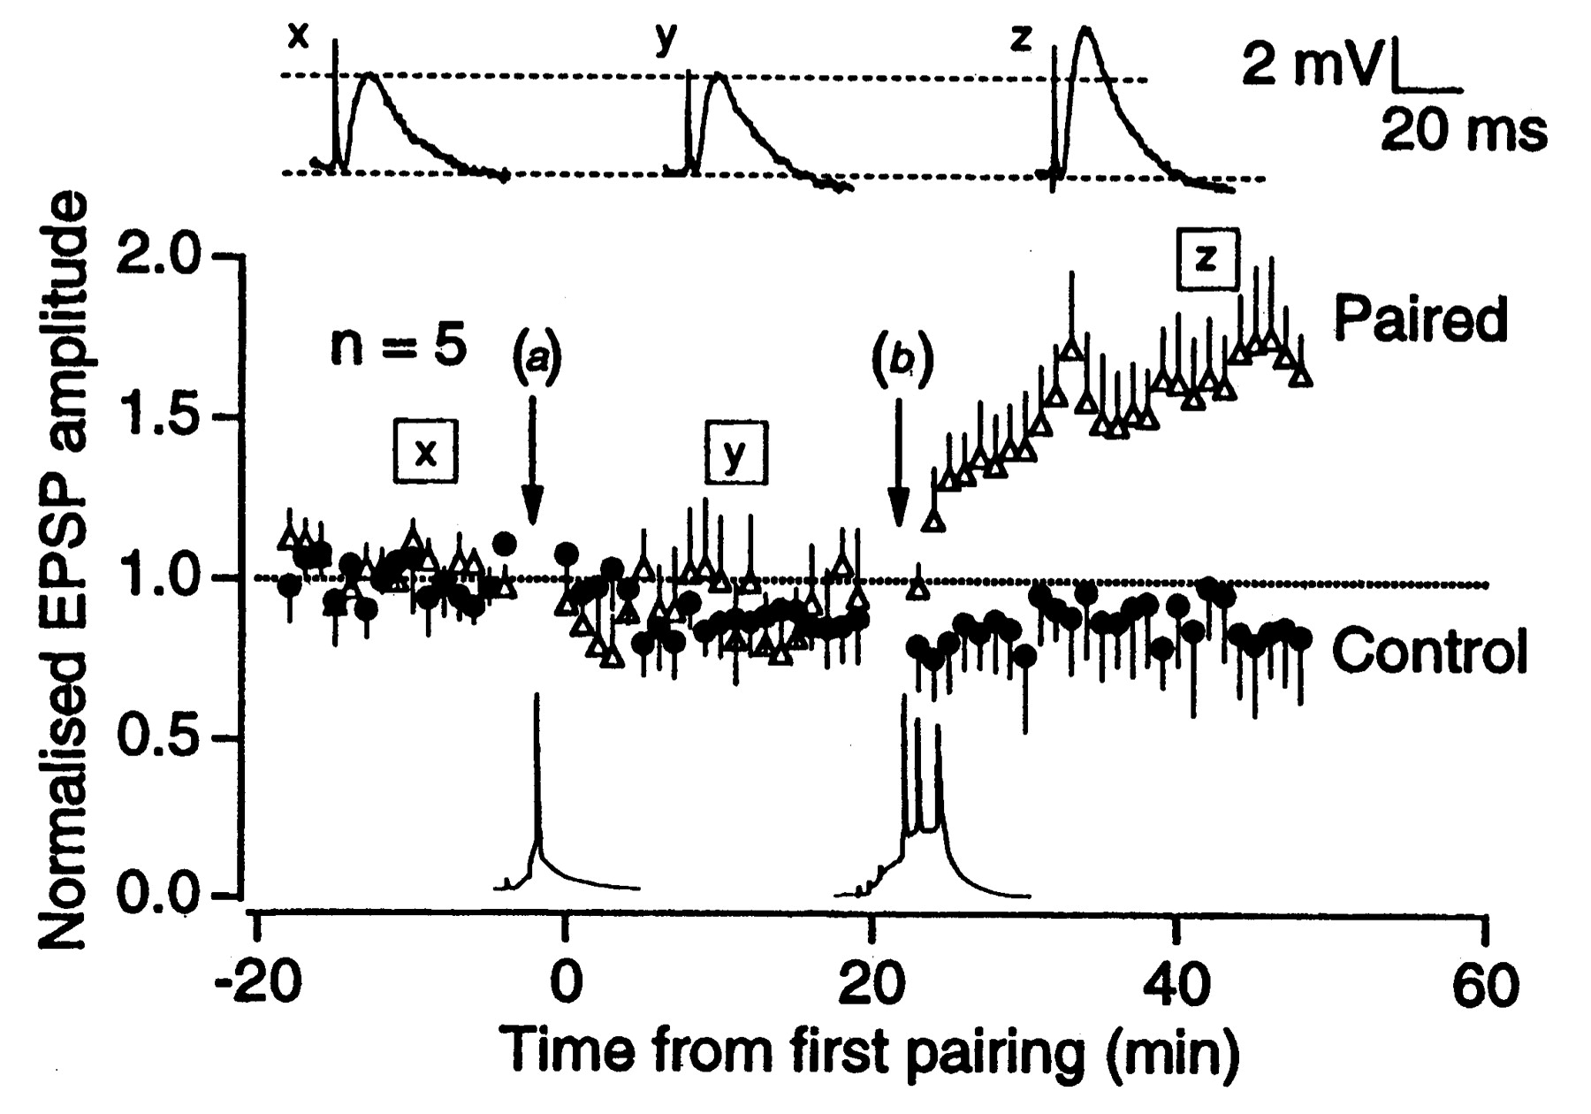
Figure 4. Bursts of spikes induce long-term potentiation (LTP). Normalized EPSP amplitude monitored over time. No ...
Notes:
Figure 4. Bursts of spikes induce long-term potentiation (LTP). Normalized EPSP amplitude monitored over time. No increase in synaptic efficacy was seen following pairing of single pulse stimulation of the Schaffer collaterals with single postsynaptic action potentials (a), whereas robust potentiation was induced by pairing afferent stimulation with postsynaptic bursts (b). Inset above: test EPSPs from a typical experiment at the indicated time points (x, y, z) [modified after Pike et al. (Pike et al., 1999)].
Unless provided in the caption above, the following copyright applies to the content of this slide: © Oxford University Press

Slide 5
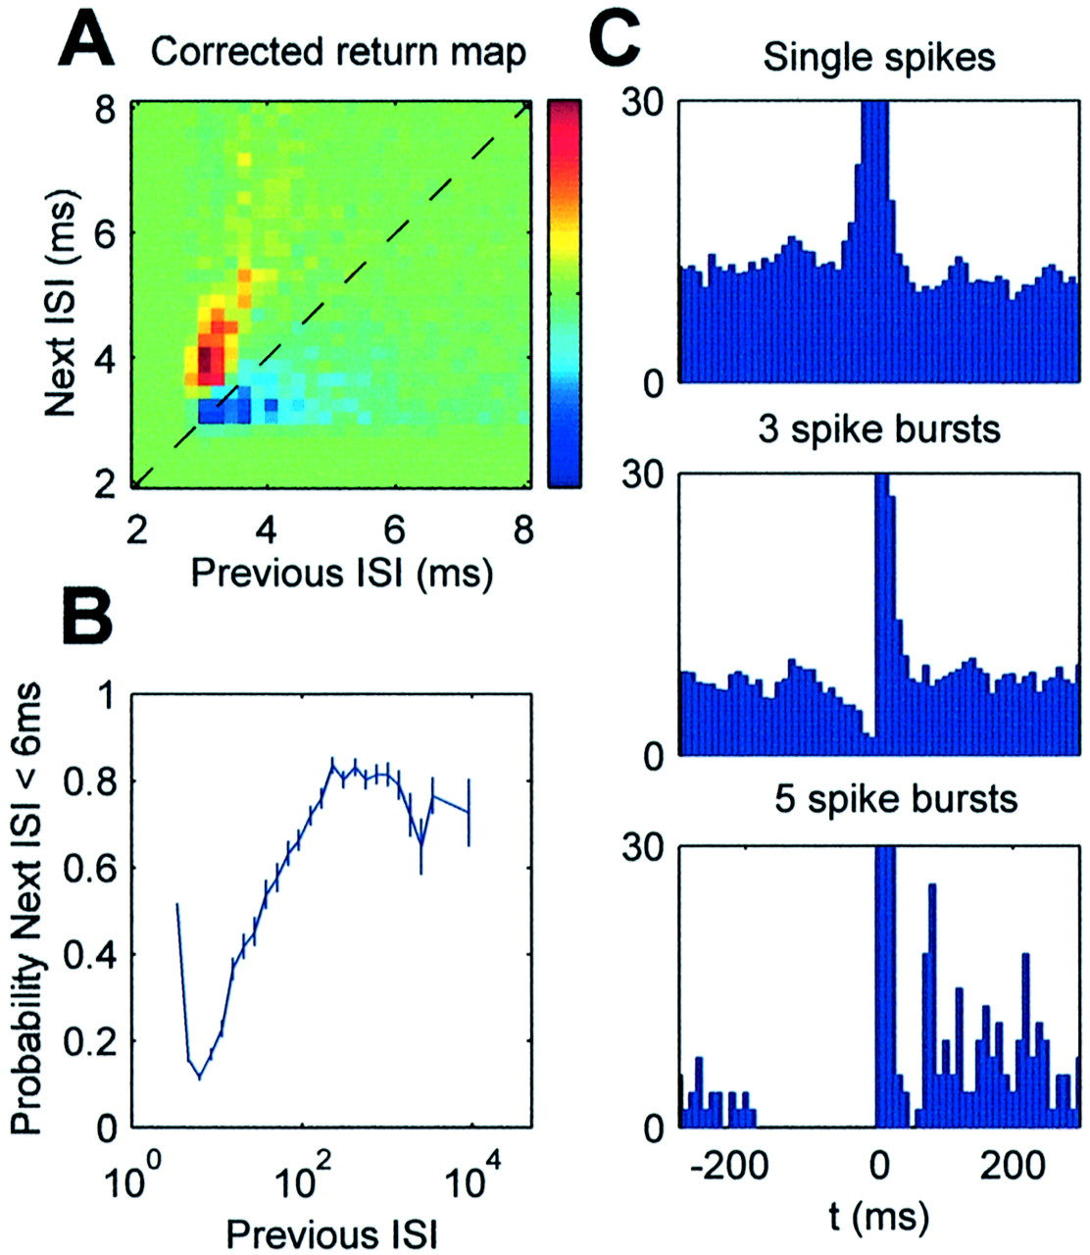
Figure 5. Single spikes ‘veto’ the occurrence of bursts. (A) Intra-burst dynamics. The pseudo-color image shows the ...
Notes:
Figure 5. Single spikes ‘veto’ the occurrence of bursts. (A) Intra-burst dynamics. The pseudo-color image shows the probability of seeing a given pair of successive interspike intervals (ISI, the return map), minus the return map (previous interspike interval versus next interspike interval) for a spike train where ISIs have been shuffled (color scale: –5×10–3 to 5×10–3 arbitrary units). The red region above the diagonal indicates the decelerating tendency of intra-burst ISIs, up to a limit of ∼6 ms. (B) Probability that an ISI is less than 6ms, as a function of the preceding ISI. (C) Averaged spike frequency, aligned on the first spike of bursts of various lengths. Silent periods occur before bursts, with longer silences before longer bursts [modified after Harris et al. (Harris et al., 2001)].
Unless provided in the caption above, the following copyright applies to the content of this slide: © Oxford University Press

Slide 6
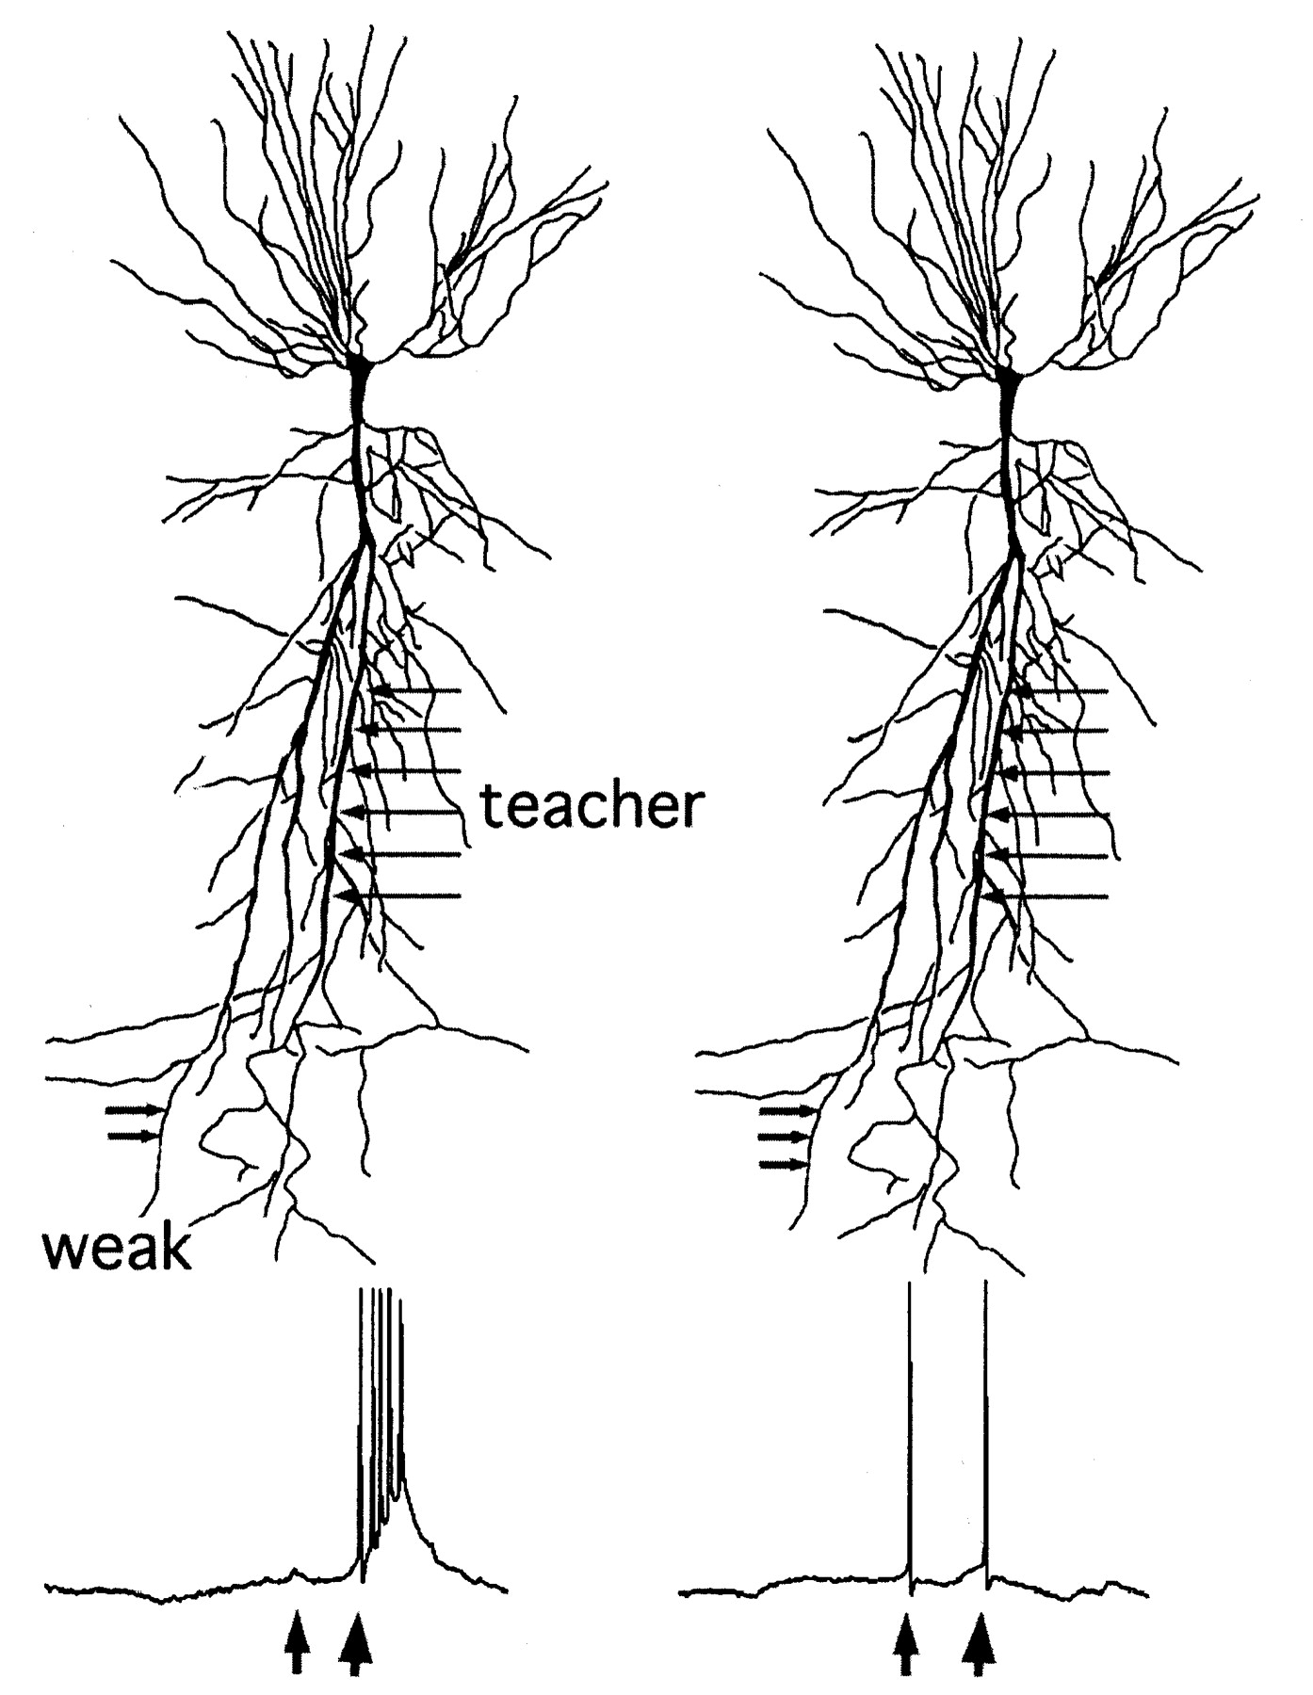
Figure 6. Bursts are hypothesized to maintain synaptic plasticity in single pyramidal neurons. A weak input (weak) is ...
Notes:
Figure 6. Bursts are hypothesized to maintain synaptic plasticity in single pyramidal neurons. A weak input (weak) is followed by a strong input (teacher). If the weak input is subthreshold (left), the strong input can trigger a burst, and can lead to strengthening of the weak input. Once the weak input becomes suprathreshold (right) as a result of weak input–strong input pairings, the evoked single spike can inhibit burst response to the same strong input. In effect, the firing in response to the potentiated weak input reduces the ability of the strong input to evoke a burst and, as a consequence, reduces further potentiation. Once the weak input becomes subthreshold, due to spontaneous decay or depotentiation of the synapse, it will allow the strong input to induce a burst; thus, potentiation will resume again (left panels). The temporal relationship between the weak and strong input and the veto effect of single spikes on bursts are suggested to maintain synaptic strength [modified after Harris et al. (Harris et al., 2001)].
Unless provided in the caption above, the following copyright applies to the content of this slide: © Oxford University Press

