Slide 1
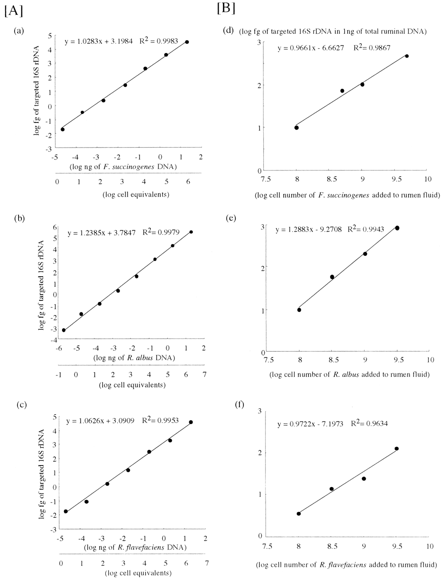
1 Quantitive ability and sensitivity of cPCR assays at pure- (A) and mixed- (B) culture levels for F. ...
Notes:
1 Quantitive ability and sensitivity of cPCR assays at pure- (A) and mixed- (B) culture levels for F. succinogenes (a and d), R. albus (b and e) and R. flavefaciens (c and f). A: Relationship between DNA from pure culture and assay values of the targeted 16S rDNA; B: relationship between cells added to rumen fluid and assay values of the targeted 16S rDNA.
Unless provided in the caption above, the following copyright applies to the content of this slide: © 2001 Federation of European Microbiological Societies

Slide 2
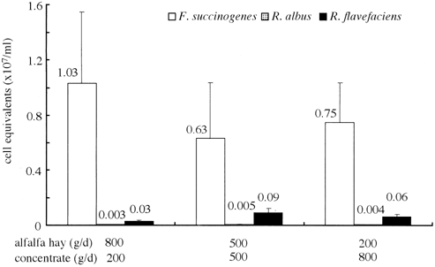
2 cPCR-aided enumeration of the three representative cellulolytic bacterial species, F. succinogenes, R. albus ...
Notes:
2 cPCR-aided enumeration of the three representative cellulolytic bacterial species, F. succinogenes, R. albus and R. flavefaciens, in the rumen of a sheep fed three diets with different proportions of alfalfa hay.
Unless provided in the caption above, the following copyright applies to the content of this slide: © 2001 Federation of European Microbiological Societies

Slide 3
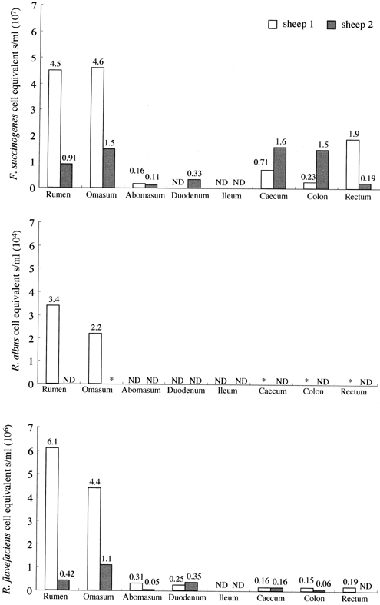
3 cPCR-aided enumeration of the three representative cellulolytic bacterial species, F. succinogenes, R. albus ...
Notes:
3 cPCR-aided enumeration of the three representative cellulolytic bacterial species, F. succinogenes, R. albus and R. flavefaciens, in various alimentary tract sites of sheep on hay (Sudan grass) and concentrate diet. ND: not detected. *: detectable but not quantifiable.
Unless provided in the caption above, the following copyright applies to the content of this slide: © 2001 Federation of European Microbiological Societies

