Slide 1
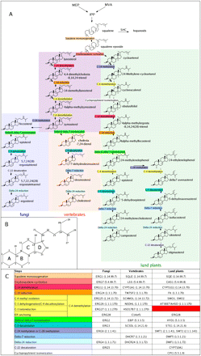
FIG. 1.— (A) Canonical pathways of sterol synthesis leading to land plants, fungi, and vertebrate sterols. Upstream of ...
Notes:
FIG. 1.— (A) Canonical pathways of sterol synthesis leading to land plants, fungi, and vertebrate sterols. Upstream of squalene, the mevalonate (MVA) and 2-C-methyl-D-erythrol 4-phosphate (MEP) ways leading to IPP are shown. Downstream of squalene, the bacterial pathway of hopanoid synthesis via SHC is also indicated. (B) Numbering of carbons and cycles of steroids. (C) Table indicating the names and EC numbers of fungi, vertebrates, and land plants genes corresponding to each step of the pathway shown in (A). The red box indicates that the gene performing C-3 ketoreduction is still unknown in land plants.
Unless provided in the caption above, the following copyright applies to the content of this slide: © The Author(s) 2009. Published by Oxford University Press on behalf of the Society for Molecular Biology and Evolution.This is an Open Access article distributed under the terms of the Creative Commons Attribution Non-Commercial License (http://creativecommons.org/licenses/by-nc/2.5), which permits unrestricted non-commercial use, distribution, and reproduction in any medium, provided the original work is properly cited.

Slide 2
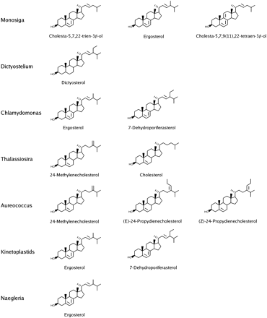
FIG. 2.— Sterols characterized from organisms other than fungi, vertebrates, and land plants present in our data set. ...
Notes:
FIG. 2.— Sterols characterized from organisms other than fungi, vertebrates, and land plants present in our data set. For sterol modifications discussed in the text, refer to figure 1B for numbering.
Unless provided in the caption above, the following copyright applies to the content of this slide: © The Author(s) 2009. Published by Oxford University Press on behalf of the Society for Molecular Biology and Evolution.This is an Open Access article distributed under the terms of the Creative Commons Attribution Non-Commercial License (http://creativecommons.org/licenses/by-nc/2.5), which permits unrestricted non-commercial use, distribution, and reproduction in any medium, provided the original work is properly cited.

Slide 3
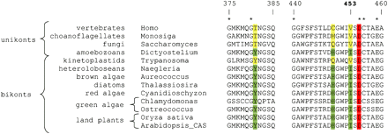
FIG. 3.— Alignment of ERG7 homologs from representative taxa. The catalytic residue D455 is highlighted in red. ...
Notes:
FIG. 3.— Alignment of ERG7 homologs from representative taxa. The catalytic residue D455 is highlighted in red. Positions 381, 449, and 453 are differentially conserved between lanosterol synthases (yellow) and cycloartenol synthases (green). The numbering refers to the H. sapiens ERG7 homolog (NP_002331).
Unless provided in the caption above, the following copyright applies to the content of this slide: © The Author(s) 2009. Published by Oxford University Press on behalf of the Society for Molecular Biology and Evolution.This is an Open Access article distributed under the terms of the Creative Commons Attribution Non-Commercial License (http://creativecommons.org/licenses/by-nc/2.5), which permits unrestricted non-commercial use, distribution, and reproduction in any medium, provided the original work is properly cited.

Slide 4
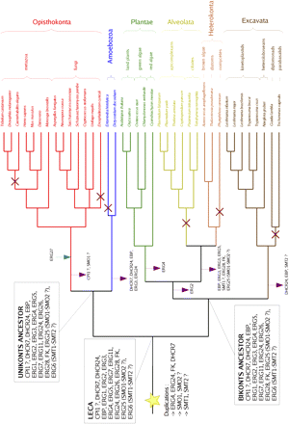
FIG. 4.— Inference of ancestral sets of sterol enzymes. These are inferred based on a consensus phylogeny of ...
Notes:
FIG. 4.— Inference of ancestral sets of sterol enzymes. These are inferred based on a consensus phylogeny of eukaryotes included in our data set according to the most recent data (Burki et al. 2008; Hampl et al. 2009) rooted in between unikonts and bikonts. Lineages where the ability to synthesize sterols has been lost are indicated by red crosses. We inferred maximal and minimal ancestral enzyme contents at the three most ancient nodes (LECA, Unikonts, and Bikonts). Additional proteins in the maximal content with respect to the minimal content are indicated by question marks (see text for details). Putative duplications inferred in the lineage leading to the LECA are indicated by a star. Losses and gains of proteins are indicated only for the most basal branches by purple and blue arrows, respectively.
Unless provided in the caption above, the following copyright applies to the content of this slide: © The Author(s) 2009. Published by Oxford University Press on behalf of the Society for Molecular Biology and Evolution.This is an Open Access article distributed under the terms of the Creative Commons Attribution Non-Commercial License (http://creativecommons.org/licenses/by-nc/2.5), which permits unrestricted non-commercial use, distribution, and reproduction in any medium, provided the original work is properly cited.

Slide 5
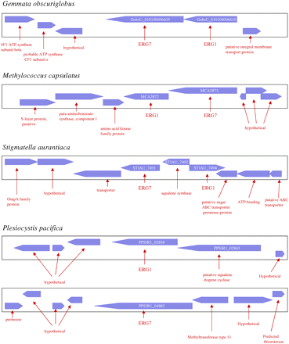
FIG. 5.— Genomic context of ERG1 and ERG7 genes in the genomes of the four sterol-synthesizing bacteria G. ...
Notes:
FIG. 5.— Genomic context of ERG1 and ERG7 genes in the genomes of the four sterol-synthesizing bacteria G. obscuriglobus, M. capsulatus, S. aurantiaca, and P. pacifica.
Unless provided in the caption above, the following copyright applies to the content of this slide: © The Author(s) 2009. Published by Oxford University Press on behalf of the Society for Molecular Biology and Evolution.This is an Open Access article distributed under the terms of the Creative Commons Attribution Non-Commercial License (http://creativecommons.org/licenses/by-nc/2.5), which permits unrestricted non-commercial use, distribution, and reproduction in any medium, provided the original work is properly cited.

Slide 6
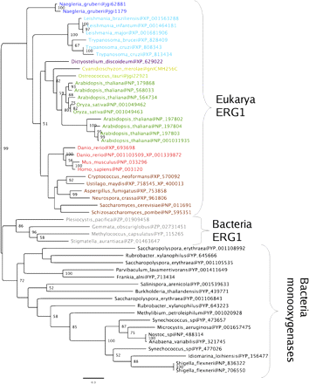
FIG. 6.— Maximum likelihood tree of ERG1 homologs. Only a subset of the most closely related bacterial monooxygenases ...
Notes:
FIG. 6.— Maximum likelihood tree of ERG1 homologs. Only a subset of the most closely related bacterial monooxygenases are included. Following removal of ambiguously aligned regions, the final data set included 130 conserved positions. The tree was obtained by PHYML (Guindon and Gascuel 2003) as detailed in Materials and Methods. For clarity, only bootstrap values >50% are shown.
Unless provided in the caption above, the following copyright applies to the content of this slide: © The Author(s) 2009. Published by Oxford University Press on behalf of the Society for Molecular Biology and Evolution.This is an Open Access article distributed under the terms of the Creative Commons Attribution Non-Commercial License (http://creativecommons.org/licenses/by-nc/2.5), which permits unrestricted non-commercial use, distribution, and reproduction in any medium, provided the original work is properly cited.

Slide 7
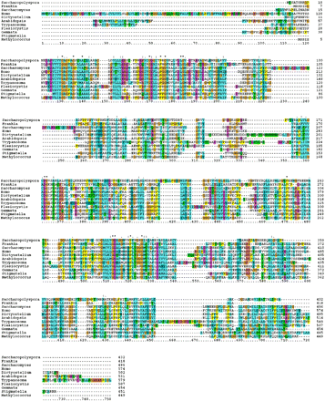
FIG. 7.— Alignment of ERG1 homologs including sequences of the four sterol-synthesizing bacteria (G. obscuriglobus, M. ...
Notes:
FIG. 7.— Alignment of ERG1 homologs including sequences of the four sterol-synthesizing bacteria (G. obscuriglobus, M. capsulatus, S. aurantiaca, and P. pacifica), of two other bacteria (Saccharopolyspora erythraea and Frankia alni), and of five representatives of eukaryotes (T. brucei, S. cerevisiae, H. sapiens, D. discoideum, and A. thaliana).
Unless provided in the caption above, the following copyright applies to the content of this slide: © The Author(s) 2009. Published by Oxford University Press on behalf of the Society for Molecular Biology and Evolution.This is an Open Access article distributed under the terms of the Creative Commons Attribution Non-Commercial License (http://creativecommons.org/licenses/by-nc/2.5), which permits unrestricted non-commercial use, distribution, and reproduction in any medium, provided the original work is properly cited.

Slide 8
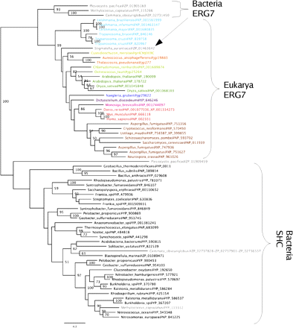
FIG. 8.— Maximum likelihood tree of ERG7 homologs. Following removal of ambiguously aligned regions, the final data ...
Notes:
FIG. 8.— Maximum likelihood tree of ERG7 homologs. Following removal of ambiguously aligned regions, the final data set included 386 conserved positions. The tree was obtained by PHYML with the same criteria as detailed in Materials and Methods.
Unless provided in the caption above, the following copyright applies to the content of this slide: © The Author(s) 2009. Published by Oxford University Press on behalf of the Society for Molecular Biology and Evolution.This is an Open Access article distributed under the terms of the Creative Commons Attribution Non-Commercial License (http://creativecommons.org/licenses/by-nc/2.5), which permits unrestricted non-commercial use, distribution, and reproduction in any medium, provided the original work is properly cited.

Slide 9
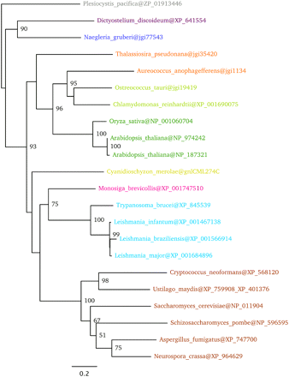
FIG. 9.— Maximum likelihood tree of putative ERG27 analogues. Following removal of ambiguously aligned regions, the ...
Notes:
FIG. 9.— Maximum likelihood tree of putative ERG27 analogues. Following removal of ambiguously aligned regions, the final data set included 483 conserved positions. The tree was obtained by PHYML with the same criteria as in Materials and Methods.
Unless provided in the caption above, the following copyright applies to the content of this slide: © The Author(s) 2009. Published by Oxford University Press on behalf of the Society for Molecular Biology and Evolution.This is an Open Access article distributed under the terms of the Creative Commons Attribution Non-Commercial License (http://creativecommons.org/licenses/by-nc/2.5), which permits unrestricted non-commercial use, distribution, and reproduction in any medium, provided the original work is properly cited.

