Slide 1
Figure 1. The in vivo/in vitro preparation. (A) Schematic of a lateral view of the rat cortex), showing the somatotopic ...
Notes:
Figure 1. The in vivo/in vitro preparation. (A) Schematic of a lateral view of the rat cortex), showing the somatotopic map. The border between the forepaw and lower jaw areas is indicated by the filled circle; the dotted lines delineate the orientation and location of a 400-μm-thick slice used for the in vitro analysis. C: caudal, R: rostral, N: medial, L: lateral. (B) Schematic coronal section from rat S1 showing the recording and stimulating configuration in a normal slice. The black circle represents the dye mark defining the location of the forepaw/lower jaw border (dotted line) determined in vivo, the schematic neuron is the neuron recorded from, and the 2 squares the sites of electrical stimulation across the border (“CB stim,” gray) and not across the border (“NCB stim,” black) from the neuron. L4 indicates the position of layer 4 and the arrow points to the cut used to isolate the supragranular layers. (C) Schematic coronal section showing the recording and stimulating configuration in a control slice. Abbreviations are as in (B).
Unless provided in the caption above, the following copyright applies to the content of this slide: © The Author 2009. Published by Oxford University Press. All rights reserved. For permissions, please e-mail: journals.permissions@oxfordjournals.org

Slide 2
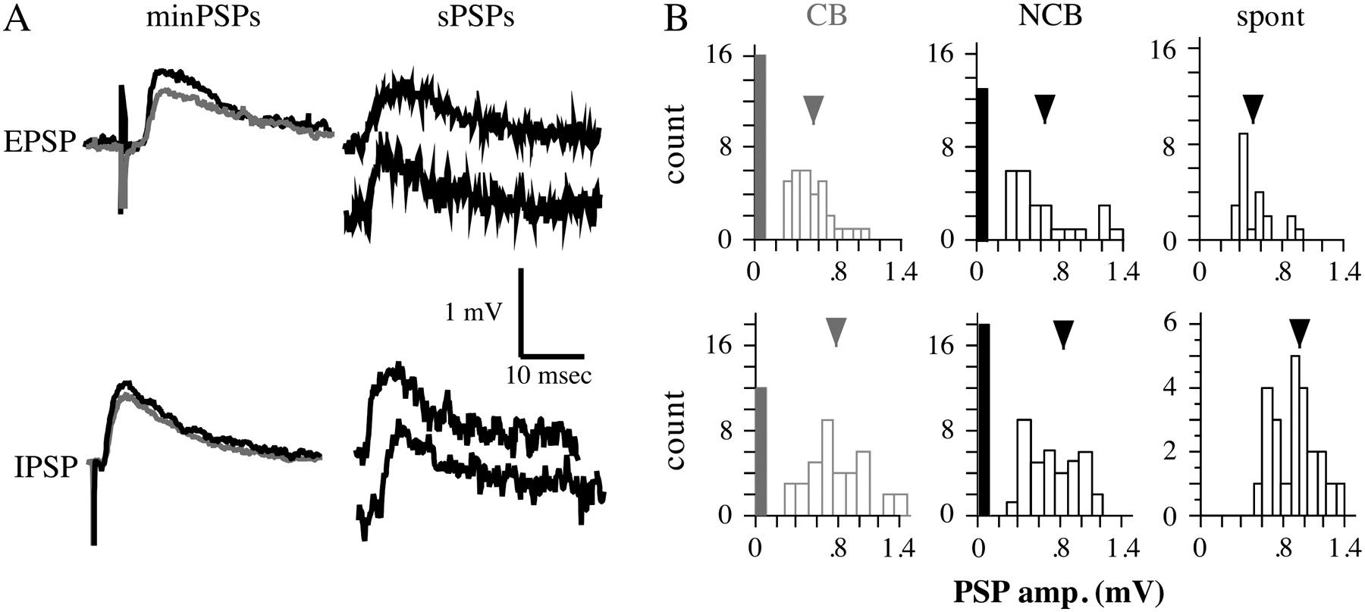
Figure 2. Examples of minimal PSPs. (A) Left: mean minimal PSPs evoked by CB (gray) and NCB (black) stimulation. ...
Notes:
Figure 2. Examples of minimal PSPs. (A) Left: mean minimal PSPs evoked by CB (gray) and NCB (black) stimulation. Stimulation intensities for minimal EPSPs were 0.016 mA for CB and 0.023 mA for NCB, and for minimal IPSPs were 0.02 mA for CB and 0.025 mA for NCB; stimuli were 300 μm horizontal from the cell. Right: Examples of spontaneous PSPs from the same neurons. (B) Amplitude distributions for minimal PSPs from CB (left) and NCB (center) stimulation, and for spontaneous PSPs (right). Open bars are the numbers of minimal PSPs in the indicated amplitude bins. The filled bars represent the number of events classed as failures, and the arrowheads indicate the mean amplitude.
Unless provided in the caption above, the following copyright applies to the content of this slide: © The Author 2009. Published by Oxford University Press. All rights reserved. For permissions, please e-mail: journals.permissions@oxfordjournals.org

Slide 3
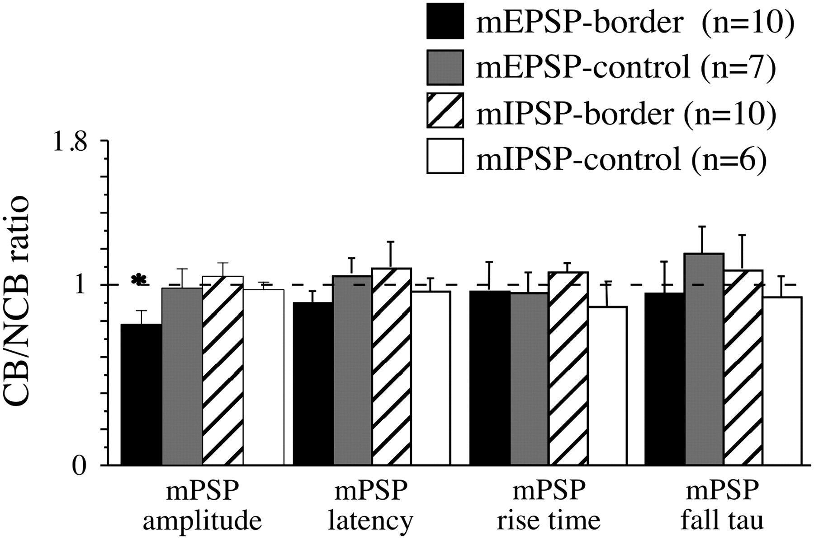
Figure 3. CB/NCB ratio for the amplitudes, latencies, rise times, and fall taus of minimal PSPs. n = the number of ...
Notes:
Figure 3. CB/NCB ratio for the amplitudes, latencies, rise times, and fall taus of minimal PSPs. n = the number of cells for each group. The bars represent the mean CB/NCB ratio. Error bars are the SEM. The dotted line indicates a value of 1, which indicates no difference between the values obtained with CB and NCB stimulation. *Significantly different from other amplitude ratios, P < 0.01, 1-way ANOVA followed by post hoc Fisher's protected least-significant difference (PLSD) tests.
Unless provided in the caption above, the following copyright applies to the content of this slide: © The Author 2009. Published by Oxford University Press. All rights reserved. For permissions, please e-mail: journals.permissions@oxfordjournals.org

Slide 4
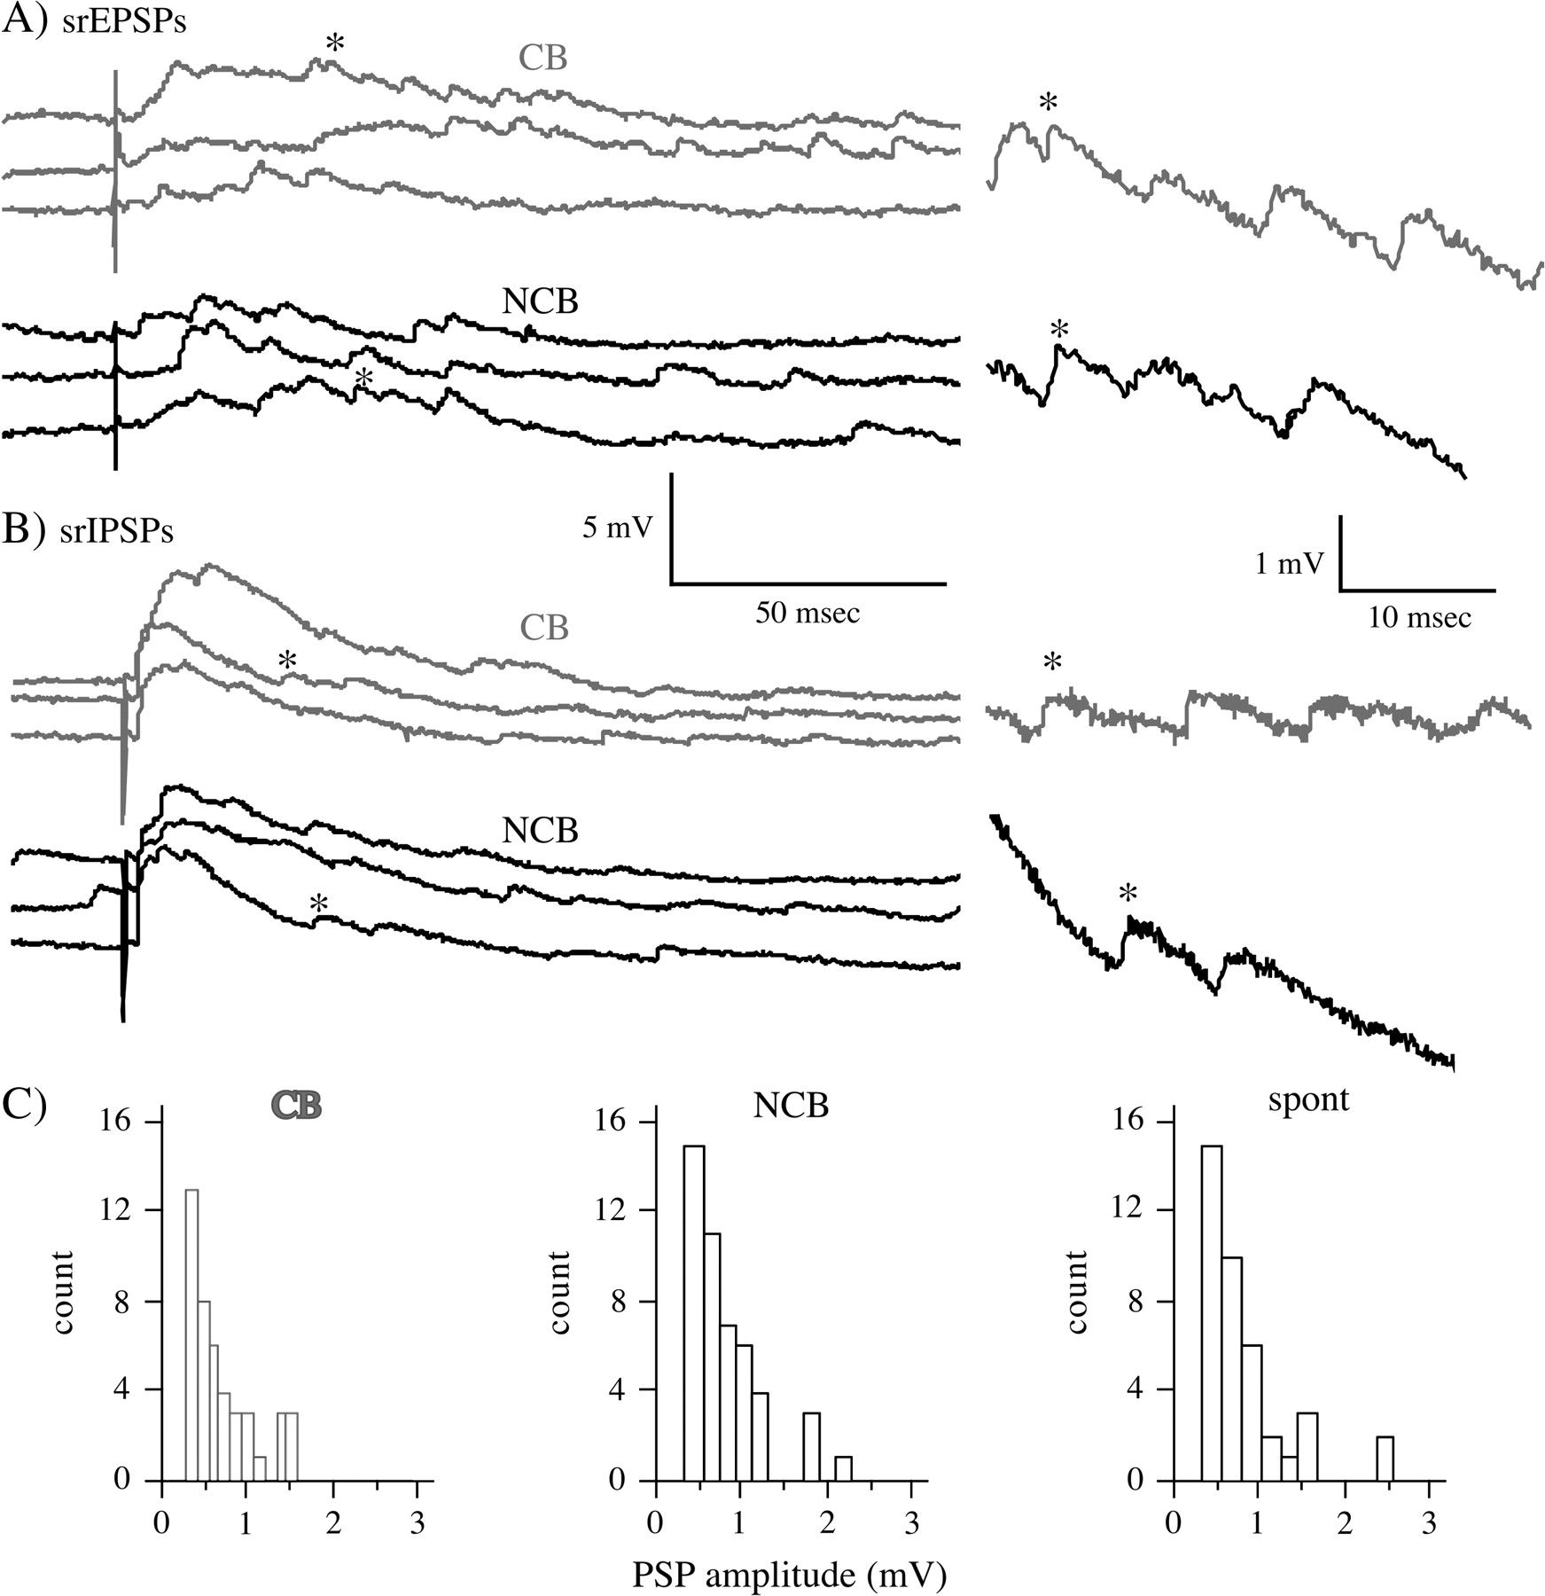
Figure 4. Examples of asynchronous PSPs evoked in 0.5 mM Ca²⁺/5 mM Sr²⁺ buffer. (A) Asynchronous ...
Notes:
Figure 4. Examples of asynchronous PSPs evoked in 0.5 mM Ca2+/5 mM Sr2+ buffer. (A) Asynchronous EPSPs recorded in the presence of 20 μM picrotoxin for CB (gray) and NCB (black) stimulation. Stimuli were 0.066 mA for CB and 0.048 mA for NCB; stimuli were 300 μm from the cell. On the right are expanded traces with the asterisk marking the corresponding events. (B) Asynchronous IPSPs evoked in the presence of 10 μM CNQX plus 100 μM APV. Stimuli were 0.051 mA for CB and 0.04 for NCB. Conventions are as in (A). (C) Amplitude distributions for asynchronous EPSPs and spontaneous EPSPs from the same cell as pictured in “A”. Left (gray): asynchronous EPSPs from CB stimulation, middle (black); asynchronous EPSPs from NCB stimulation, right: spontaneous EPSPs.
Unless provided in the caption above, the following copyright applies to the content of this slide: © The Author 2009. Published by Oxford University Press. All rights reserved. For permissions, please e-mail: journals.permissions@oxfordjournals.org

Slide 5
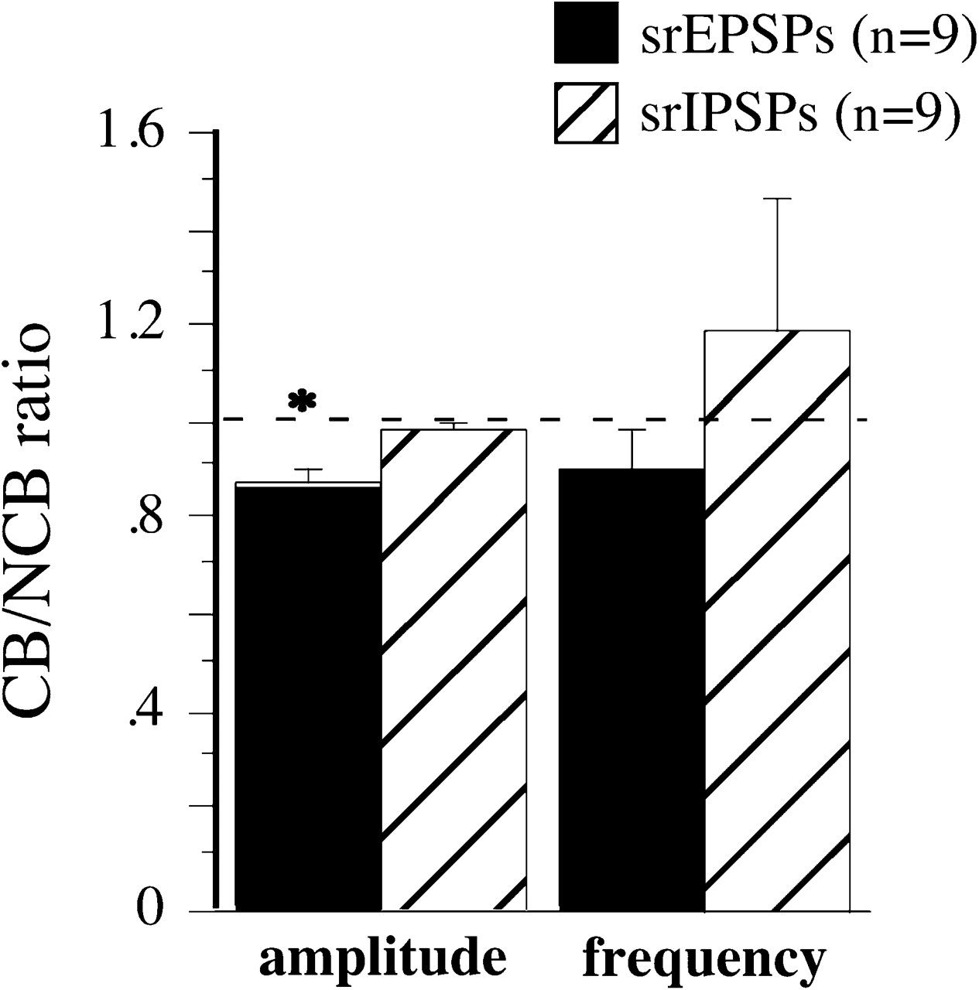
Figure 5. Mean CB/NCB ratio of asynchronous EPSP (black) and asynchronous IPSP (hatched) amplitude and frequency. n = ...
Notes:
Figure 5. Mean CB/NCB ratio of asynchronous EPSP (black) and asynchronous IPSP (hatched) amplitude and frequency. n = the number of cells for each group and the error bars are the SEM. The dotted line indicates a value of 1, which indicates no difference between the values obtained with CB and NCB stimulation. *Significantly different from 1 (P < 0.01, 1-sample t-test).
Unless provided in the caption above, the following copyright applies to the content of this slide: © The Author 2009. Published by Oxford University Press. All rights reserved. For permissions, please e-mail: journals.permissions@oxfordjournals.org

Slide 6
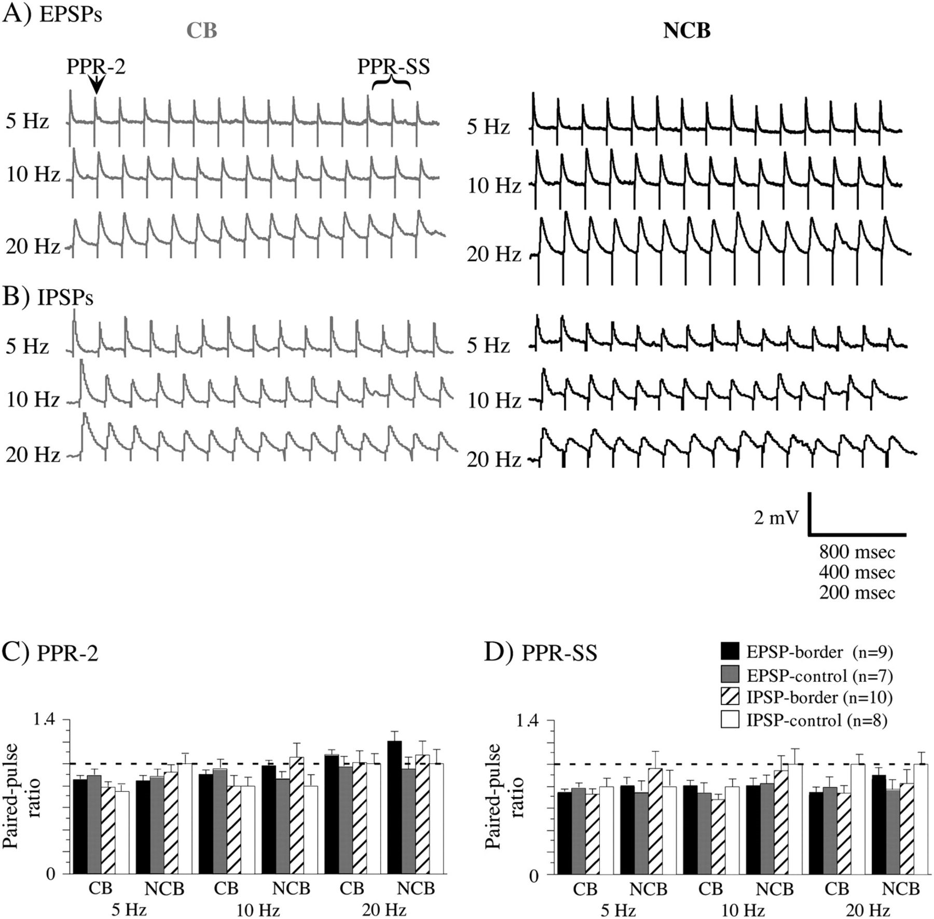
Figure 6. Examples of trains of EPSPs (A) and IPSPs (B) evoked by CB (gray) and NCB (black) stimulation at various ...
Notes:
Figure 6. Examples of trains of EPSPs (A) and IPSPs (B) evoked by CB (gray) and NCB (black) stimulation at various frequencies. The time scale is equal to 800, 400, 200, ms for 5, 10, 20 Hz, respectively. Two ratios were used to quantify these trains: PPR-2, in which the amplitude of the second PSP was divided by the first; and PPR-SS, in which the mean amplitude of the last 3 PSPs was divided by the amplitude of the first. The mean values of PPR-2 (C) and PPR-SS are plotted in (C) and (D). The error bars are the SEM. n = the number of cells in each group. The dotted line indicates a value of 1, which indicates no difference in amplitude between first and second PSPs (PPR-2) or first and last PSPs (PPR-SS). Note that no values differ significantly between corresponding CB and NCB stimulation (1-way ANOVA).
Unless provided in the caption above, the following copyright applies to the content of this slide: © The Author 2009. Published by Oxford University Press. All rights reserved. For permissions, please e-mail: journals.permissions@oxfordjournals.org

