Slide 1
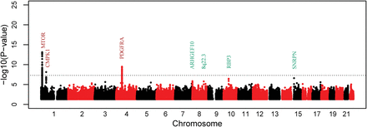
Table 2. Association of the index SNPs with corneal curvature CHR, chromosome; BP, position based on GRCh human genome ...
Notes:
Table 2. Association of the index SNPs with corneal curvature CHR, chromosome; BP, position based on GRCh human genome build 37; N, the number of individuals with valid information at each locus; EAF, effect allele frequency; StdErr, the standard error of the effect. The effect sizes were based on the normalized CC values. aAlleles were given by the effect allele/other allele. bStage refers to the meta-analysis of Stages 1, 2 and/or 3. cThe cytoband location is presented since there is no gene in the 1 Mb region around the index SNP. Figure 1.Manhattan plots of the genome-wide association meta-analysis in Stage 1 (n = 7440). The −log 10 of the genomic controlled P-vales are plotted against the genomic positions. The genome-wide significant loci in this stage are labeled in brown. In addition to the index SNPs at the brown loci, the index SNPs in suggestively significant loci (P < 5 × 10−6, labeled in aquamarine) were carried forward to the Stage 2. The dashed line represents P < 5 × 10−8; the dotted line represents P < 5 × 10−6.
Unless provided in the caption above, the following copyright applies to the content of this slide: © The Author 2014. Published by Oxford University Press. All rights reserved. For Permissions, please email: journals.permissions@oup.com

Slide 2
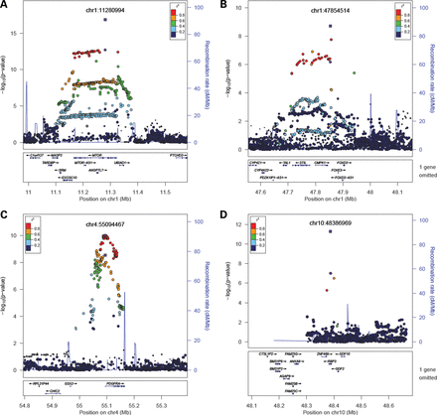
Figure 2. Regional association plots of the associated loci in the meta-analysis of Stages 1 and 2 (n = 9913). The −log ...
Notes:
Figure 2. Regional association plots of the associated loci in the meta-analysis of Stages 1 and 2 (n = 9913). The −log 10 of the genomic controlled P-values are plotted against the genomic positions. The variants within the 500 kb regions around (A) MTOR (rs74225573), (B) CMPK1 (rs17103186), (C) PDGFRA (rs1800813) and (D) RBP3 (rs11204213) gene are plotted. The round dots represent the Stage 1 signals, while the square dots represent the meta-analysis of Stage 1 and 2.
Unless provided in the caption above, the following copyright applies to the content of this slide: © The Author 2014. Published by Oxford University Press. All rights reserved. For Permissions, please email: journals.permissions@oup.com

