Slide 1
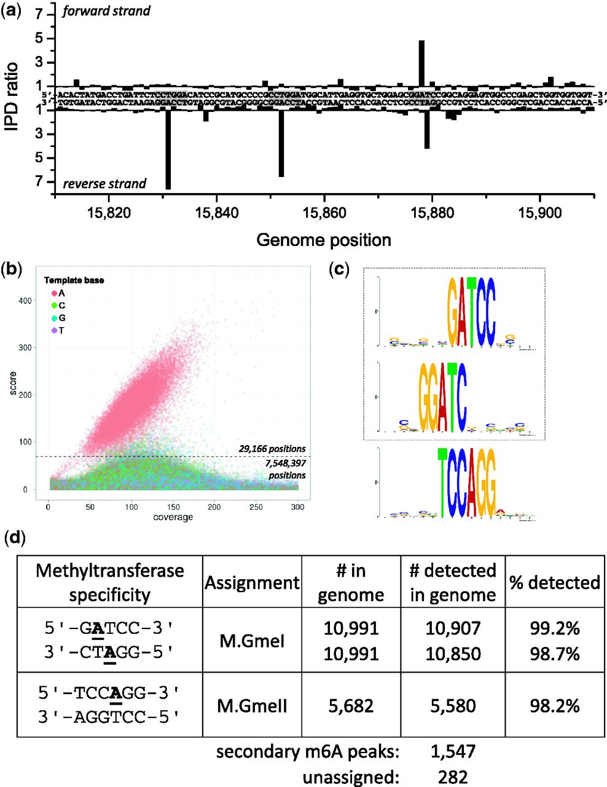
Figure 1. Methylome determination of G. metallireducens GS-15. (a) Example trace of kinetic variation, showing three ...
Notes:
Figure 1. Methylome determination of G. metallireducens GS-15. (a) Example trace of kinetic variation, showing three instances of methylated sequence regions. (b) Scatter plot of sequencing coverage and kinetic score for all genomic positions. The colors indicate the bases as shown in the upper left of the panel. The cutoff for detected genomic positions is indicated by the dashed line. (c) MTase specificities determined from the genomic positions detected as methylated. They are highlighted as gray boxes in the example trace (a). (d) Summary of detected methylated positions across the genome.
Unless provided in the caption above, the following copyright applies to the content of this slide: © The Author(s) 2012. Published by Oxford University Press.This is an Open Access article distributed under the terms of the Creative Commons Attribution License (http://creativecommons.org/licenses/by/3.0/), which permits unrestricted, distribution, and reproduction in any medium, provided the original work is properly cited.

Slide 2
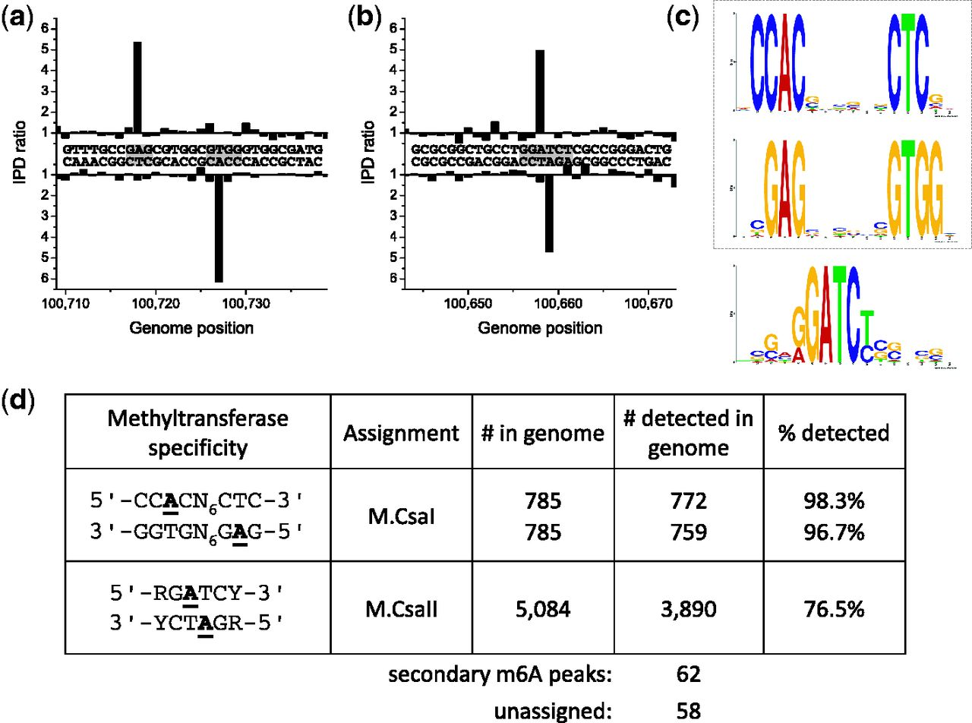
Figure 2. Methylome determination of C. salexigens. (a and b) Example traces of kinetic variation, showing two ...
Notes:
Figure 2. Methylome determination of C. salexigens. (a and b) Example traces of kinetic variation, showing two instances of methylated positions. (c) MTase specificities determined from the genomic positions detected as methylated. (d) Summary of detected methylated positions across the genome.
Unless provided in the caption above, the following copyright applies to the content of this slide: © The Author(s) 2012. Published by Oxford University Press.This is an Open Access article distributed under the terms of the Creative Commons Attribution License (http://creativecommons.org/licenses/by/3.0/), which permits unrestricted, distribution, and reproduction in any medium, provided the original work is properly cited.

Slide 3
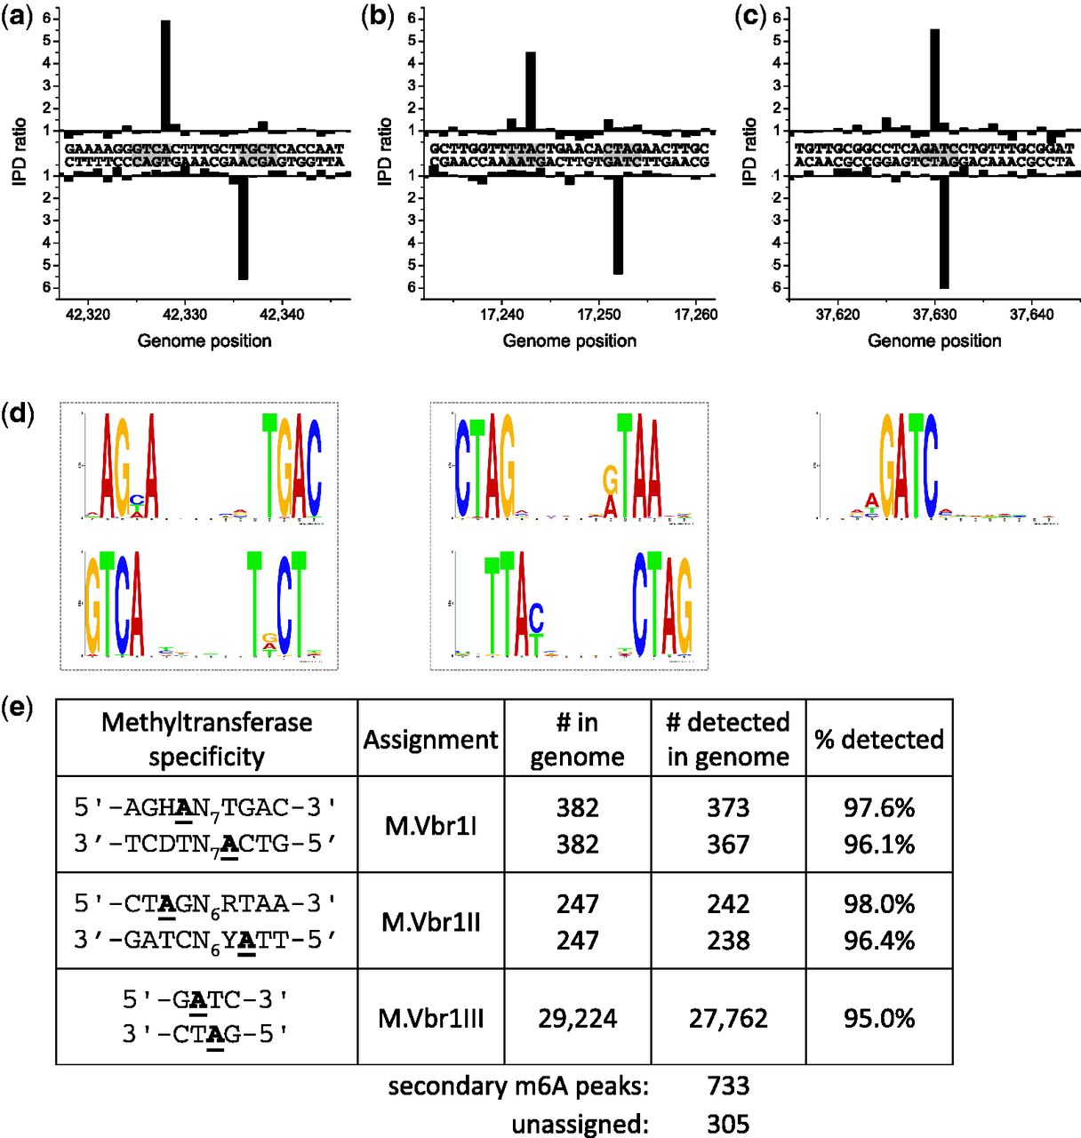
Figure 3. Methylome determination of V. breoganii 1C-10. (a–c) Example traces of kinetic variation, showing instances ...
Notes:
Figure 3. Methylome determination of V. breoganii 1C-10. (a–c) Example traces of kinetic variation, showing instances of the detected methylated motifs. (d) MTase specificities determined from the genomic positions detected as methylated. (e) Summary of detected methylated positions across the genome.
Unless provided in the caption above, the following copyright applies to the content of this slide: © The Author(s) 2012. Published by Oxford University Press.This is an Open Access article distributed under the terms of the Creative Commons Attribution License (http://creativecommons.org/licenses/by/3.0/), which permits unrestricted, distribution, and reproduction in any medium, provided the original work is properly cited.

Slide 4
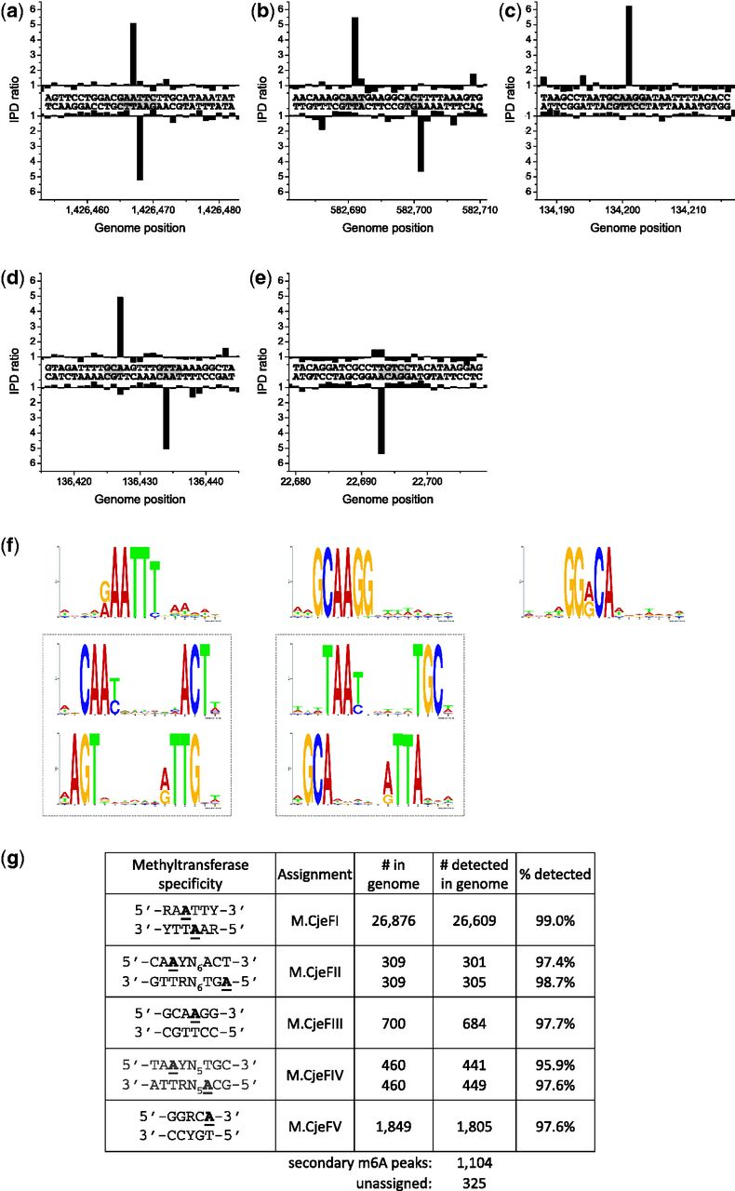
Figure 4. Methylome determination of C. jejuni 81-176. (a–e) Example traces of kinetic variation, showing instances of ...
Notes:
Figure 4. Methylome determination of C. jejuni 81-176. (a–e) Example traces of kinetic variation, showing instances of the detected methylated motifs. (f) MTase specificities determined from the genomic positions detected as methylated. (g) Summary of detected methylated positions across the genome.
Unless provided in the caption above, the following copyright applies to the content of this slide: © The Author(s) 2012. Published by Oxford University Press.This is an Open Access article distributed under the terms of the Creative Commons Attribution License (http://creativecommons.org/licenses/by/3.0/), which permits unrestricted, distribution, and reproduction in any medium, provided the original work is properly cited.

Slide 5
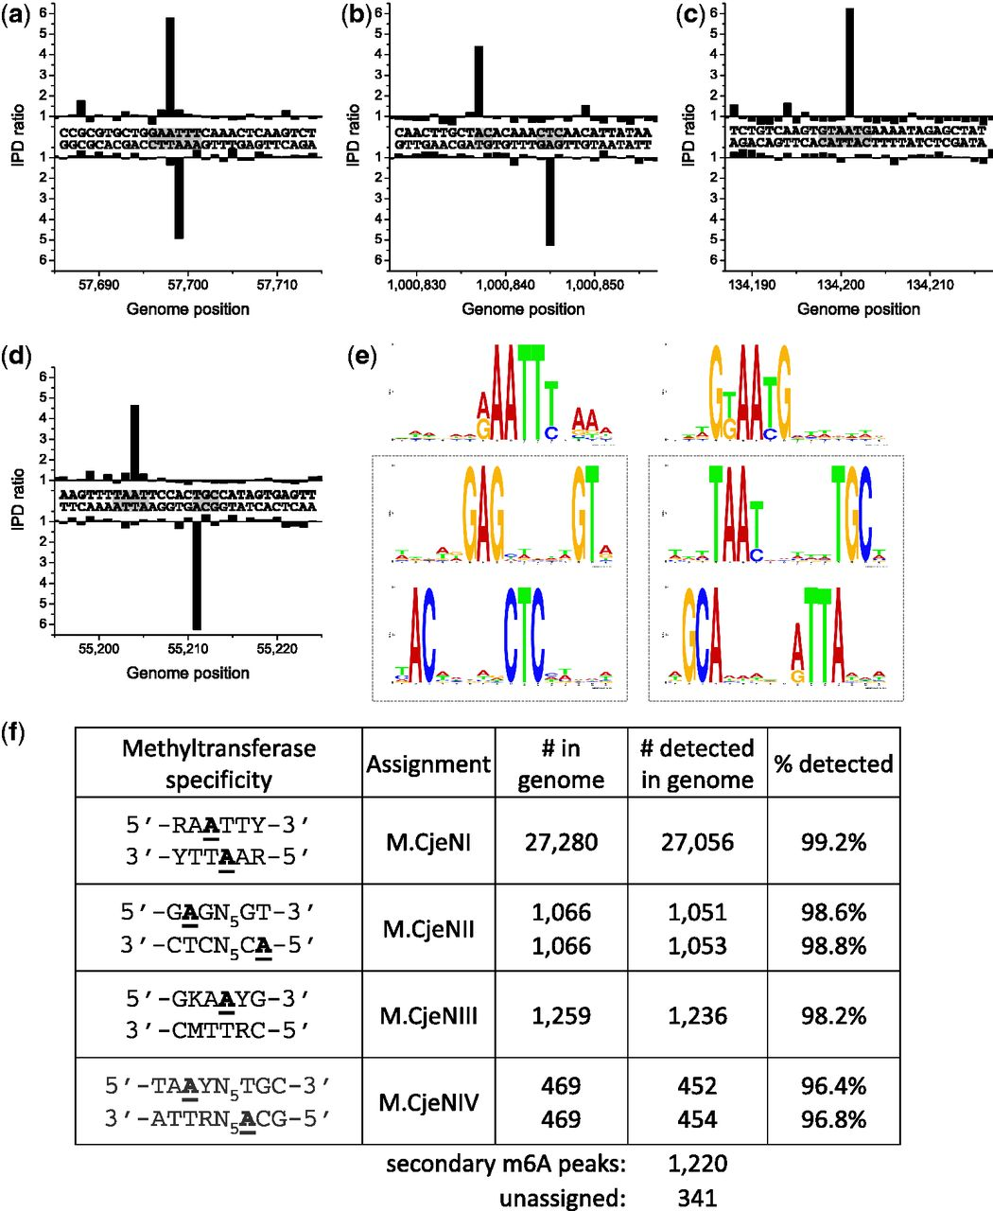
Figure 5. Methylome determination of C. jejuni NCTC 11168. (a–d) Example traces of kinetic variation, showing instances ...
Notes:
Figure 5. Methylome determination of C. jejuni NCTC 11168. (a–d) Example traces of kinetic variation, showing instances of the detected methylated motifs. (e) MTase specificities determined from the genomic positions detected as methylated. (f) Summary of detected methylated positions across the genome.
Unless provided in the caption above, the following copyright applies to the content of this slide: © The Author(s) 2012. Published by Oxford University Press.This is an Open Access article distributed under the terms of the Creative Commons Attribution License (http://creativecommons.org/licenses/by/3.0/), which permits unrestricted, distribution, and reproduction in any medium, provided the original work is properly cited.

Slide 6
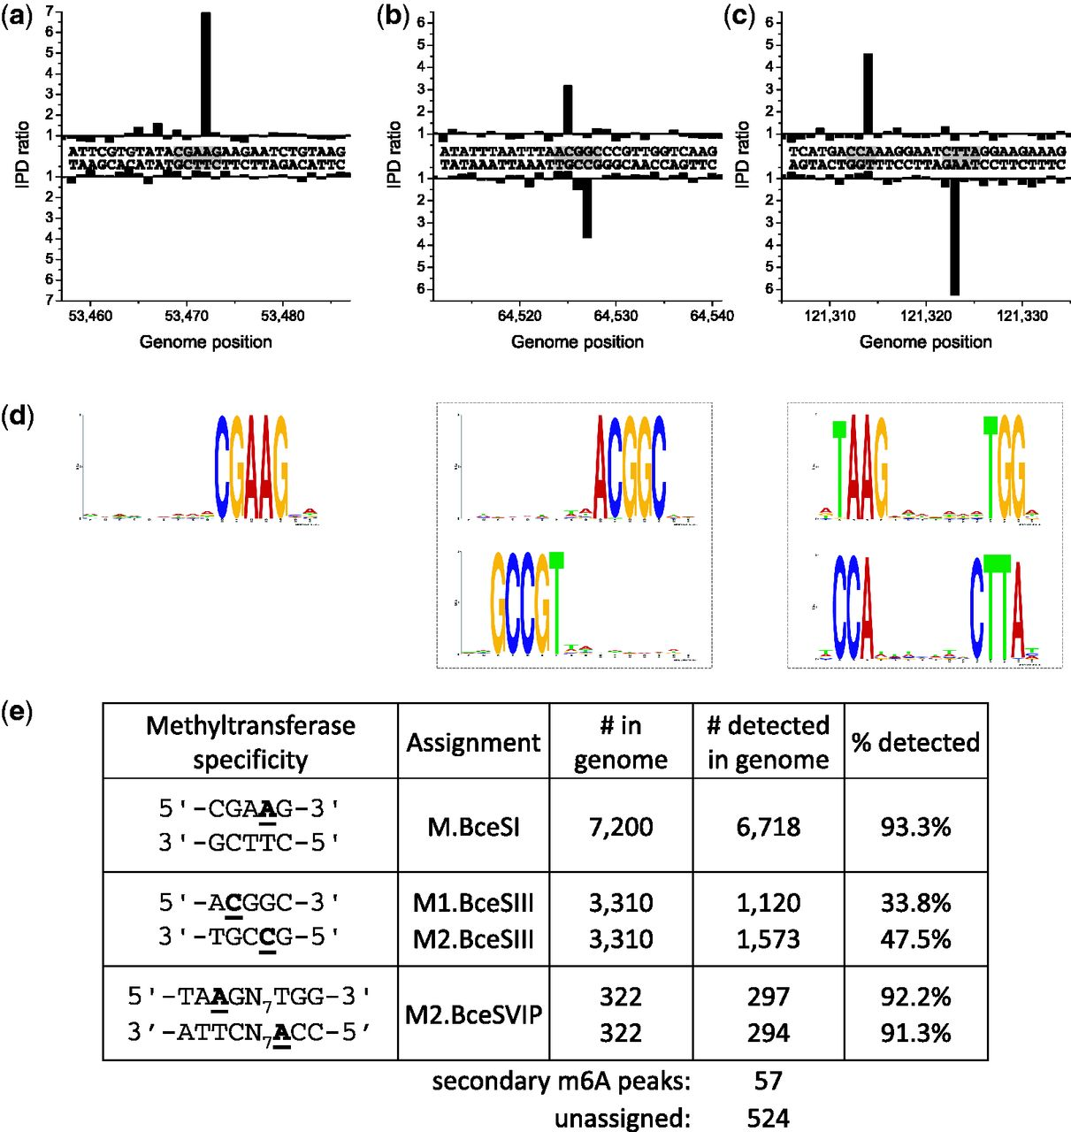
Figure 6. Methylome determination of B. cereus ATCC 10987. (a–c) Example traces of kinetic variation, showing instances ...
Notes:
Figure 6. Methylome determination of B. cereus ATCC 10987. (a–c) Example traces of kinetic variation, showing instances of the detected methylated motifs. (d) MTase specificities determined from the genomic positions detected as methylated. (e) Summary of detected methylated positions across the genome.
Unless provided in the caption above, the following copyright applies to the content of this slide: © The Author(s) 2012. Published by Oxford University Press.This is an Open Access article distributed under the terms of the Creative Commons Attribution License (http://creativecommons.org/licenses/by/3.0/), which permits unrestricted, distribution, and reproduction in any medium, provided the original work is properly cited.

