Slide 1
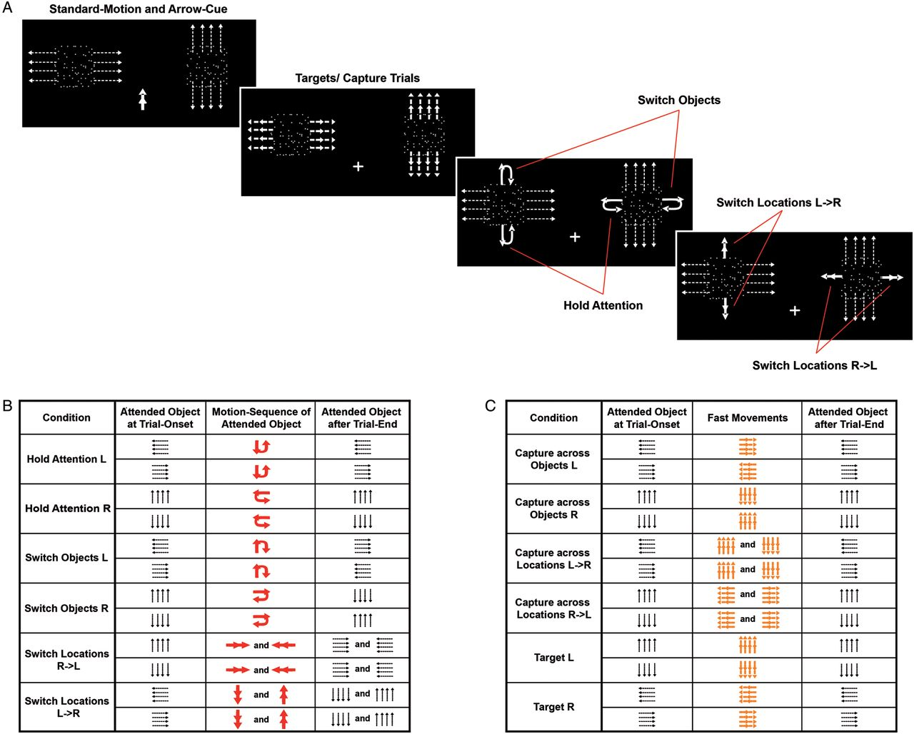
Figure 1. Schematic illustration of the experimental design. (A) Motion sequences presented during the experiment. ...
Notes:
Figure 1. Schematic illustration of the experimental design. (A) Motion sequences presented during the experiment. Subjects were presented with 2 apertures located in the left and right visual fields, in which 2 overlapping transparent surfaces continuously moved into opposite horizontal (left aperture) and vertical (right aperture) directions. At the beginning of each run (and every 10th trial thereafter), a central cue indicated the surface to be attended (upper-left screenshot). Fast movements in the predominant motion direction of the surface (left-middle screenshot) served as targets (fast movement of the currently attended surface), to which the subjects were required to perform a button press response. However, fast movements could also occur within the unattended surfaces, which—due to their target similarity—involuntarily captured the subjects’ attention across surfaces (fast movement of an unattended object at the attended location) or across spatial locations (fast movement of an unattended object at the unattended location). These fast movements within the unattended surfaces, however, were completely task-irrelevant and subjects were instructed to ignore them. The cue sequences that prompted subjects to voluntarily redirect their attention consisted of 2 short displacements orthogonal to the predominant motion direction of the attended surface (right-middle and lower-right screenshot). See Materials and Methods for a detailed description of these cue sequences. (B) Schematic illustration of trial types during which attention was voluntarily controlled. The columns indicate which particular surface had to be attended at trial onset (left column) and which surface had to be attended after completion of the trial (right column). Red arrows (middle column) indicate the motion directions of the cue sequence that guided the subjects’ voluntary attention. (C) Schematic illustration of the targets and both types of capture trials. The columns indicate which particular surface had to be attended at trial onset (left column), the particular surface that executed a fast movement (indicated by the direction of the orange arrows; middle column), and which surface had to be attended after trial completion (right column). Target trials were defined as fast movements in the predominant motion direction of the attended surface, whereas fast movements of the unattended surface involuntarily captured the subjects’ attention across objects (fast movement of an unattended object at the attended location) or across spatial locations (fast movement of an unattended object at the unattended location); importantly, these latter trials represented nontargets and did not require a button press.
Unless provided in the caption above, the following copyright applies to the content of this slide: © The Author 2012. Published by Oxford University Press. All rights reserved. For Permissions, please e-mail: journals.permissions@oup.com

Slide 2
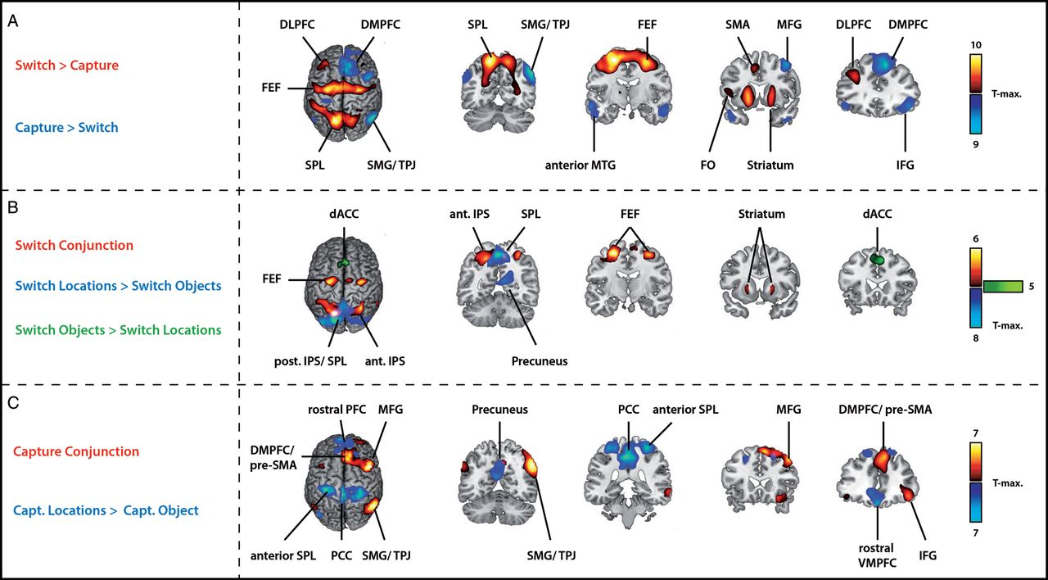
Figure 2. (A) Group activation maps for the comparison of goal-directed and stimulus-driven allocation of attention. ...
Notes:
Figure 2. (A) Group activation maps for the comparison of goal-directed and stimulus-driven allocation of attention. Warm colors (red/yellow) depict regions that are more active during voluntary than during stimulus-driven orienting, whereas the inverse contrast (stimulus-driven > voluntary shifts of attention) is shown in blue/cyan. For both comparisons, data were collapsed to include trials in which attention was shifted across objects as well as across locations. (B) Group activation maps for the comparison of voluntary shifts between objects and locations. Activity common to both voluntary shift types (conjunction of the “Switch Objects > Hold” and “Switch Locations > Hold” contrasts) is shown in red/yellow, whereas activations specific to both voluntary shift processes are illustrated in blue/cyan (“Switch Locations > Switch Objects”) and green (“Switch Objects > Switch Locations”). (C) Group activation maps for the comparison of stimulus-driven shifts between objects and locations. Activations common to both kinds of capture trials (conjunction of the “Capture across Objects > Hold” and “Capture across Locations > Hold” contrasts) are depicted in red/yellow. Brain areas that were more strongly activated during stimulus-driven orienting across locations than across objects (“Capture across Locations > Capture across Objects”) are shown in blue/cyan, while we did not observe any significant activation for the inverse comparison.
Unless provided in the caption above, the following copyright applies to the content of this slide: © The Author 2012. Published by Oxford University Press. All rights reserved. For Permissions, please e-mail: journals.permissions@oup.com

Slide 3
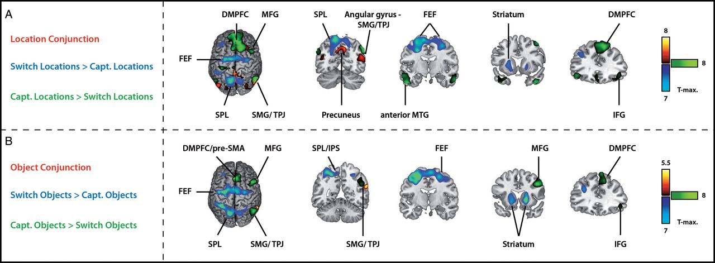
Figure 3. (A) Group activation maps for the comparison of voluntary versus stimulus-driven shifts between locations. ...
Notes:
Figure 3. (A) Group activation maps for the comparison of voluntary versus stimulus-driven shifts between locations. Activations common to both location-based shift types (conjunction of the “Switch Locations > Hold” and “Capture across Locations > Hold” contrasts) are illustrated in red/yellow, whereas activations specific to voluntary or stimulus-driven spatial shifts are illustrated in blue/cyan (“Switch Locations > Capture across Locations”) and green (“Capture across Locations > Switch Locations”). (B) Group activation maps for the comparison of voluntary versus stimulus-driven shifts between objects. Activity common to both voluntary and stimulus-driven shifts across objects (conjunction of the “Switch Objects > Hold” and “Capture across Objects > Hold” contrasts) is depicted in red/yellow. Brain areas showing higher activity to voluntary compared with stimulus-driven shifts across objects are shown in blue/cyan (“Switch Objects > Capture across Objects”), whereas significant activations for the opposite comparison are shown in green (“Capture across Objects > Switch Objects”).
Unless provided in the caption above, the following copyright applies to the content of this slide: © The Author 2012. Published by Oxford University Press. All rights reserved. For Permissions, please e-mail: journals.permissions@oup.com

