Slide 1
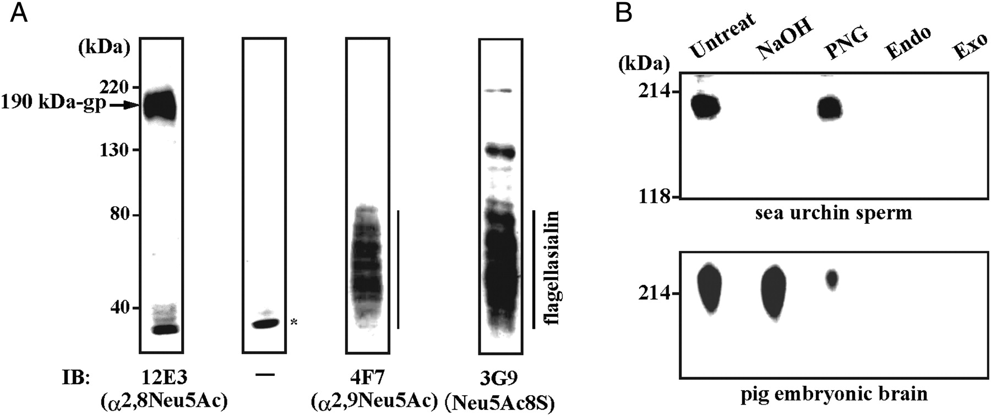
Fig. 1. Detection of α2,8-linked polyNeu5Ac-containing glycoprotein derived from 1% Triton X-100 extract of sea ...
Notes:
Fig. 1. Detection of α2,8-linked polyNeu5Ac-containing glycoprotein derived from 1% Triton X-100 extract of sea urchin sperm by western blot analysis. (A) Sea urchin sperm lysate was subjected to SDS–PAGE and immunoblotted with mAb.12E3, mAb.4F7 and mAb.3G9, which recognizes α2,8-linked polyNeu5Ac, α2,9-linked polyNeu5Ac and Neu5Ac8S, respectively. An arrow and bars indicate the α2,8-linked polyNeu5Ac-containing 190 kDa-gp and the α2,9-linked polyNeu5Ac-containing flagellasialin, respectively. Asterisk indicates the non-specific staining. (B) Sea urchin sperm lysate (upper panel) and pig embryonic brain homogenate (lower panel) were electrophoresed and electroblotted onto the polyvinylidene fluoride membrane. The membrane was blocked with 1% BSA and treated as follows: Untreat, untreatment; NaOH, incubated with 0.1 N NaOH at 37°C for 18 h; PNG, incubated with 2 mU of PNGase F at 37°C for 18 h; Endo, incubated with 0.9 mU of Endo-N at 37°C for 18 h; Exo, incubated with 100 mU of C. perfringens sialidase at 37°C for 18 h. The α2,8-linked polyNeu5Ac was detected with mAb.12E3.
Unless provided in the caption above, the following copyright applies to the content of this slide: © The Author 2011. Published by Oxford University Press. All rights reserved. For permissions, please e-mail: journals.permissions@oup.com

Slide 2
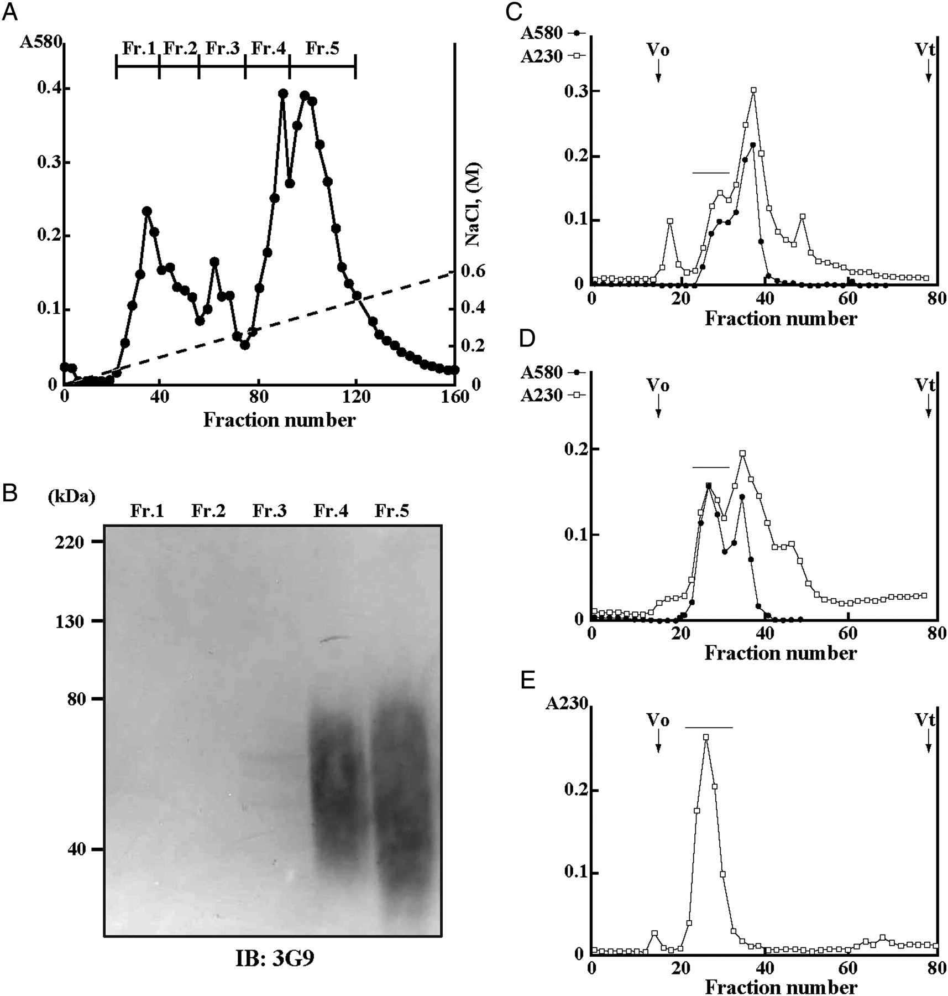
Fig. 2. Purification of α2,8-linked polyNeu5Ac-containing glycopeptides derived from trypsin digests of sea urchin ...
Notes:
Fig. 2. Purification of α2,8-linked polyNeu5Ac-containing glycopeptides derived from trypsin digests of sea urchin sperm lysates. (A) DEAE-Toyopearl 650 M anion-exchange chromatography of trypsin digests of delipidated H. pulcherrimus sperm lysates. The sample was applied to a column equilibrated with 10 mM Tris–HCl (pH 8.0) (2.2 × 15 cm) and eluted with a linear gradient of NaCl (0–0.6 M). The concentration of NaCl was indicated by a dotted line. The elution profile was monitored for Sia by the resorcinol method (black dots, A580). The fractions indicated by bars were pooled. Fr.1, 20–40; Fr.2, 41–55; Fr.3, 56–73; Fr.4, 74–91; Fr.5, 92–118. (B) Western blot analysis of the Fr.1–Fr.5 with mAb.3G9 showed that flagellasialin was recovered in Fr.4 and Fr.5 as a smear at 40–80 kDa. Sephacryl S-100 chromatography of the Fr.2 (C) and Fr.3 (D). The early eluting Sia-containing fractions indicated by the bars were pooled. (E) Sephacryl S-100 re-chromatography of the pooled fraction in (C and D). The Sia-containing fractions were pooled as indicated by the bar and designated α2,8GP. Elution profiles were monitored for absorbance at 230 nm (open circles; A230) and for the Sia analysis by the resorcinol method (black dots; A580 in C and D). V0, void volume. Vt, total volume.
Unless provided in the caption above, the following copyright applies to the content of this slide: © The Author 2011. Published by Oxford University Press. All rights reserved. For permissions, please e-mail: journals.permissions@oup.com

Slide 3
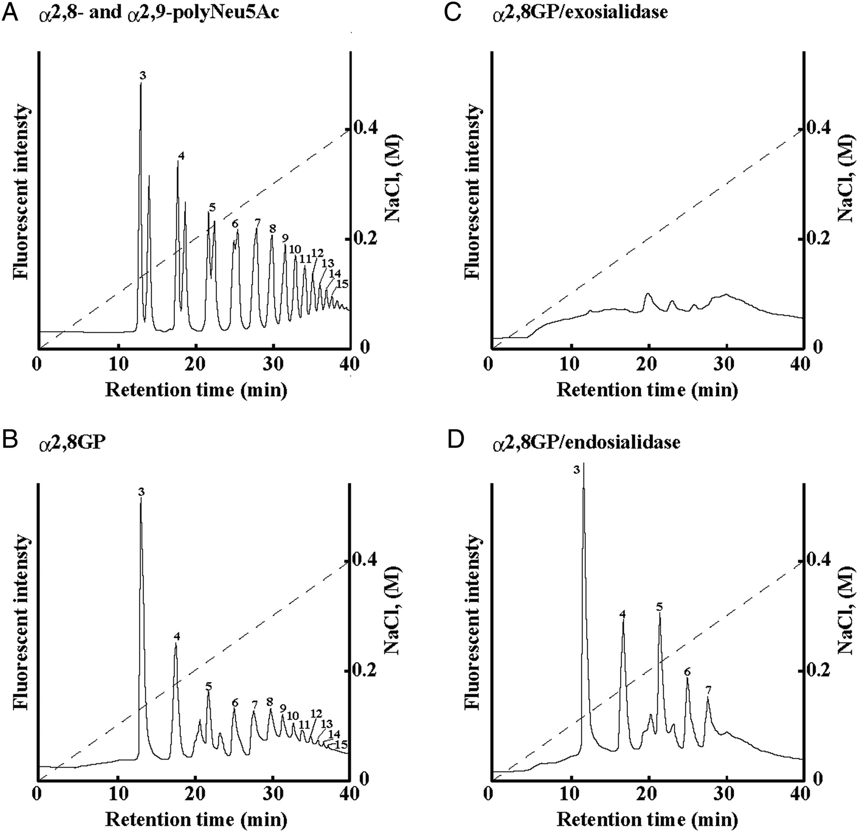
Fig. 3. Detection of polyNeu5Ac structure by a mild acid hydrolysis/DMB/fluorometric anion-exchange HPLC method. (A) ...
Notes:
Fig. 3. Detection of polyNeu5Ac structure by a mild acid hydrolysis/DMB/fluorometric anion-exchange HPLC method. (A) Co-chromatography of DMB derivatives of authentic α2,8- and α2,9-linked polyNeu5Ac. DMB derivatives were applied to a Mono Q anion-exchange chromatography and eluted with 10 mM Tris–HCl (pH 8.0) with a gradient from 0 to 0.4 M NaCl as indicated by a dotted line. The elution was monitored by a fluorescence detector (excitation 373 nm and emission 448 nm). These oligo/polyNeu5Ac are separated from each other for peaks with DP of up to 6, whereas peaks with DP ≥7 are co-eluted. The early and the late eluting peaks of each doublet are oligomers of α2,8- and α2,9-linked Neu5Ac, respectively (Miyata et al. 2004). The number at each peak represents the DP. HPLC of DMB derivatives of the α2,8GP before (B) and after (C) treatment with exosialidases and α2,8-linked polyNeu5Ac-specific endosialidase (D).
Unless provided in the caption above, the following copyright applies to the content of this slide: © The Author 2011. Published by Oxford University Press. All rights reserved. For permissions, please e-mail: journals.permissions@oup.com

Slide 4
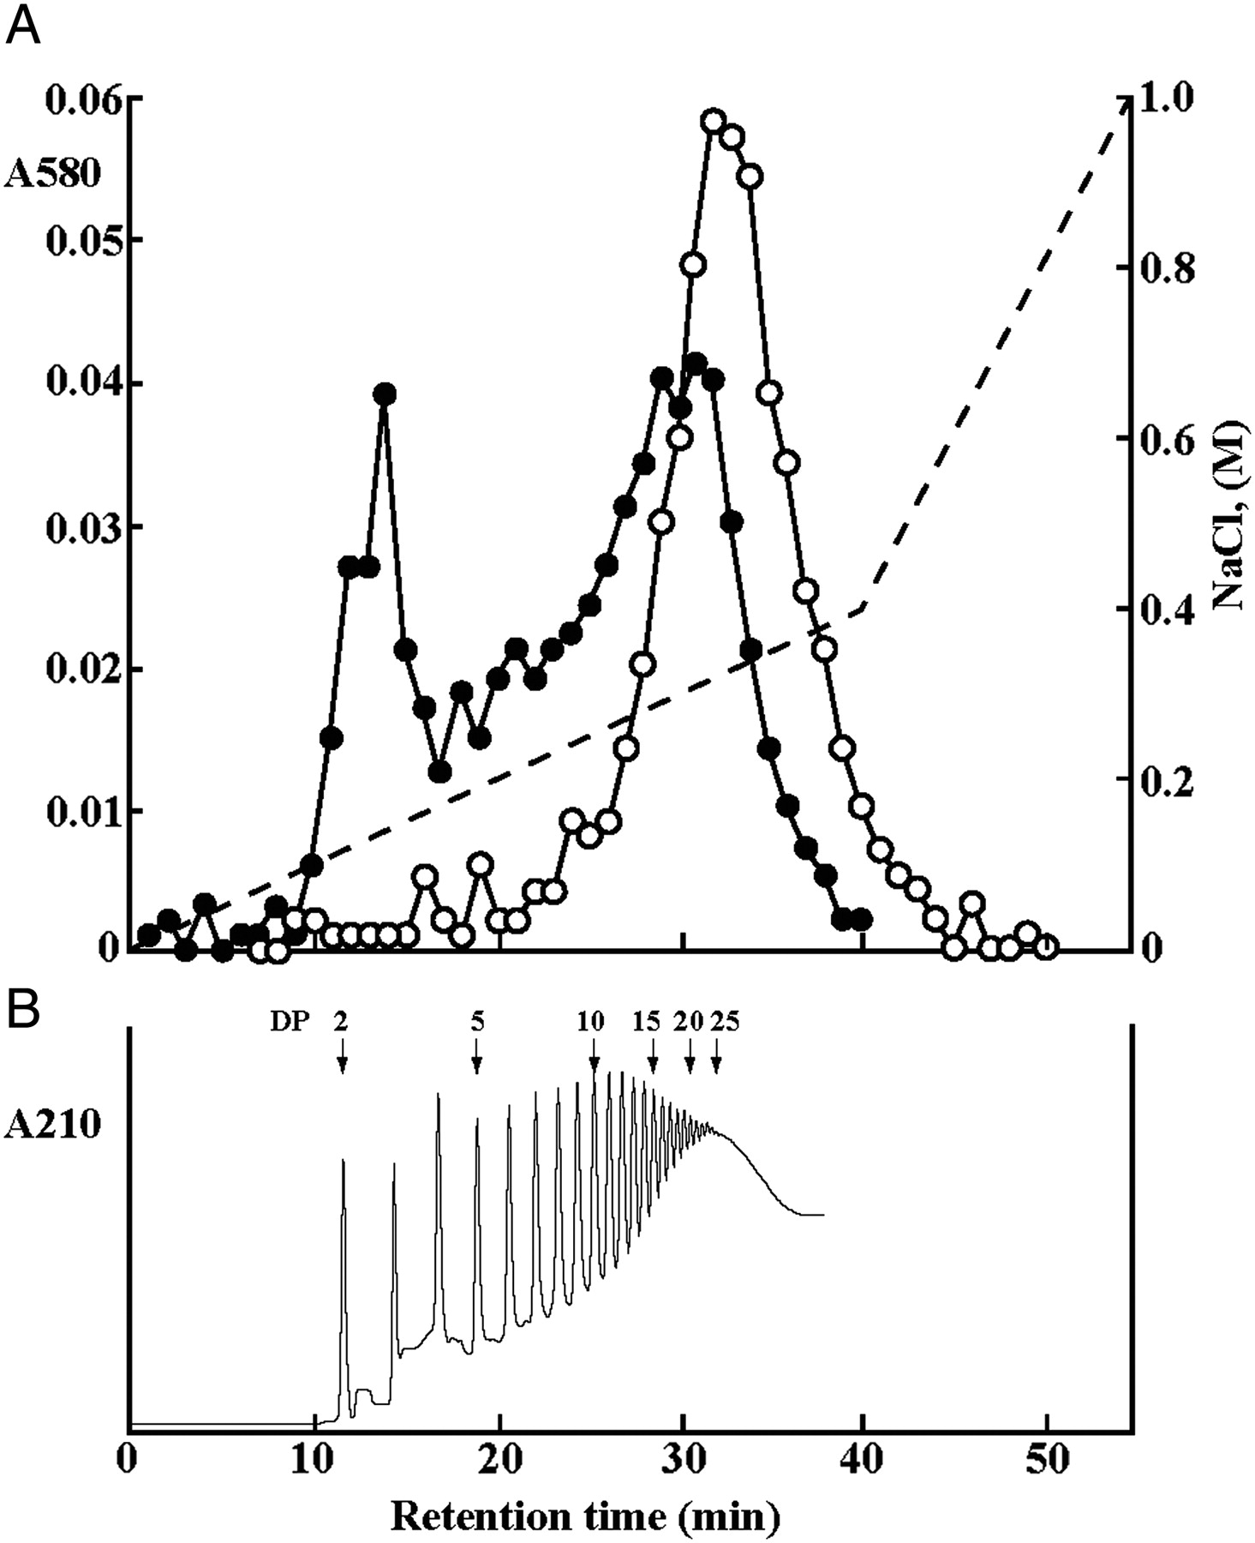
Fig. 4. Mono Q anion-exchange HPLC of sialoglycan alditols obtained from α2,8GP by alkaline borohydride treatment. ...
Notes:
Fig. 4. Mono Q anion-exchange HPLC of sialoglycan alditols obtained from α2,8GP by alkaline borohydride treatment. (A) The sialooligosaccharide alditols obtained by treatment of the α2,8GP (0.1 mg as Sia) with 0.1 N NaOH, 1 M NaBH4 as described under Materials and methods were applied to a Mono Q column (0.5 × 5 cm) and eluted with a gradient from 0 to 1.0 M NaCl in 20 mM Tris–HCl (pH 8.0). The NaCl concentration is shown by a dotted line. Elution profiles of the α2,8GP before (open circles) and after (black dots) alkaline treatment were monitored for Sia by the resorcinol method (A580). (B) The mild acid hydrolysate of authentic α2,8-linked polyNeu5Ac was applied to a Mono Q column as same in (A). The arrow heads with numbers represents the DP. Elution profile was monitored for absorbance at 210 nm (A210).
Unless provided in the caption above, the following copyright applies to the content of this slide: © The Author 2011. Published by Oxford University Press. All rights reserved. For permissions, please e-mail: journals.permissions@oup.com

Slide 5
Fig. 5. Localization of the α2,8-linked polyNeu5Ac-containing glycoconjugates in sea urchin sperm. (A) Western ...
Notes:
Fig. 5. Localization of the α2,8-linked polyNeu5Ac-containing glycoconjugates in sea urchin sperm. (A) Western blotting with mAb.12E3 (IB: 12E3) of the flagellum fraction (lane 1) and the head fraction (lane 2); 190 kDa-gp detected with mAb.12E3 is shown on the left side of the panel. Fluorometric anion-exchange HPLC of the mild acid hydrolysate of 25 μg (as protein) each of whole sperm (B), the flagellum fraction (C) and the 250 μg (as protein) of head fraction (D). The mild acid hydrolysis and HPLC were carried out as described in Materials and methods. See also the legend of Fig. 3. The numbers show the elution positions of α2,8- or α2,9-linked oligo/polyNeu5Ac with a series of DPs. S1 indicates the Neu5Ac8S and S2–S5 indicate that (Neu5Ac)1–4 capped with Neu5Ac8S at the non-reducing terminal end.
Unless provided in the caption above, the following copyright applies to the content of this slide: © The Author 2011. Published by Oxford University Press. All rights reserved. For permissions, please e-mail: journals.permissions@oup.com

Slide 6
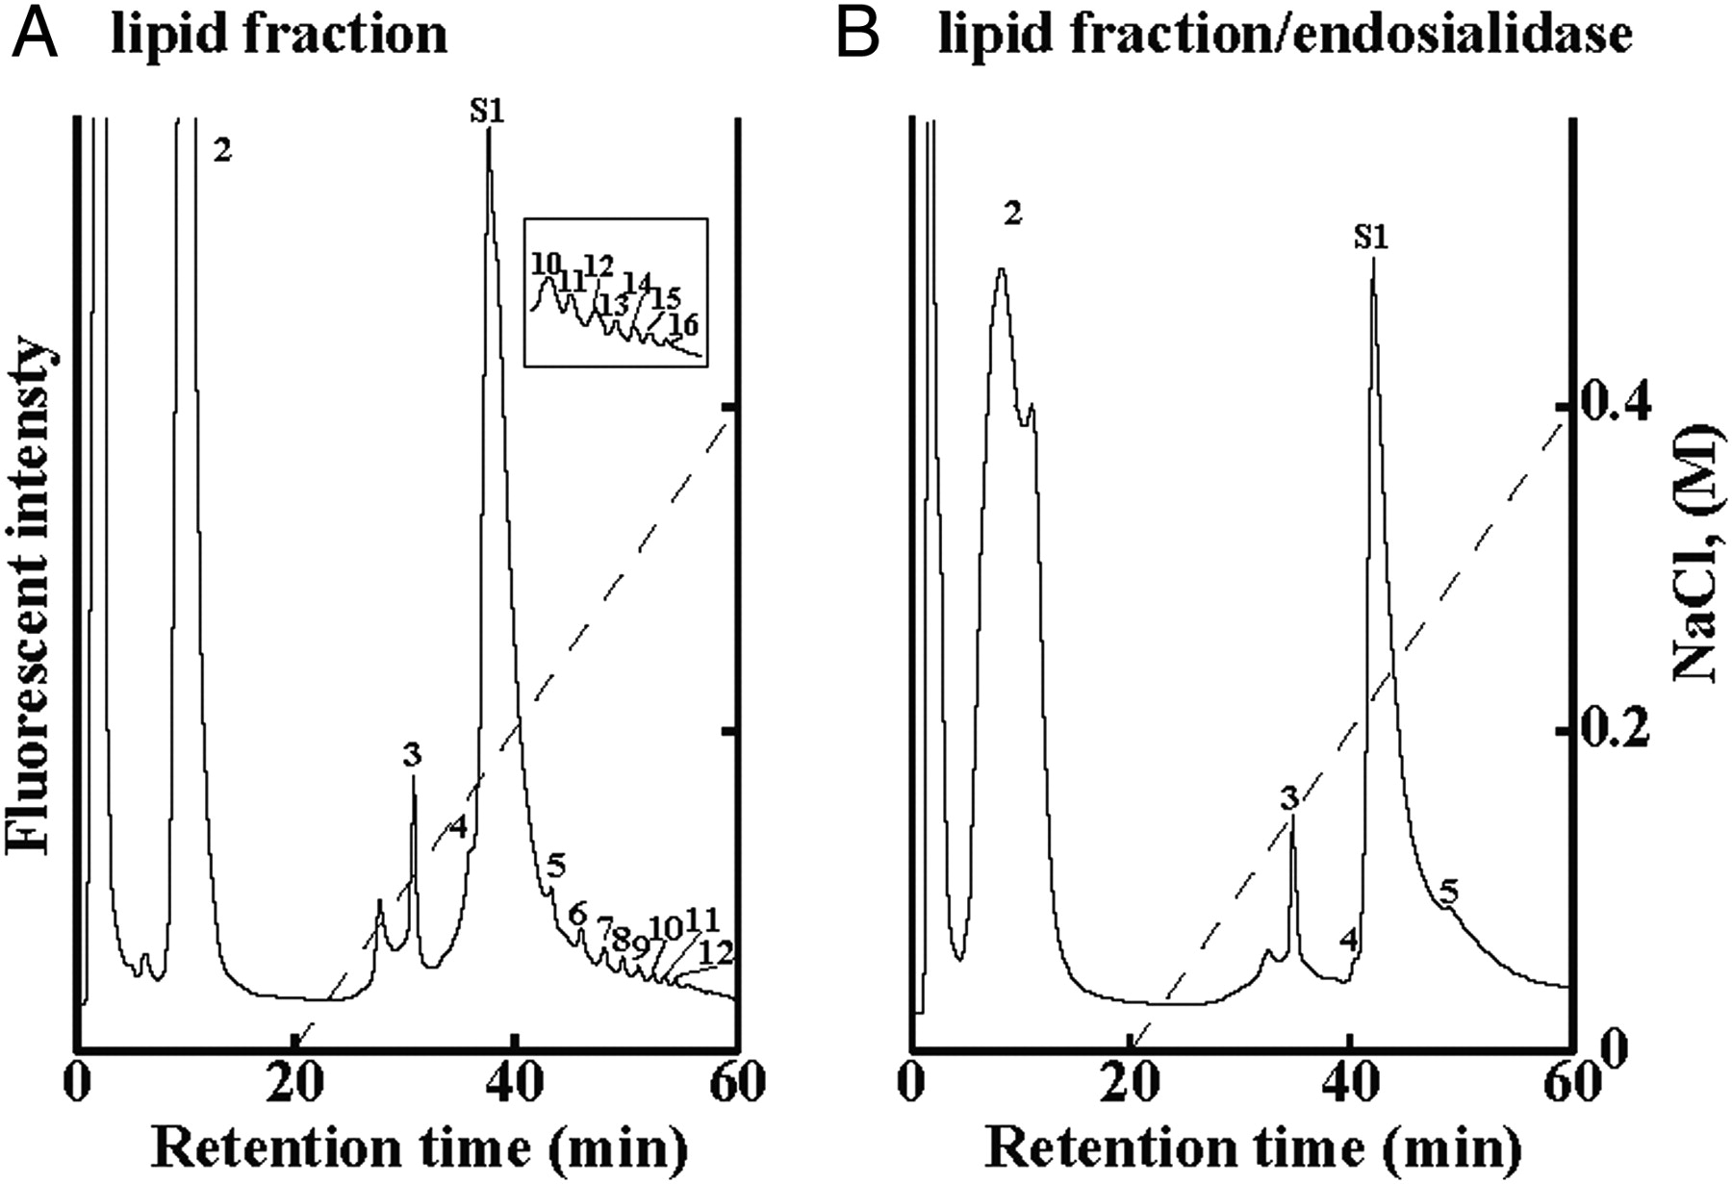
Fig. 6. Detection of polyNeu5Ac structure from the lipid fraction by a mild acid hydrolysis/DMB/fluorometric ...
Notes:
Fig. 6. Detection of polyNeu5Ac structure from the lipid fraction by a mild acid hydrolysis/DMB/fluorometric anion-exchange HPLC method. The lipid fraction was mild acid hydrolyzed with 0.01 N TFA at 50°C for 1 h. The mild acid hydrolysate was then derivatized with DMB and applied to a Mono Q anion-exchange chromatography before (A) and after (B) treatment with α2,8-linked polyNeu5Ac-specific endosialidase. The numbers show the elution positions of α2,8-linked oligo/polyNeu5Ac with a series of DPs. S1 indicates the Neu5Ac8S and S2 indicate that (Neu5Ac)1 capped with Neu5Ac8S at the non-reducing terminal end.
Unless provided in the caption above, the following copyright applies to the content of this slide: © The Author 2011. Published by Oxford University Press. All rights reserved. For permissions, please e-mail: journals.permissions@oup.com

Slide 7
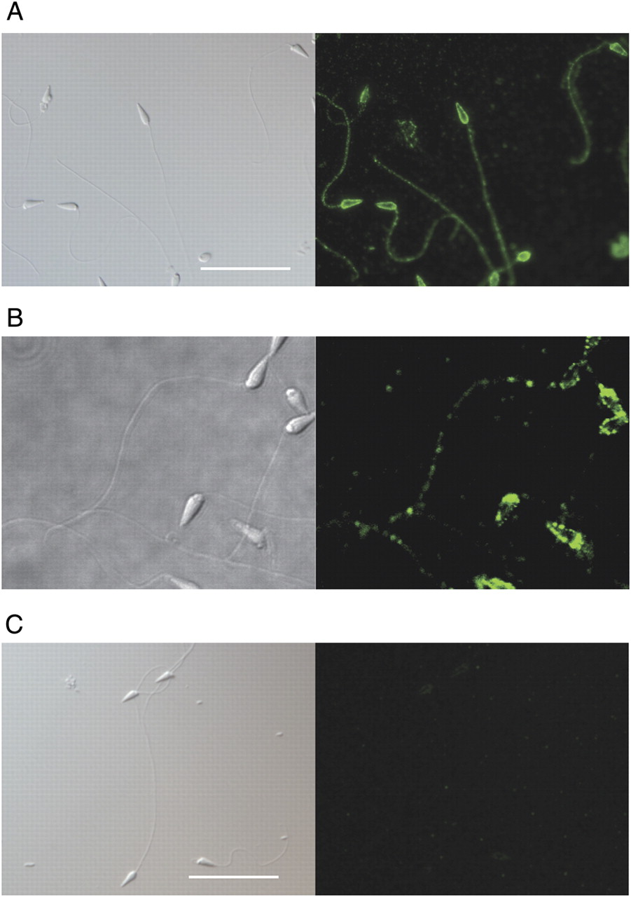
Fig. 7. Immunofluorescence localization of the α2,8-linked polyNeu5Ac epitope on sea urchin sperm. Sperm were ...
Notes:
Fig. 7. Immunofluorescence localization of the α2,8-linked polyNeu5Ac epitope on sea urchin sperm. Sperm were deposited onto poly-l-lysine-treated glass coverslips and subjected to blocking with 3 mg/mL BSA, 0.1 mg/mL normal goat IgG in PBS for 1 h. The fixed sperm on the coverslips were incubated with mAb.12E3 (20 µg/mL) at 4°C for overnight, followed by incubation with Alexa 488-conjugated goat anti-mouse IgM antibodies at room temperature for 1 h. For detergent treatment, the coverslips were treated with 0.2% Triton X-100 in PBS at room temperature for 40 min before blocking. Isotype negative controls also ran with normal mouse IgM, instead of mAb.12E3. No immunofluorescence was observed. Sperm were observed with an Olympus BX51 microscope equipped with epifluorescence or an Olympus FV1000-D laser-scanning confocal microscope. In each panel, diffraction interference contrast images and immunofluorescence are shown on the left and right, respectively. The scale bars indicate 200 μm. (A) mAb.12E3; (B) mAb.12E3, confocal images; (C) mAb.12E3, 0.2% Triton X-100-treated sperm.
Unless provided in the caption above, the following copyright applies to the content of this slide: © The Author 2011. Published by Oxford University Press. All rights reserved. For permissions, please e-mail: journals.permissions@oup.com

