Slide 1
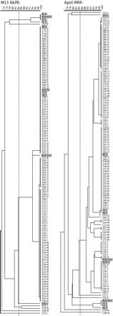
Figure 1. Molecular typing of A. baumannii isolates. Clustering relationships inferred from RAPD analysis with the ...
Notes:
Figure 1. Molecular typing of A. baumannii isolates. Clustering relationships inferred from RAPD analysis with the primer M13 and MRA. The dendrograms were generated using BioNumerics software (Applied Maths) using UPGMA and the Dice coefficient. Broken lines denote isolates belonging to the same RAPD or MRA type.22 Study codes (see Supplementary Data) are shown on the right. Reference strains (see Supplementary Data) are highlighted with grey shading.
Unless provided in the caption above, the following copyright applies to the content of this slide: © The Author 2010. Published by Oxford University Press on behalf of the British Society for Antimicrobial Chemotherapy. All rights reserved. For Permissions, please e-mail: journals.permissions@oxfordjournals.org

Slide 2
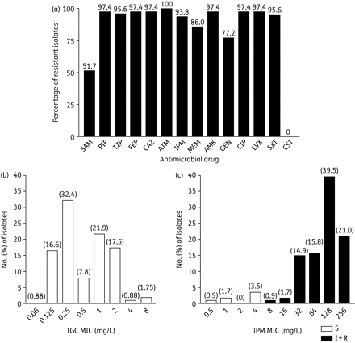
Figure 2. Analysis of antimicrobial susceptibility. (a) Antibiotic resistance for 114 A. baumannii isolates. Isolates ...
Notes:
Figure 2. Analysis of antimicrobial susceptibility. (a) Antibiotic resistance for 114 A. baumannii isolates. Isolates showing an intermediate level of susceptibility were classified as resistant. (b and c) Distribution of MIC values of TGC and IPM, respectively, for 114 A. baumannii isolates. SAM, ampicillin/sulbactam; PIP, piperacillin; TZP, piperacillin/tazobactam; FEP, cefepime; CAZ, ceftazidime; ATM, aztreonam; IPM, imipenem; MEM, meropenem; AMK, amikacin; GEN, gentamicin; CIP, ciprofloxacin; LVX, levofloxacin; SXT, trimethoprim/sulfamethoxazole; CST, colistin; TGC, tigecycline.
Unless provided in the caption above, the following copyright applies to the content of this slide: © The Author 2010. Published by Oxford University Press on behalf of the British Society for Antimicrobial Chemotherapy. All rights reserved. For Permissions, please e-mail: journals.permissions@oxfordjournals.org

Slide 3
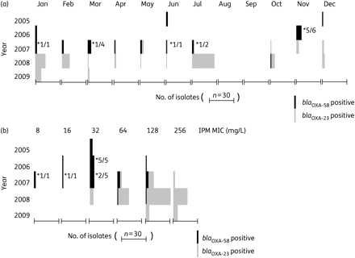
Figure 3. Evolution of carbapenemase gene carriage and influence on carbapenem resistance. (a) Distribution of ...
Notes:
Figure 3. Evolution of carbapenemase gene carriage and influence on carbapenem resistance. (a) Distribution of blaOXA-23-like- and blaOXA-58-like-positive isolates per year and month. (b) Distribution of IPM MIC values during the 5 year investigation period. *Ratio of blaOXA-58-positive isolates that were meropenem susceptible and IPM resistant; all blaOXA-23-positive isolates were meropenem resistant and IPM resistant. IPM, imipenem.
Unless provided in the caption above, the following copyright applies to the content of this slide: © The Author 2010. Published by Oxford University Press on behalf of the British Society for Antimicrobial Chemotherapy. All rights reserved. For Permissions, please e-mail: journals.permissions@oxfordjournals.org

