Slide 1
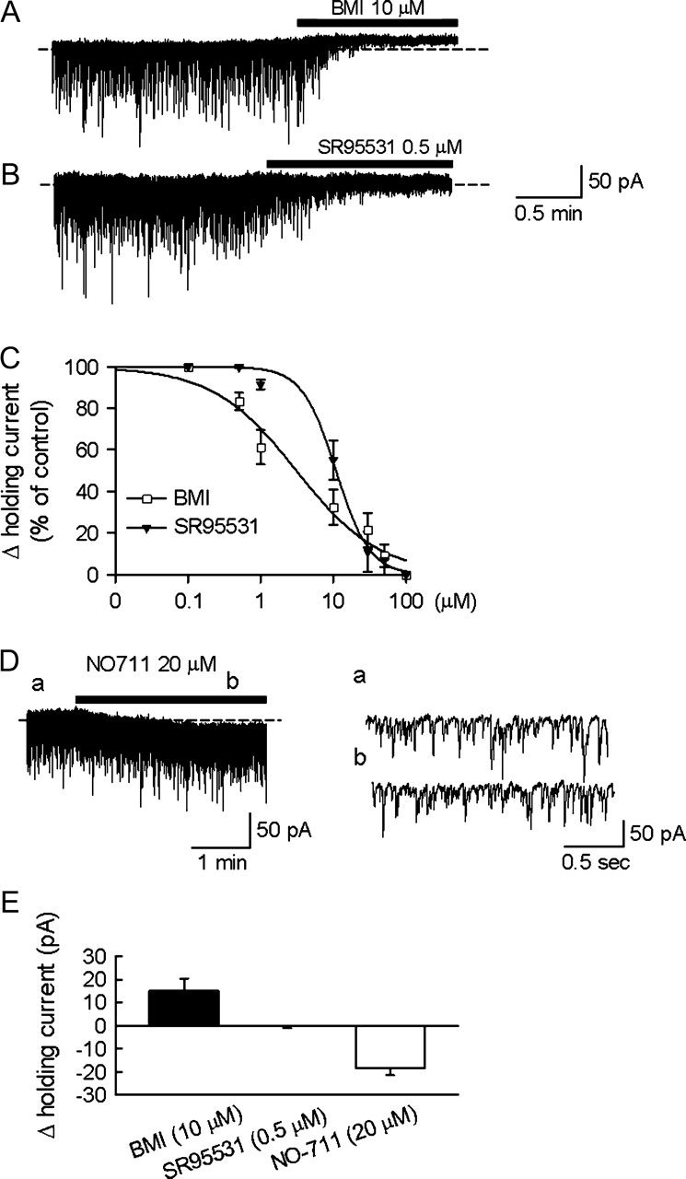
Figure 1. Tonic and synaptic GABAergic currents in rat cortical neurons. (A) BMI (10 μM) abolished mIPSCs and induced ...
Notes:
Figure 1. Tonic and synaptic GABAergic currents in rat cortical neurons. (A) BMI (10 μM) abolished mIPSCs and induced an outward shift of the holding current (Ihold). The dashed line depicts the Ihold in the absence of BMI. (B) SR95531 (0.5 μM) also abolished mIPSCs but had no significant effect on Ihold. (C) Dose–response relationships for the outward shift of Ihold induced by GABAA receptor antagonists, BMI (□, n = 5) and SR95534 (▾, n = 4–6). Note the apparent lower affinity of SR95534 (the half maximal inhibitory concentration [Ic50] = 11.2 μM) compared with BMI (IC50 = 4.7 μM) against the tonic GABAA receptor. Bars represent standard error of the mean. Control (100 μM) Ihold values of SR95534 and BMI were 10.9 ± 3.3 pA and 11.9 ± 1.1 pA, respectively. (D) Blocking GABA uptake with NO711 resulted in an inward shift in Ihold without changing peak mIPSCs amplitude and frequency. mIPSCs indicated by a and b are shown in expanded time scale in the right panels. (E) The bar graph illustrates the changes in Ihold during the application of BMI, SR95531, and NO711.
Unless provided in the caption above, the following copyright applies to the content of this slide: © The Author 2006. Published by Oxford University Press. All rights reserved. For permissions, please e-mail: journals.permissions@oxfordjournals.org

Slide 2
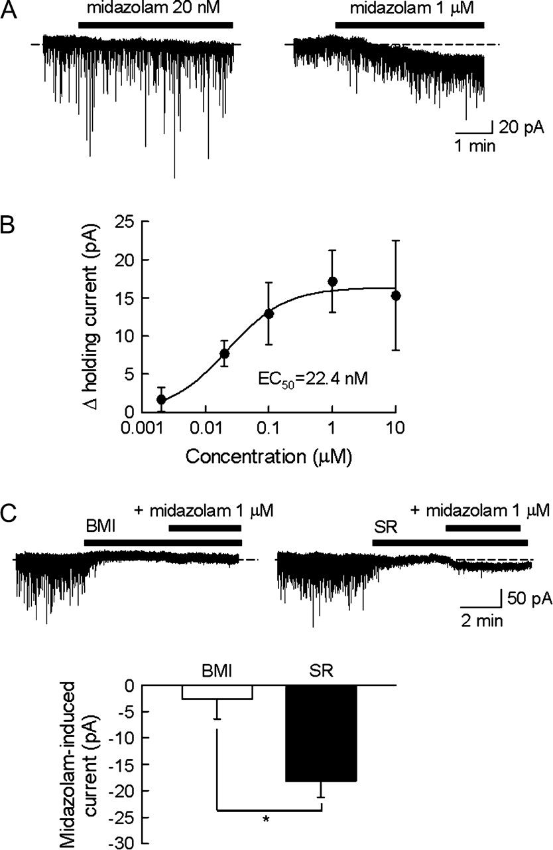
Figure 2. Midazolam caused an increase in the tonic current. (A) I_{hold} shifted to inward with the ...
Notes:
Figure 2. Midazolam caused an increase in the tonic current. (A) Ihold shifted to inward with the application of midazolam (20 nM and 1 μM) to layer V pyramidal cells. (B) The concentration-dependent increase in the amplitude of the tonic current caused by midazolam. Each data point represents the averaged values ± standard error of the mean (n = 4–5). (C) Midazolam failed to induce tonic current in the presence of BMI (10 μM), but did induce tonic current in the presence of SR95531 (1 μM). The midazolam-induced tonic currents in the presence of BMI (n = 3) or SR95531 (n = 5) are summarized in the bar graph. *P < 0.01.
Unless provided in the caption above, the following copyright applies to the content of this slide: © The Author 2006. Published by Oxford University Press. All rights reserved. For permissions, please e-mail: journals.permissions@oxfordjournals.org

Slide 3
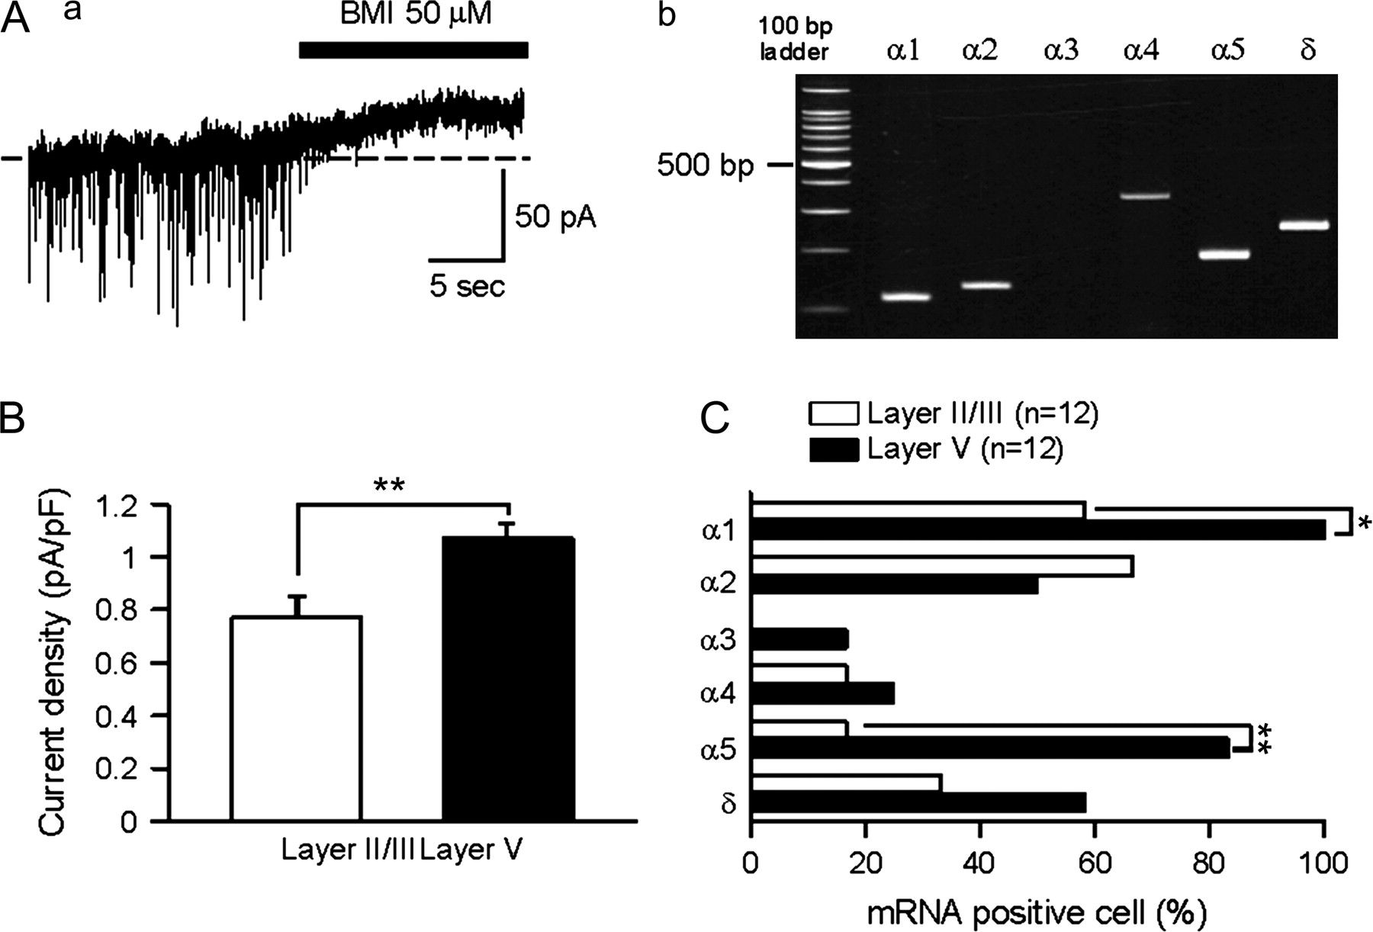
Figure 3. Tonic current recordings followed by single-cell RT-PCR for GABA_{A} receptor subunit mRNAs. (Aa) ...
Notes:
Figure 3. Tonic current recordings followed by single-cell RT-PCR for GABAA receptor subunit mRNAs. (Aa) Representative trace of an outward shift of Ihold caused by focal application of BMI. (Ab) mRNA expression profile of the α1–5 and δ GABAA receptor subunits from the cell in (Aa). Note that the α3-subunit mRNA was not expressed. (B) Summary of BMI-inhibited tonic current density in layers II/III and V neurons. BMI significantly decreased the tonic current density in both layer II/III (n = 12) and layer V neurons (n = 12). The decrease in the layer V neurons was significantly larger (P < 0.01). (C) Proportion of cells expressing α1−5 and δ GABAA receptor subunit mRNAs in layers II/III and V neurons. Note that the expression of the α1 and α5 subunits was significantly higher in layer V neurons than in layer II/III neurons. *P < 0.05, **P < 0.01, χ2 test.
Unless provided in the caption above, the following copyright applies to the content of this slide: © The Author 2006. Published by Oxford University Press. All rights reserved. For permissions, please e-mail: journals.permissions@oxfordjournals.org

Slide 4
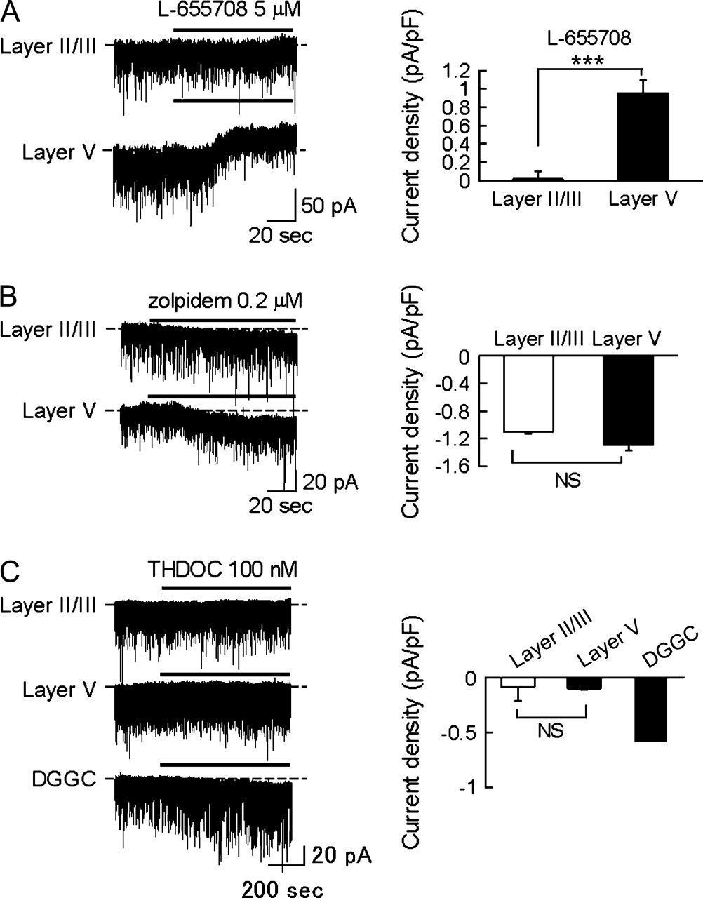
Figure 4. Comparison of the pharmacological properties of the tonic current in layers II/III and V neurons. (A) ...
Notes:
Figure 4. Comparison of the pharmacological properties of the tonic current in layers II/III and V neurons. (A) L-655708 (5 μM) produced an outward shift of Ihold in layer V neurons but not in layer II/III neurons. (***P < 0.001). (B) Zolpidem (0.2 μM) produced an inward shift of tonic current in both layer II/III and layer V neurons. There was no significant difference between layer II/III and layer V neurons. NS, not significant. (C) THDOC did not affect tonic currents in either layer II/III or layer V neurons. To confirm the effectiveness of THDOC on a tonic current at this concentration, THDOC was applied on the DGGCs. A shift in Ihold indicates THDOC-sensitive tonic conductance in DGGC.
Unless provided in the caption above, the following copyright applies to the content of this slide: © The Author 2006. Published by Oxford University Press. All rights reserved. For permissions, please e-mail: journals.permissions@oxfordjournals.org

