Slide 1
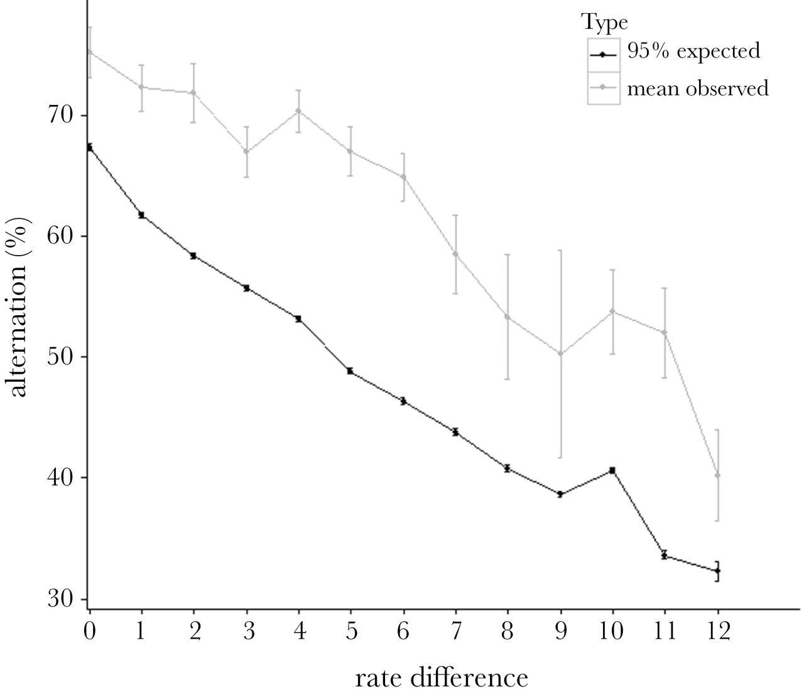
Figure 1 Mean observed and expected alternation in relation to the difference in provisioning rate between the ...
Notes:
Figure 1 Mean observed and expected alternation in relation to the difference in provisioning rate between the parents. Bars for observed values represent SE, and bars for expected values represent 5% and 95% CIs. All observed mean alternation values exceed the upper 95% CIs of expected scores and, as expected, alternation decrease as a function of increasing provisioning rate difference.
Unless provided in the caption above, the following copyright applies to the content of this slide: © The Author 2015. Published by Oxford University Press on behalf of the International Society for Behavioral Ecology. All rights reserved. For permissions, please e-mail: journals.permissions@oup.com

Slide 2
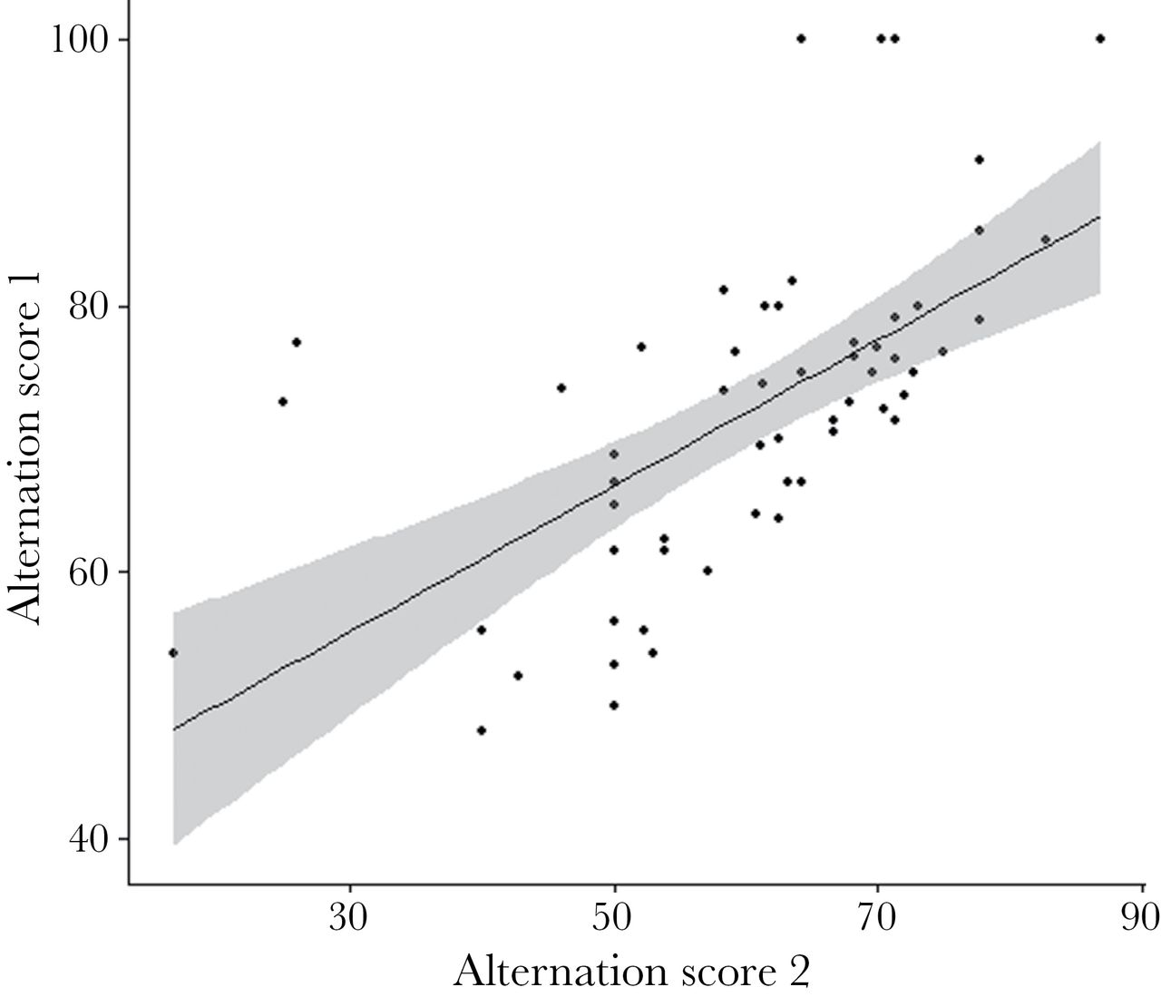
Figure 2 Relationship between 2 randomly sampled measures of alternation values from repeated observations at the same ...
Notes:
Figure 2 Relationship between 2 randomly sampled measures of alternation values from repeated observations at the same nest. The line represents fitted values (linear model [LM]: F1,52 = 33.1, P < 0.001, R2 = 0.377) with its SE represented by shaded areas.
Unless provided in the caption above, the following copyright applies to the content of this slide: © The Author 2015. Published by Oxford University Press on behalf of the International Society for Behavioral Ecology. All rights reserved. For permissions, please e-mail: journals.permissions@oup.com

Slide 3
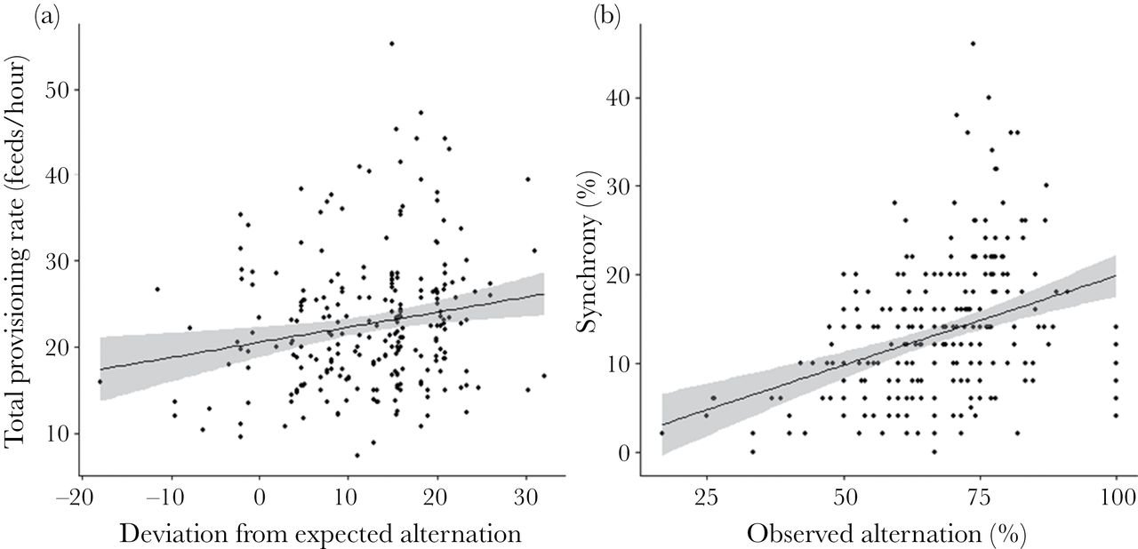
Figure 3 Relationships between (a) total provisioning rate (feeds/hour) and alternation (F_{1,245} = 7.447, P ...
Notes:
Figure 3 Relationships between (a) total provisioning rate (feeds/hour) and alternation (F1,245 = 7.447, P < 0.01) and (b) synchrony of provisioning visits between parents (number of alternated feeds that occurred within a minute of the previous feed) and alternation (F1,245 = 35.98, P < 0.001). Lines show the predicted values.
Unless provided in the caption above, the following copyright applies to the content of this slide: © The Author 2015. Published by Oxford University Press on behalf of the International Society for Behavioral Ecology. All rights reserved. For permissions, please e-mail: journals.permissions@oup.com

Slide 4
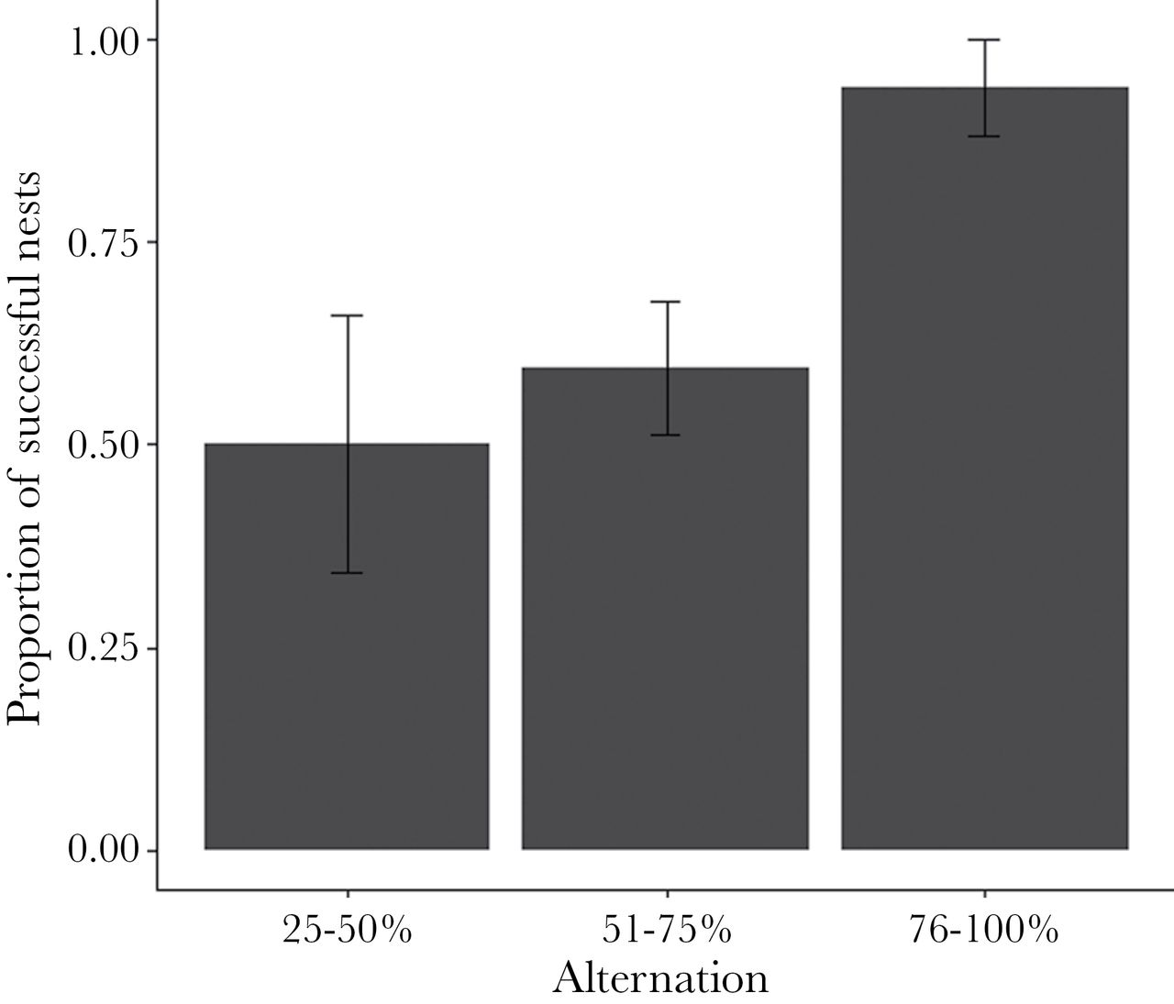
Figure 4 Mean + SE proportion of nests that produced fledglings as a function of varying degrees of alternation. ...
Notes:
Figure 4 Mean + SE proportion of nests that produced fledglings as a function of varying degrees of alternation. Alternation was modeled as a continuous variable but for visualization purposes is grouped according to the level of alternation achieved on day 6 of the nestling period.
Unless provided in the caption above, the following copyright applies to the content of this slide: © The Author 2015. Published by Oxford University Press on behalf of the International Society for Behavioral Ecology. All rights reserved. For permissions, please e-mail: journals.permissions@oup.com

Slide 5
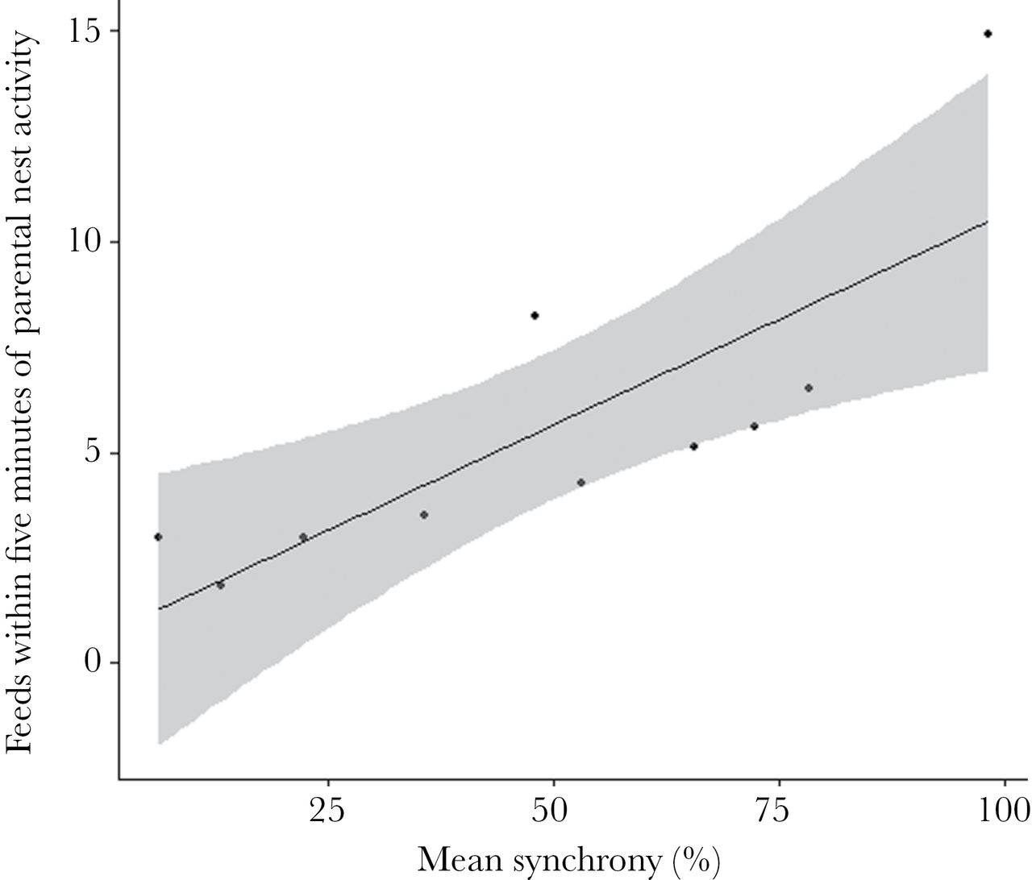
Figure 5 Relationship between the mean nest activity (see Methods for details) and mean synchrony scores for nests in ...
Notes:
Figure 5 Relationship between the mean nest activity (see Methods for details) and mean synchrony scores for nests in 2012. The regression line is derived from values predicted by a linear model and shows a significant relationship between nest activity and mean synchrony score (LM: F1,5 = 13.78, P = 0.014), with SE represented by shading.
Unless provided in the caption above, the following copyright applies to the content of this slide: © The Author 2015. Published by Oxford University Press on behalf of the International Society for Behavioral Ecology. All rights reserved. For permissions, please e-mail: journals.permissions@oup.com

