Slide 1
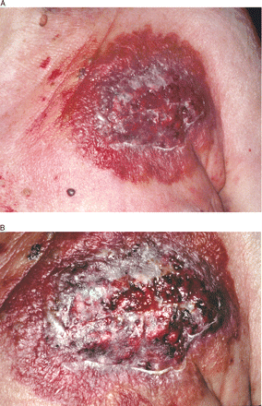
Figure 1 (A) Erythematous, infiltrated plaque with beginning central necrosis and (B) evolving lesion 2 days later. ...
Notes:
Figure 1 (A) Erythematous, infiltrated plaque with beginning central necrosis and (B) evolving lesion 2 days later. Necrotic ulcer with coarse granulation tissue and bluish borders forming circular segments.
Unless provided in the caption above, the following copyright applies to the content of this slide: © The European Society of Cardiology 2006. All rights reserved. For Permissions, please e-mail: journals.permissions@oxfordjournals.org

