Slide 1
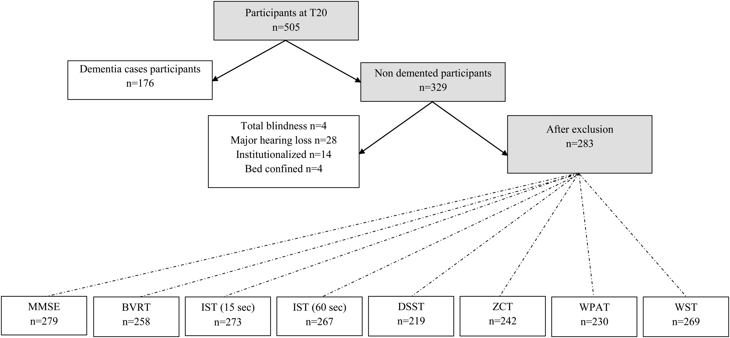
Fig. 1. Flow chart: Study sample for the norms of the different tests (MMSE, BVRT, IST, DSST, ZCT, WPAT, and WST) in ...
Notes:
Fig. 1. Flow chart: Study sample for the norms of the different tests (MMSE, BVRT, IST, DSST, ZCT, WPAT, and WST) in the PAQUID cohort at 20-year follow-up. Note: MMSE = Mini-Mental State Examination; BVRT = Benton Visual Retention Test; IST = Isaacs’ Set Test; DSST = Digit Symbol Substitution Test; ZCT = Zazzo's Cancellation Task (short 8-line version); WPAT = Wechsler Paired-Associates Test; WST = Wechsler Similarities Test.
Unless provided in the caption above, the following copyright applies to the content of this slide: © The Author 2015. Published by Oxford University Press. All rights reserved. For permissions, please e-mail: journals.permissions@oup.com.

