Slide 1
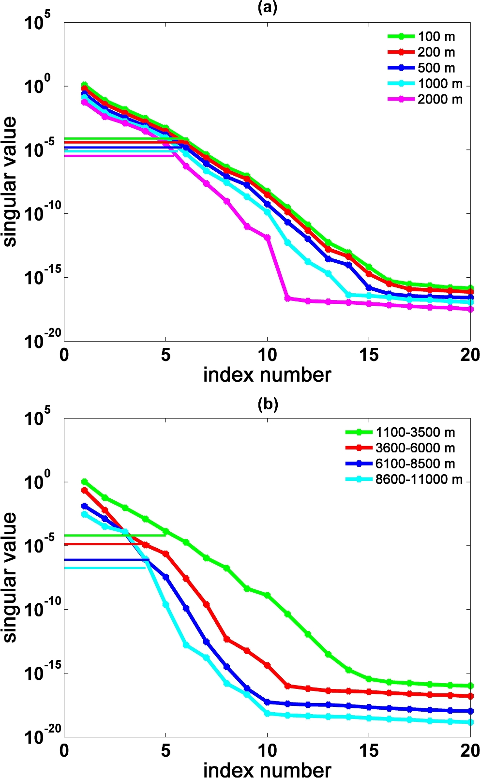
Figure 1. Singular value plots (a) for different transmitter spacing, (b) for different offset ranges. The horizontal ...
Notes:
Figure 1. Singular value plots (a) for different transmitter spacing, (b) for different offset ranges. The horizontal lines emanating from the y-axis show the cut-off value.
Unless provided in the caption above, the following copyright applies to the content of this slide: © The Authors 2017. Published by Oxford University Press on behalf of The Royal Astronomical Society.

Slide 2
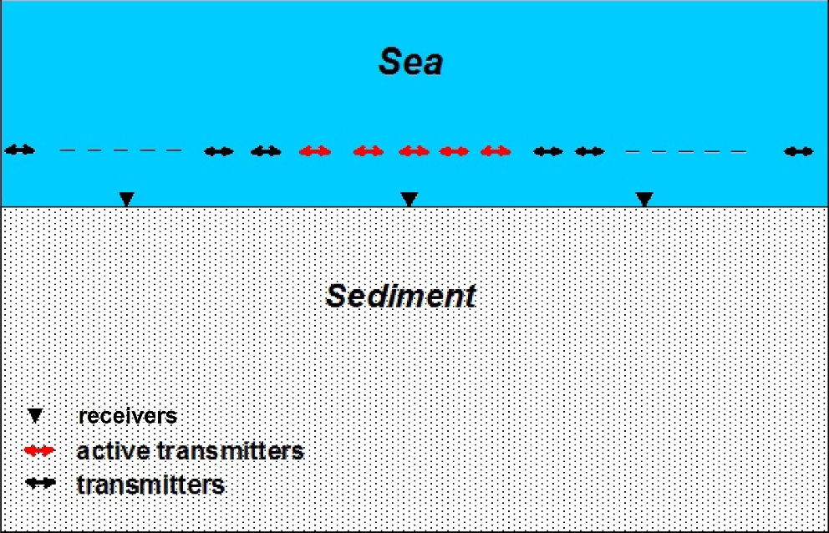
Figure 2. Schematic diagram presenting the simultaneously active multiple transmitters concept, transmitters coloured ...
Notes:
Figure 2. Schematic diagram presenting the simultaneously active multiple transmitters concept, transmitters coloured in red are simultaneously active and their joint response is recorded at all receiver positions.
Unless provided in the caption above, the following copyright applies to the content of this slide: © The Authors 2017. Published by Oxford University Press on behalf of The Royal Astronomical Society.

Slide 3
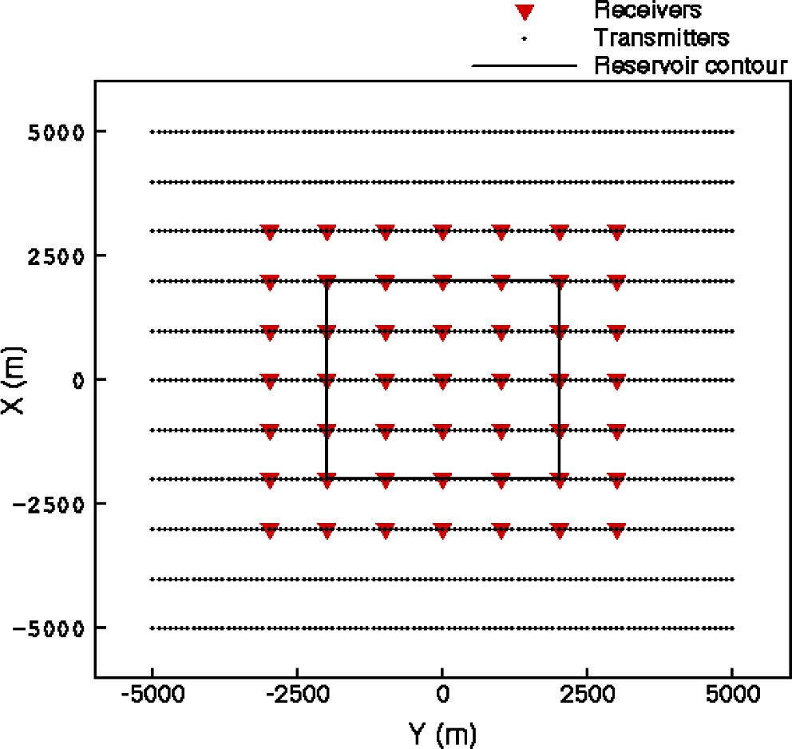
Figure 3. Schematic diagram for survey layout used for synthetic data simulation.
Notes:
Figure 3. Schematic diagram for survey layout used for synthetic data simulation.
Unless provided in the caption above, the following copyright applies to the content of this slide: © The Authors 2017. Published by Oxford University Press on behalf of The Royal Astronomical Society.

Slide 4
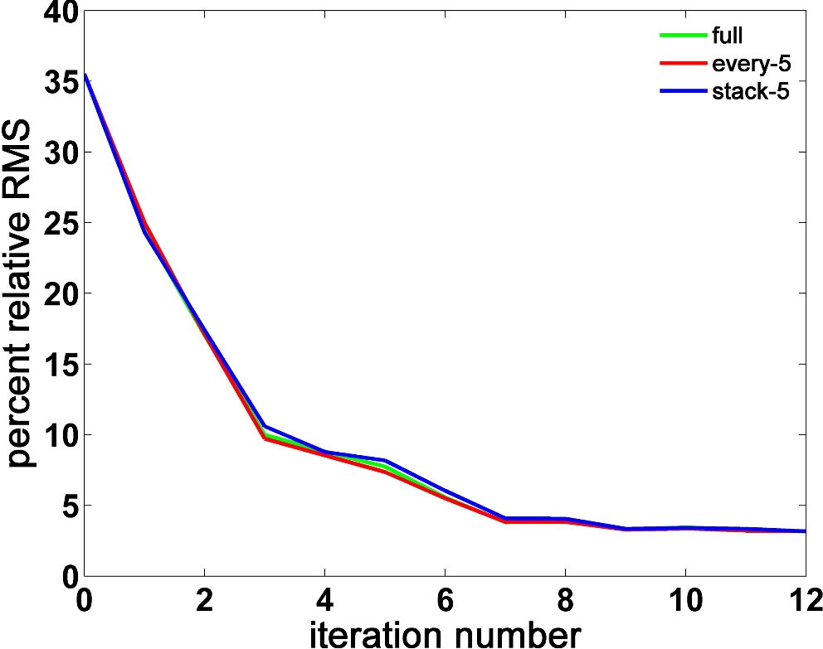
Figure 4. Percent relative RMS error plots for the noise free data experiment.
Notes:
Figure 4. Percent relative RMS error plots for the noise free data experiment.
Unless provided in the caption above, the following copyright applies to the content of this slide: © The Authors 2017. Published by Oxford University Press on behalf of The Royal Astronomical Society.

Slide 5
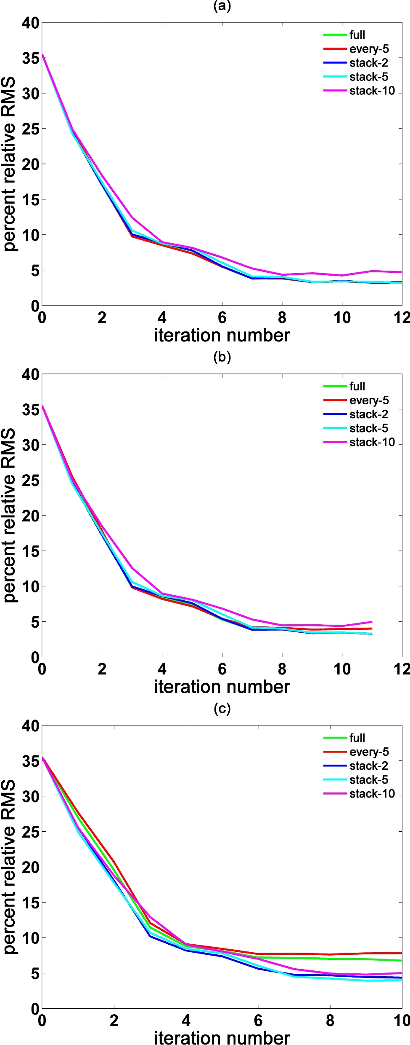
Figure 5. Percent relative RMS error plots for the uncorrelated noise experiments, (a) 3 percent noise; (b) 10 percent ...
Notes:
Figure 5. Percent relative RMS error plots for the uncorrelated noise experiments, (a) 3 percent noise; (b) 10 percent noise; (c) 20 percent noise.
Unless provided in the caption above, the following copyright applies to the content of this slide: © The Authors 2017. Published by Oxford University Press on behalf of The Royal Astronomical Society.

Slide 6
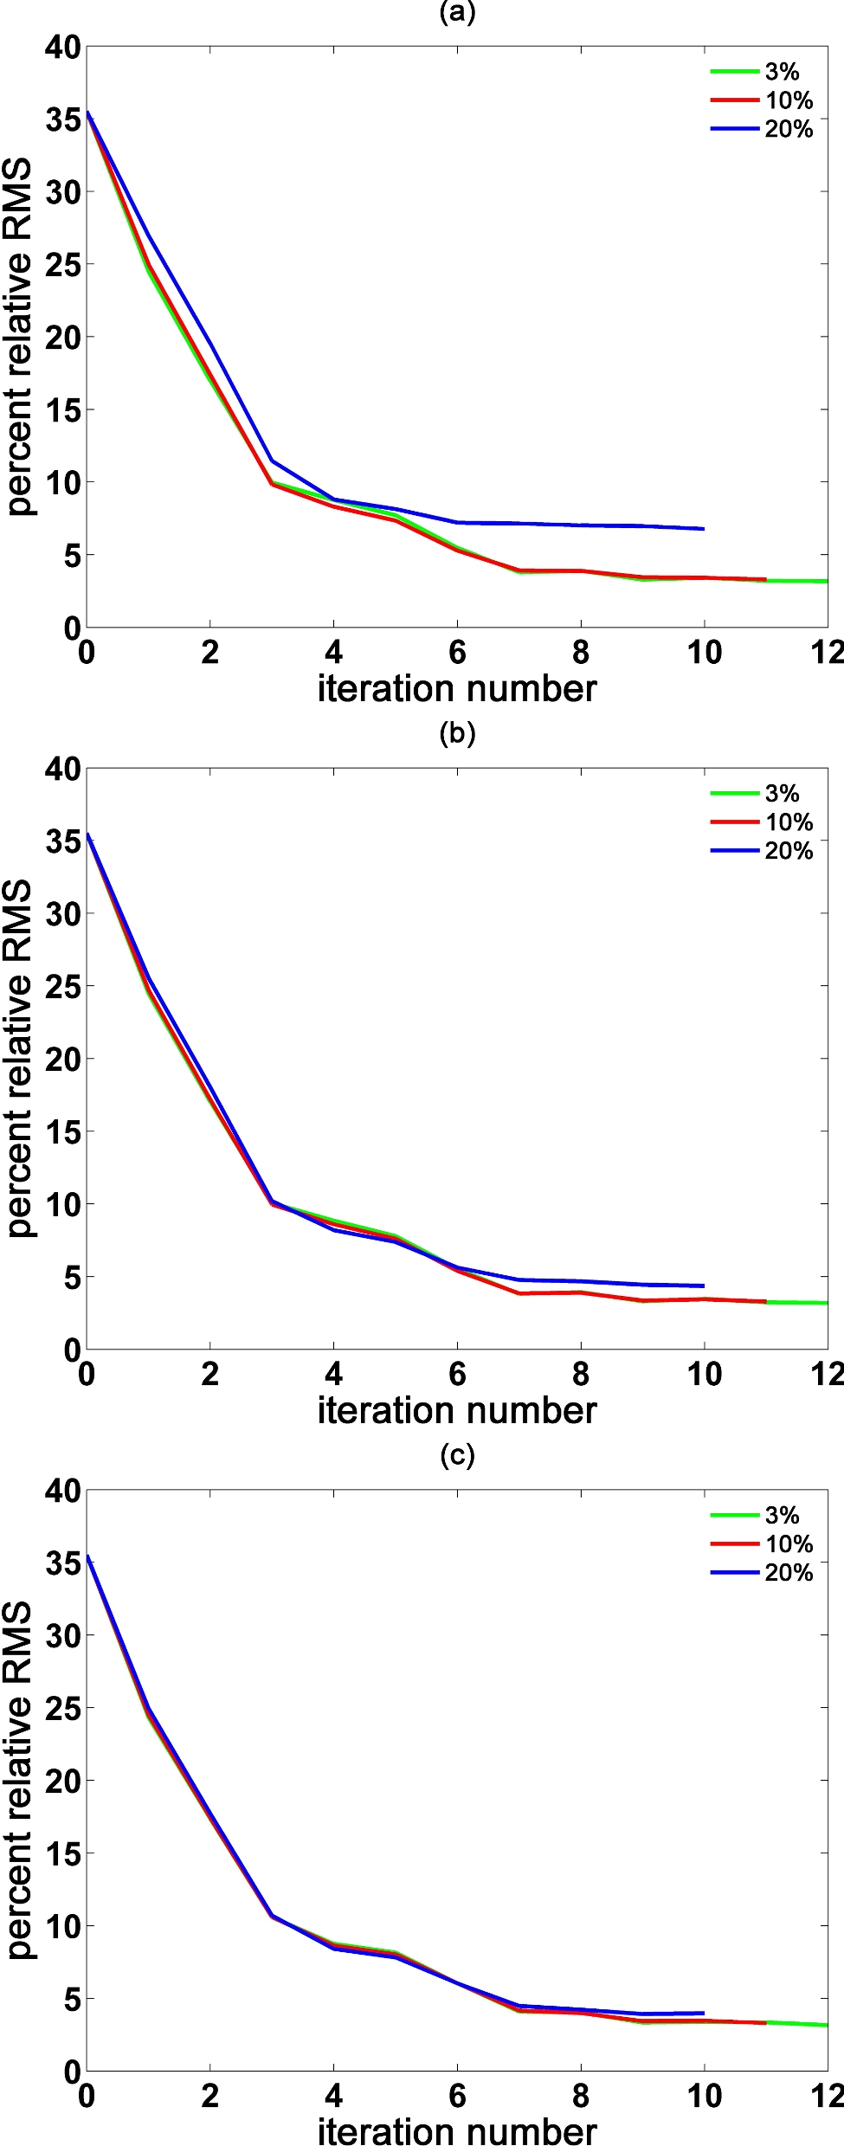
Figure 6. Percent relative RMS error plots for the uncorrelated noise experiments for different levels of noise, (a) ...
Notes:
Figure 6. Percent relative RMS error plots for the uncorrelated noise experiments for different levels of noise, (a) full; (b) stack-2; (c) stack-5.
Unless provided in the caption above, the following copyright applies to the content of this slide: © The Authors 2017. Published by Oxford University Press on behalf of The Royal Astronomical Society.

Slide 7
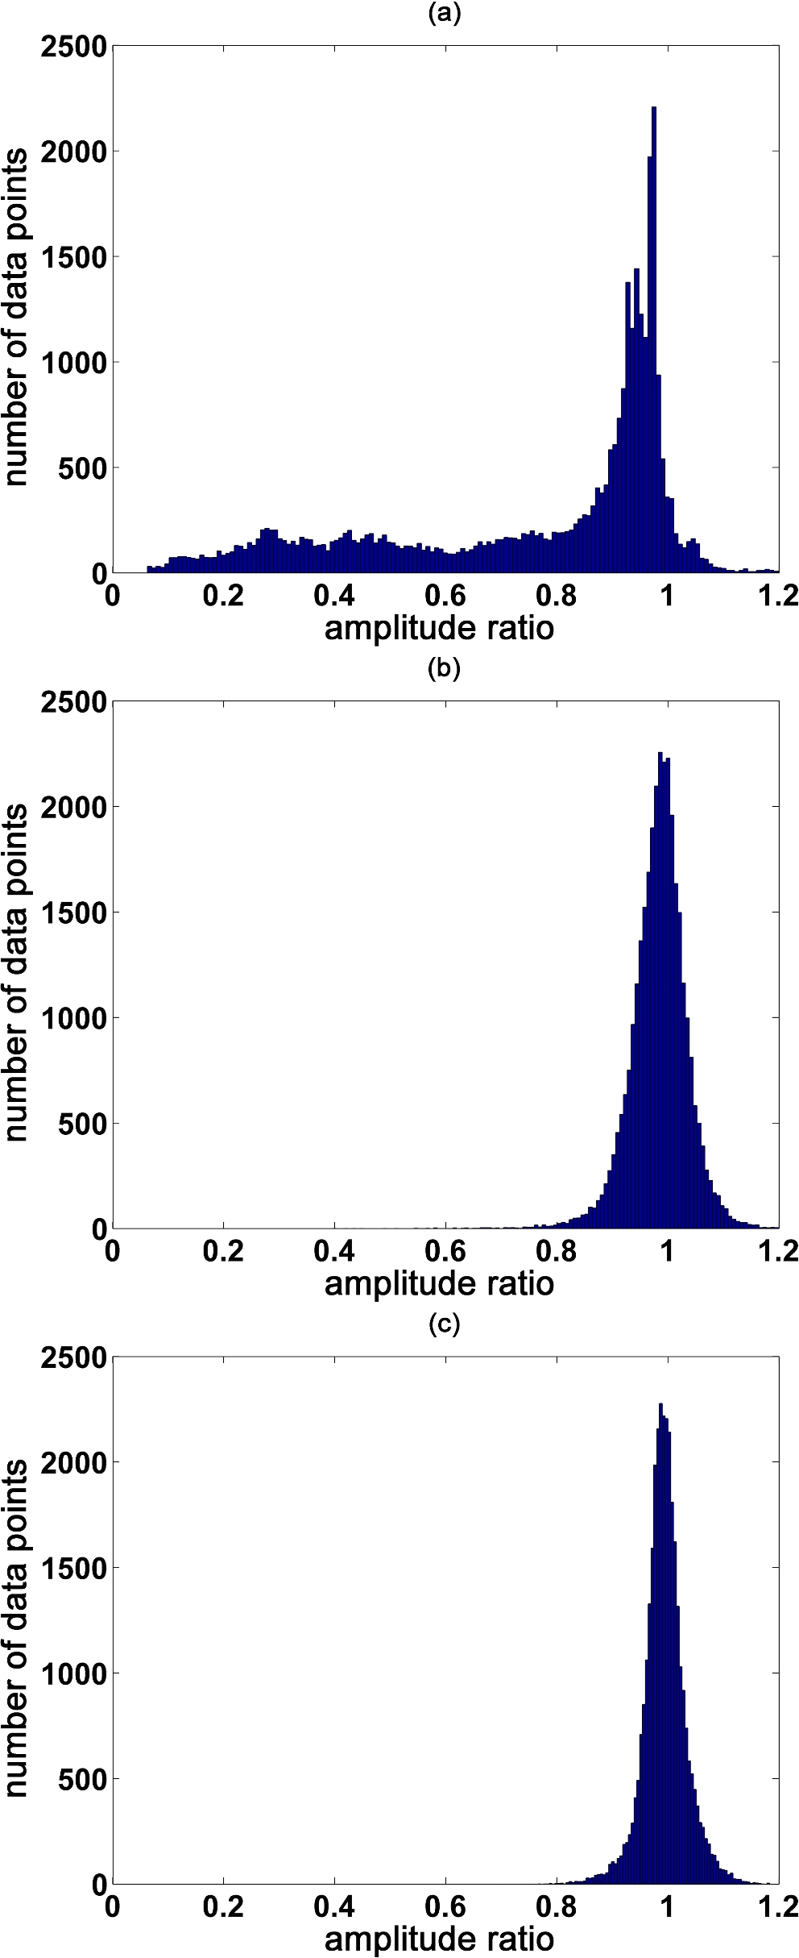
Figure 7. Histogram of the amplitude ratios of all data points included in the inversion of uncorrelated additive noise ...
Notes:
Figure 7. Histogram of the amplitude ratios of all data points included in the inversion of uncorrelated additive noise experiment, (a) initial iteration; (b) final iteration of full inversion run; (c) final iteration of stack-5 inversion run.
Unless provided in the caption above, the following copyright applies to the content of this slide: © The Authors 2017. Published by Oxford University Press on behalf of The Royal Astronomical Society.

Slide 8
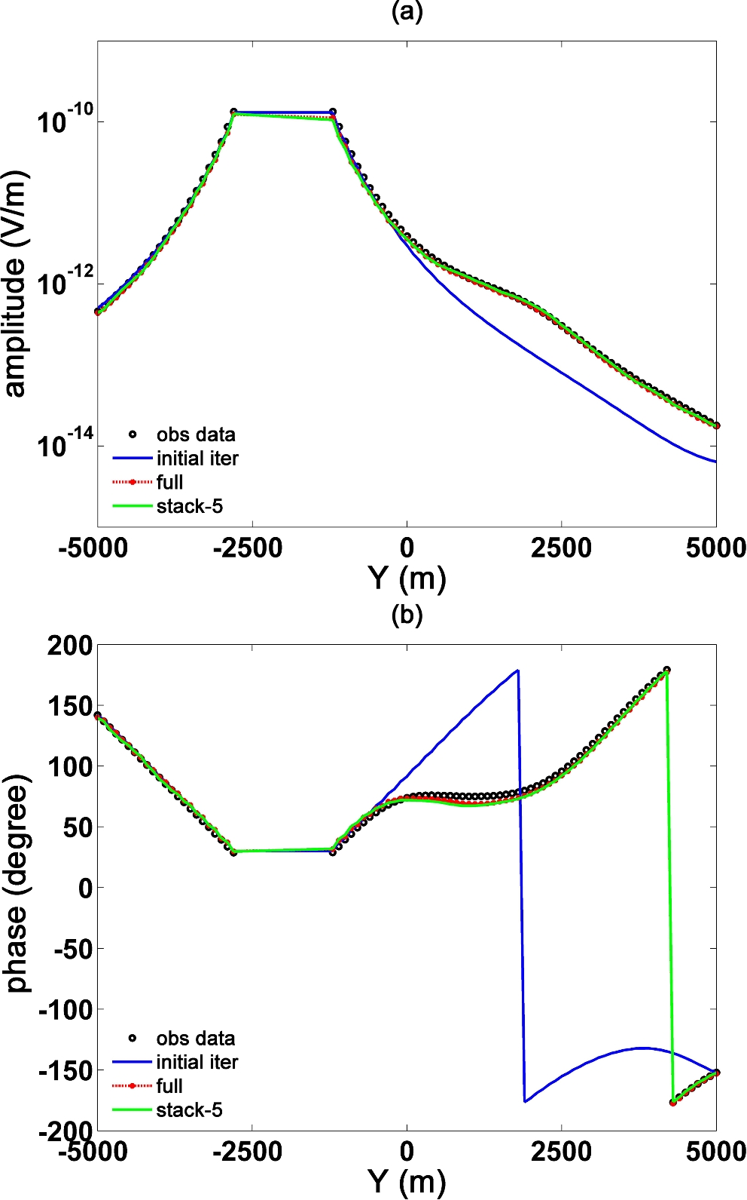
Figure 8. Plots of predicted data of initial iteration, full, stack-5 inversion runs and observed data of uncorrelated ...
Notes:
Figure 8. Plots of predicted data of initial iteration, full, stack-5 inversion runs and observed data of uncorrelated additive noise experiment for a receiver placed at 0 m, −2000 m in x- and y-direction respectively, (a) amplitude; (b) phase.
Unless provided in the caption above, the following copyright applies to the content of this slide: © The Authors 2017. Published by Oxford University Press on behalf of The Royal Astronomical Society.

Slide 9
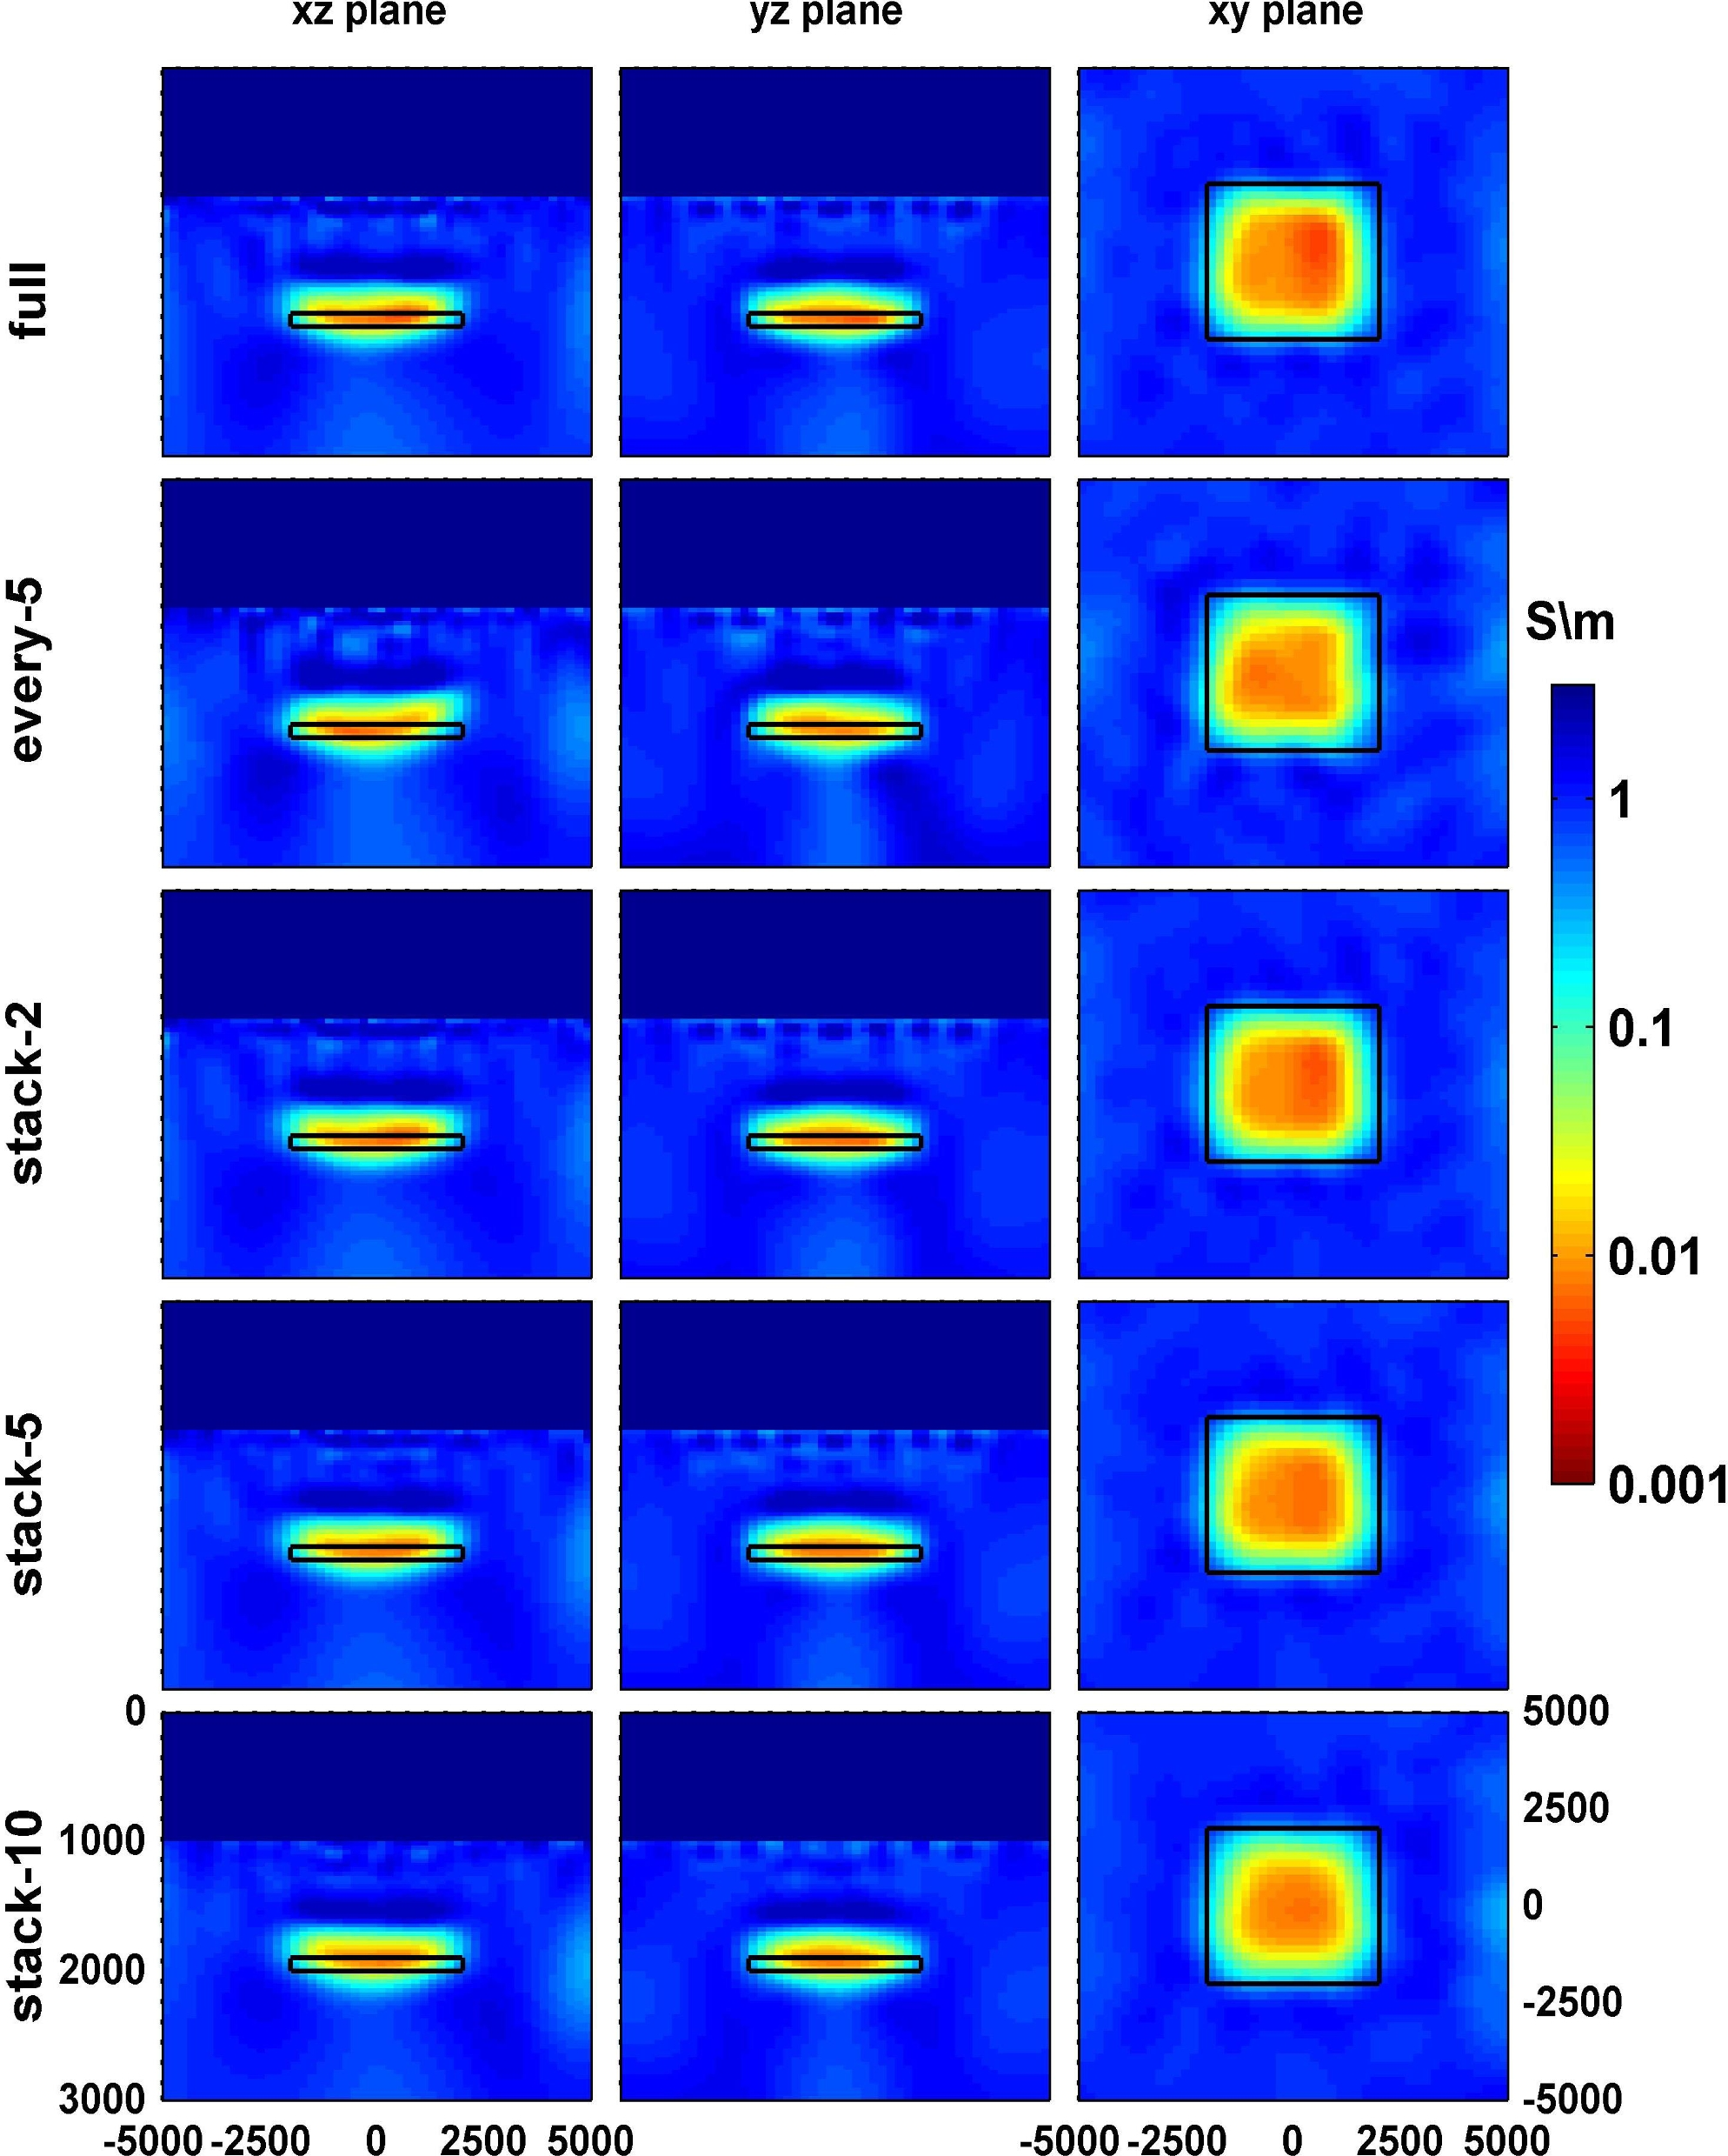
Figure 9. Inverted models of uncorrelated additive noise experiment: xz plane view at y = 0 m, yz plane view at ...
Notes:
Figure 9. Inverted models of uncorrelated additive noise experiment: xz plane view at y = 0 m, yz plane view at x = 0 m, xy plane view at z = 1900 m. Black rectangle shows the actual boundary of the resistive body.
Unless provided in the caption above, the following copyright applies to the content of this slide: © The Authors 2017. Published by Oxford University Press on behalf of The Royal Astronomical Society.

Slide 10
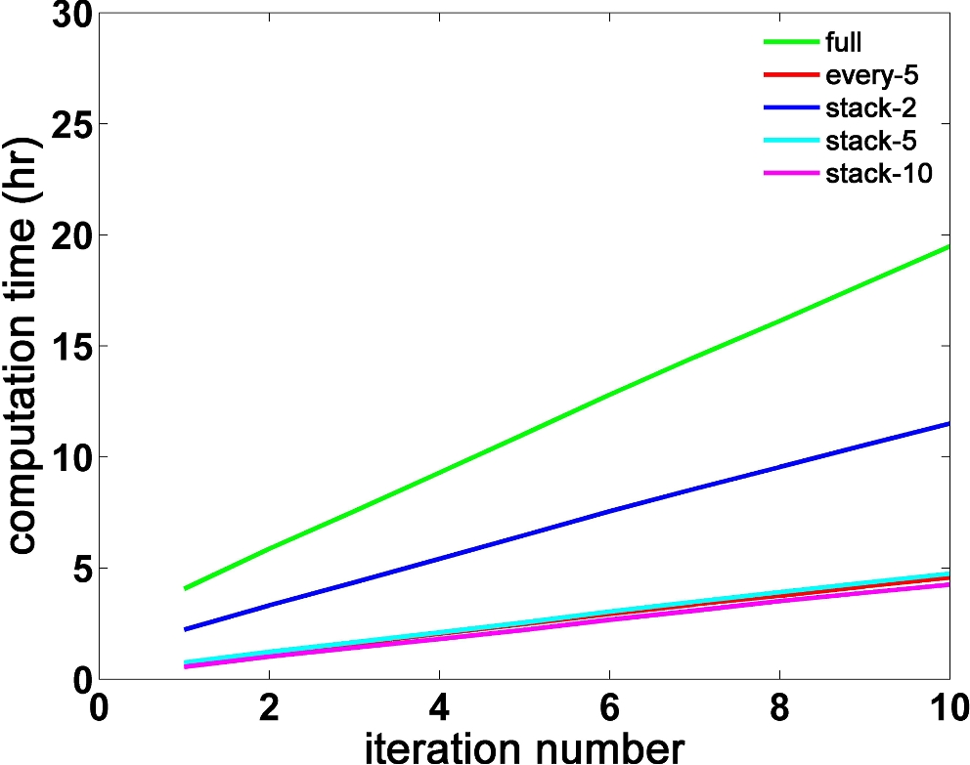
Figure 10. Time statistic comparison of 20 percent uncorrelated additive noise experiment.
Notes:
Figure 10. Time statistic comparison of 20 percent uncorrelated additive noise experiment.
Unless provided in the caption above, the following copyright applies to the content of this slide: © The Authors 2017. Published by Oxford University Press on behalf of The Royal Astronomical Society.

Slide 11
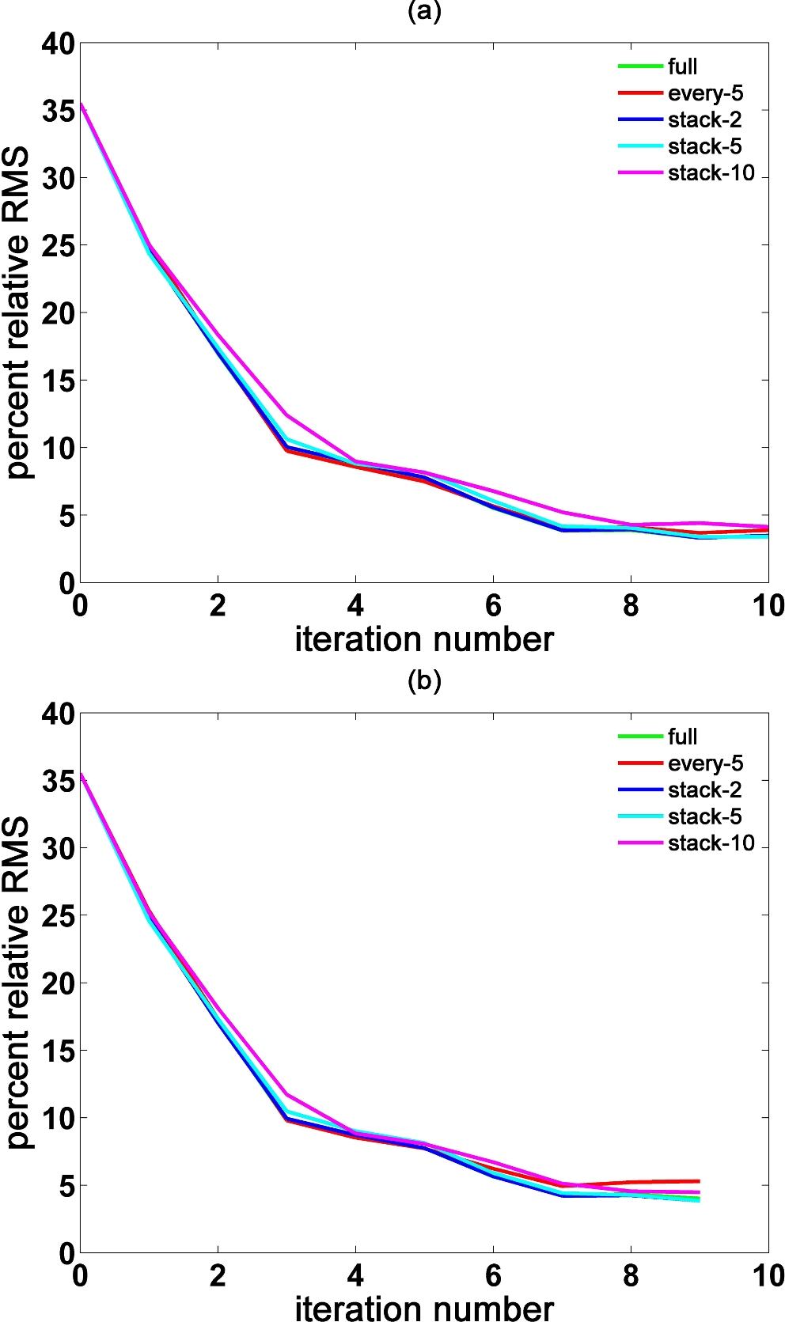
Figure 11. Percent relative RMS error plots for the correlated non-additive noise experiment, (a) 10 and 20 m standard ...
Notes:
Figure 11. Percent relative RMS error plots for the correlated non-additive noise experiment, (a) 10 and 20 m standard deviation of transmitter position perturbation in in-line and cross-line directions, respectively, (b) 30 and 50 m standard deviation of transmitter position perturbation in in-line and cross-line directions, respectively
Unless provided in the caption above, the following copyright applies to the content of this slide: © The Authors 2017. Published by Oxford University Press on behalf of The Royal Astronomical Society.

Slide 12
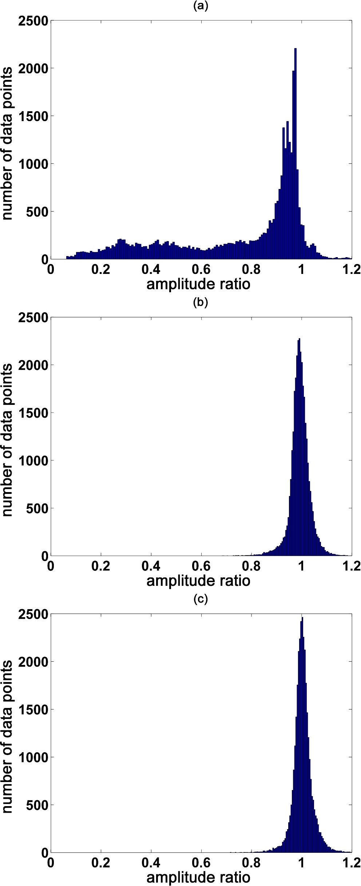
Figure 12. Histogram of the amplitude ratios of all data points included in the inversion of correlated non-additive ...
Notes:
Figure 12. Histogram of the amplitude ratios of all data points included in the inversion of correlated non-additive noise experiment, (a) initial iteration; (b) final iteration of full inversion run; (c) final iteration of stack-5 inversion run.
Unless provided in the caption above, the following copyright applies to the content of this slide: © The Authors 2017. Published by Oxford University Press on behalf of The Royal Astronomical Society.

Slide 13
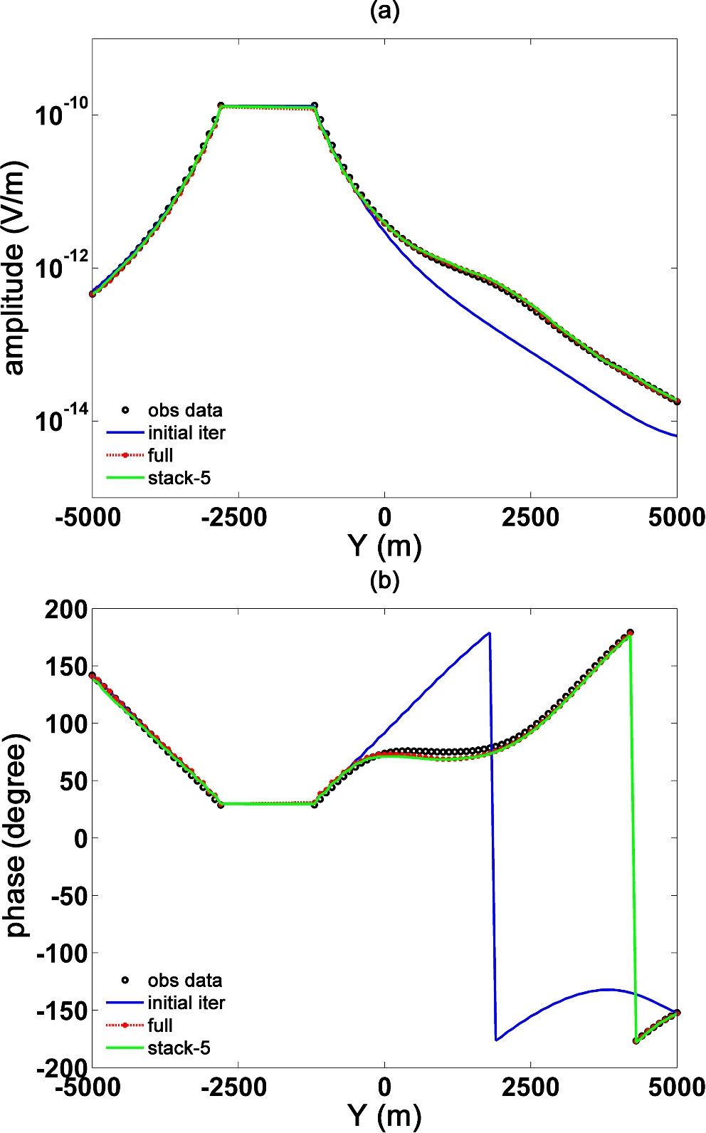
Figure 13. Plots of predicted data of initial iteration, full, stack-5 inversion runs and observed data of correlated ...
Notes:
Figure 13. Plots of predicted data of initial iteration, full, stack-5 inversion runs and observed data of correlated non-additive noise experiment for a receiver placed at 0, −2000 m in the x- and y-directions, respectively, (a) amplitude; (b) phase.
Unless provided in the caption above, the following copyright applies to the content of this slide: © The Authors 2017. Published by Oxford University Press on behalf of The Royal Astronomical Society.

Slide 14
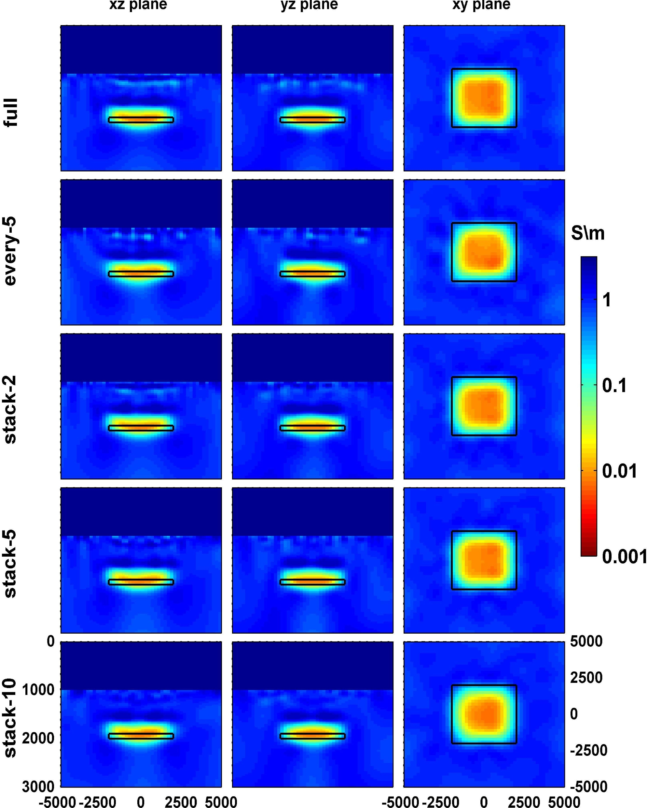
Figure 14. Inverted models of correlated non-additive noise experiment: xz plane view at y = 0 m, yz plane view at ...
Notes:
Figure 14. Inverted models of correlated non-additive noise experiment: xz plane view at y = 0 m, yz plane view at x = 0 m, xy plane view at z = 1900 m. Black rectangle shows the actual boundary of the resistive body.
Unless provided in the caption above, the following copyright applies to the content of this slide: © The Authors 2017. Published by Oxford University Press on behalf of The Royal Astronomical Society.

Slide 15
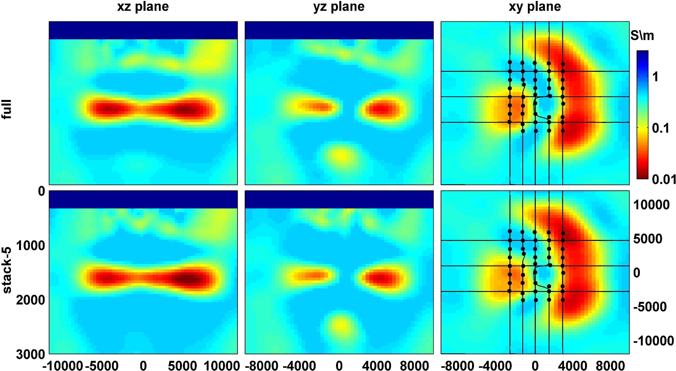
Figure 15. Inverted models of Troll field data: xz plane view at y = 3000 m; yz plane view at x = 0 m; xy plane view at ...
Notes:
Figure 15. Inverted models of Troll field data: xz plane view at y = 3000 m; yz plane view at x = 0 m; xy plane view at z = 1500 m. To show the data coverage, receiver positions (black dots) and the towlines (black lines) are overlaid on top of the xy slice.
Unless provided in the caption above, the following copyright applies to the content of this slide: © The Authors 2017. Published by Oxford University Press on behalf of The Royal Astronomical Society.

