Slide 1
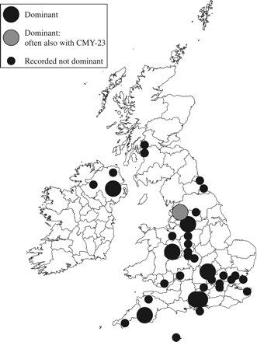
Figure 1 Occurrence of the epidemic E. coli strain A with CTX-M-15 β-lactamase in the UK, 2003–5.
Notes:
Figure 1 Occurrence of the epidemic E. coli strain A with CTX-M-15 β-lactamase in the UK, 2003–5.
Unless provided in the caption above, the following copyright applies to the content of this slide: © The Author 2006. Published by Oxford University Press on behalf of the British Society for Antimicrobial Chemotherapy. All rights reserved. For Permissions, please e-mail: journals.permissions@oxfordjournals.org

Slide 2
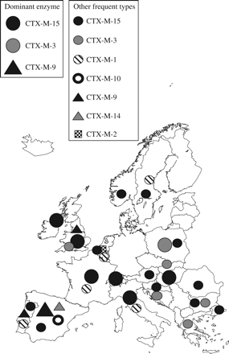
Figure 2 Dominant and frequent CTX-M β-lactamase types in different European countries. Data for France, Italy, ...
Notes:
Figure 2 Dominant and frequent CTX-M β-lactamase types in different European countries. Data for France, Italy, Poland, Spain and the UK are based on the references cited in the text. Those for other countries are based on further reports, 25,99–105 also, for Croatia, B. Bedenic and M. Gniadkowski., unpublished data and, for Switzerland, A. Wenger and P. Nordmann, unpublished data, with national dominance only inferred based on large-scale surveys. Many other CTX-M enzymes have been isolated on a few occasions or (as with CTX-M-5-producing Salmonella Typhimurium in Latvia) have caused sizeable but time-defined outbreaks before apparently declining. CTX-M-type enzymes are emerging rapidly also in Greece but reports that stress prevalence do not identify the particular enzyme types.
Unless provided in the caption above, the following copyright applies to the content of this slide: © The Author 2006. Published by Oxford University Press on behalf of the British Society for Antimicrobial Chemotherapy. All rights reserved. For Permissions, please e-mail: journals.permissions@oxfordjournals.org

Slide 3
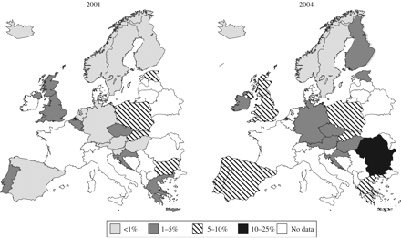
Figure 3 Prevalence of resistance to extended-spectrum cephalosporins among E. coli isolates from bacteraemias, as ...
Notes:
Figure 3 Prevalence of resistance to extended-spectrum cephalosporins among E. coli isolates from bacteraemias, as reported under the European Antimicrobial Resistance Surveillance System () in 2001 and 2004, supplemented with UK data based on laboratories' reports to the Health Protection Agency.
Unless provided in the caption above, the following copyright applies to the content of this slide: © The Author 2006. Published by Oxford University Press on behalf of the British Society for Antimicrobial Chemotherapy. All rights reserved. For Permissions, please e-mail: journals.permissions@oxfordjournals.org

