Slide 1
Figure 1 Logo of the IeDEA
Notes:
Figure 1 Logo of the IeDEA
Unless provided in the caption above, the following copyright applies to the content of this slide: Published by Oxford University Press on behalf of the International Epidemiological Association © The Author 2011; all rights reserved.

Slide 2
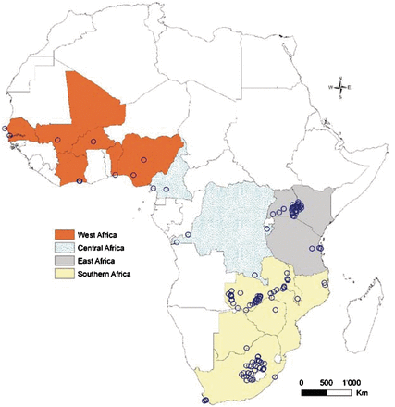
Figure 2 Map of 183 ART facilities participating in the four African regions of the International epidemiological ...
Notes:
Figure 2 Map of 183 ART facilities participating in the four African regions of the International epidemiological Databases to Evaluate AIDS
Unless provided in the caption above, the following copyright applies to the content of this slide: Published by Oxford University Press on behalf of the International Epidemiological Association © The Author 2011; all rights reserved.

Slide 3
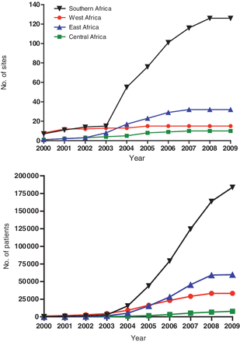
Figure 3 Cumulative number of treatment sites (a) and cumulative number of patients starting antiretroviral therapy ...
Notes:
Figure 3 Cumulative number of treatment sites (a) and cumulative number of patients starting antiretroviral therapy (b) in the four African regions of the IeDEA
Unless provided in the caption above, the following copyright applies to the content of this slide: Published by Oxford University Press on behalf of the International Epidemiological Association © The Author 2011; all rights reserved.

