Slide 1
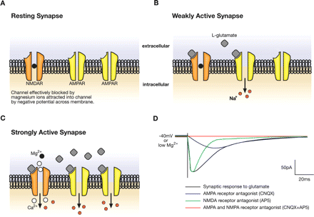
Fig. 1 The NMDA receptor as a coincidence detector. This figure depicts a glutamatergic postsynaptic membrane ...
Notes:
Fig. 1 The NMDA receptor as a coincidence detector. This figure depicts a glutamatergic postsynaptic membrane containing AMPA and NMDA subtypes of glutamate receptor. Under conditions of rest or low levels of input activity, the channel of the NMDA receptor is blocked by positively charged magnesium ions (Mg2+) (A). Glutamate molecules released from the pre-synaptic terminal diffuse across the synaptic cleft and bind to both sub-types of receptor, opening AMPA receptor channels. The resulting inward current flow carried by Na+ ions depolarises the post-synaptic membrane to produce an excitatory post-synaptic potential (EPSP). Low concentrations of released glutamate do not depolarise the postsynaptic membrane sufficiently to relieve the Mg2+ -block of the NMDA receptor channel (B). High concentrations of glutamate released at a strongly active synapse produce strong depolarisation of the post-synaptic membrane, resulting in the expulsion of magnesium ions from the NMDA receptor channel, and allowing influx of Na+ and Ca2+ ions (C). Thus the NMDA receptor acts as a detector of coincident pre and post-synaptic activity. Panel D illustrates intracellular recordings of excitatory synaptic currents under conditions of low magnesium or membrane depolarisation (either of which result in unblocked NMDA receptor channels and ion permeation when glutamate is bound to the receptor; black trace). Application of antagonists of AMPA receptors (CNQX; blue trace) or NMDA receptors (AP5; green trace) results in selective abolition of fast or slow components of the EPSP, respectively.
Unless provided in the caption above, the following copyright applies to the content of this slide: © The Author (2006). Published by Oxford University Press on behalf of the Guarantors of Brain. All rights reserved. For Permissions, please email: journals.permissions@oxfordjournals.org

Slide 2
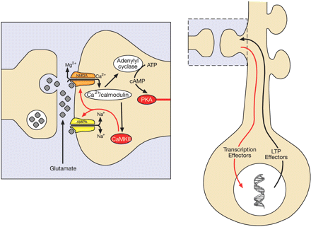
Fig. 2 Intracellular signalling mechanisms mediating NMDA receptor-dependent long-term potentiation (LTP). Localised ...
Notes:
Fig. 2 Intracellular signalling mechanisms mediating NMDA receptor-dependent long-term potentiation (LTP). Localised signalling at the synapse is mediated by kinases activated by calcium (Ca2+) influx through the NMDA receptor interacting with calmodulin (left-hand panel). Ca2+/calmodulin activates Ca2+/calmodulin-dependent kinase II (CaMKII) that, in turn, alters synaptic transmission through post-synaptic modifications of glutamate receptors, either via phosphorylation to alter the conductance state of existing channels or by facilitating the insertion of new receptors into the membrane. There is also evidence for pre-synaptic changes, culminating in increased transmitter release. Adenylyl cyclases are activated by Ca2+/calmodulin, thereby activating the cAMP-dependent protein kinase (PKA). This kinase can initiate signalling to the cell nucleus, via a number of intermediary steps, resulting in changes in transcription and eventual expression of proteins involved in long-lasting changes that mediate persistent LTP (right-hand panel).
Unless provided in the caption above, the following copyright applies to the content of this slide: © The Author (2006). Published by Oxford University Press on behalf of the Guarantors of Brain. All rights reserved. For Permissions, please email: journals.permissions@oxfordjournals.org

Slide 3
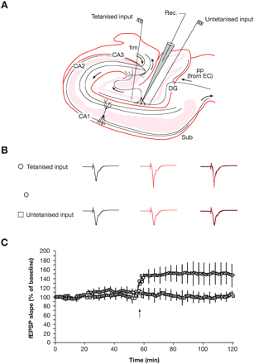
Fig. 3 Induction of long-term potentiation (LTP) in the human hippocampus. (A) Diagram of a hippocampal slice ...
Notes:
Fig. 3 Induction of long-term potentiation (LTP) in the human hippocampus. (A) Diagram of a hippocampal slice prepared from excised human temporal lobe. Granule and pyramidal cell fields are shaded in pink. The schematic shows the excitatory 'tri-synaptic loop comprising (i) perforant path (PP) fibres originating in the entorhinal cortex (EC) terminating on granule cells in the dentate gyrus (DG), (ii) granule cells in turn projecting, via their axons, the mossy fibres, to the CA3 subfield of the hippocampus. Here the mossy fibres terminate on proximal apical dendrites of pyramidal cells. The latter in turn, project via the Schaffer collaterals to subfield CA1, where they terminate upon pyramidal neurons, the axons of which project to the subiculum (Sub). A recording electrode is shown in the dendritic field of granule cells to monitor field potentials evoked by two electrodes placed on either side to activate non-overlapping populations of PP axons. Evoked synaptic field potentials are shown in panel B. Responses prior to the delivery of a high-frequency train through one of the two stimulating electrodes are shown in black. Responses after the tetanus are shown in red. The other stimulating electrode activates a non-tetanised control pathway. Low frequency stimuli are delivered to both pathways throughout the experiment. A plot of the slope of the population EPSP against time shows a large and maintained increase in synaptic efficacy in the tetanised pathway but not in the control pathway following delivery of the high frequency train (arrow) (C). Adapted, with permission, from Beck et al. (2000).
Unless provided in the caption above, the following copyright applies to the content of this slide: © The Author (2006). Published by Oxford University Press on behalf of the Guarantors of Brain. All rights reserved. For Permissions, please email: journals.permissions@oxfordjournals.org

Slide 4
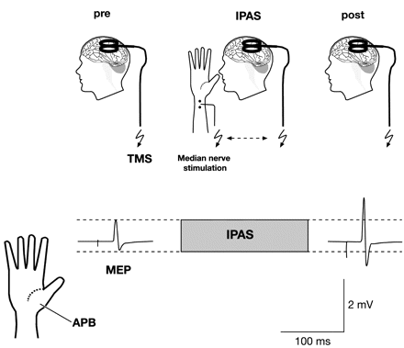
Fig. 4 Interventional paired associative stimulation (IPAS). Transcranial magnetic stimulation (TMS) is delivered to ...
Notes:
Fig. 4 Interventional paired associative stimulation (IPAS). Transcranial magnetic stimulation (TMS) is delivered to the hand representation area in region M1 of the motor cortex with single test pulses at an intensity set to elicit a motor evoked potential (MEP) in the abductor pollicis brevis (APB) muscle of the thumb. Electrical stimuli to the median nerve are paired with TMS (e.g. 90 pairs with an inter-stimulus interval of 25msec). After pairing, test TMS pulses elicit an enhanced MEP. The potentiation of the MEP can last for at least an hour. MEPs represent averages of 20 samples. Adapted, with permission, from Stefan et al. (2000).
Unless provided in the caption above, the following copyright applies to the content of this slide: © The Author (2006). Published by Oxford University Press on behalf of the Guarantors of Brain. All rights reserved. For Permissions, please email: journals.permissions@oxfordjournals.org

