Slide 1
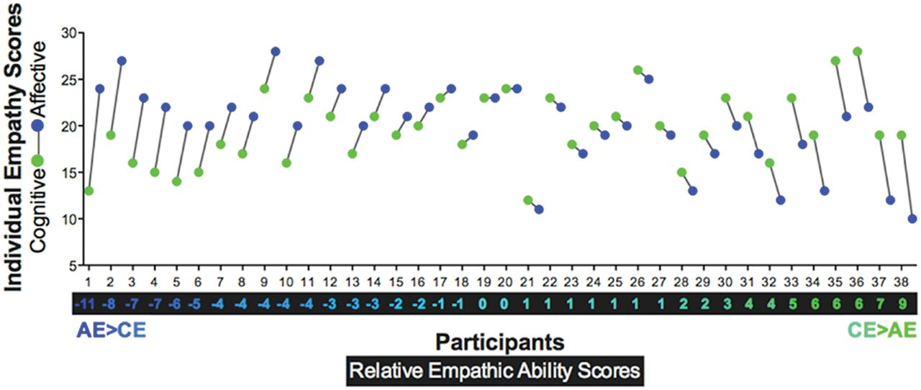
Fig. 1 Each participant's (n = 38) absolute affective empathy (AE; blue) and cognitive empathy (CE; green) scores ...
Notes:
Fig. 1 Each participant's (n = 38) absolute affective empathy (AE; blue) and cognitive empathy (CE; green) scores are plotted, with their relative empathy score (REA) (CE minus AE; gradient from blue to green) displayed below the x-axis. Negative scores indicate a dominance of affective empathy (AE > CE), and positive scores indicate a dominance of cognitive (CE > AE).
Unless provided in the caption above, the following copyright applies to the content of this slide: © The Author(s) (2011). Published by Oxford University Press.This is an Open Access article distributed under the terms of the Creative Commons Attribution Non-Commercial License (http://creativecommons.org/licenses/by-nc/4.0/), which permits non-commercial re-use, distribution, and reproduction in any medium, provided the original work is properly cited. For commercial re-use, please contact journals.permissions@oup.com

Slide 2
Fig. 3 REA scores were significantly negatively correlated with Barratt Impulsiveness Scale (BIS) total scores (left ...
Notes:
Fig. 3 REA scores were significantly negatively correlated with Barratt Impulsiveness Scale (BIS) total scores (left graph) and Buss-Perry Aggression Questionnaire (BPAQ) Anger subscale scores (right graph). Relative weakness in CE and dominance of AE was associated with higher levels of impulsivity and anger-related aggression. All tests were thresholded using a Bonferroni correction for multiple comparisons (P < 0.05/17 = 0.003).
Unless provided in the caption above, the following copyright applies to the content of this slide: © The Author(s) (2011). Published by Oxford University Press.This is an Open Access article distributed under the terms of the Creative Commons Attribution Non-Commercial License (http://creativecommons.org/licenses/by-nc/4.0/), which permits non-commercial re-use, distribution, and reproduction in any medium, provided the original work is properly cited. For commercial re-use, please contact journals.permissions@oup.com

Slide 3
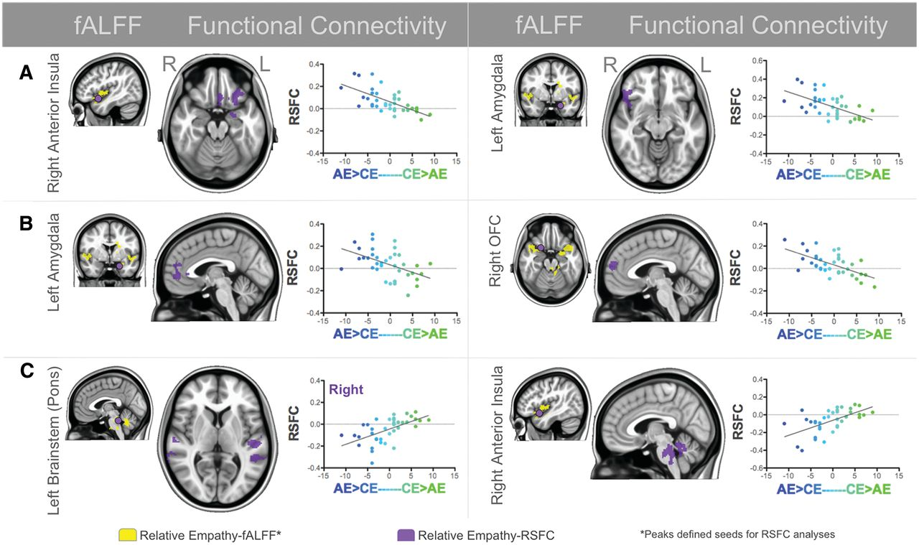
Fig. 2 Examples of the three patterns of the RSFC–REA brain–behavior relationships. Brains with yellow clusters ...
Notes:
Fig. 2 Examples of the three patterns of the RSFC–REA brain–behavior relationships. Brains with yellow clusters indicate significant fALFF–REA relationships, the peaks of which defined seed regions for RSFC analyses, identified with purple dots. Brains with purple clusters represent significant RSFC-REA relationships with the seed region. (A) Dominance of AE was associated with stronger positive RSFC, dominance of CE with weaker positive RSFC; observed between the right ventral anterior insula seed and left OFC/subcallosal cortex/amygdala (left column), and the left amygdala seed and right OFC/temporal pole/ventral anterior insula (right column). (B) Dominance of AE was associated with stronger positive RSFC, dominance of CE with stronger negative RSFC; observed between the left amygdala seed and bilateral perigenual ACC (left column), and the right OFC seed and bilateral paracingulate gyrus (right column). (C) Dominance of CE was associated with stronger positive RSFC, dominance of AE with stronger negative RSFC; observed between the left brainstem (pons) seed and bilateral superior temporal gyri/sulci (left column), and the right ventral anterior insula seed and bilateral brainstem/cerebellum (right column). All results were significant at Z > 2.3, cluster significance: P < 0.05 corrected for multiple comparisons using Gaussian random field theory. Brains are presented in radiological orientation (right = left).
Unless provided in the caption above, the following copyright applies to the content of this slide: © The Author(s) (2011). Published by Oxford University Press.This is an Open Access article distributed under the terms of the Creative Commons Attribution Non-Commercial License (http://creativecommons.org/licenses/by-nc/4.0/), which permits non-commercial re-use, distribution, and reproduction in any medium, provided the original work is properly cited. For commercial re-use, please contact journals.permissions@oup.com

