Slide 1
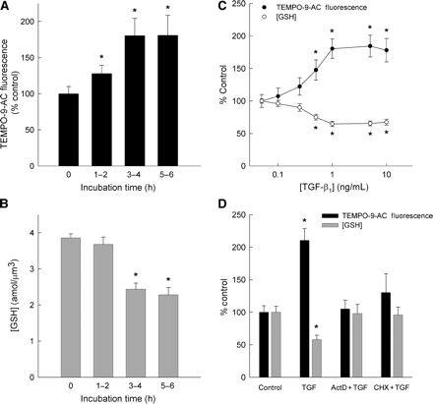
Figure 1 Alterations in myocyte levels of ROS and GSH by TGF-β₁. (A and B) Myocytes were incubated with 1 ...
Notes:
Figure 1 Alterations in myocyte levels of ROS and GSH by TGF-β1. (A and B) Myocytes were incubated with 1 ng/mL TGF-β1 for up to 6 h and the cellular levels of ROS and GSH were measured by fluorescence microscopy using the probes TEMPO-9-AC and mBCl, respectively. (C) ROS and GSH levels were measured as a function of TGF-β1 concentration (3–4 h treatment). (D) Pretreatment of myocytes with actinomycin D (1 µg/mL, ActD) or cycloheximide (100 µmol/L, CHX) prevented changes in GSH content (grey bar) and ROS levels elicited by TGF-β1. Each bar represents the mean from 30 to 40 myocytes isolated from five rat hearts. *P < 0.05 vs. control.
Unless provided in the caption above, the following copyright applies to the content of this slide: Published on behalf of the European Society of Cardiology. All rights reserved. © The Author 2007. For Permissions please email: journals.permissions@oxfordjournals.org

Slide 2
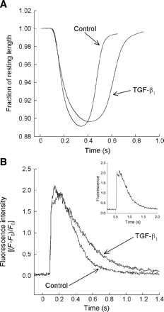
Figure 2 Myocyte contractile dysfunction elicited by TGF-β₁. (A) Representative traces of mechanical ...
Notes:
Figure 2 Myocyte contractile dysfunction elicited by TGF-β1. (A) Representative traces of mechanical responses in a control and TGF-β1-treated (1 ng/mL, 3–4 h) myocyte measured by edge-detection (0.5 Hz). (B) Comparison of the intracellular Ca2+ transient in a TGF-β1-treated and control myocyte (0.5 Hz) measured by confocal microscopy. Inset figure shows a second example from a TGF-β1-treated myocyte illustrating a secondary peak of the Ca2+ transient.
Unless provided in the caption above, the following copyright applies to the content of this slide: Published on behalf of the European Society of Cardiology. All rights reserved. © The Author 2007. For Permissions please email: journals.permissions@oxfordjournals.org

Slide 3
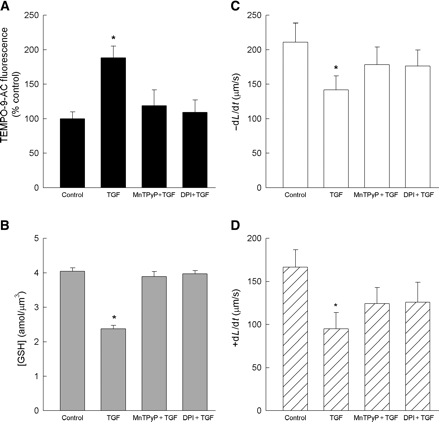
Figure 3 Effects of ROS inhibitors on myocytes treated with TGF-β₁. MnTPyP (50 µmol/l) and DPI (30 µmol/l) ...
Notes:
Figure 3 Effects of ROS inhibitors on myocytes treated with TGF-β1. MnTPyP (50 µmol/l) and DPI (30 µmol/l) prevented the increase in ROS levels (A) and GSH depletion (B) induced by 1 ng/mL TGF-β1. (C and D) The rates of myocyte shortening (−dL/dt) and re-lengthening (+dL/dt) were diminished by TGF-β1 alone and prevented by MnTPyP or DPI. Each bar represents the mean from 30 to 35 myocytes from five rat hearts. *P < 0.05 vs. control.
Unless provided in the caption above, the following copyright applies to the content of this slide: Published on behalf of the European Society of Cardiology. All rights reserved. © The Author 2007. For Permissions please email: journals.permissions@oxfordjournals.org

Slide 4
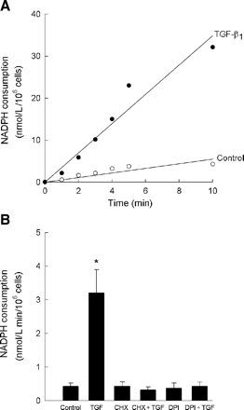
Figure 4 Increased NADPH utilization by myocytes treated with 1 ng/mL TGF-β₁. (A) Rate of NADPH consumption ...
Notes:
Figure 4 Increased NADPH utilization by myocytes treated with 1 ng/mL TGF-β1. (A) Rate of NADPH consumption was greater in TGF-β1-treated myocytes than in untreated cells. (B) Increased NADPH utilization was abolished by DPI (30 µmol/L) or cycloheximide (CHX, 100 µmol/L). Each bar represents the mean from 30 to 35 myocytes from five rat hearts. *P < 0.05 vs. control.
Unless provided in the caption above, the following copyright applies to the content of this slide: Published on behalf of the European Society of Cardiology. All rights reserved. © The Author 2007. For Permissions please email: journals.permissions@oxfordjournals.org

Slide 5
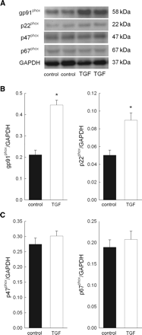
Figure 5 Protein abundance of NAD(P)H oxidase subunits in TGF-β₁-treated myocytes. (A) Representative ...
Notes:
Figure 5 Protein abundance of NAD(P)H oxidase subunits in TGF-β1-treated myocytes. (A) Representative western blots of gp91phox, p22phox, p47phox, and p67phox in suspensions of control and TGF-β1-treated myocytes. (B) Mean densitometry measurements of gp91phox (left panel) and p22phox expressed relative to GAPDH. *P < 0.05 vs. control. (C) Mean densitometry measurements of p47phox (left panel) and p67phox expressed relative to GAPDH. Each bar represents the mean from myocyte suspensions isolated from three to seven rat hearts.
Unless provided in the caption above, the following copyright applies to the content of this slide: Published on behalf of the European Society of Cardiology. All rights reserved. © The Author 2007. For Permissions please email: journals.permissions@oxfordjournals.org

Slide 6
Figure 6 Effects of reducing agents on myocytes treated with TGF-β₁. (A) GSH or NAC (10 mmol/L) prevented ...
Notes:
Figure 6 Effects of reducing agents on myocytes treated with TGF-β1. (A) GSH or NAC (10 mmol/L) prevented the increase in ROS production elicited by TGF-β1, whereas dithiotheitol (DTT) had no effect. (B and C) Changes in the rates of myocyte shortening (−dL/dt) and re-lengthening (+dL/dt) induced by TGF-β1 were prevented by pretreatment with GSH or NAC. Each bar represents the mean from 25 to 30 myocytes isolated from five rat hearts. *P < 0.05 vs. control.
Unless provided in the caption above, the following copyright applies to the content of this slide: Published on behalf of the European Society of Cardiology. All rights reserved. © The Author 2007. For Permissions please email: journals.permissions@oxfordjournals.org

Slide 7
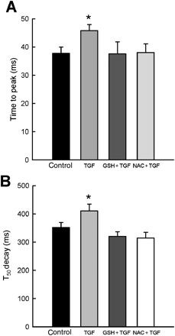
Figure 7 Effects of reducing agents on Ca²⁺ transients in myocytes treated with TGF-β₁. GSH and ...
Notes:
Figure 7 Effects of reducing agents on Ca2+ transients in myocytes treated with TGF-β1. GSH and NAC abolished the increases in time to peak (A) and T50 decay (B) elicited by TGF-β1. Each bar represents the mean from 25 to 30 myocytes isolated from five hearts. *P < 0.05 vs. control.
Unless provided in the caption above, the following copyright applies to the content of this slide: Published on behalf of the European Society of Cardiology. All rights reserved. © The Author 2007. For Permissions please email: journals.permissions@oxfordjournals.org

Slide 8
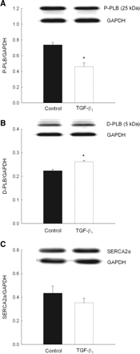
Figure 8 Phosphorylation status of phospholamban in TGF-β₁-treated myocytes. Protein abundance of ...
Notes:
Figure 8 Phosphorylation status of phospholamban in TGF-β1-treated myocytes. Protein abundance of phosphorylated (P-PLB, A) and dephosphorylayed (D-PLB, B) phospholamban was examined by western blot in myocyte suspensions from four hearts treated with TGF-β1. *P < 0.05 vs. control. (C) Protein abundance of SERCA2a measured in cell suspensions from three hearts. Mean densitometry values are expressed relative to GAPDH.
Unless provided in the caption above, the following copyright applies to the content of this slide: Published on behalf of the European Society of Cardiology. All rights reserved. © The Author 2007. For Permissions please email: journals.permissions@oxfordjournals.org

