Slide 1
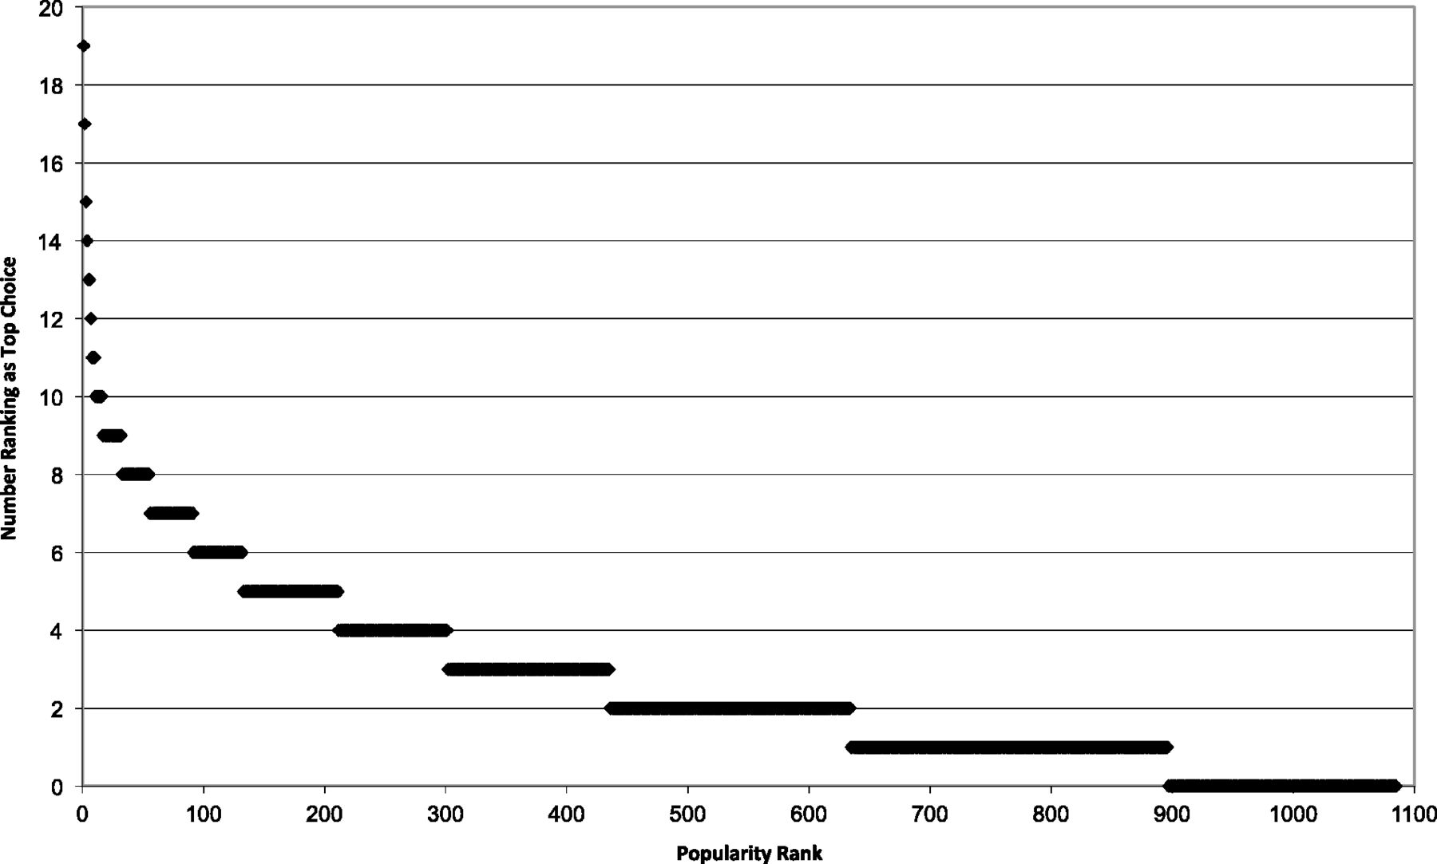
Figure I Popularity of Programs as Top Choice (2003)
Notes:
Figure I Popularity of Programs as Top Choice (2003)
Unless provided in the caption above, the following copyright applies to the content of this slide: © The Author(s) 2013. Published by Oxford University Press, on behalf of President and Fellows of Harvard College. All rights reserved. For Permissions, please email: journals.permissions@oup.com

Slide 2
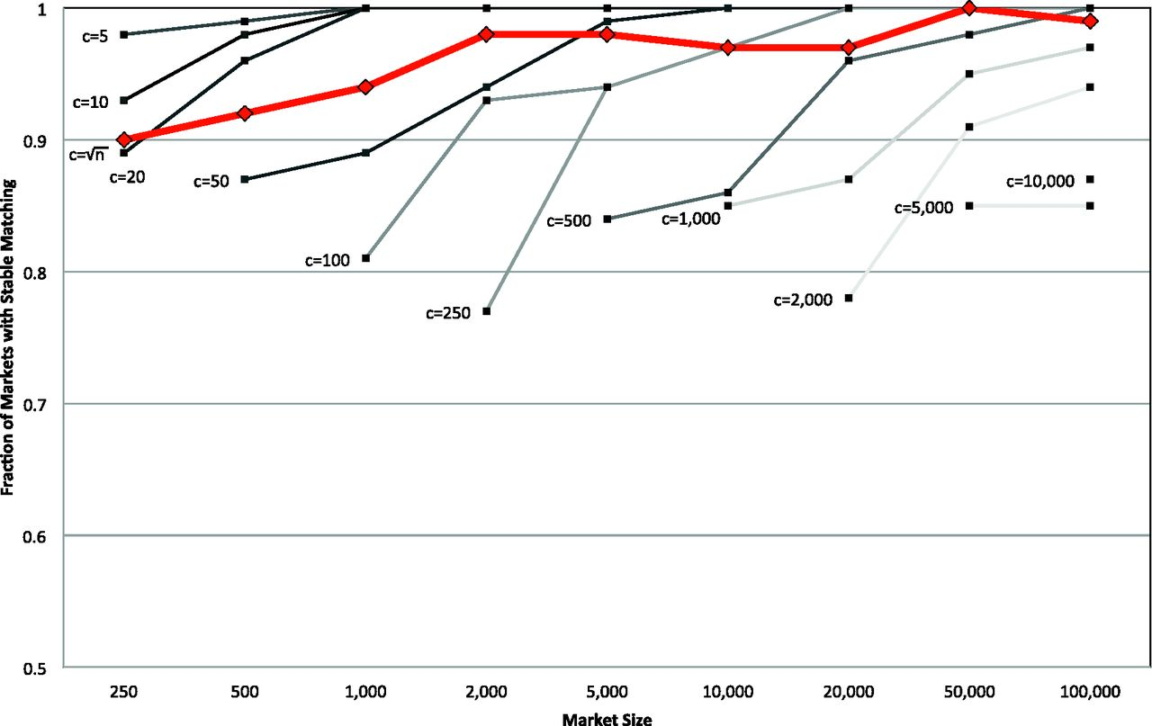
Figure II Market with a Stable Matching with Preferences from Uniform Distribution
Notes:
Figure II Market with a Stable Matching with Preferences from Uniform Distribution
Unless provided in the caption above, the following copyright applies to the content of this slide: © The Author(s) 2013. Published by Oxford University Press, on behalf of President and Fellows of Harvard College. All rights reserved. For Permissions, please email: journals.permissions@oup.com

Slide 3
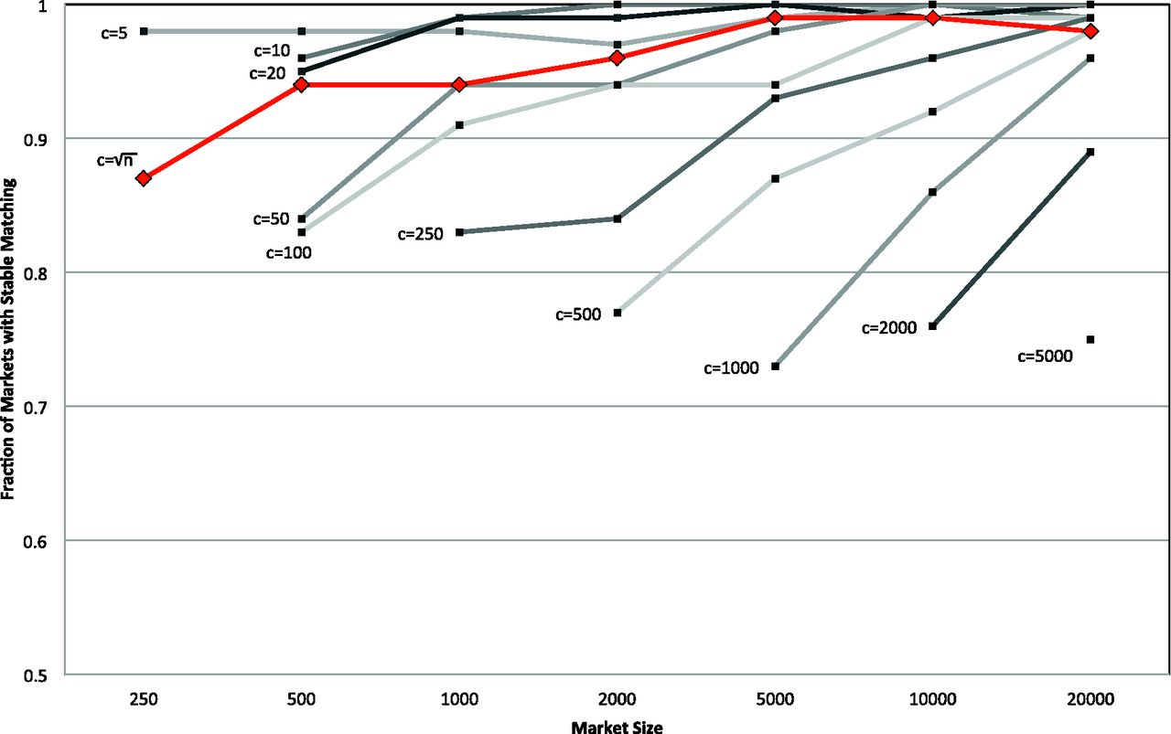
Figure III Market with a Stable Matching with Calibrated Preferences
Notes:
Figure III Market with a Stable Matching with Calibrated Preferences
Unless provided in the caption above, the following copyright applies to the content of this slide: © The Author(s) 2013. Published by Oxford University Press, on behalf of President and Fellows of Harvard College. All rights reserved. For Permissions, please email: journals.permissions@oup.com

