Slide 1
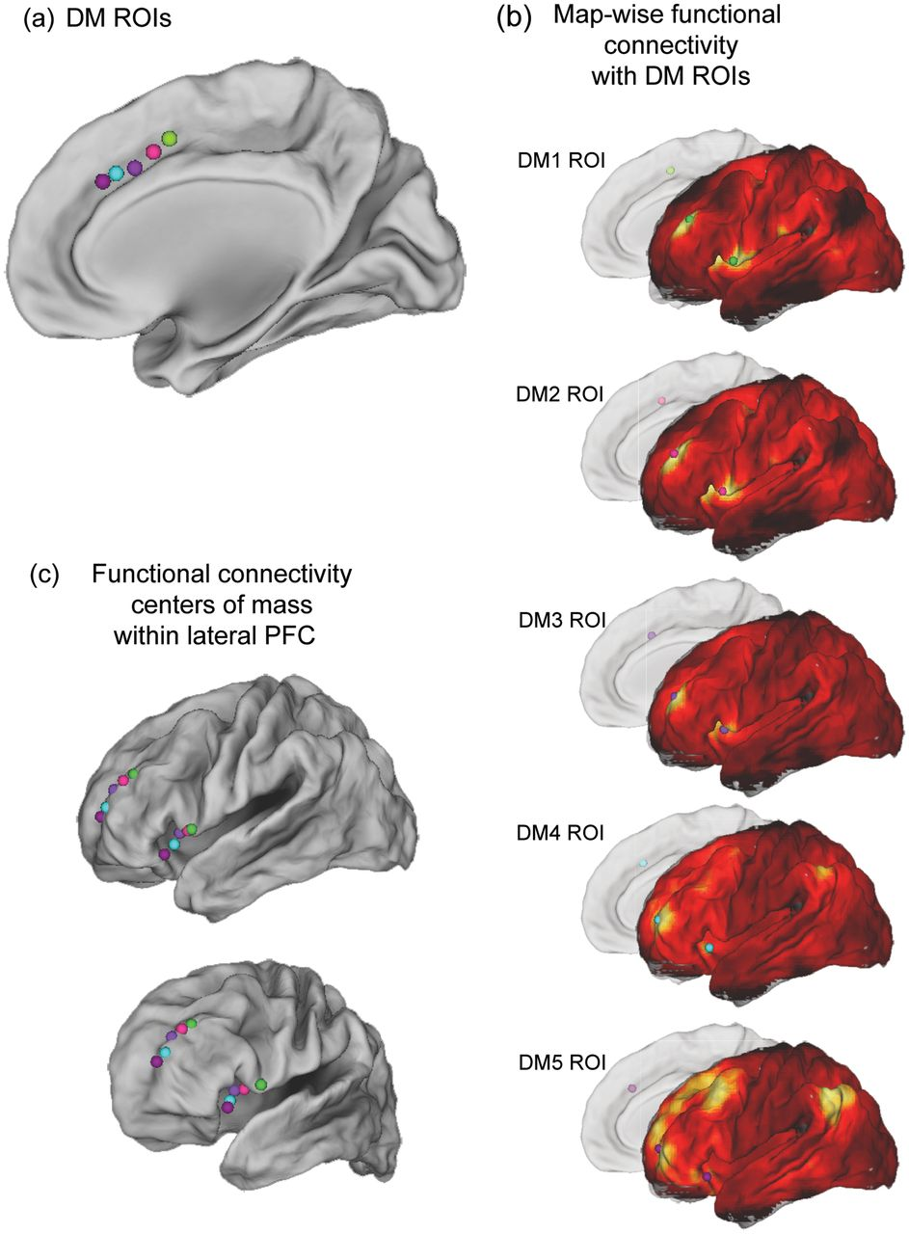
Figure 1. Results from map-wise analysis examining functional connectivity between 5 ROIs positioned along the ...
Notes:
Figure 1. Results from map-wise analysis examining functional connectivity between 5 ROIs positioned along the rostro-caudal axis of the dorsomedial frontal cortex and voxels along lateral PFC. (a) Depicts the coordinates of the 5 dorsomedial frontal cortex ROIs (DM1–5). (b) Resting-state functional connectivity between DM1–5 and the lateral surface. No threshold has been applied. Note that centers of mass (depicted as colored spheres) appear in both DLPFC and VLPFC in all 5 statistical maps. Note also the rostral progression of connectivity along both DLPFC and VLPFC as the DM ROI progresses rostrally. (c) Depicts the coordinates of the resulting DLPFC and VLPFC centers-of-mass projected onto the lateral surface. The bottom brain figure illustrates these coordinates not projected. Note that DM1–5 are projected onto the right hemisphere for ease of visualization; however, left lateralized DM1–5 ROIs were used in all analyses.
Unless provided in the caption above, the following copyright applies to the content of this slide: © The Author 2012. Published by Oxford University Press. All rights reserved. For Permissions, please e-mail: journals.permissions@oup.com

Slide 2
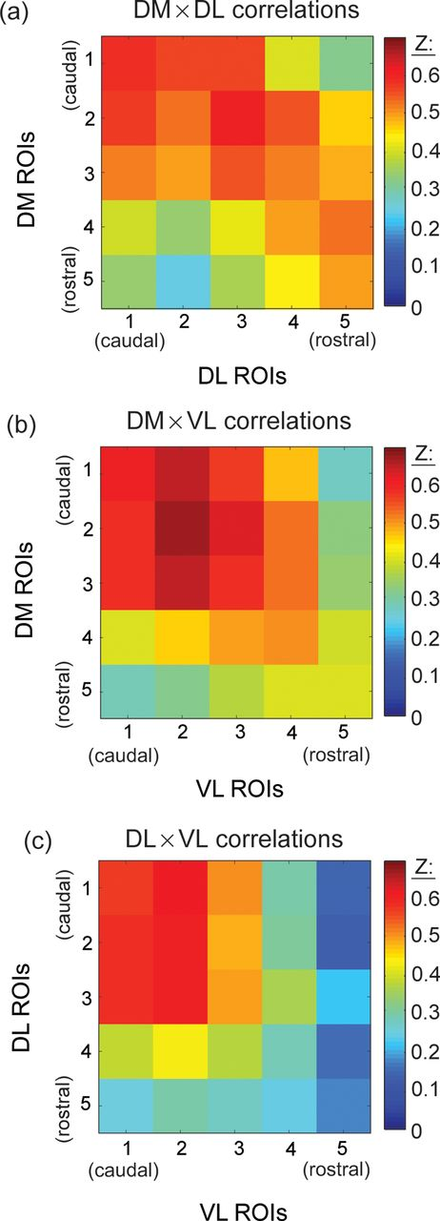
Figure 2. Results from ROI × ROI correlations from an independent dataset. In each of these panels, each cell ...
Notes:
Figure 2. Results from ROI × ROI correlations from an independent dataset. In each of these panels, each cell represents the group averaged Fisher-transformed correlation value (z-score) (He et al. 2007; Van Dijk et al. 2010) for a given ROI pair. All 3 panels demonstrate a rostro-caudal organization. This can be observed in each panel by noting that the maximal correlations fall along or near the diagonal line. All correlations depicted in all 3 plots, included those along the diagonal, are statistically significant (P < 0.05, corrected). (a) Correlation matrix from the DM × DL ROI analysis. Caudal DM ROIs correlate most highly with caudal DL ROIs and rostral DM ROIs correlate most highly with rostral DL ROIs. (b) Correlation matrix from the DM × VL ROI analysis. Caudal DM ROIs correlate most highly with caudal DL ROIs, and despite lower overall correlations between rostral ROIs, rostral DM ROIs correlate most highly with rostral DL ROIs. (c) Correlation matrix from the DL × VL analysis. Caudal DL ROIs correlate most with caudal VL ROIs and rostral ROIs are less highly correlated.
Unless provided in the caption above, the following copyright applies to the content of this slide: © The Author 2012. Published by Oxford University Press. All rights reserved. For Permissions, please e-mail: journals.permissions@oup.com

Slide 3
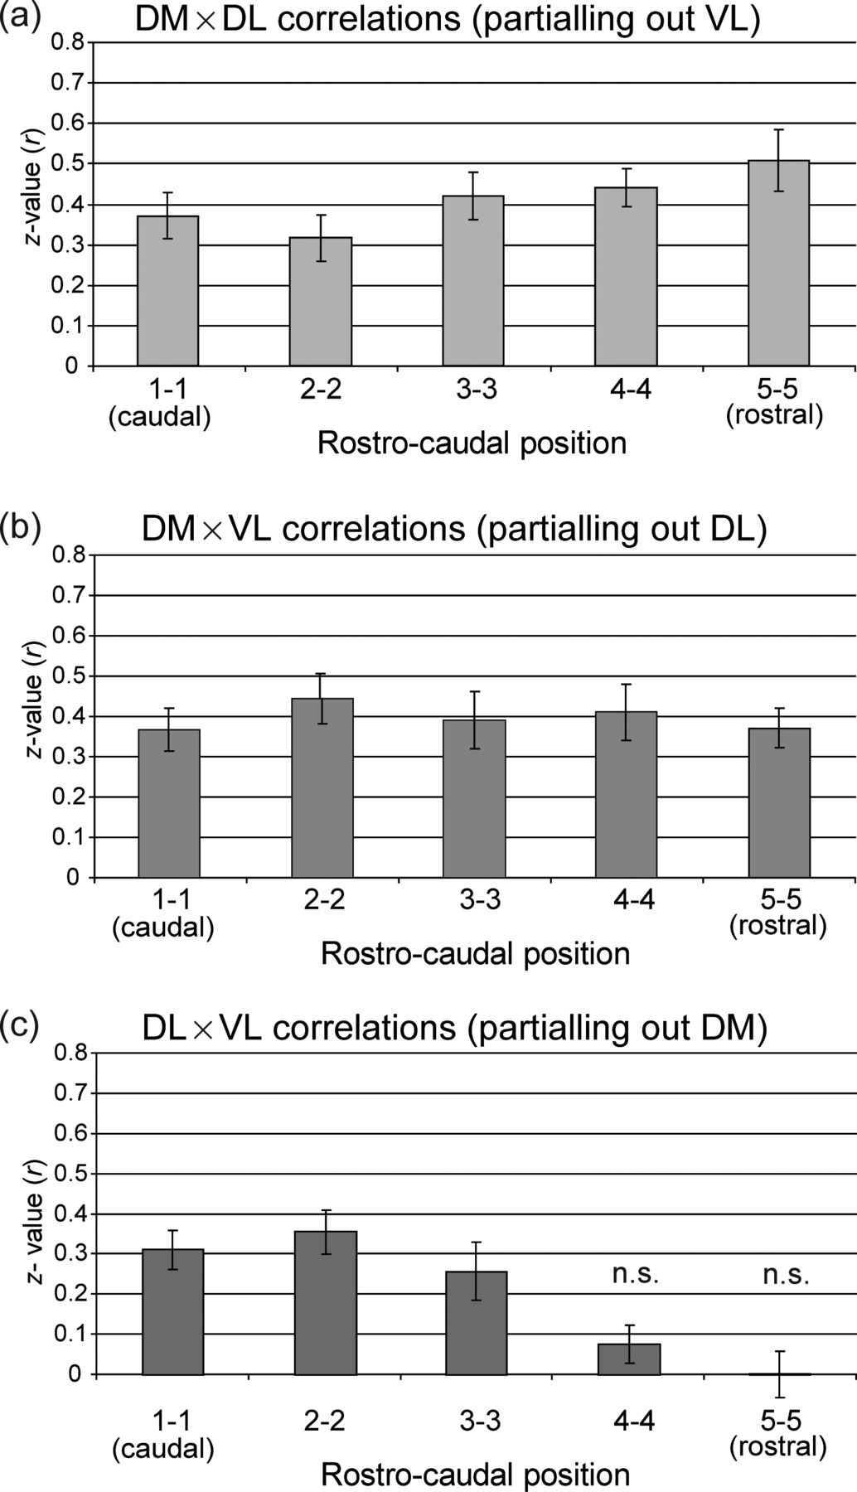
Figure 3. Results from partial correlation analyses. Demonstrates that connections between the dorsomedial frontal ...
Notes:
Figure 3. Results from partial correlation analyses. Demonstrates that connections between the dorsomedial frontal cortex and DLPFC and between the dorsomedial frontal cortex and VLPFC along the rostro-caudal axis are statistically independent and parallel. (a) Group-averaged correlations between matched DM ROIs and DL ROIs after partialling out the time series of the corresponding VL ROI. For instance, the leftmost bar in this panel is the value of the correlation between DM1 × DL1 (most caudal position) after partialling out VL1. (b) Group-averaged correlations between matched DM ROIs and VL ROIs after partialling out the time series of the corresponding DL ROI. Partial correlations are in Fisher-transformed r-values (z-scores). All correlations are statistically significant (P < 0.05) after Bonferroni correction except were noted by “n.s.”
Unless provided in the caption above, the following copyright applies to the content of this slide: © The Author 2012. Published by Oxford University Press. All rights reserved. For Permissions, please e-mail: journals.permissions@oup.com

Slide 4
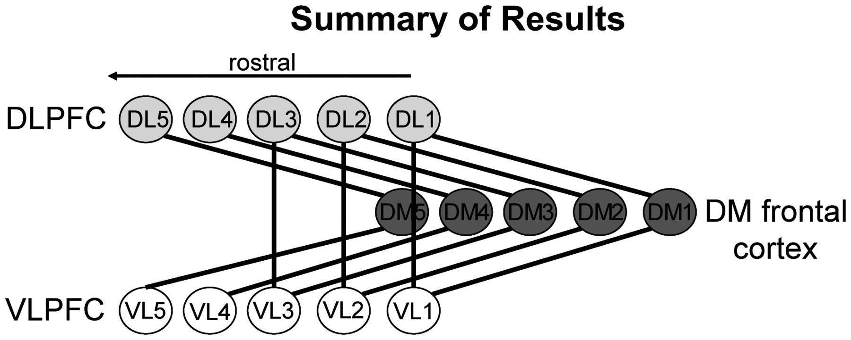
Figure 4. Summary of results and framework for understanding intrinsic organization of the frontal cortex. We ...
Notes:
Figure 4. Summary of results and framework for understanding intrinsic organization of the frontal cortex. We identified parallel dorsolateral and ventrolateral streams of connectivity with the dorsomedial frontal cortex using resting-state time-series correlations. VLPFC ROIs (VL1–5) and DLPFC ROIs (DL1–5) were maximally connected with DM ROIs (DM1–5) at similar rostro-caudal positions. The correlations between DL1–5 and DM1–5 and between VL1–5 and DM1–5 remained significant after a partial correlation analysis was performed. However, the correlations between the more rostral VL and DL ROIs no longer remained significant after partialling.
Unless provided in the caption above, the following copyright applies to the content of this slide: © The Author 2012. Published by Oxford University Press. All rights reserved. For Permissions, please e-mail: journals.permissions@oup.com

