Slide 1
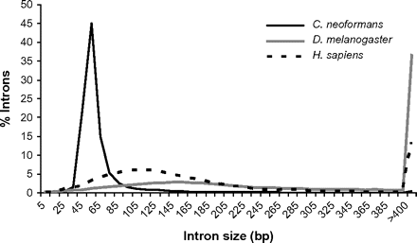
FIG. 1.— Intron size distribution in Cryptococcus neoformans, Drosophila melanogaster, and Homo sapiens. Distributions ...
Notes:
FIG. 1.— Intron size distribution in Cryptococcus neoformans, Drosophila melanogaster, and Homo sapiens. Distributions are based on 29,146 C. neoformans introns, 61,031 D. melanogaster introns, and 239,661 H. sapiens introns. Numbers on horizontal axis indicate midpoint of each 10 bp interval. Homo sapiens and D. melanogaster intron data were drawn, respectively, from the March 2006 and April 2006 assemblies available at the UCSC genome browser database (Karolchik et al. 2003).
Unless provided in the caption above, the following copyright applies to the content of this slide: © The Author 2008. Published by Oxford University Press on behalf of the Society for Molecular Biology and Evolution. All rights reserved. For permissions, please e-mail: journals.permissions@oxfordjournals.org

Slide 2
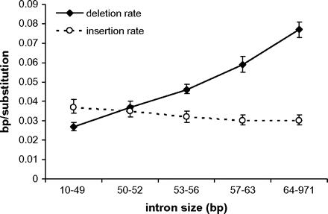
FIG. 2.— Insertion and deletion rates as a function of intron size in coding-region introns. Error bars indicate 95% ...
Notes:
FIG. 2.— Insertion and deletion rates as a function of intron size in coding-region introns. Error bars indicate 95% CIs. Modal intron size is 52 bp. Bin sizes approximate quintile divisions of introns according to size. From left to right, bins contain 5,468, 4,736, 5,218, 4,409, and 4,872 introns. All deletion rates are significantly different from each other (P < 10−4). The insertion rates of the leftmost and rightmost bins are significantly different (P = 0.001).
Unless provided in the caption above, the following copyright applies to the content of this slide: © The Author 2008. Published by Oxford University Press on behalf of the Society for Molecular Biology and Evolution. All rights reserved. For permissions, please e-mail: journals.permissions@oxfordjournals.org

Slide 3
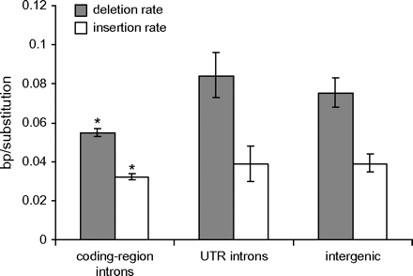
FIG. 4.— Overall insertion and deletion rates in various noncoding sequence classes. Error bars indicate 95% CIs. ...
Notes:
FIG. 4.— Overall insertion and deletion rates in various noncoding sequence classes. Error bars indicate 95% CIs. Insertion rate and deletion rate are significantly reduced in coding-region introns relative to UTR introns and intergenic sequence (bootstrapping; P < 10−4).
Unless provided in the caption above, the following copyright applies to the content of this slide: © The Author 2008. Published by Oxford University Press on behalf of the Society for Molecular Biology and Evolution. All rights reserved. For permissions, please e-mail: journals.permissions@oxfordjournals.org

Slide 4
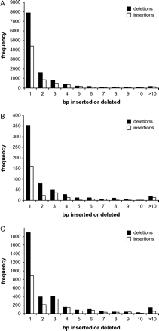
FIG. 3.— Indel size spectra in various noncoding sequence classes. (A) coding-region introns, (B) UTR introns, and (C) ...
Notes:
FIG. 3.— Indel size spectra in various noncoding sequence classes. (A) coding-region introns, (B) UTR introns, and (C) intergenic sequence. ins, insertion; del, deletion.
Unless provided in the caption above, the following copyright applies to the content of this slide: © The Author 2008. Published by Oxford University Press on behalf of the Society for Molecular Biology and Evolution. All rights reserved. For permissions, please e-mail: journals.permissions@oxfordjournals.org

