Slide 1
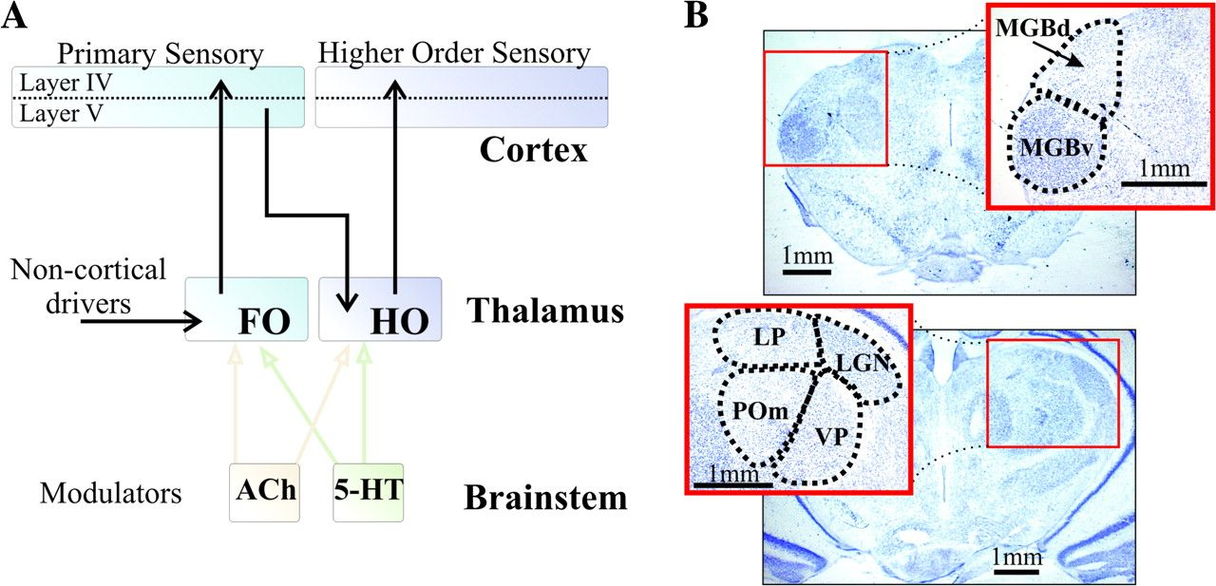
Figure 1. (A) Schematic representation of thalamocortical driver connections (black arrows) and 2 brainstem modulatory ...
Notes:
Figure 1. (A) Schematic representation of thalamocortical driver connections (black arrows) and 2 brainstem modulatory thalamic afferents (colored arrows) for first order (FO) and higher order (HO) thalamic relays. Brainstem cholinergic (ACh) and serotonergic (5-HT) centers are schematically indicated. (B) Nissl stain of typical coronal slices used in our experiments. Top, slice including auditory thalamus with expanded: MGBd, dorsal portion of the medial geniculate body; MGBv, ventral portion of the medial geniculate body. Bottom, slice including visual and somatosensory thalamus with expanded inset: LGN, (dorsal) lateral geniculate nucleus; LP, lateral posterior nucleus; POm, posterior medial nucleus; VP, ventral posterior nucleus.
Unless provided in the caption above, the following copyright applies to the content of this slide: © The Author 2008. Published by Oxford University Press. All rights reserved. For permissions, please e-mail: journals.permissions@oxfordjournals.org

Slide 2
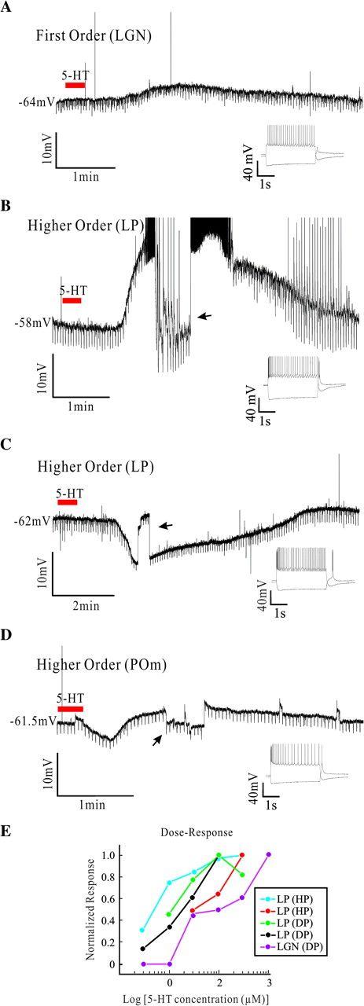
Figure 2. Effects of 5-HT on first and higher order relay cells. (A) Representative example of a first order relay ...
Notes:
Figure 2. Effects of 5-HT on first and higher order relay cells. (A) Representative example of a first order relay cell's response to 5-HT (100 μM, ≈30 s). Downward deflections correspond to negative current pulses (−10 pA, 400 ms, 3–4 s between pulses) used to measure input resistance. Below the right part of the voltage trace is an inset showing the cell responses to steps of current injection, and similar insets are shown in (B)-(D). (B) Example representative of depolarizing responses observed in higher order relay cells. The upward spikes are truncated action potentials. The arrow here and in (C) indicates a period of adjustment of DC current injection. (C) Example representative of hyperpolarizing responses observed in higher order relay cells. (D) Example of a higher order cell showing a mixed response. (E) Dose–response curves for 5 cells, and they are labeled regarding nucleus of origin and response to 5-HT (DP, depolarizing; HP, hyperpolarizing). Abbreviations for nuclei as in Figure 1.
Unless provided in the caption above, the following copyright applies to the content of this slide: © The Author 2008. Published by Oxford University Press. All rights reserved. For permissions, please e-mail: journals.permissions@oxfordjournals.org

Slide 3
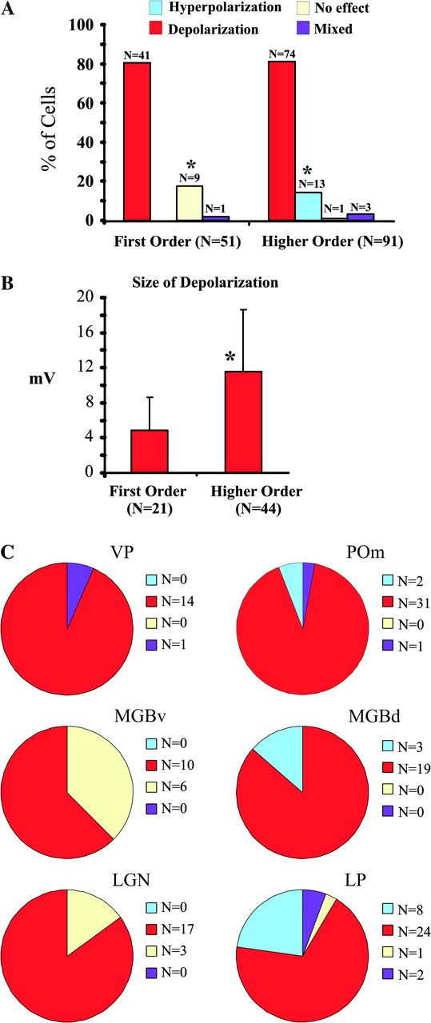
Figure 3. Population responses to 5-HT. (A) Frequency of the different effects of 5-HT on first and higher order relay ...
Notes:
Figure 3. Population responses to 5-HT. (A) Frequency of the different effects of 5-HT on first and higher order relay cells. (B) Size of the depolarizing effect in first order and higher order nuclei. (C) Distribution of the effects in individual nuclei (first order in left column and higher order in right column). Abbreviations for nuclei as in Figure 1. Asterisks indicate significant difference.
Unless provided in the caption above, the following copyright applies to the content of this slide: © The Author 2008. Published by Oxford University Press. All rights reserved. For permissions, please e-mail: journals.permissions@oxfordjournals.org

Slide 4
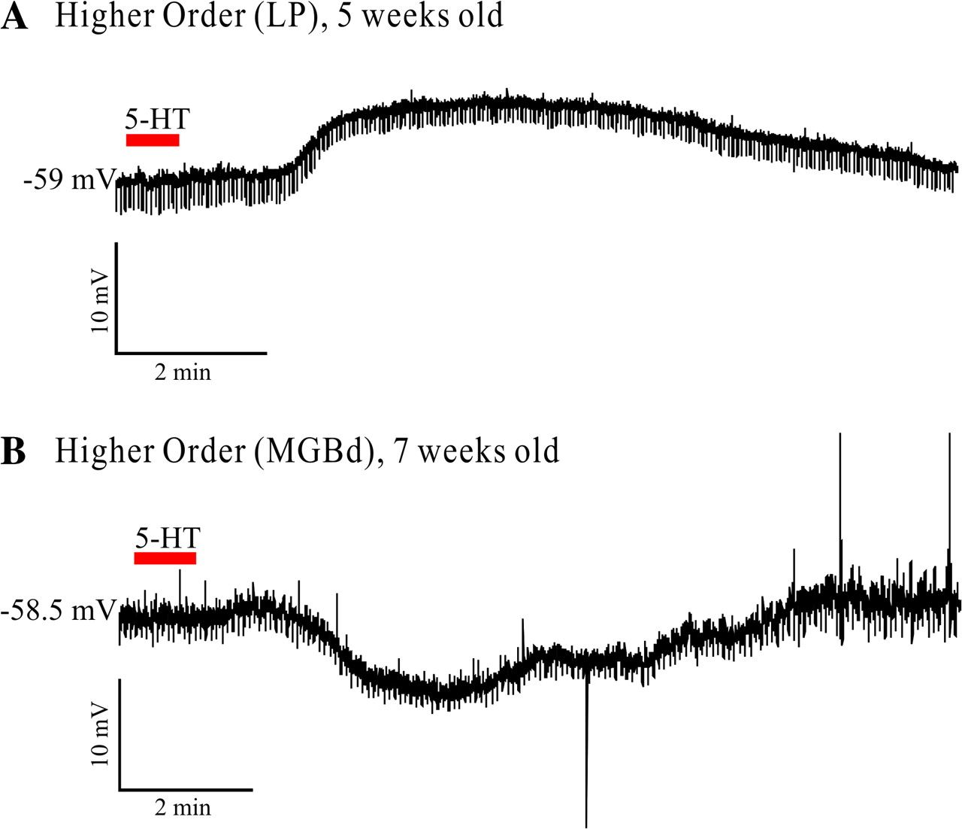
Figure 4. Effect of 5-HT in older animals. (A) Current-clamp recording showing the effect of bath-applied 5-HT on a ...
Notes:
Figure 4. Effect of 5-HT in older animals. (A) Current-clamp recording showing the effect of bath-applied 5-HT on a cell from the dorsal medial geniculate body of a 5-week-old rat. (B) Current-clamp recording of the effect of bath-applied 5-HT on a cell from the lateral posterior nucleus of a 7-week-old rat.
Unless provided in the caption above, the following copyright applies to the content of this slide: © The Author 2008. Published by Oxford University Press. All rights reserved. For permissions, please e-mail: journals.permissions@oxfordjournals.org

Slide 5
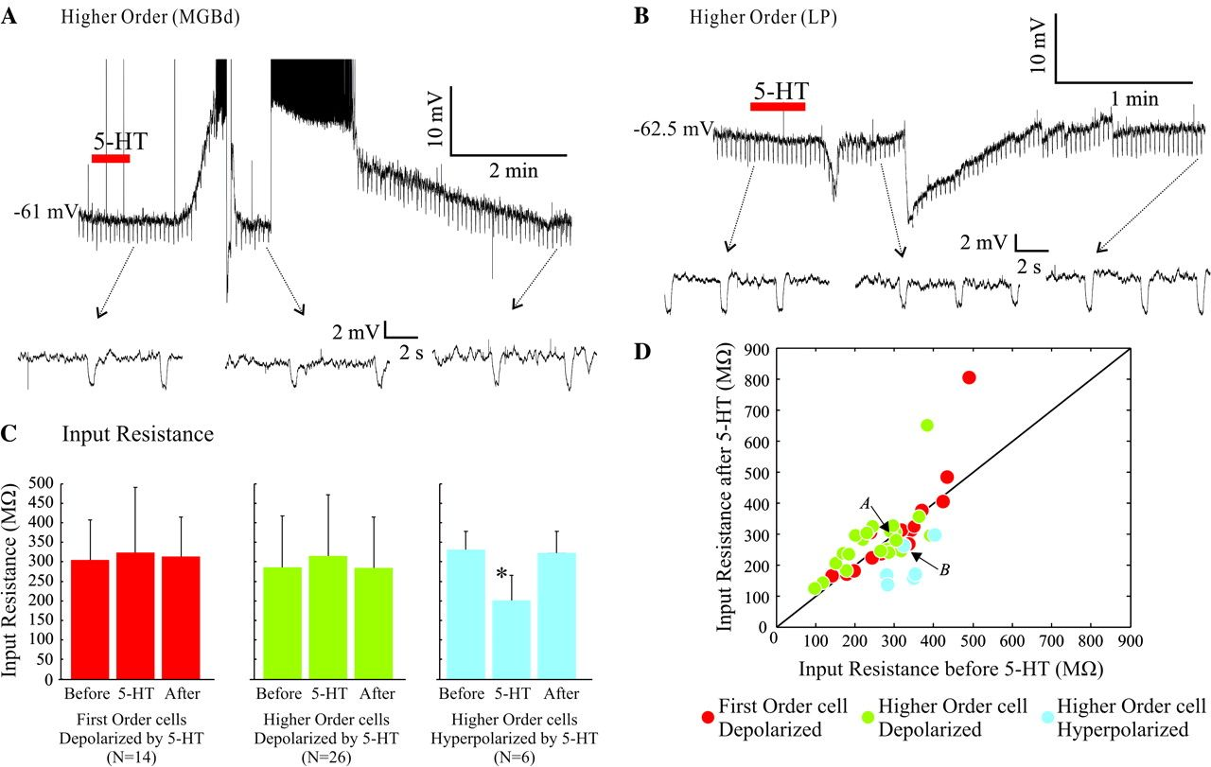
Figure 5. Effect of 5-HT on input resistance. (A, B) DC current injection during the peak of the effect was adjusted to ...
Notes:
Figure 5. Effect of 5-HT on input resistance. (A, B) DC current injection during the peak of the effect was adjusted to bring the potential back to the baseline membrane potential to compare input resistance at the same voltage level. Expanded traces below each main trace show the negative current pulses (−10 pA, 400 ms; 3–4 s between pulses) used to measure input resistance. (C) Average input resistance (±SD) before, during and after the effect of 5-HT for first order depolarizing (left), higher order depolarizing (center), and higher order hyperpolarizing (right) cells. Asterisk indicates significant difference. (D) Input resistance before and during the effect of 5-HT effect for all the cells measured. Arrows locate examples shown in (A) and (B).
Unless provided in the caption above, the following copyright applies to the content of this slide: © The Author 2008. Published by Oxford University Press. All rights reserved. For permissions, please e-mail: journals.permissions@oxfordjournals.org

Slide 6
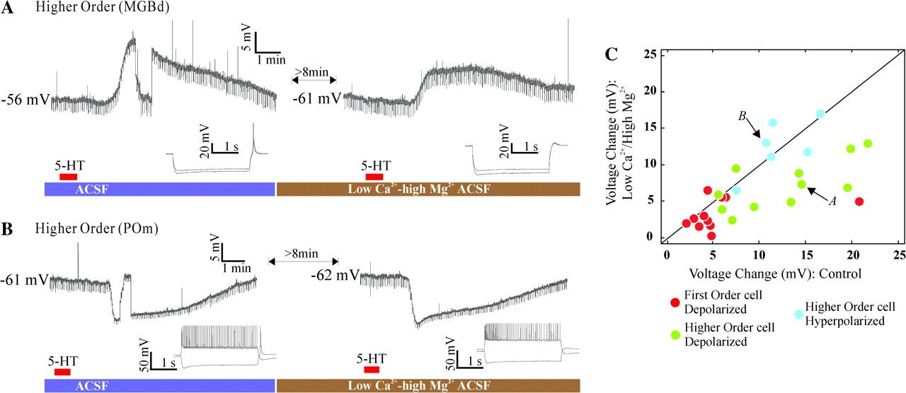
Figure 6. Direct postsynaptic effects of 5-HT. (A) Higher order relay cell depolarized by 5-HT in normal ACSF (left) is ...
Notes:
Figure 6. Direct postsynaptic effects of 5-HT. (A) Higher order relay cell depolarized by 5-HT in normal ACSF (left) is also depolarized by 5-HT in presence of low Ca2+ (0.5 mM)-high Mg2+ (8 mM) ACSF (right), which blocks synaptic transmission. (B) Effect on the response of a higher order relay cell hyperpolarized by 5-HT. (C) Population results for the low Ca2+-high Mg2+ experiments, showing the peak effect evoked by 5-HT before and in the presence of low Ca2+-high Mg2+ ACSF. Arrows locate examples shown in (A) and (B).
Unless provided in the caption above, the following copyright applies to the content of this slide: © The Author 2008. Published by Oxford University Press. All rights reserved. For permissions, please e-mail: journals.permissions@oxfordjournals.org

Slide 7
Figure 7. Effect of Methysergide (an antagonist for 5-HT₁, 5-HT₂, and 5-HT₇ receptors) ...
Notes:
Figure 7. Effect of Methysergide (an antagonist for 5-HT1, 5-HT2, and 5-HT7 receptors) on 5-HT response. (A) Effect for a first order relay cell depolarized by 5-HT. (B) Voltage change caused by 5-HT before (control), during (+MS), and after (recovery) the application of methysergide (MS).
Unless provided in the caption above, the following copyright applies to the content of this slide: © The Author 2008. Published by Oxford University Press. All rights reserved. For permissions, please e-mail: journals.permissions@oxfordjournals.org

