Slide 1
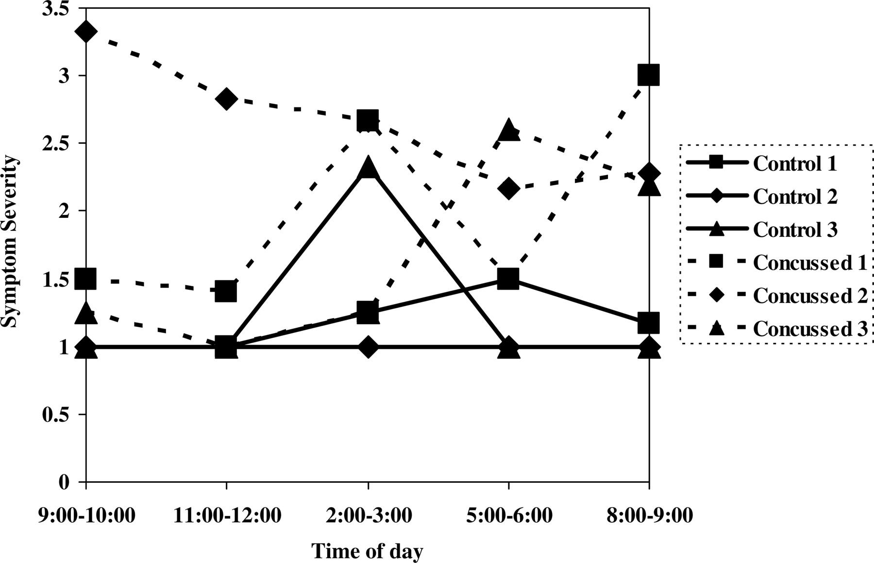
Fig. 1. Symptom severity ratings on concentration for all students at five times per day collapsed across days.
Notes:
Fig. 1. Symptom severity ratings on concentration for all students at five times per day collapsed across days.
Unless provided in the caption above, the following copyright applies to the content of this slide: © The Author 2009. Published by Oxford University Press. All rights reserved. For permissions, please e-mail: journals.permissions@oxfordjournals.org.

Slide 2
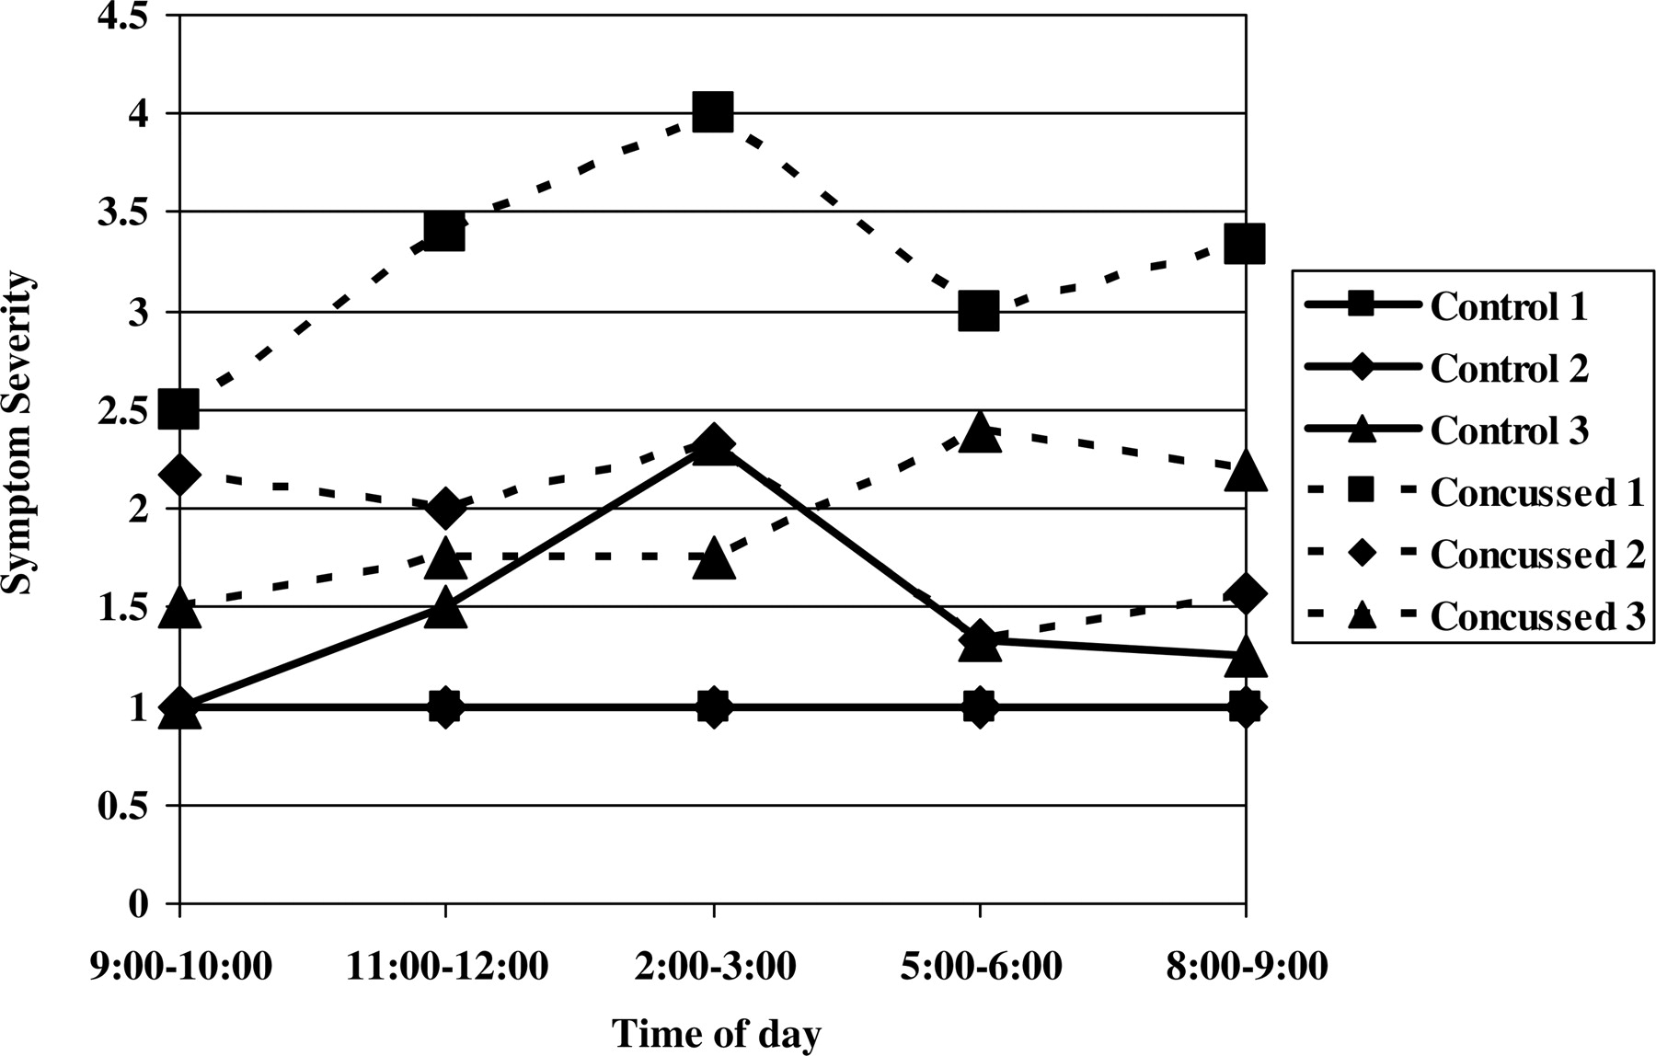
Fig. 2. Symptom severity ratings on irritability for all students at five times per day collapsed across days.
Notes:
Fig. 2. Symptom severity ratings on irritability for all students at five times per day collapsed across days.
Unless provided in the caption above, the following copyright applies to the content of this slide: © The Author 2009. Published by Oxford University Press. All rights reserved. For permissions, please e-mail: journals.permissions@oxfordjournals.org.

Slide 3
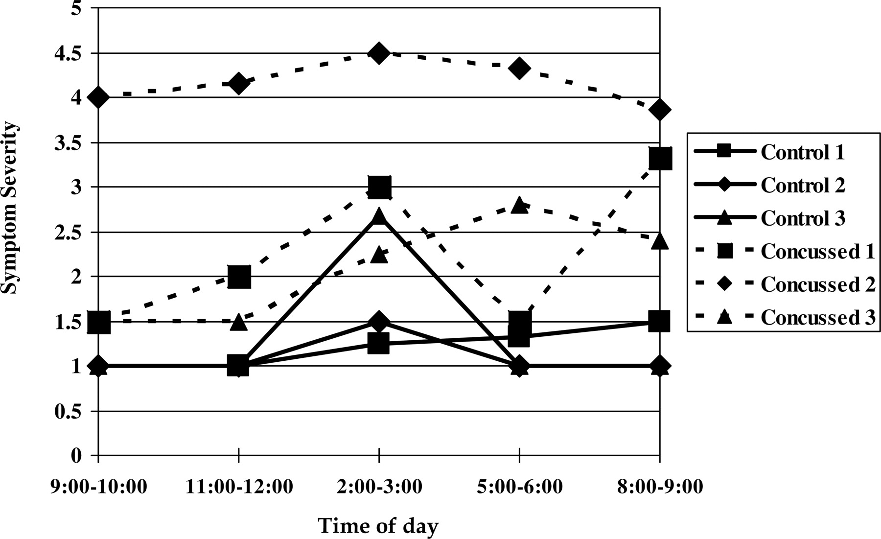
Fig. 3. Symptom severity ratings on headaches for all students at five times per day collapsed across days.
Notes:
Fig. 3. Symptom severity ratings on headaches for all students at five times per day collapsed across days.
Unless provided in the caption above, the following copyright applies to the content of this slide: © The Author 2009. Published by Oxford University Press. All rights reserved. For permissions, please e-mail: journals.permissions@oxfordjournals.org.

