Slide 1
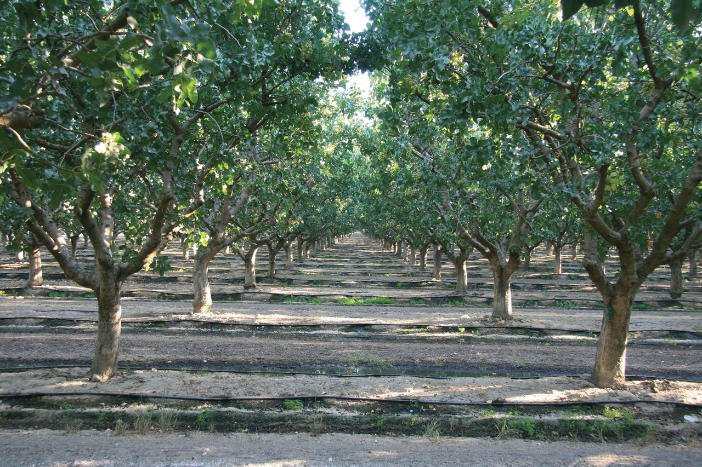
Fig. 1. Pistachio acreage has increased in the past 20 yr in California.
Notes:
Fig. 1. Pistachio acreage has increased in the past 20 yr in California.
Unless provided in the caption above, the following copyright applies to the content of this slide: © The Authors 2016. Published by Oxford University Press on behalf of Entomological Society of America. This is an Open Access article distributed under the terms of the Creative Commons Attribution Non-Commercial License ( http://creativecommons.org/licenses/by-nc/4.0/ ), which permits non-commercial re-use, distribution, and reproduction in any medium, provided the original work is properly cited. For commercial re-use, please contact journals.permissions@oup.com

Slide 2
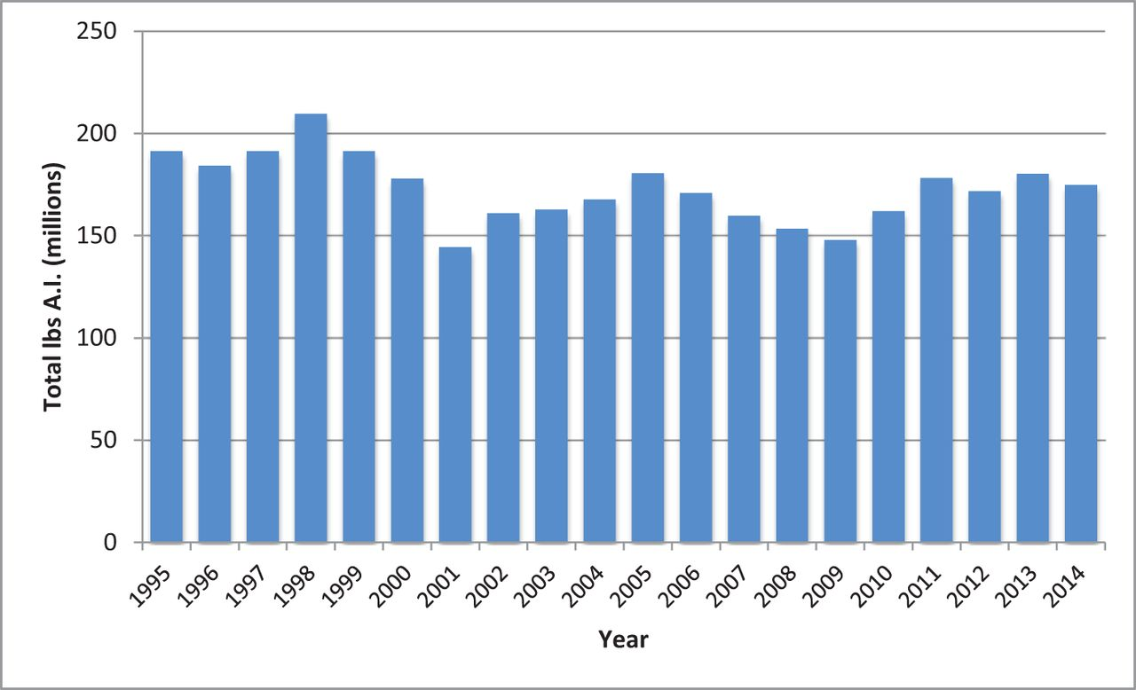
Fig. 2. Total pounds of active ingredient applied in agricultural production and postharvest fumigation in California ...
Notes:
Fig. 2. Total pounds of active ingredient applied in agricultural production and postharvest fumigation in California from 1995 to 2014. Data obtained from California Department of Pesticide Regulation (2015).
Unless provided in the caption above, the following copyright applies to the content of this slide: © The Authors 2016. Published by Oxford University Press on behalf of Entomological Society of America. This is an Open Access article distributed under the terms of the Creative Commons Attribution Non-Commercial License ( http://creativecommons.org/licenses/by-nc/4.0/ ), which permits non-commercial re-use, distribution, and reproduction in any medium, provided the original work is properly cited. For commercial re-use, please contact journals.permissions@oup.com

Slide 3
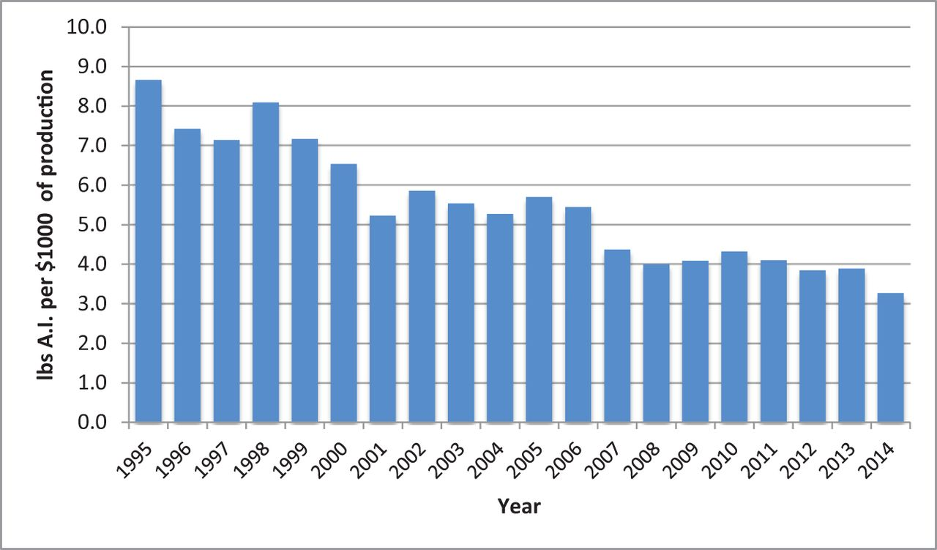
Fig. 3. Average pounds of active ingredient applied per US$1,000 value of agricultural production from 1995 to 2014. ...
Notes:
Fig. 3. Average pounds of active ingredient applied per US$1,000 value of agricultural production from 1995 to 2014. Data obtained from Pesticide Use Annual Summaries (California Department of Pesticide Regulation) and California Agricultural Statistics Review (California Department of Food and Agriculture).
Unless provided in the caption above, the following copyright applies to the content of this slide: © The Authors 2016. Published by Oxford University Press on behalf of Entomological Society of America. This is an Open Access article distributed under the terms of the Creative Commons Attribution Non-Commercial License ( http://creativecommons.org/licenses/by-nc/4.0/ ), which permits non-commercial re-use, distribution, and reproduction in any medium, provided the original work is properly cited. For commercial re-use, please contact journals.permissions@oup.com

Slide 4
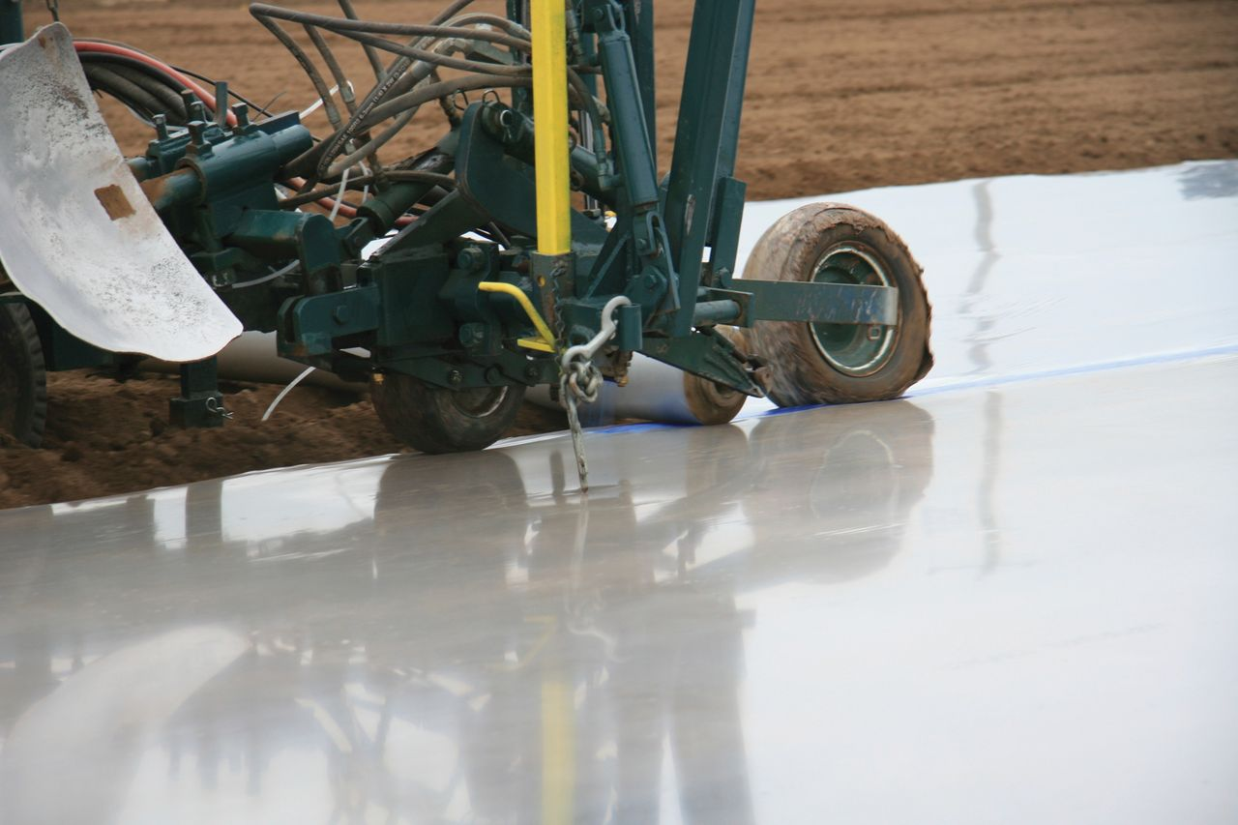
Fig. 4. Use of totally impermeable film and gluing overlapping tarp edges during soil fumigation.
Notes:
Fig. 4. Use of totally impermeable film and gluing overlapping tarp edges during soil fumigation.
Unless provided in the caption above, the following copyright applies to the content of this slide: © The Authors 2016. Published by Oxford University Press on behalf of Entomological Society of America. This is an Open Access article distributed under the terms of the Creative Commons Attribution Non-Commercial License ( http://creativecommons.org/licenses/by-nc/4.0/ ), which permits non-commercial re-use, distribution, and reproduction in any medium, provided the original work is properly cited. For commercial re-use, please contact journals.permissions@oup.com

