Slide 1
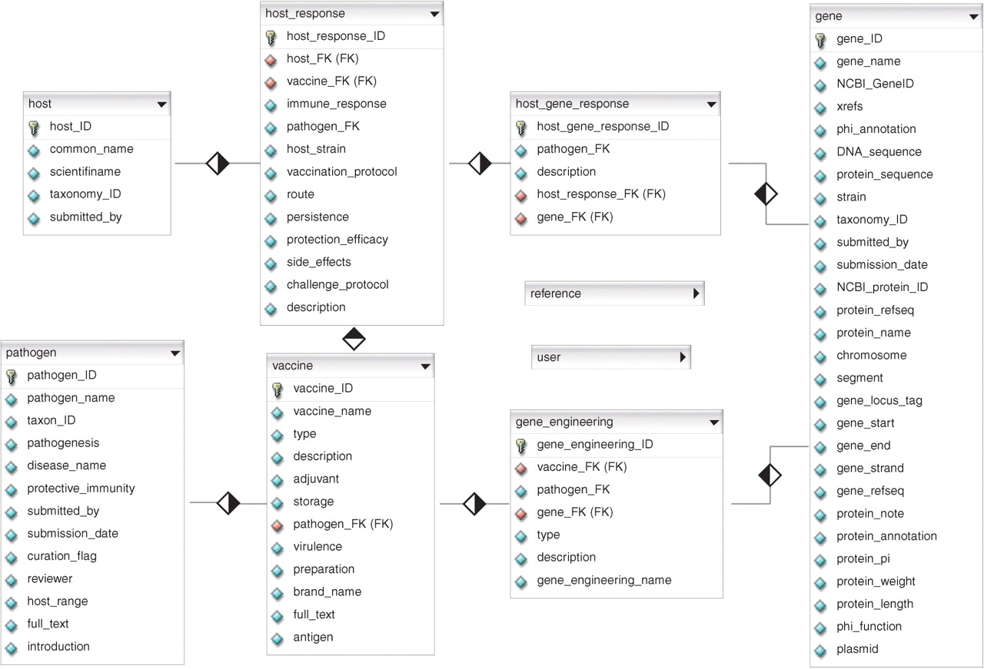
Figure 1. Entity relationship diagram of the VIOLIN database. The details of table reference and user are not shown in ...
Notes:
Figure 1. Entity relationship diagram of the VIOLIN database. The details of table reference and user are not shown in this figure. The diamond represents a one-to-many (blank-to-solid) relationship between two tables.
Unless provided in the caption above, the following copyright applies to the content of this slide: © 2007 The Author(s)This is an Open Access article distributed under the terms of the Creative Commons Attribution Non-Commercial License (http://creativecommons.org/licenses/by-nc/2.0/uk/) which permits unrestricted non-commercial use, distribution, and reproduction in any medium, provided the original work is properly cited.

Slide 2
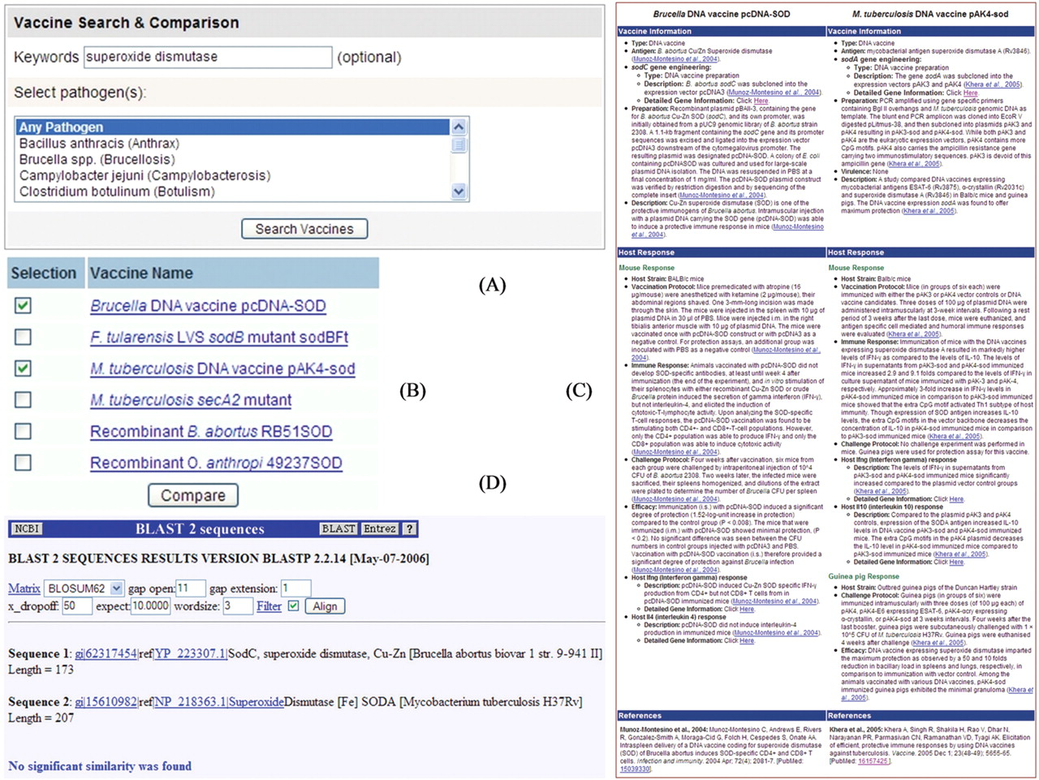
Figure 2. Example of vaccine search and comparison. A keyword search of ‘superoxide dismutase’ (SOD) in Vaxquery (A) ...
Notes:
Figure 2. Example of vaccine search and comparison. A keyword search of ‘superoxide dismutase’ (SOD) in Vaxquery (A) identified five vaccines curated in VIOLIN, including the Brucella abortus DNA vaccine expressing the gene sodC encoding for Cu/Zn superoxide dismutase and M. tuberculosis expressing the gene sodA encoding for Fe superoxide dismutase (B). DNA vaccines against either enzyme have been found to be effective against challenge infections by virulent B. abortus or M. tuberculosis strains (C). However, a VIOLIN BLAST-2-Sequences search did not find significant similarity between these two SOD protein sequences (D).
Unless provided in the caption above, the following copyright applies to the content of this slide: © 2007 The Author(s)This is an Open Access article distributed under the terms of the Creative Commons Attribution Non-Commercial License (http://creativecommons.org/licenses/by-nc/2.0/uk/) which permits unrestricted non-commercial use, distribution, and reproduction in any medium, provided the original work is properly cited.

