Slide 1
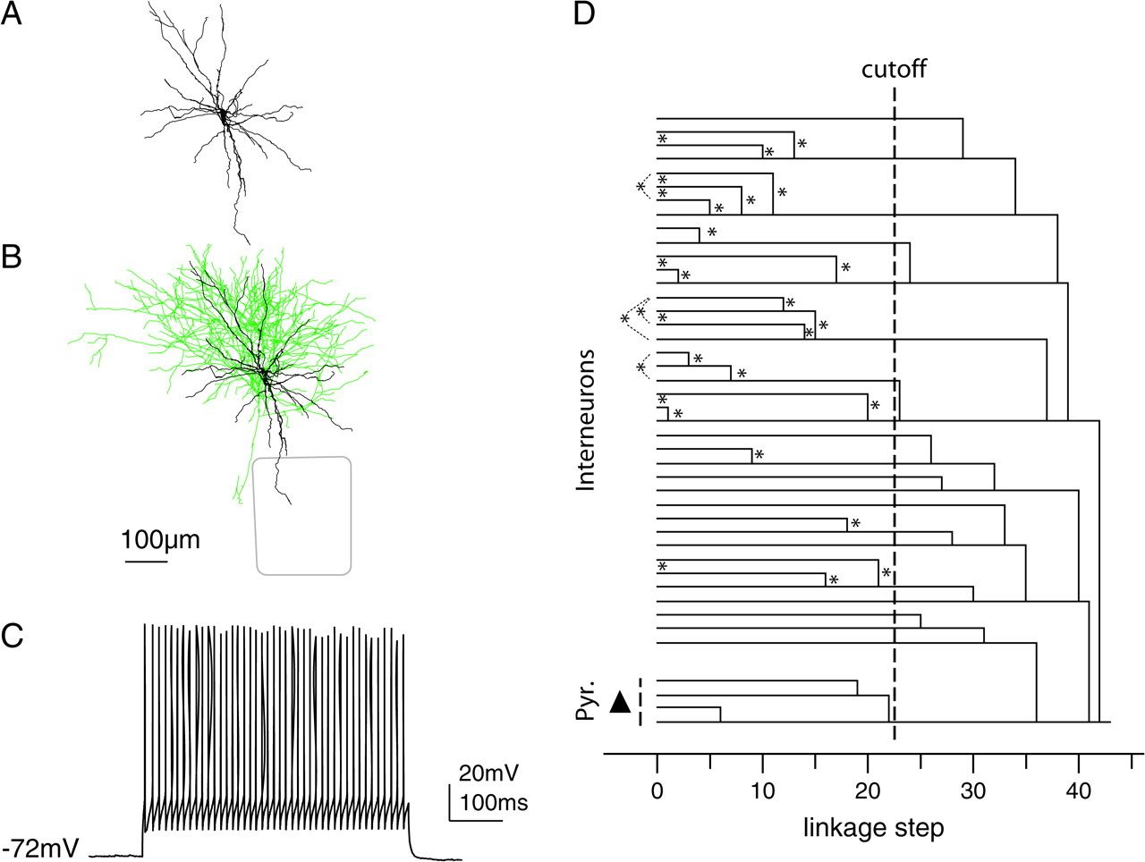
Figure 1. Illustration of parameter sets used in the feature vector for the CA. (A) The feature vector contained 4 ...
Notes:
Figure 1. Illustration of parameter sets used in the feature vector for the CA. (A) The feature vector contained 4 parameters related to dendritic geometry: total dendritic length, length per primary dendrite, number of primary dendrites, and dendritic polarity index. (B) The feature vector contained 2 parameters related to axonal projection: laterality of axonal projection and verticality of axonal projection. (C) The feature vector contained 5 parameters related to electrical excitability: AP frequency adaptation ratio, AHP adaptation, AP half-width, input resistance at the soma, and AP threshold (for details, see text). (D) Linkage dendrogram for one CA iteration. The data matrix contained 39 INs and 4 L2/3 pyramidal neurons as control (black triangle). In each iteration, the weights of parameters were randomly varied (cf. Table 1), random variation was added to each data point, and a random number of neurons was excluded from the analysis. As cutoff (dashed line), the linkage step was chosen at which the pyramidal neurons were linked into one cluster. Then, all 2-neuron linkages that occurred up to that point were recorded (asterisks; in this CA 30 pairs of 2-neuron linkages were recorded).
Unless provided in the caption above, the following copyright applies to the content of this slide: © The Author 2008. Published by Oxford University Press. All rights reserved. For permissions, please e-mail: journals.permissions@oxfordjournals.org

Slide 2
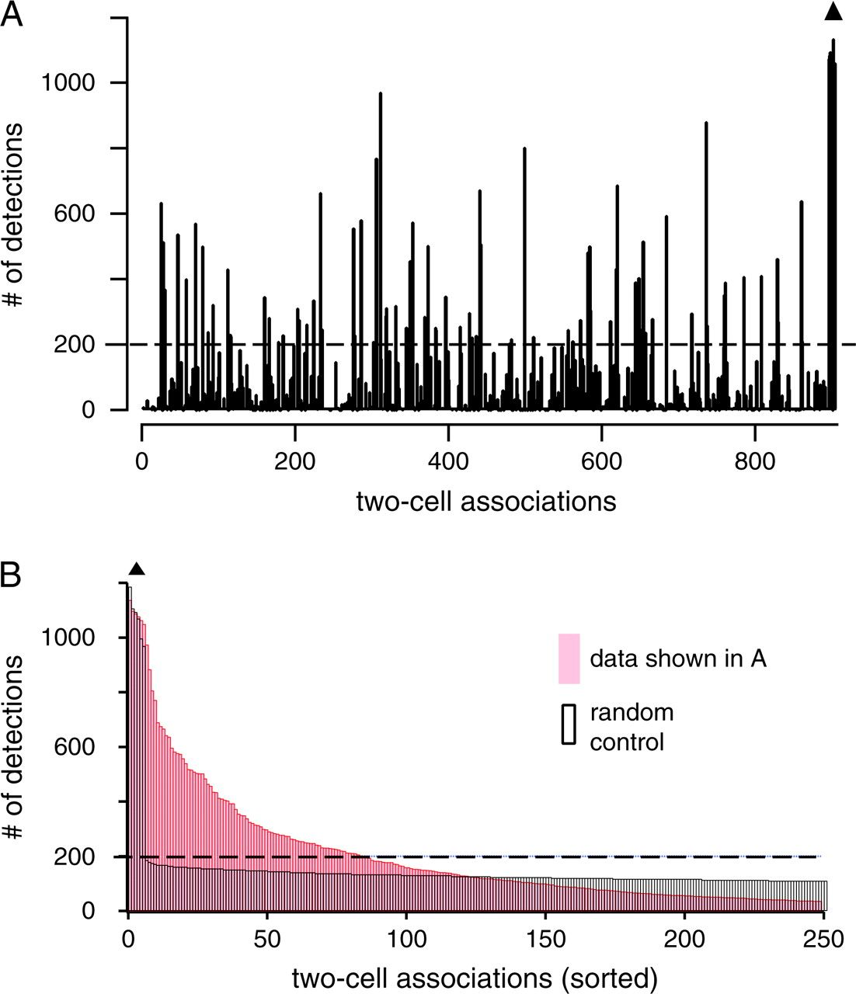
Figure 2. Associations after 1200 CAs. (A) Histogram of 2-neuron linkages that occurred in 1200 CAs of the type shown ...
Notes:
Figure 2. Associations after 1200 CAs. (A) Histogram of 2-neuron linkages that occurred in 1200 CAs of the type shown in Figure 1D. The number of pair associations is plotted against all 946 possible 2-neuron associations in a sample of 43 neurons. The 4 control pyramidal neurons clustered in >80% of the iterations (black triangle indicates the 6 pairwise pyramidal cell associations). (B) Histogram of control iterations. The data matrix was randomly shuffled for each parameter, such that only random associations should be detected. The histogram was sorted by detection count. Random control is shown in black, the original data (as in A) in red. Note that more than 70 associations were above threshold, whereas the majority was not (dashed lines in A, B). Only associations above threshold were used to link groups of INs (single linkage, starting with the most frequent associations).
Unless provided in the caption above, the following copyright applies to the content of this slide: © The Author 2008. Published by Oxford University Press. All rights reserved. For permissions, please e-mail: journals.permissions@oxfordjournals.org

Slide 3
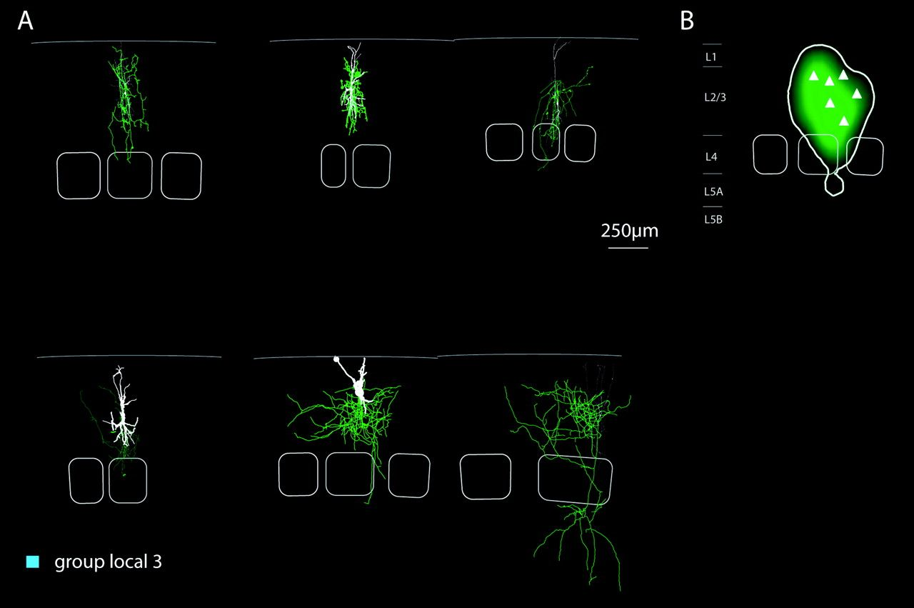
Figure 9. Group local 3-INs. (A) Reconstructions and (B) average axonal density map. The grouping of these cells was ...
Notes:
Figure 9. Group local 3-INs. (A) Reconstructions and (B) average axonal density map. The grouping of these cells was mainly caused by their similarity in electrical excitability and dendritic parameters. The axon of these cells was largely confined to the home column (94 ± 5% axon length within home column borders). The dendrites of group local 3 cells all entered L1. These neurons had very broad APs (half-width 0.63 ± 0.15 ms), high somatic input resistance (370 ± 60 MΩ), and strongest AP frequency adaptation ratio with a low AP threshold (−0.82 ± 0.13, −49 ± 4 mV. respectively).
Unless provided in the caption above, the following copyright applies to the content of this slide: © The Author 2008. Published by Oxford University Press. All rights reserved. For permissions, please e-mail: journals.permissions@oxfordjournals.org

Slide 4
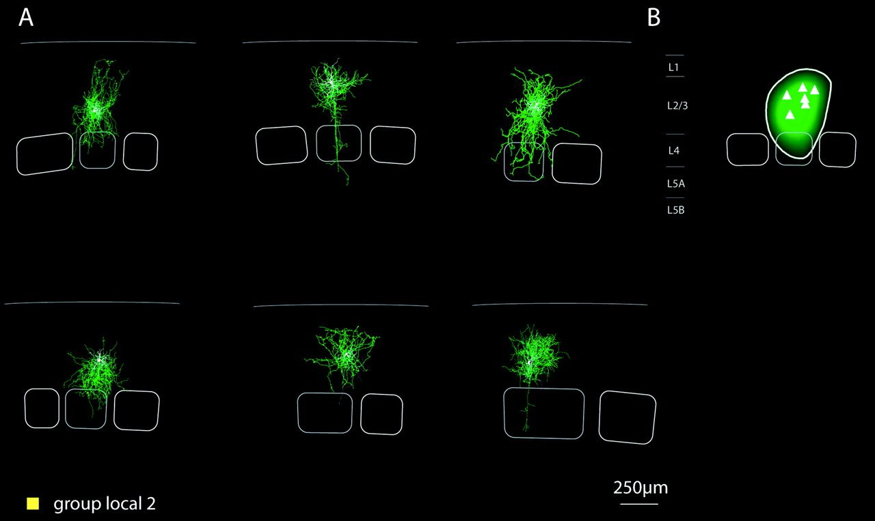
Figure 8. Group local 2 INs. (A) Reconstructions and (B) average axonal density map. Group local 2 comprised 6 cells ...
Notes:
Figure 8. Group local 2 INs. (A) Reconstructions and (B) average axonal density map. Group local 2 comprised 6 cells with highly local axonal projections at a high density (total axonal length of 21 ± 5.6 mm). The cells had short dendritic trees with many short dendrites (2.8 ± 0.6 mm total dendritic length, 7 ± 2 dendrites with 410 ± 80 μm average length per dendrite, Figs 3B,C and Table 3). They had a high AP firing threshold (−39 ± 6 mV), comparably low somatic input resistances (160 ± 20 MΩ), and either none or positive AHP adaptation (1.9 ± 2.4 mV).
Unless provided in the caption above, the following copyright applies to the content of this slide: © The Author 2008. Published by Oxford University Press. All rights reserved. For permissions, please e-mail: journals.permissions@oxfordjournals.org

Slide 5
Figure 7. Group local 1 INs. (A) Reconstructions and (B) average axonal density map. Group local 1 INs had very dense ...
Notes:
Figure 7. Group local 1 INs. (A) Reconstructions and (B) average axonal density map. Group local 1 INs had very dense axonal projections (30 ± 6 mm total axonal length) that had a minor nonlocal contribution (11 ± 5% of the axon left the home column). Three of the 4 cells in this group projected mainly to L3. Group local 1 cells had the highest number of primary dendrites (7.7 ± 1.5). They were homogeneous in their passive and active membrane properties (Fig. 4, black squares). They had very small AP half-widths and low somatic input resistances (0.33 ± 0.09 ms, 110 ± 52 MΩ, respectively) as well as little AP frequency and AHP adaptation (−0.13 ± 0.18 and 1.6 ± 0.72 mV, respectively).
Unless provided in the caption above, the following copyright applies to the content of this slide: © The Author 2008. Published by Oxford University Press. All rights reserved. For permissions, please e-mail: journals.permissions@oxfordjournals.org

Slide 6
Figure 6. Group lateral 1 INs. (A) Reconstructions and (B) average axonal density map. Group lateral 1 INs projected ...
Notes:
Figure 6. Group lateral 1 INs. (A) Reconstructions and (B) average axonal density map. Group lateral 1 INs projected mainly to layer 2 of the home and the neighboring column. Layer 1 was spared by the axonal arbor of these cells (note horizontal delineation of axonal projection at the L2–L1 border). This group of cells had the largest dendritic trees of the sample (4.8 ± 1.15 mm total dendritic length, cf. Fig. 3C and Table 3). All cells had low somatic input resistance (91 ± 0.06 MΩ), small AP half-widths, and either none or positive AP frequency adaptation ratios (0.14 ± 0.28, Fig. 4C) with a high AP threshold (−41 ± 3 mV, Fig. 4C).
Unless provided in the caption above, the following copyright applies to the content of this slide: © The Author 2008. Published by Oxford University Press. All rights reserved. For permissions, please e-mail: journals.permissions@oxfordjournals.org

Slide 7
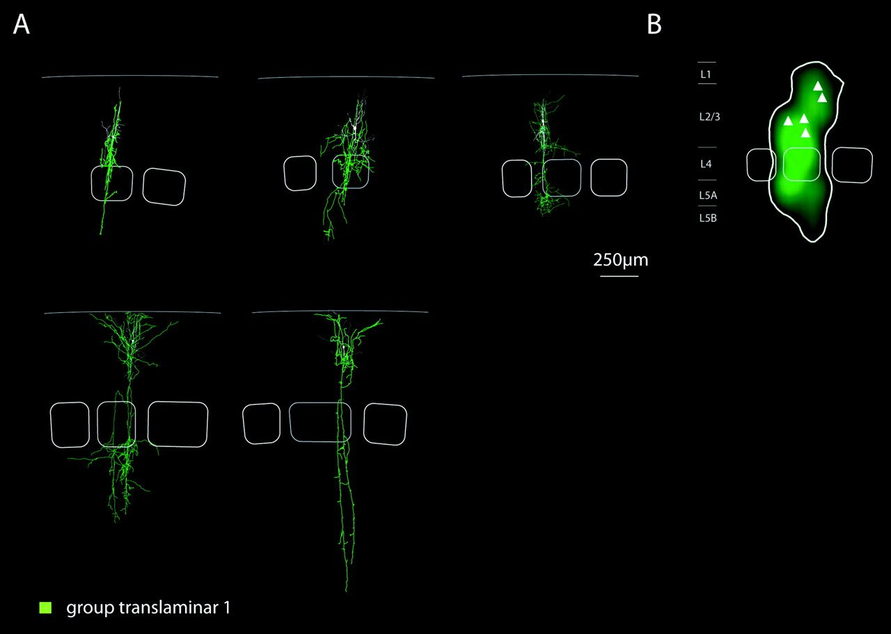
Figure 5. Group translaminar 1 INs. (A) Reconstructions and (B) average axonal density map. This group comprised cells ...
Notes:
Figure 5. Group translaminar 1 INs. (A) Reconstructions and (B) average axonal density map. This group comprised cells with a dual axonal projection domain. One domain was located in L2/3 of the home column, and a second domain was located in lower layers 4 and 5A. The dendritic arbors had a polarity index of 3.7 ± 0.4. This group of cells had a small AHP adaptation (0.63 ± 1.1 mV) and broad APs (0.5 ± 0.13 ms).
Unless provided in the caption above, the following copyright applies to the content of this slide: © The Author 2008. Published by Oxford University Press. All rights reserved. For permissions, please e-mail: journals.permissions@oxfordjournals.org

Slide 8
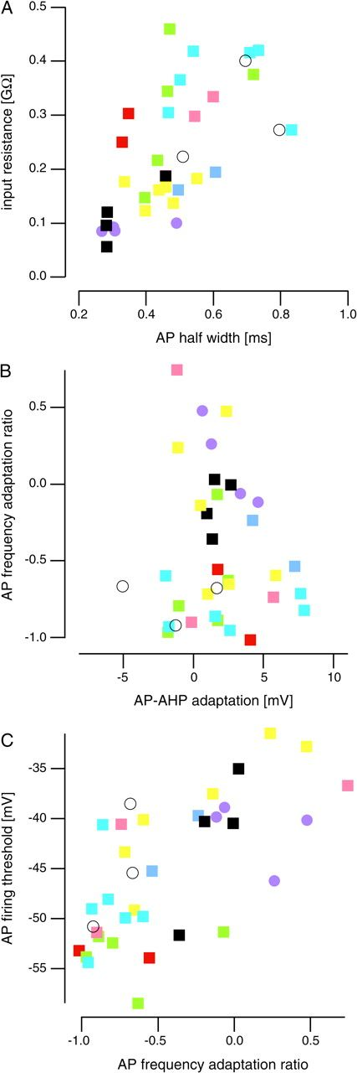
Figure 4. Distribution of groups of INs in the electrical excitability parameter space. Color code as in Figure 3. For ...
Notes:
Figure 4. Distribution of groups of INs in the electrical excitability parameter space. Color code as in Figure 3. For quantifications, compare Table 4.
Unless provided in the caption above, the following copyright applies to the content of this slide: © The Author 2008. Published by Oxford University Press. All rights reserved. For permissions, please e-mail: journals.permissions@oxfordjournals.org

Slide 9
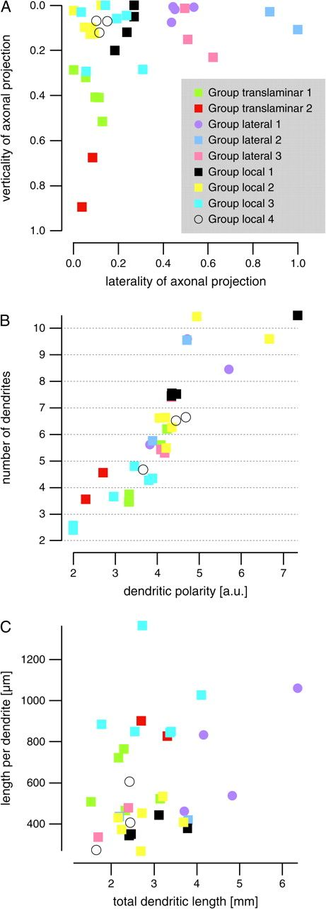
Figure 3. Distribution of groups of INs in the parameter space. (A) Distribution of groups of INs with respect to the 2 ...
Notes:
Figure 3. Distribution of groups of INs in the parameter space. (A) Distribution of groups of INs with respect to the 2 axonal parameters. Nine groups are shown in color code. (B, C) Distribution with respect to the 4 dendritic geometry parameters. For display in principal components space, compare Supplementary Figure 5. For quantifications, compare Tables 2 and 3.
Unless provided in the caption above, the following copyright applies to the content of this slide: © The Author 2008. Published by Oxford University Press. All rights reserved. For permissions, please e-mail: journals.permissions@oxfordjournals.org

Slide 10
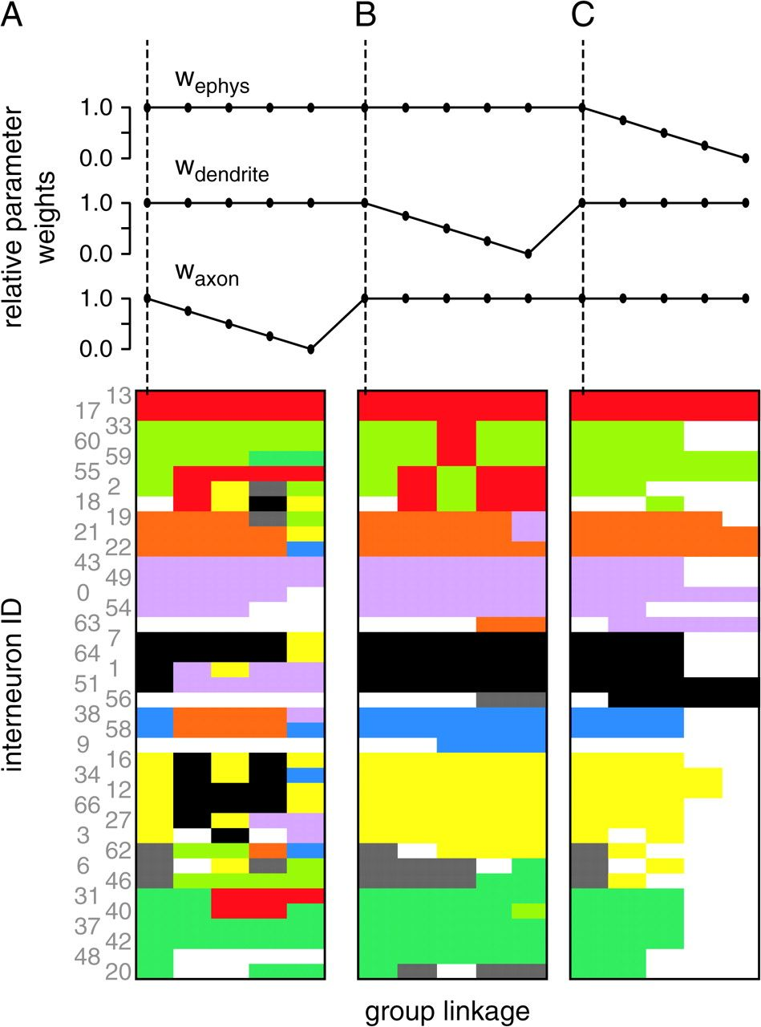
Figure 10. Stability of group detection to varying weights of parameter sets. A total of 13 iCAs (1200 CA each) were ...
Notes:
Figure 10. Stability of group detection to varying weights of parameter sets. A total of 13 iCAs (1200 CA each) were made with varying relative weights of the electrical, dendritical, and axonal parameter sets wephys, wdend, waxon. The first column shown is the unaltered iCA (wephys = wdend = waxon; dashed vertical lines). (A) Group detection is shown for decreasing relative axonal parameter weight waxon; (B) for decreasing relative dendritic parameter weight wdend; (C) for decreasing relative electrical parameter weight wephys. Reduction of the axonal parameter weight waxon resulted in declustering (A), whereas the other 2 parameter groups maintained relatively stable group assignments (B, C). Note that for reduction of the electrical parameter weight wephys < 0.5, most INs could not be assigned to groups unless pyramidal neurons were misclassified as INs (see Results). For details on the chosen parameter weights, compare Methods and Table 1.
Unless provided in the caption above, the following copyright applies to the content of this slide: © The Author 2008. Published by Oxford University Press. All rights reserved. For permissions, please e-mail: journals.permissions@oxfordjournals.org

Slide 11
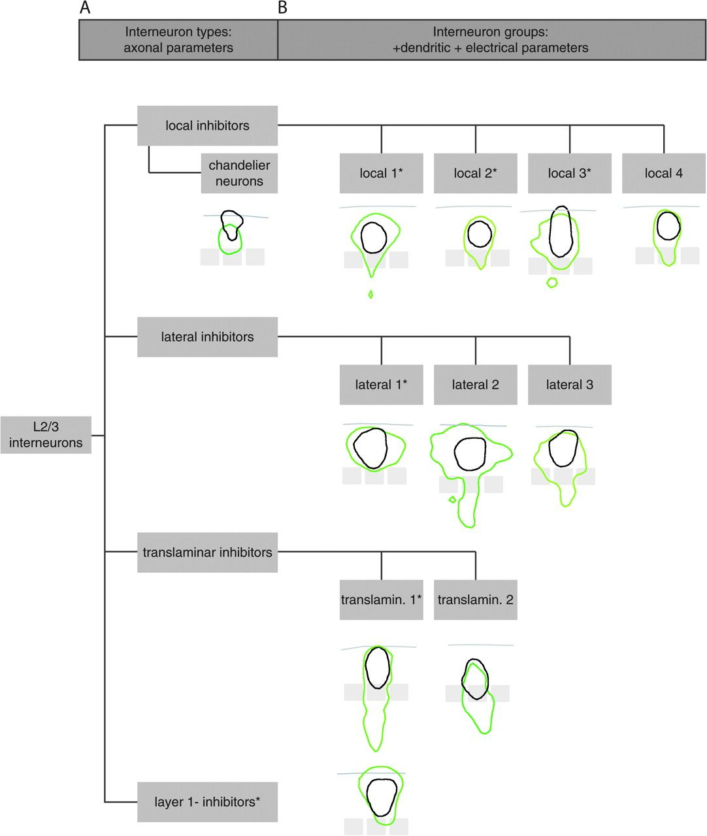
Figure 11. Scheme of IN types and groups. (A) A quantitative analysis of axonal projections yielded the definition of 4 ...
Notes:
Figure 11. Scheme of IN types and groups. (A) A quantitative analysis of axonal projections yielded the definition of 4 main types of INs that established common innervation domains with reference to cortical columns: local, lateral, translaminar, and L1 inhibitors (Helmstaedter et al. 2008a). “Chandelier neurons” also showed local axonal projections. Local, lateral, and translaminar inhibitors comprised INs with heterogeneous dendritic and electrical parameters. These were therefore further analyzed using the iCAs presented in this study. (B) The multiparameter analysis including axonal, dendritic, and electrical parameters identified 9 groups of INs that had common innervation domains (defined by their type of axonal projection, Helmstaedter et al. 2008a) and in addition had common dendritic geometry and electrical excitability parameters. Insets: average outlines of axonal (green) and dendritic (black) domains are shown as 90% contour lines for each group, superimposed on an average barrel pattern. Asterisks indicates selection of groups with ≥4 neurons in the sample (cf. Figs 5–9). For groups with <4 neurons in the sample, reconstructions are shown in Supplementary Figures 1–Supplementary Data.
Unless provided in the caption above, the following copyright applies to the content of this slide: © The Author 2008. Published by Oxford University Press. All rights reserved. For permissions, please e-mail: journals.permissions@oxfordjournals.org

