Slide 1
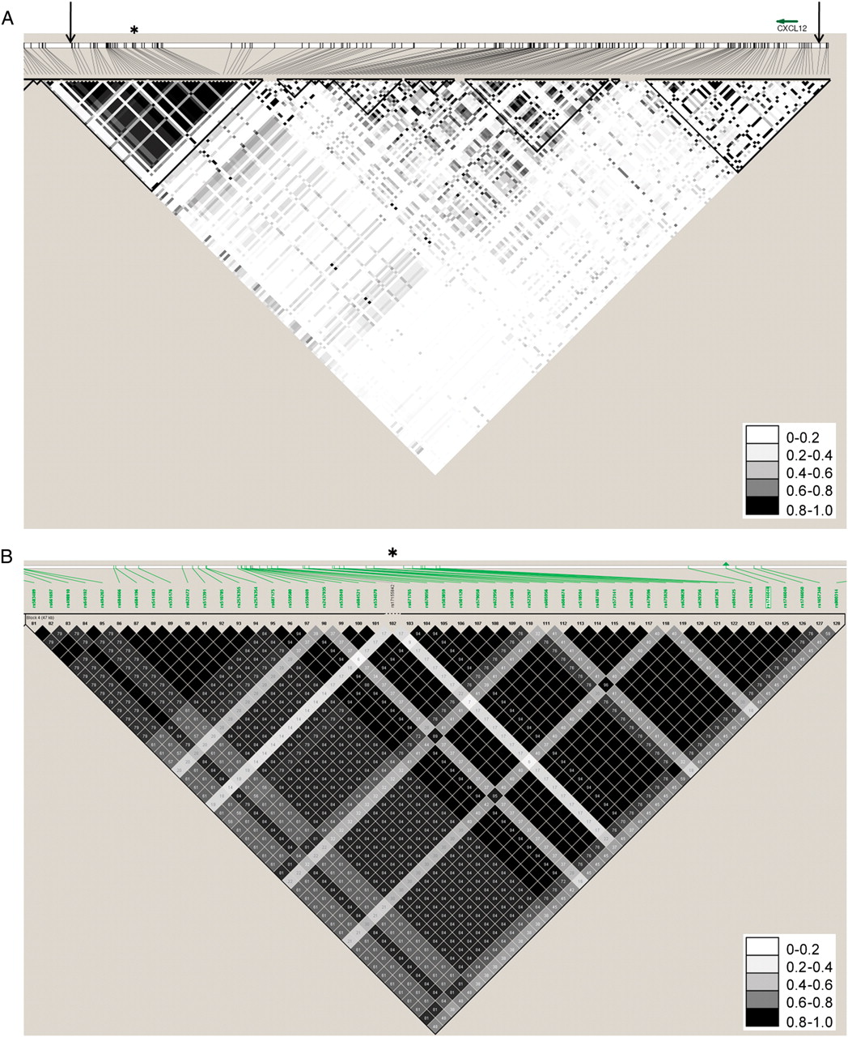
Figure 1 The genomic region analysed surrounding the CXCL12 region. (A) Linkage disequilibrium in PennCath in the ...
Notes:
Figure 1 The genomic region analysed surrounding the CXCL12 region. (A) Linkage disequilibrium in PennCath in the CXCL12 region, with arrows demarcating the region from around CXCL12 to the genome-wide association studies region. The asterisk denotes the haplotype block which contains rs1746048 and rs501120. (B) A magnified view of the haplotype block containing rs1746048 and rs501120 from the HapMap CEU population. The asterisk corresponds to the same position as the PennCath linkage disequilibrium plot, and the green arrowhead denotes rs1746048.
Unless provided in the caption above, the following copyright applies to the content of this slide: Published on behalf of the European Society of Cardiology. All rights reserved. © The Author 2011. For permissions please email: journals.permissions@oup.com

Slide 2
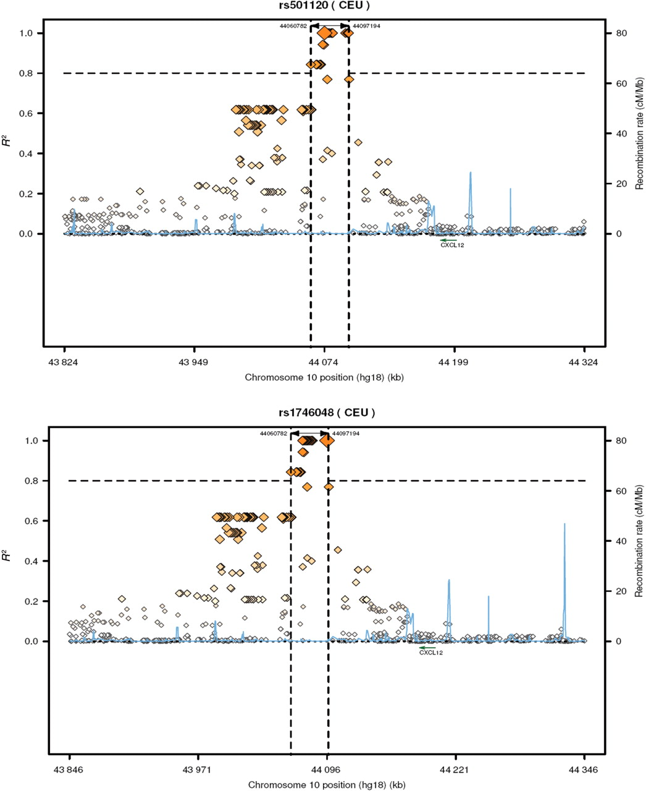
Figure 2 Two published coronary artery disease single-nucleotide polymorphisms and surrounding regions, including two ...
Notes:
Figure 2 Two published coronary artery disease single-nucleotide polymorphisms and surrounding regions, including two recombinant hotspots around CXCL12. Each single-nucleotide polymorphism is shown with linkage disequilibrium (r2) and recombination rates at these loci using HapMap CEU data; vertical dashed lines demarcate a linkage disequilibrium block in which r2 > 0.8.
Unless provided in the caption above, the following copyright applies to the content of this slide: Published on behalf of the European Society of Cardiology. All rights reserved. © The Author 2011. For permissions please email: journals.permissions@oup.com

