Slide 1
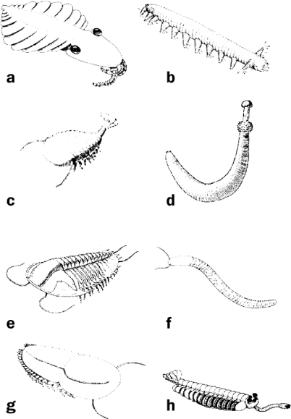
Figure 1. Some animals of the Burgess Shale that are rarely preserved in nearby contemporaneous Middle Cambrian rocks. ...
Notes:
Figure 1. Some animals of the Burgess Shale that are rarely preserved in nearby contemporaneous Middle Cambrian rocks. (a) Anomalocaris, systematic status unclear, up to. 0.5 meters long. (b) Aysheaia, onychophoran, 1 to 6 centimeters (cm). (c) Sidneyia, arthropod, 5 to 13 cm. (d) Ottoia, priapulid, 2 to 16 cm. (e) Naraoia, two-lobed noncalcified trilobite, 9 to 40 millimeters (mm). (f) Pikaia, chordate, 4 cm. (g) Olenoides, trilobite, 50 to 85 mm. (h) Opabinia, status unknown, 4 to 7 cm. Reprinted from Levinton (2001) with the permission of the Smithsonian Institution.
Unless provided in the caption above, the following copyright applies to the content of this slide: © 2008 American Institute of Biological Sciences.

Slide 2
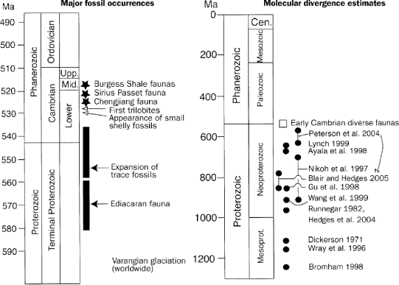
Figure 2. Left: Major fossil occurrences near the beginning of the Cambrian period. Right: Estimates of the divergence ...
Notes:
Figure 2. Left: Major fossil occurrences near the beginning of the Cambrian period. Right: Estimates of the divergence time of the protostomes and deuterostomes (i.e., bilaterian animal phyla) derived from various analyses of molecular sequences (Smith 1999, Levinton 2001).
Unless provided in the caption above, the following copyright applies to the content of this slide: © 2008 American Institute of Biological Sciences.

Slide 3
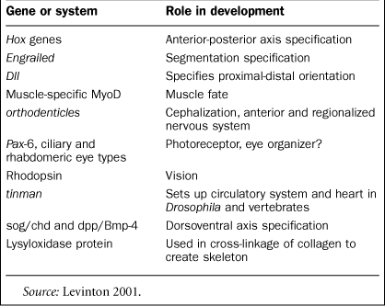
Table 1. Important developmental genes, proteins, or genetically specified systems found in both Protostomes and ...
Notes:
Table 1. Important developmental genes, proteins, or genetically specified systems found in both Protostomes and Deuterostomes, which together constitute the bilaterian animal phyla, or in a presumed common ancestor.
Unless provided in the caption above, the following copyright applies to the content of this slide: © 2008 American Institute of Biological Sciences.

Slide 4
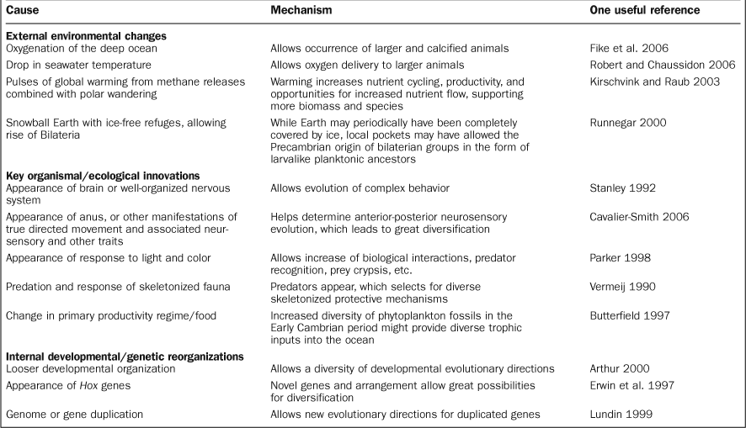
Table 2. Some possible causes of the Cambrian explosion.
Notes:
Table 2. Some possible causes of the Cambrian explosion.
Unless provided in the caption above, the following copyright applies to the content of this slide: © 2008 American Institute of Biological Sciences.

