Slide 1
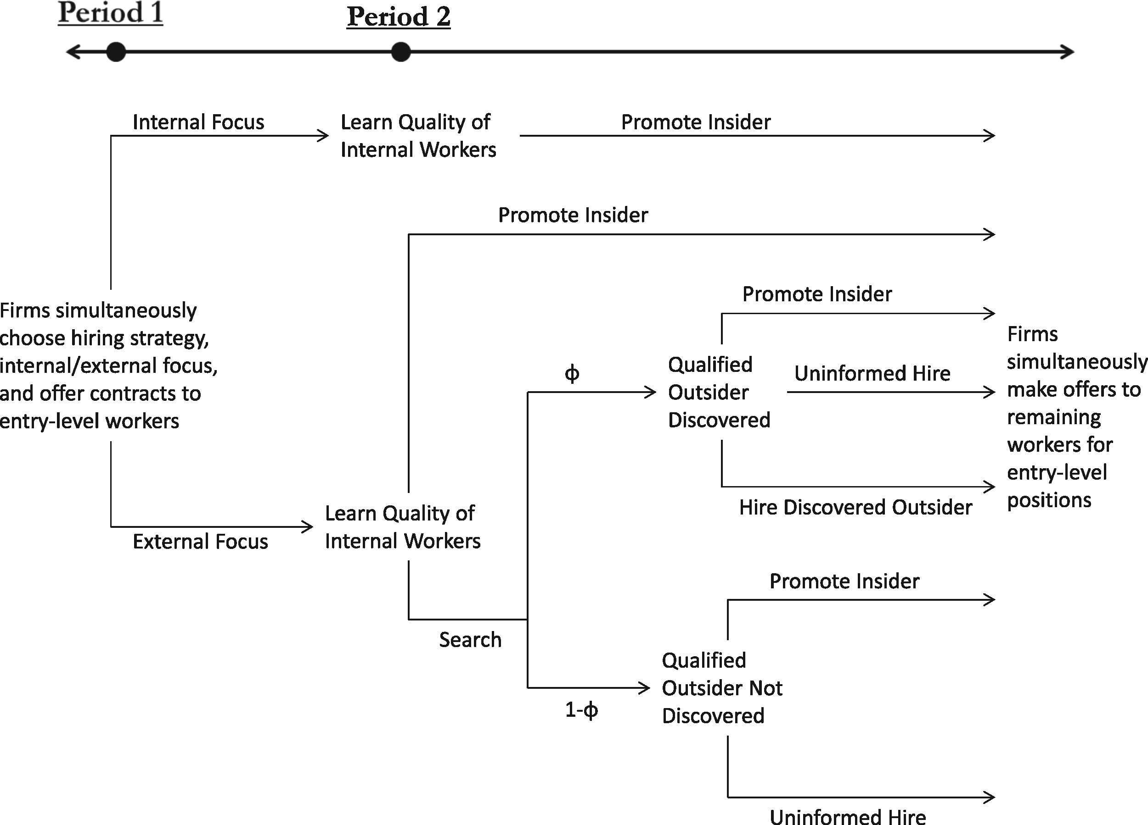
(1) Outline of Model.
Notes:
(1) Outline of Model.
Unless provided in the caption above, the following copyright applies to the content of this slide: © The Author 2016. Published by Oxford University Press on behalf of Yale University. All rights reserved. For Permissions, please email: journals.permissions@oup.com

Slide 2
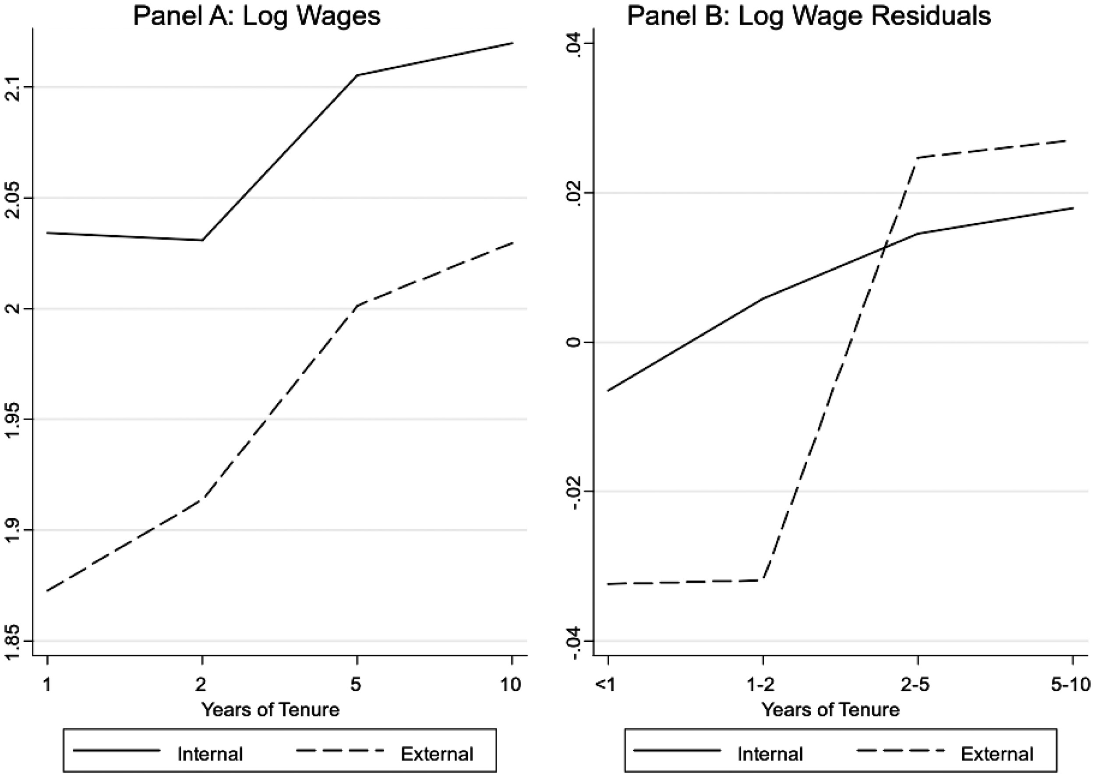
Figure 2. Entry-Level Wages across Tenure Categories. Notes: Estimated entry-level wages for workers at internally ...
Notes:
Figure 2. Entry-Level Wages across Tenure Categories. Notes: Estimated entry-level wages for workers at internally focused and externally focused establishments across the bounded tenure categories. Panel A shows raw difference in log wages without any controls. Panel B shows residuals of a regression of log wages on 6 education dummies, 16 ethnicity dummies, 8 age dummies, a gender dummy, Standard Occupation Classification 2000 (SOC2000) three-digit fixed effects, Standard Industry Classification 2003 (SIC2003) three-digit fixed effects, Government Office Region fixed effects, and the log of establishment size.
Unless provided in the caption above, the following copyright applies to the content of this slide: © The Author 2016. Published by Oxford University Press on behalf of Yale University. All rights reserved. For Permissions, please email: journals.permissions@oup.com

