Slide 1
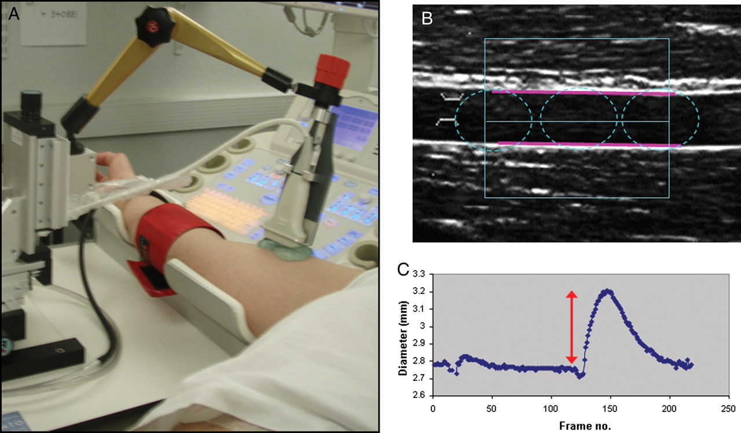
Figure 1 Set up for flow-mediated dilatation. (A) Recommended positioning of the sphygmomanometer cuff and use of the ...
Notes:
Figure 1 Set up for flow-mediated dilatation. (A) Recommended positioning of the sphygmomanometer cuff and use of the ultrasound probe holder. (B) Placement of the region of interest box using the edge detection analysis software for flow-mediated dilatation analysis. (C) Output generated by edge detection software that permits assessment of the vasodilatory response.
Unless provided in the caption above, the following copyright applies to the content of this slide: Published on behalf of the European Society of Cardiology. All rights reserved. © The Author 2010. For permissions please email: journals.permissions@oxfordjournals.org

Slide 2
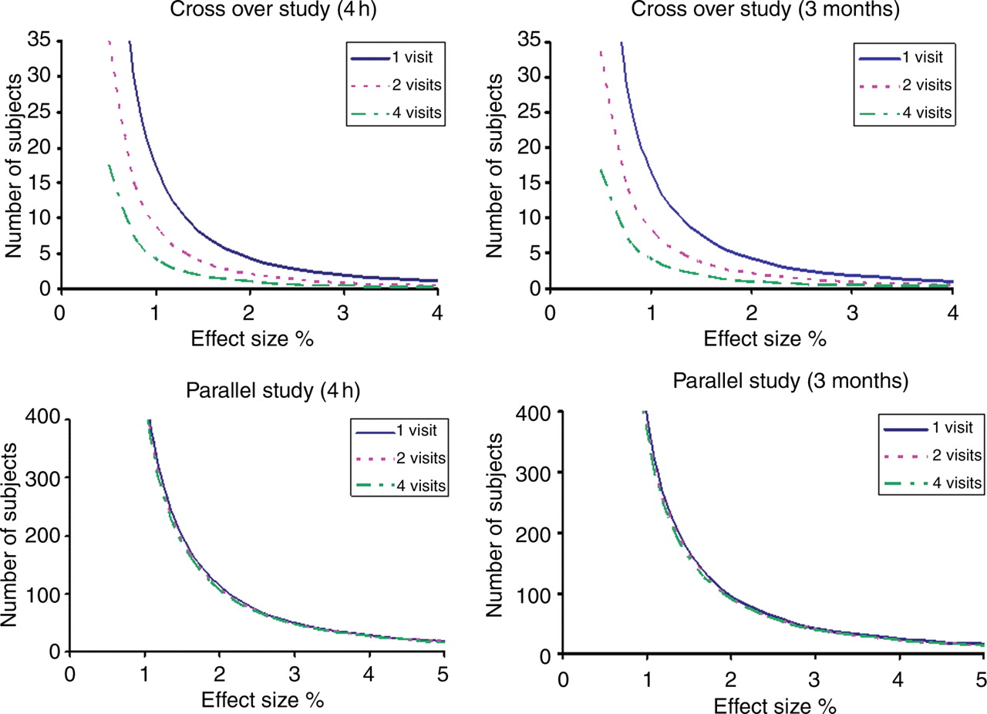
Figure 2 Power curves for estimating subjects required for flow-mediated dilatation studies in crossover and parallel ...
Notes:
Figure 2 Power curves for estimating subjects required for flow-mediated dilatation studies in crossover and parallel studies. Relation between effect on maximum percent change in flow-mediated dilation (%) and number of subjects required in crossover and parallel study designs at 80% power and 5% significance, 4–6 h and 3 months apart with three monitoring strategies: 1, 2, or 4 measures pre- and post-treatment.
Unless provided in the caption above, the following copyright applies to the content of this slide: Published on behalf of the European Society of Cardiology. All rights reserved. © The Author 2010. For permissions please email: journals.permissions@oxfordjournals.org

Slide 3
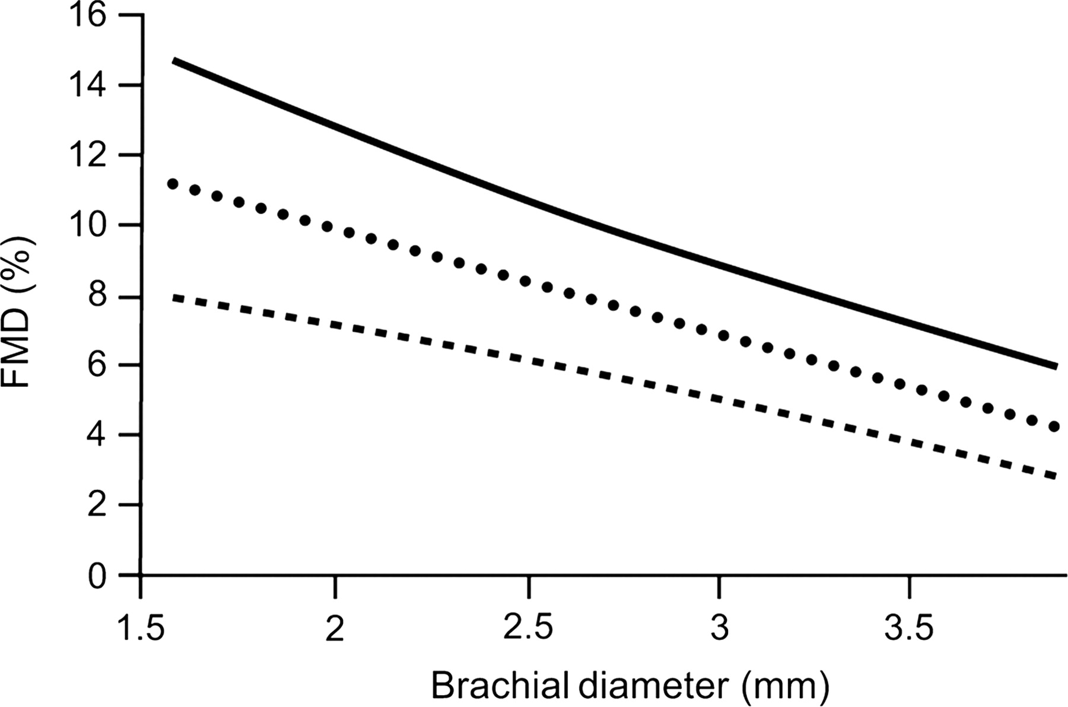
Figure 3 Nomogram for flow-mediated dilatation according to the vessel baseline diameter. A negative linear ...
Notes:
Figure 3 Nomogram for flow-mediated dilatation according to the vessel baseline diameter. A negative linear association exists between baseline diameter and flow-mediated dilatation. For a specific baseline diameter, flow-mediated dilatation can be estimated. The black line shows the 75th percentile, the circle dashed line the 50th percentile, and the rectangular dashed line the 25th percentile of the population.
Unless provided in the caption above, the following copyright applies to the content of this slide: Published on behalf of the European Society of Cardiology. All rights reserved. © The Author 2010. For permissions please email: journals.permissions@oxfordjournals.org

